Slide 1
I Can, Can You?
First Grade
1.2

Slide 2
Rhyming Story
In a rhyming story, some words end with the same sounds.

Slide 3
Rhyming words
Words that sound the same
Which words rhyme?
cat pig hat bag
big Sam got run
Pam hot sun rag

Slide 4
Rhyming words
Words that sound the same
Which words rhyme?
cat pig hat bag
big Sam got run
Pam hot sun rag

Slide 5
Rhyming words
Words that sound the same
Which words rhyme?
pig bag
big Sam got run
Pam hot sun rag

Slide 6
Rhyming words
Words that sound the same
Which words rhyme?
bag
Sam got run
Pam hot sun rag

Slide 7
Rhyming words
Words that sound the same
Which words rhyme?
Sam got run
Pam hot sun

Slide 8
Rhyming words
Words that sound the same
Which words rhyme?
got run
hot sun

Slide 9
Rhyming words
Words that sound the same
Which words rhyme?
run
sun

Slide 10
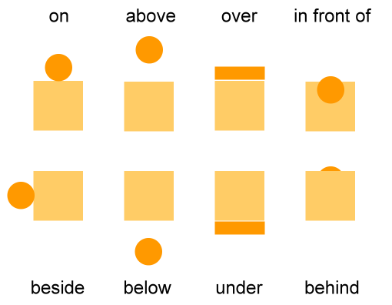
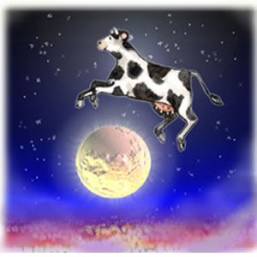
over
Can you jump over a mat?

Slide 11
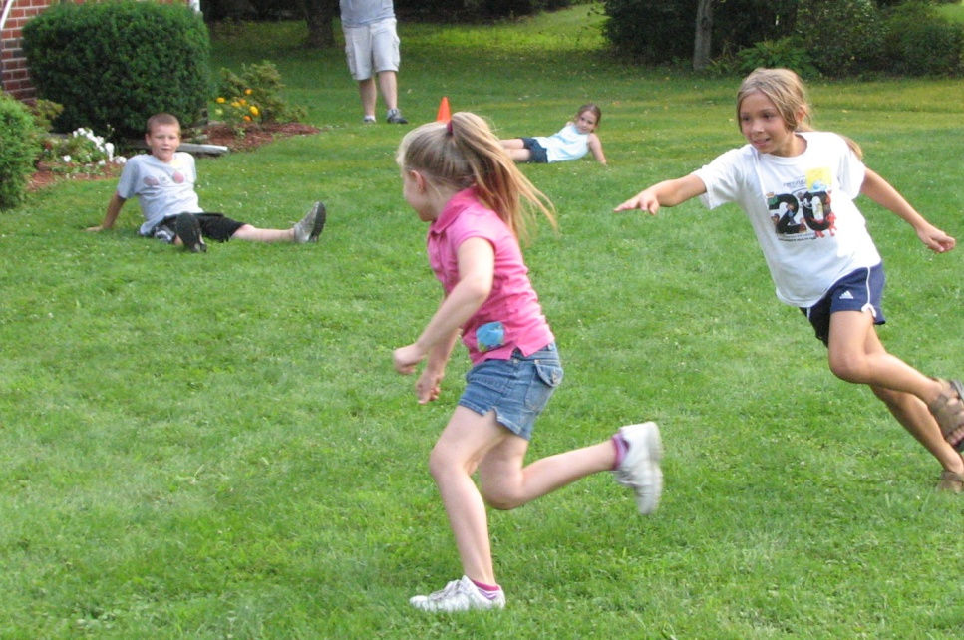
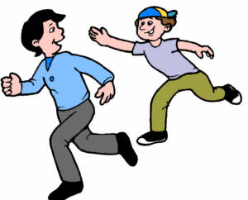
tag
Can you tag a tree?

Slide 12
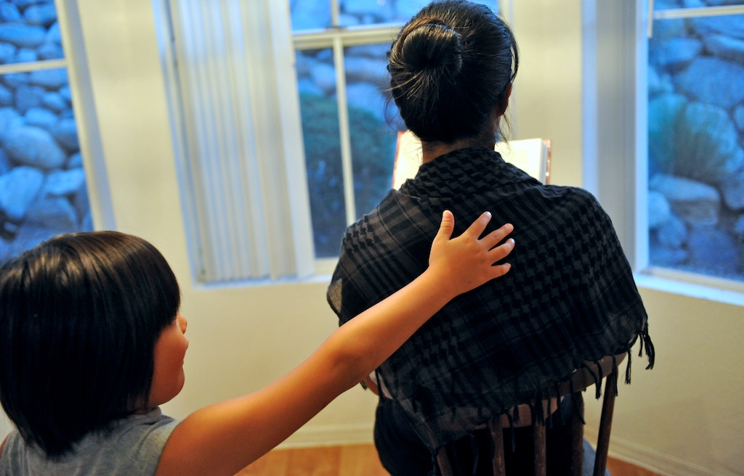
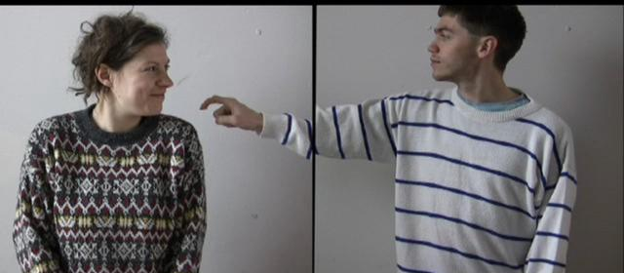
tap
Can you tap?

Slide 13
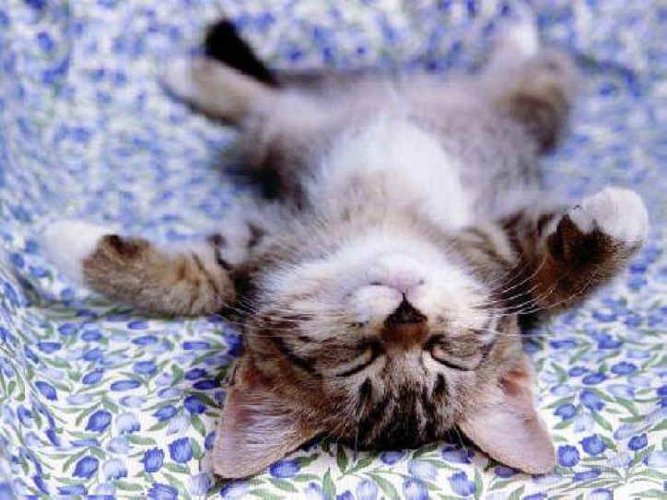
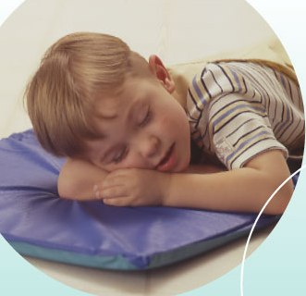
nap
I can nap.

Slide 14
Sight Words
yes
it
too Yes, I can do it, too!

