Slide 1
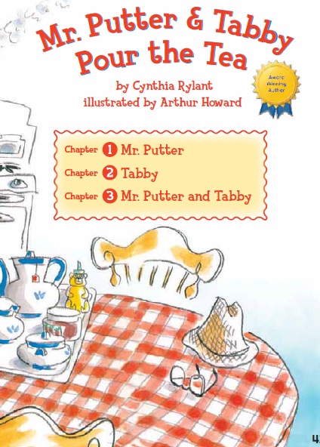
Mr. Putter & Tabby
Pour the Tea
1.2

Slide 2
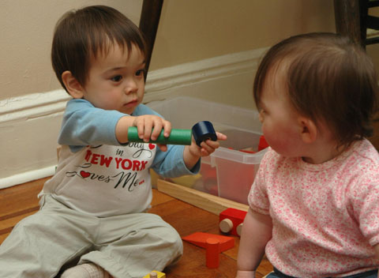
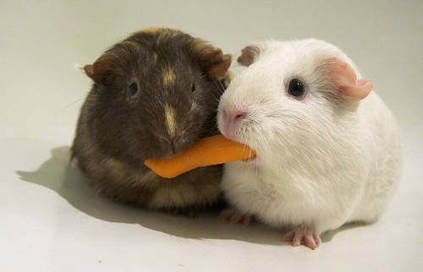
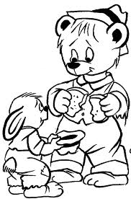
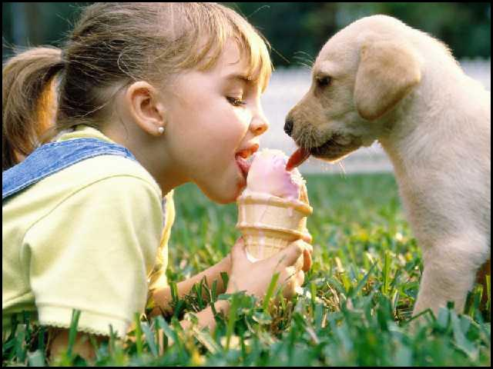
share
To give some of what one person has to someone else

Slide 3
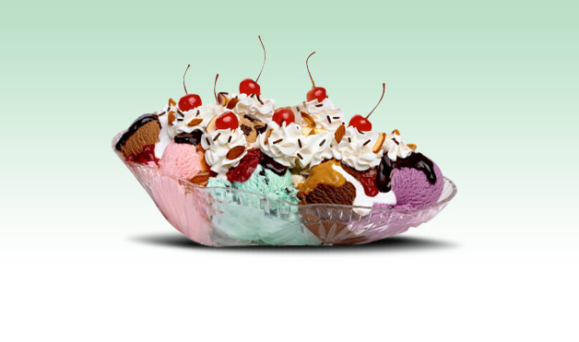

wonderful
He had wonderful stories to tell.
Great; excellent
What is something you think is wonderful?

Slide 4
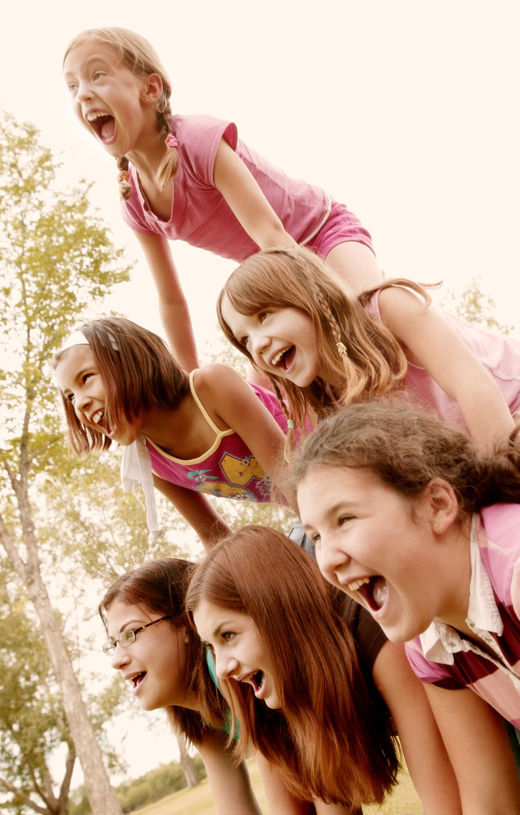
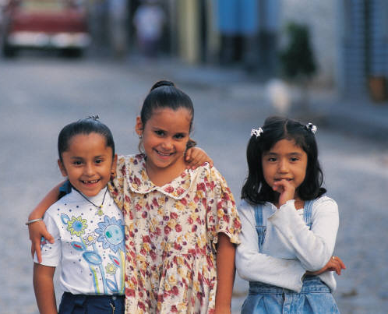
company
Mr. Putter wished for some company
Meaning: A friend or friends

Slide 5
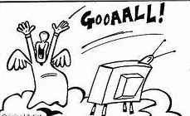
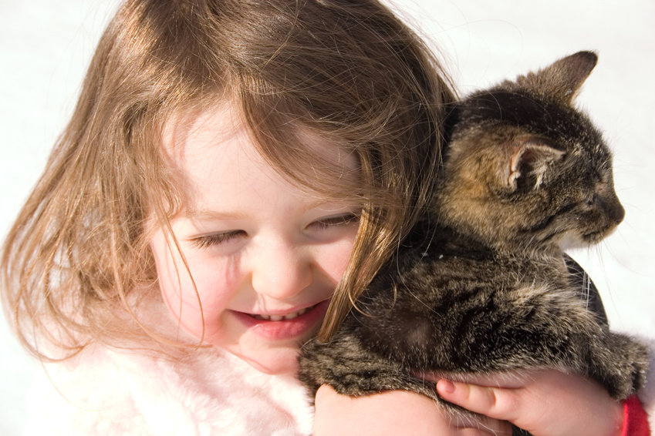
delighted
Mr. Putter was delighted.
Meaning: very happy

Slide 6

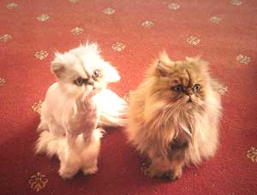
thinning
The cat’s fur was thinning.
Meaning: Becoming thin; decreasing in number

Slide 7


enjoyed
They enjoyed each other’s company
Meaning: got joy or pleasure from; was happy with

Slide 8
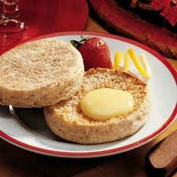
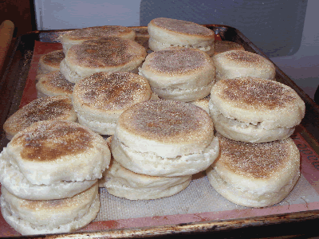
English muffin
Mr. Putter and Tabby liked to share an English muffin.

Slide 9
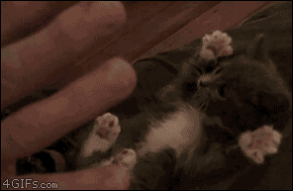
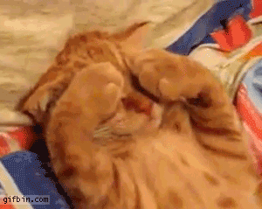
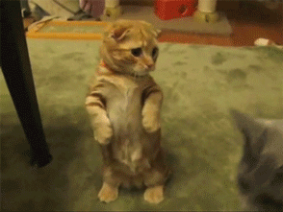
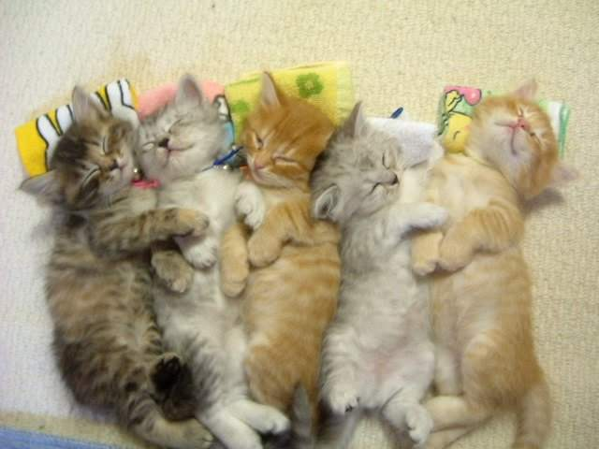
kittens
I was hoping for a cat, not a kitten.

Slide 10
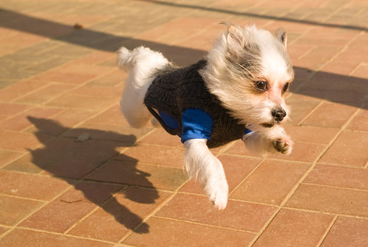
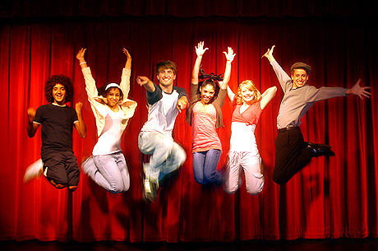
peppy
Full of energy

Slide 11
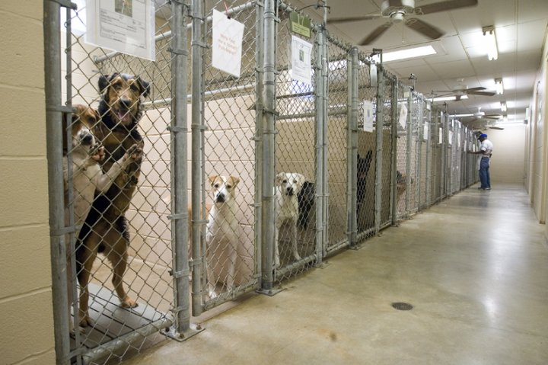
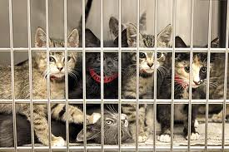
(animal) shelter

Slide 12
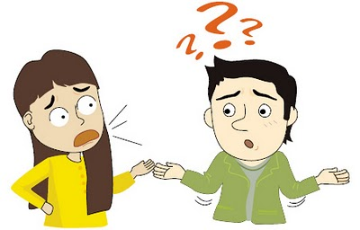
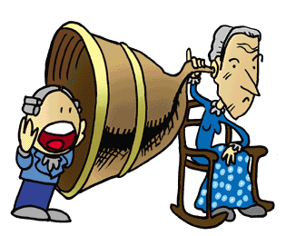
deaf
Unable to hear

