Slide 1
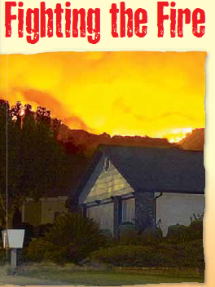
1.3

Slide 2
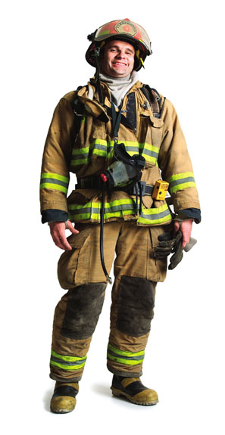
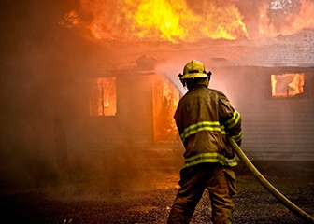
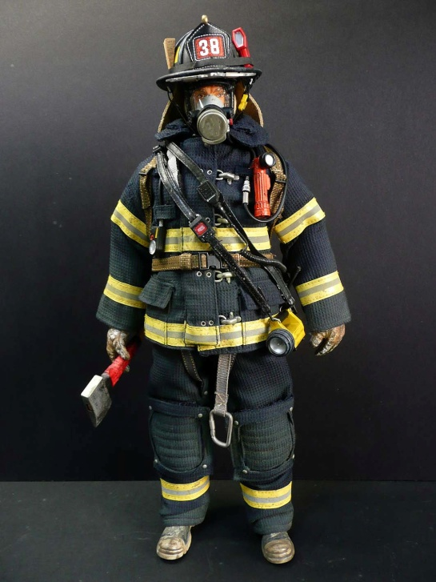
firefighters
Men and women whose job is to put out fires

Slide 3
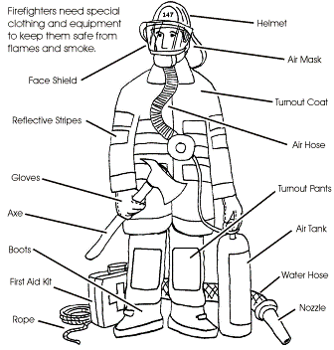

Slide 4
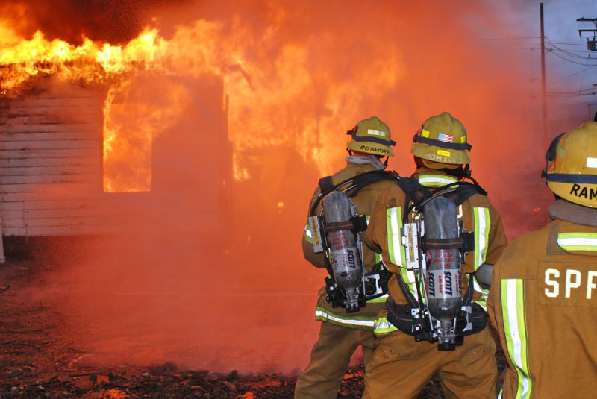

Slide 5
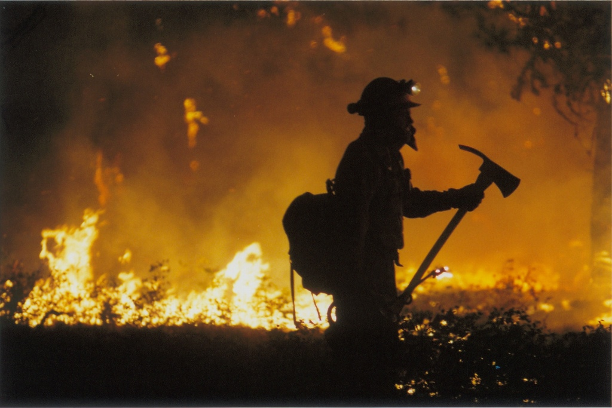

Slide 6
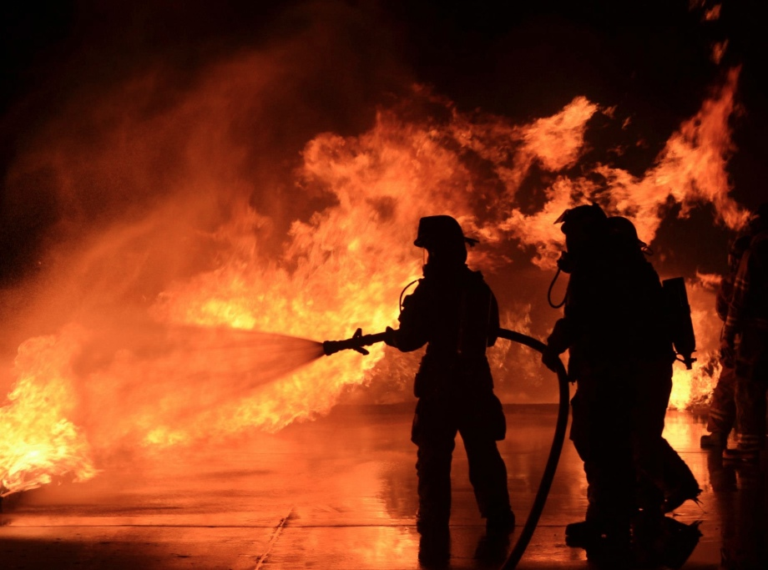

Slide 7
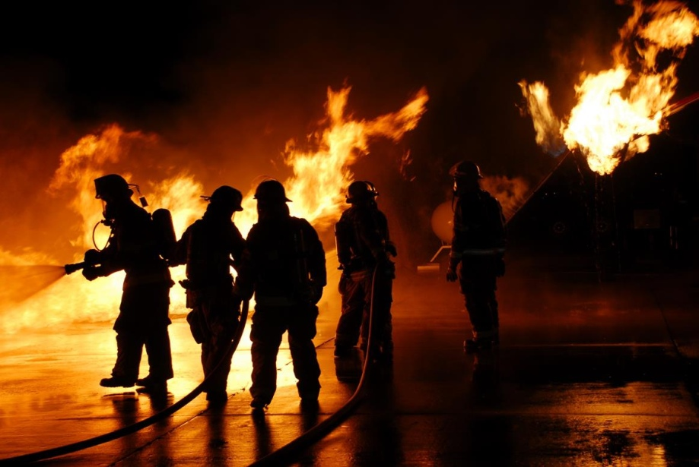

Slide 8
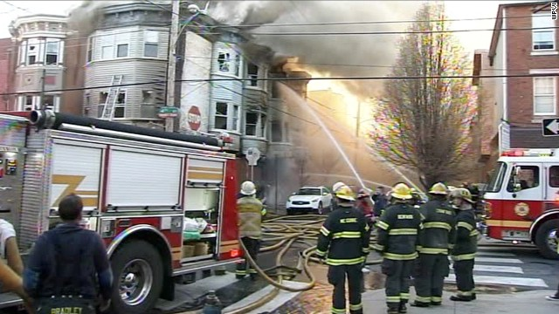

Slide 9
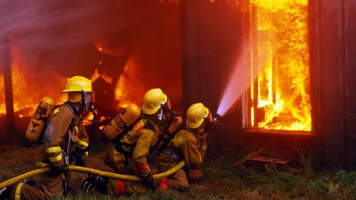

Slide 10
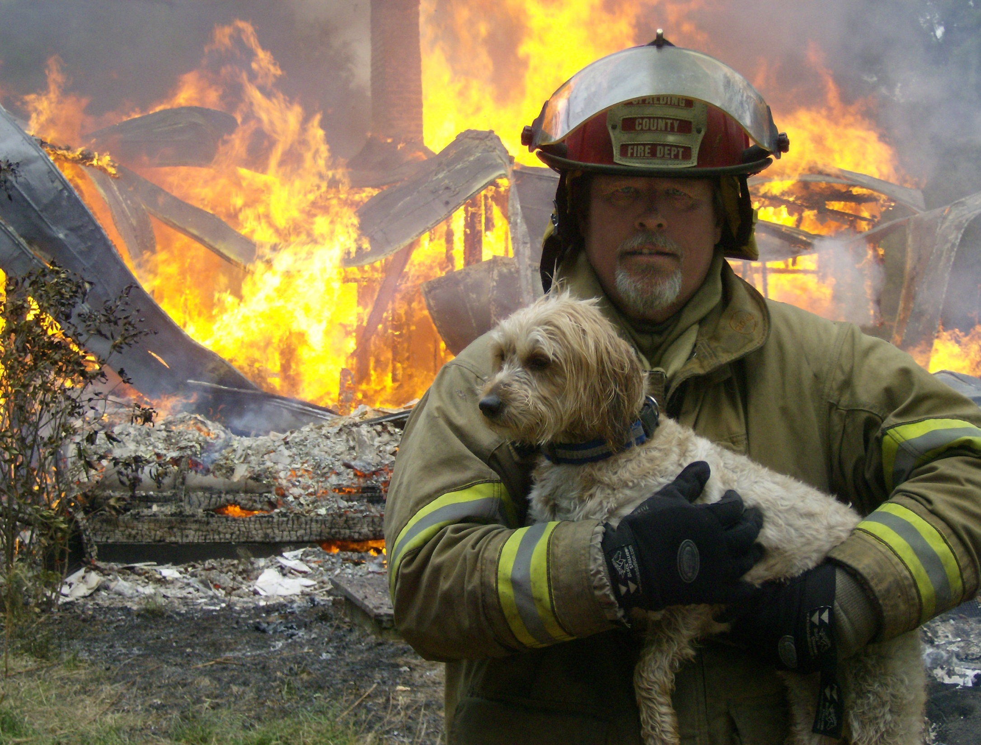

Slide 11
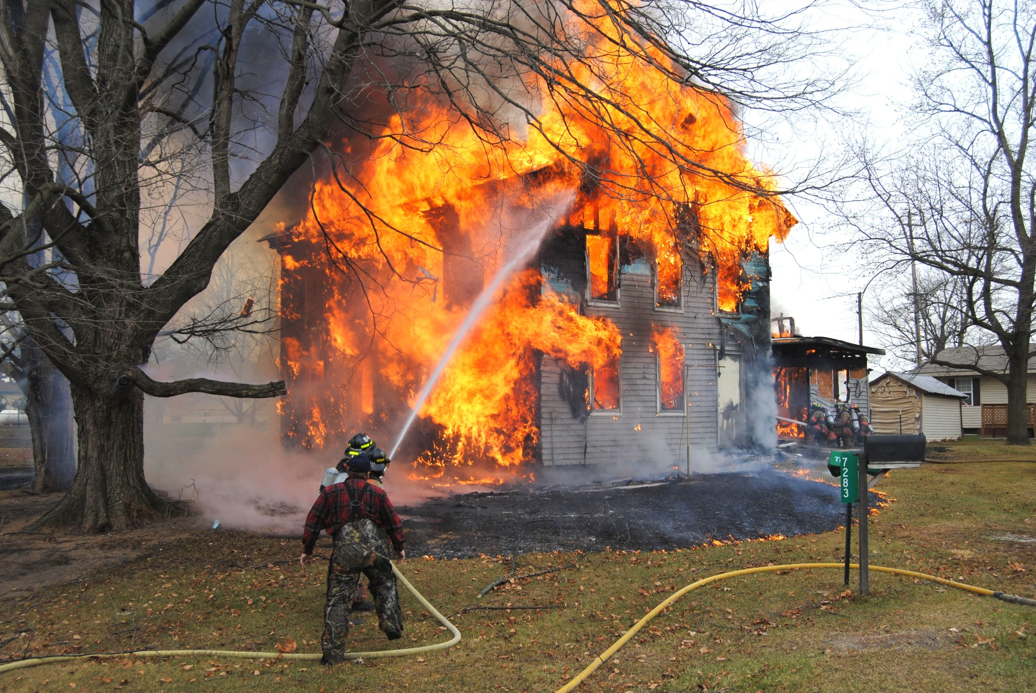

Slide 12
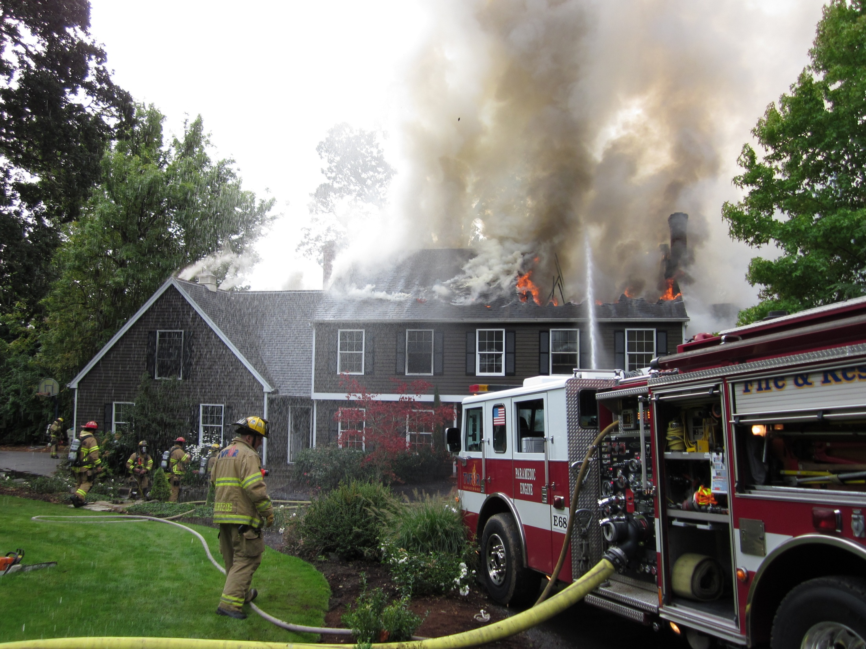

Slide 13
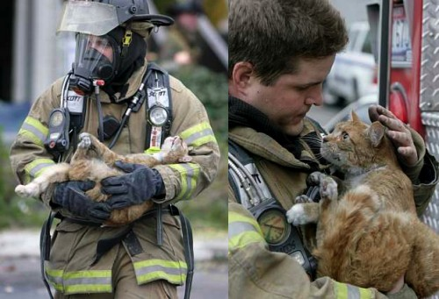

Slide 14
Firefighter
Here is a great video about the gear that firefighters wear (click the link): {3 min 18 sec}
  http://www.youtube.com/watch?v=tQ6oHVjQx8w

Slide 15
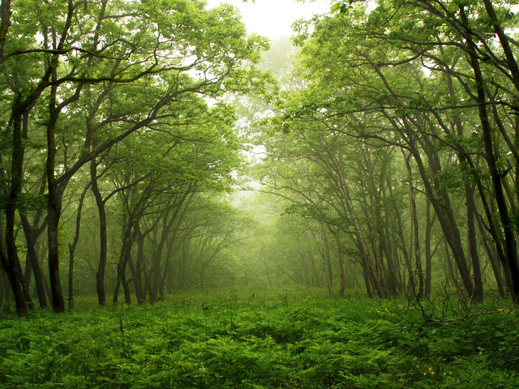
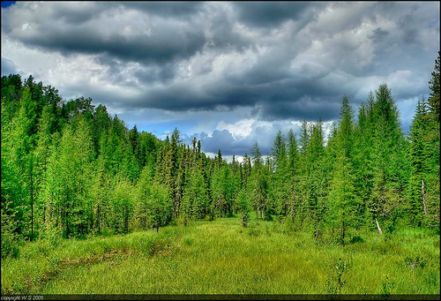
forest
One day, the sky over the forest filled with smoke.
Meaning: A large area of land covered by trees and other plants

Slide 16
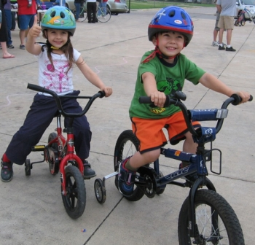
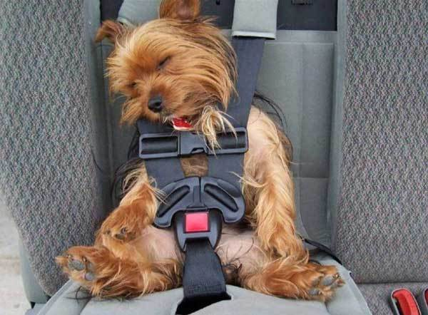
safe
People who lived near the forest did not feel safe.
Meaning: To be kept from danger

Slide 17
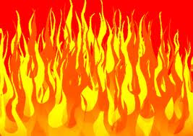
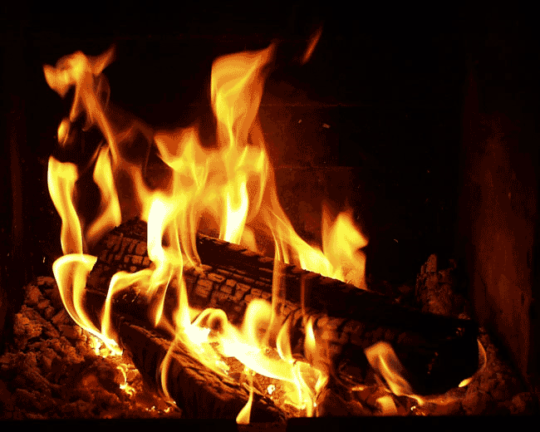
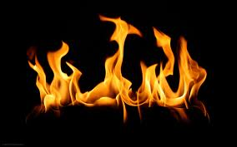
flames
The firefighters dumped water onto the flames.
Meaning: the glowing parts of a fire

Slide 18
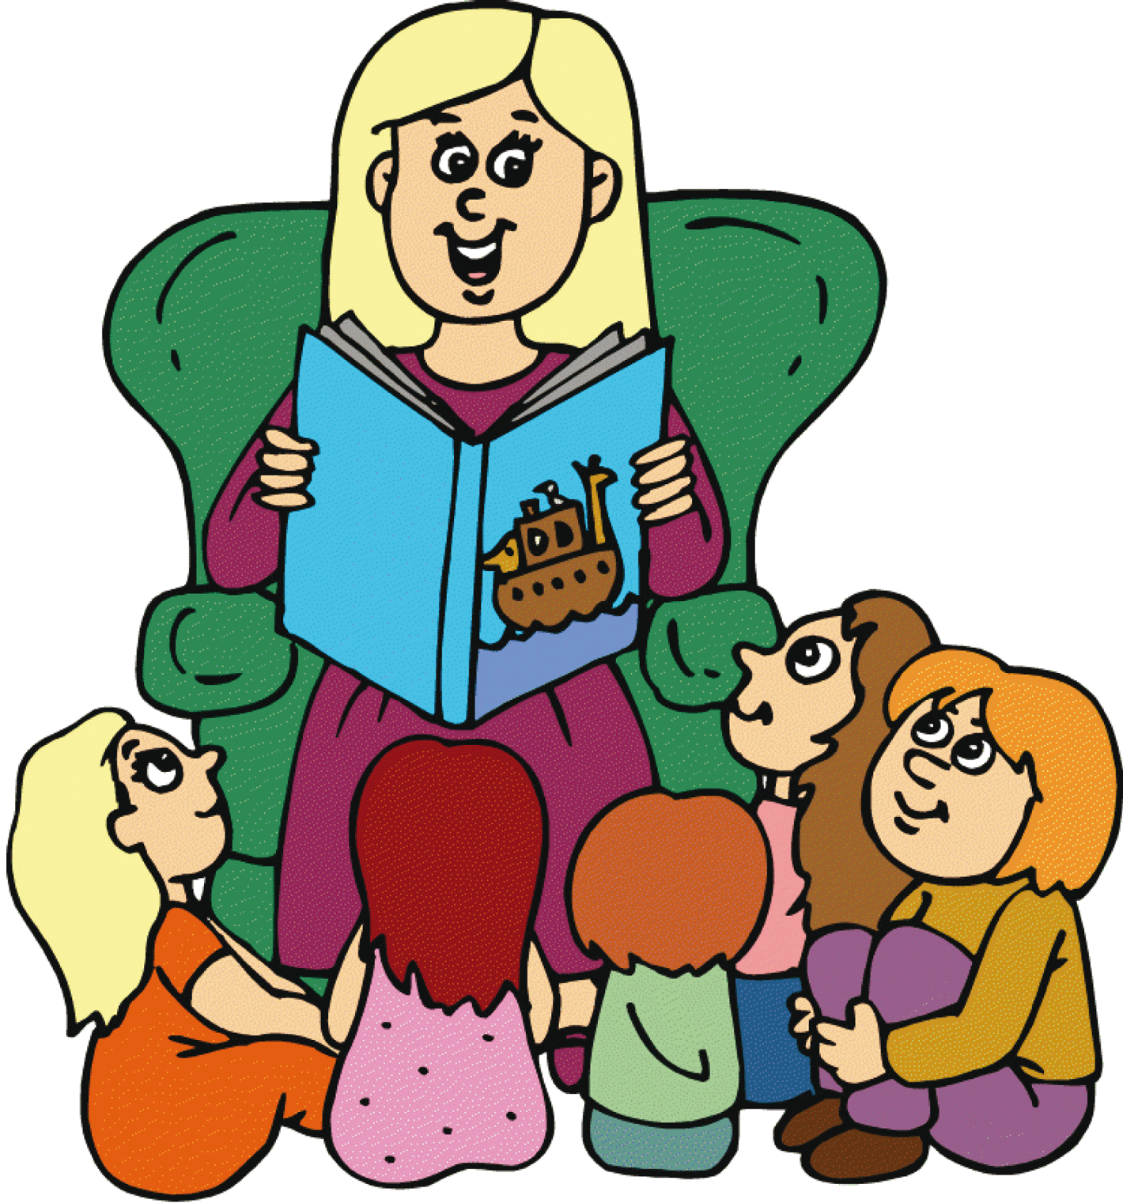
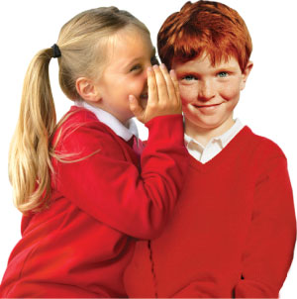
tell
The firefighters tell people to get away from the fire.
Meaning: to give information
Tell me a story

Slide 19
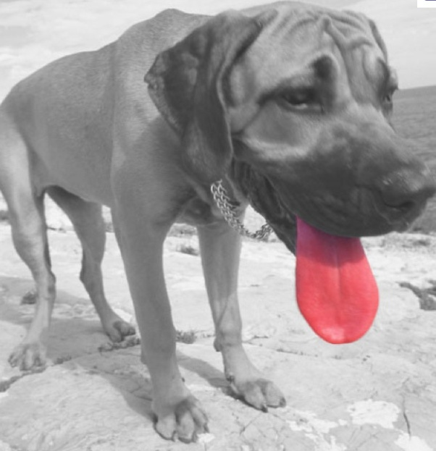
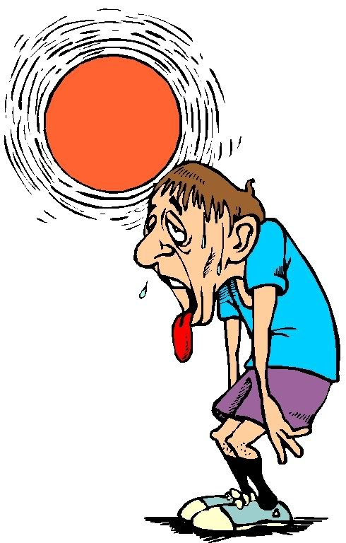
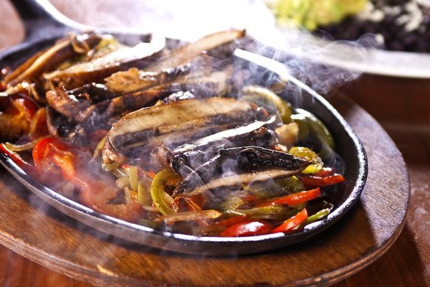
heat
Firefighters use special clothes to protect themselves from the heat.
Meaning: Great heat or high temperatures

Slide 20
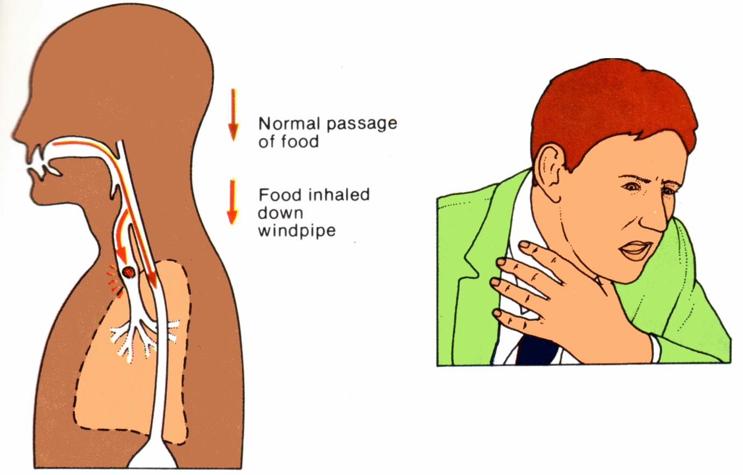
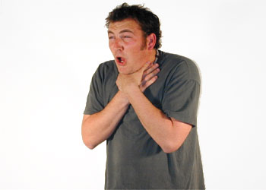
choke
People did not want to choke on the smoke in the air.
Meaning: to have trouble breathing

Slide 21
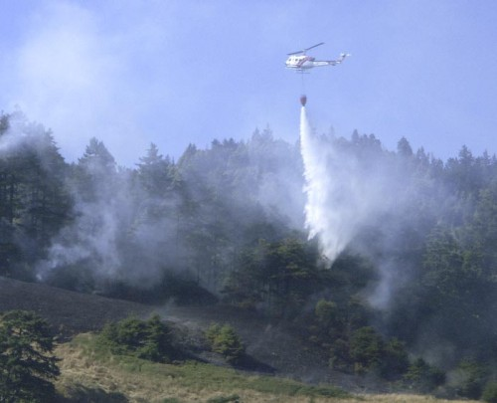
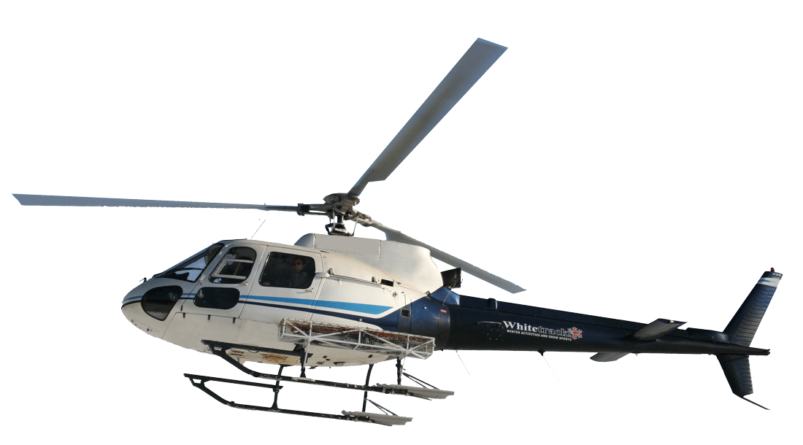
helicopter

Slide 22
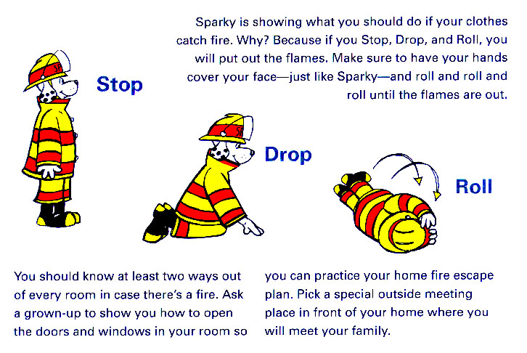
Fire Safety

Slide 23
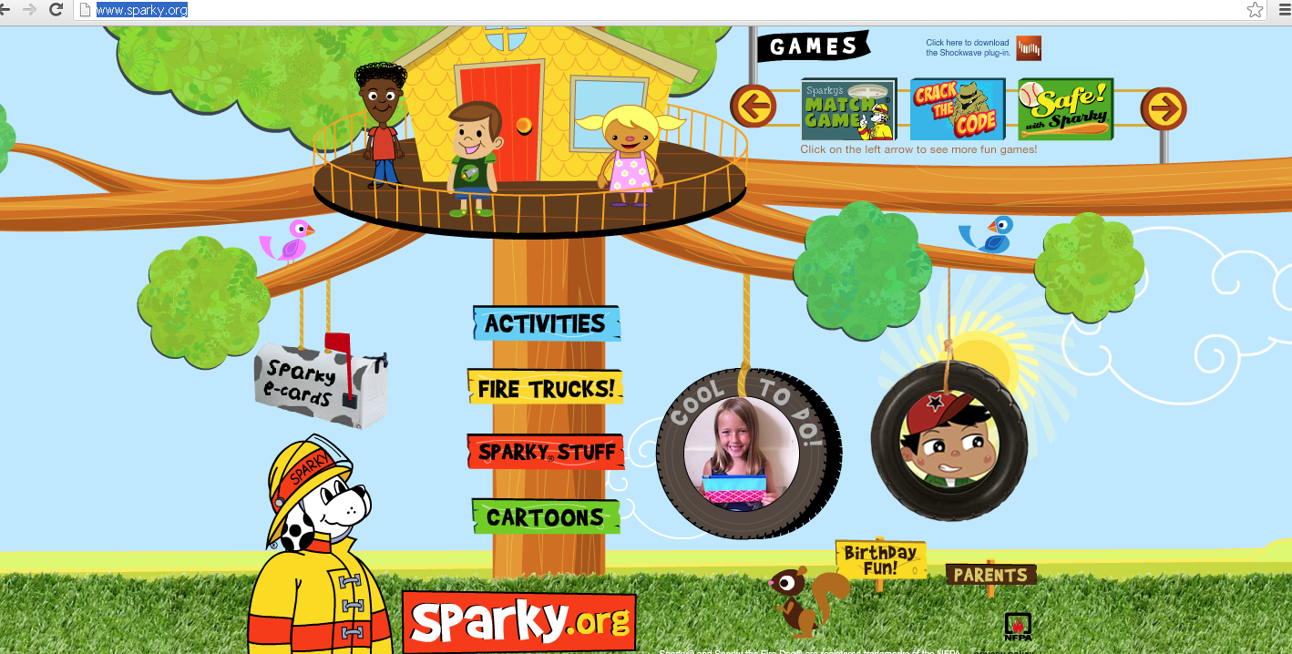
For more information about fire safety:
http://www.sparky.org/

Slide 24
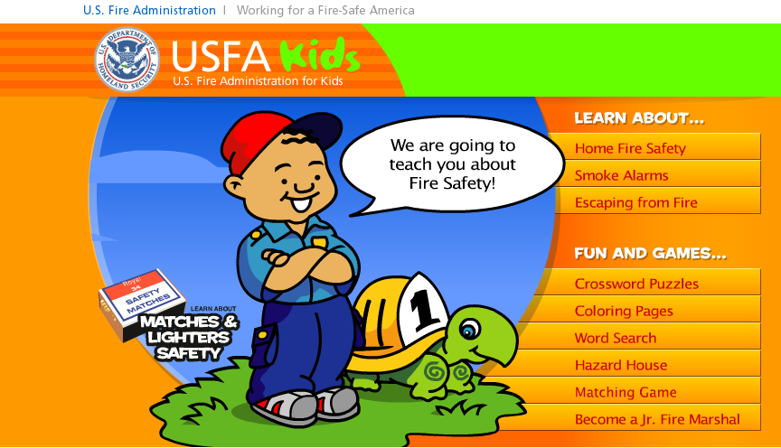
For more information about fire safety:
http://www.usfa.fema.gov/kids/flash.shtm

