Slide 1
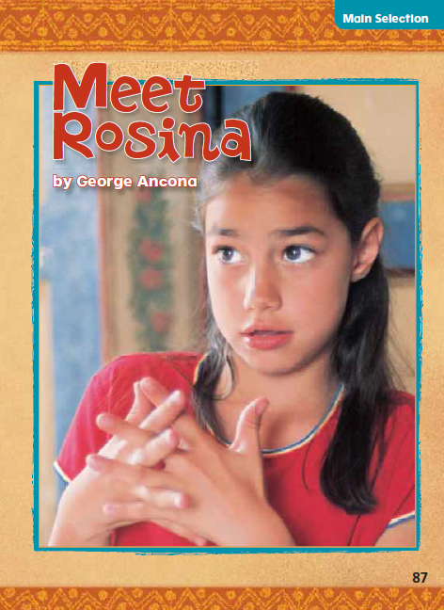
Meet Rosina
1.4

Slide 2
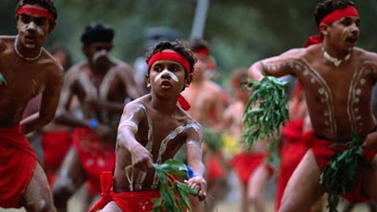
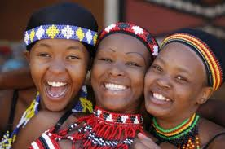
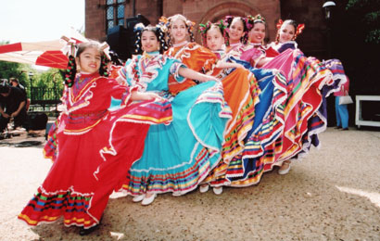
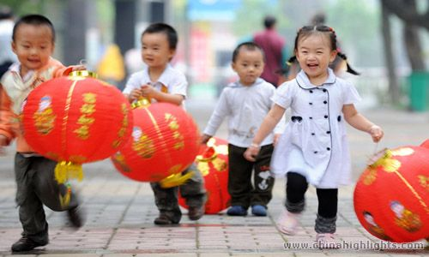
cultures
We learn about different cultures
Meaning: The arts, beliefs, and customs that make up a way of life for a group of people

Slide 3
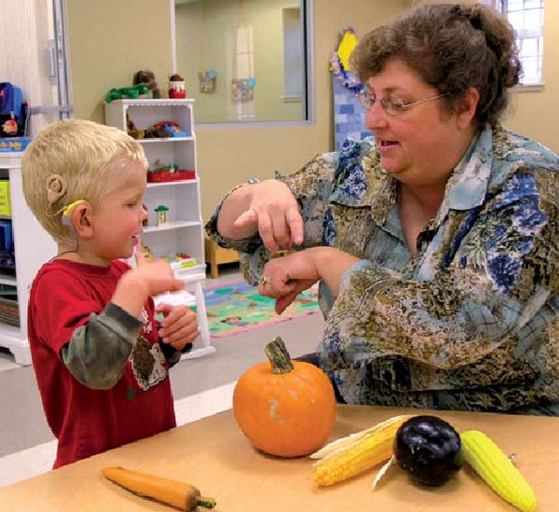

deaf
I am deaf, so I talk with my hands.
Meaning: Not able to hear, or not able to hear well

Slide 4


language
The teachers use American Sign Language.
Meaning: A way of telling ideas and feelings to others
English, Spanish, Chinese, Vietnamese, Portuguese, Italian, Greek

Slide 5
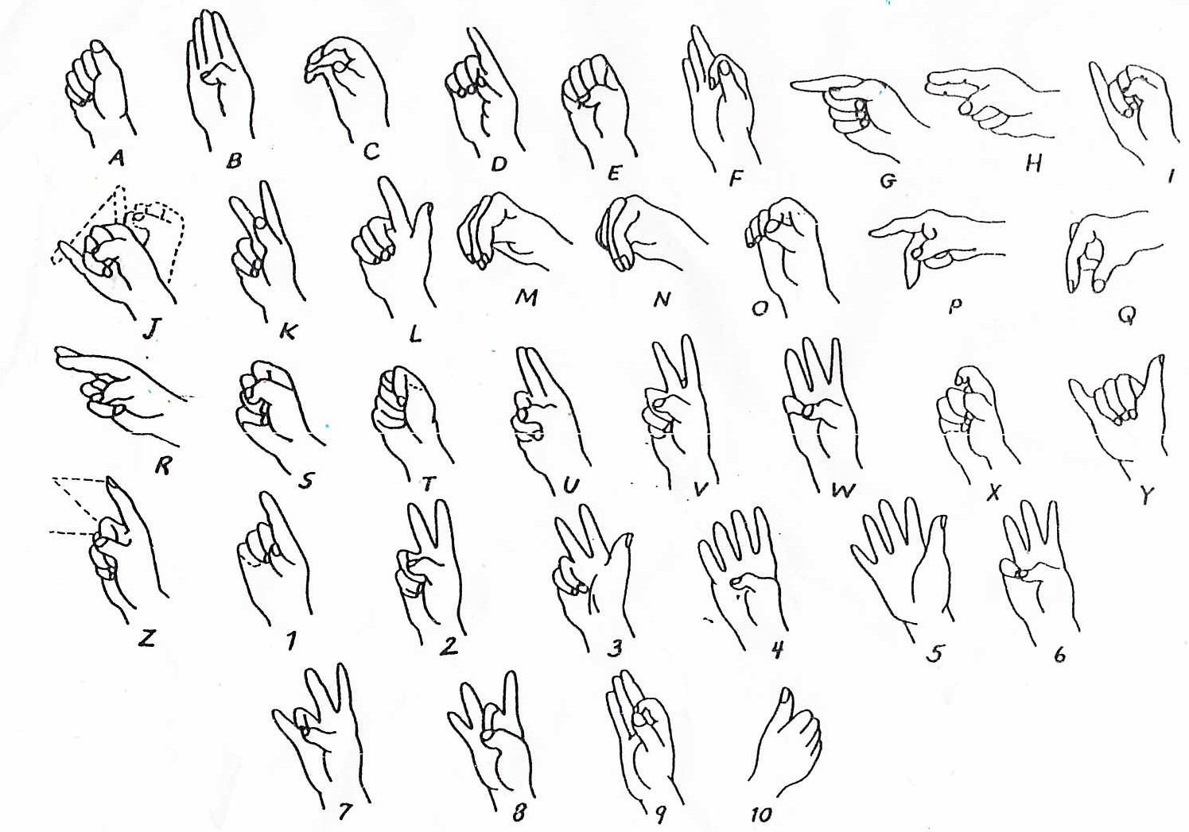
American Sign Language

Slide 6
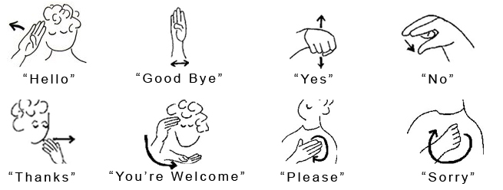
American Sign Language
Can you do these signs?

Slide 7
Learn ASL!
Learn how to sign some animal words! {2:08}
  http://www.youtube.com/watch?v=_BF8ZH_Hut0
Animal sign song: http://www.youtube.com/watch?v=ohjlMkxe1Wc

Slide 8
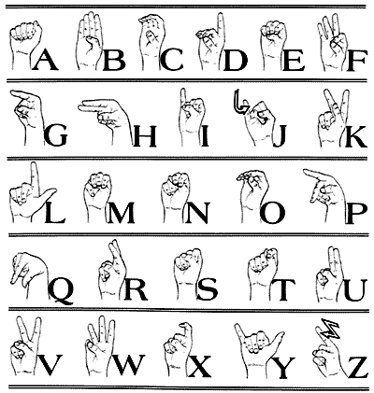
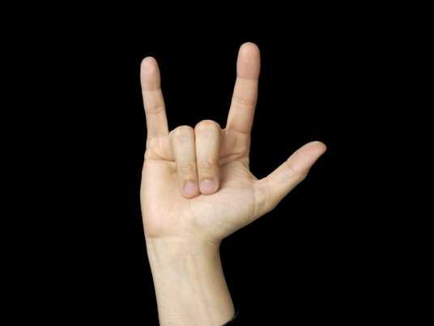
signing
Meaning: showing words and letters with your hands and fingers
“I love you”

Slide 9
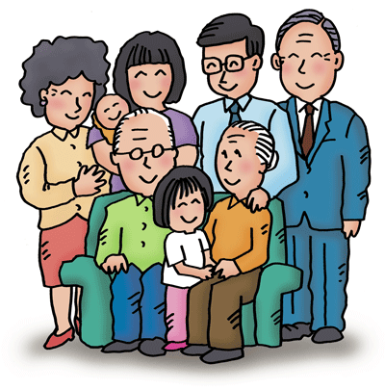
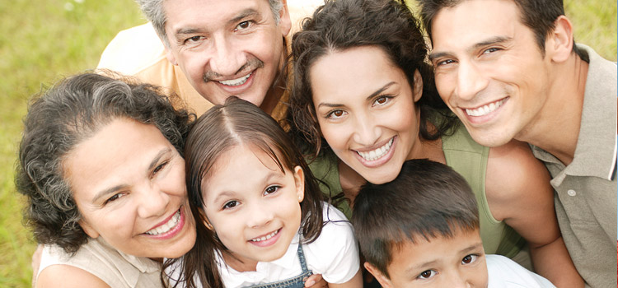
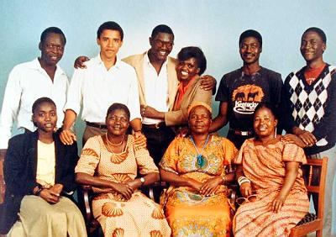
relatives
I see pictures of my relatives
Meaning: people who are part of a family

Slide 10
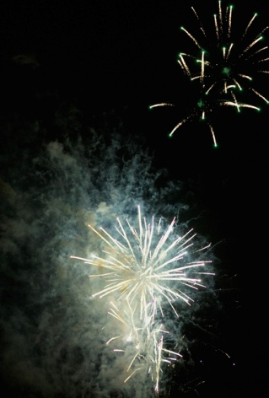



celebrate
We celebrate when we win a game!
Meaning: To show that something is important in a special way
Fourth of July Valentine’s Day
Christmas Halloween
Notes:
Holidays are celebrated differently by different cultures and families. Your family might celebrate different holidays than other families. You might eat a special meal, so visit someone, or even dress up!
However, we don’t only celebrate holidays. We can also celebrate when we are happy about something. For example, you might celebrate a team winning, getting good grades, or the end of the school year!

Slide 11
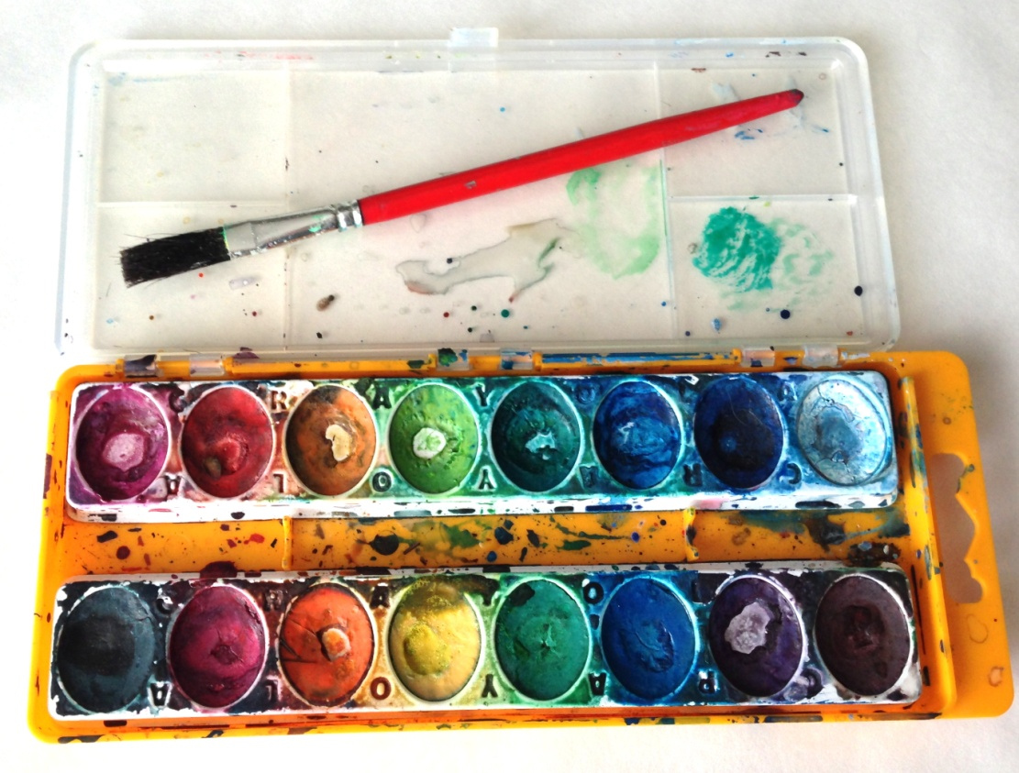
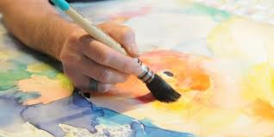
watercolors
I like to paint using watercolors.
watercolor painting

Slide 12
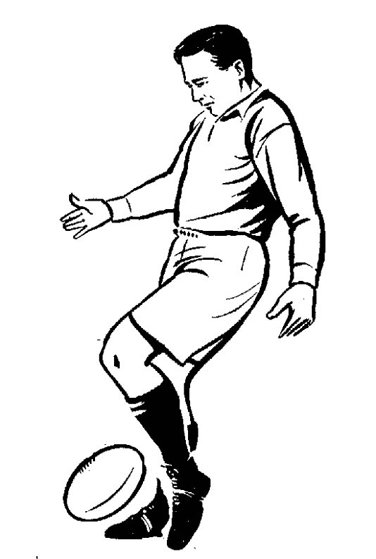
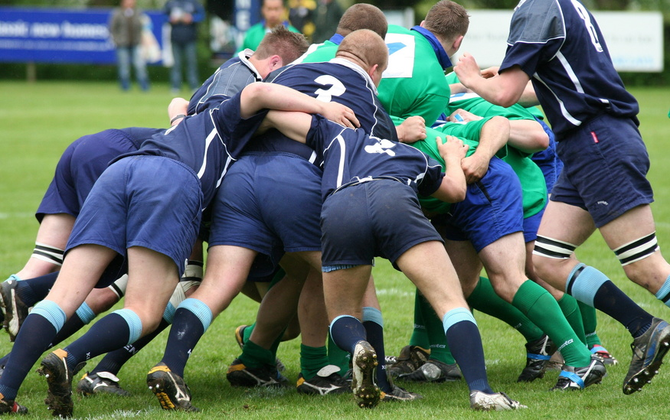
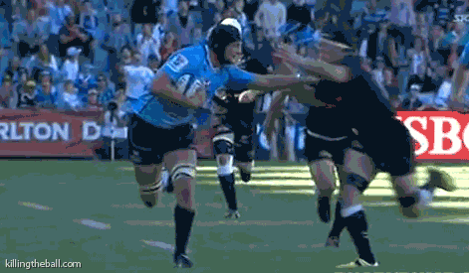
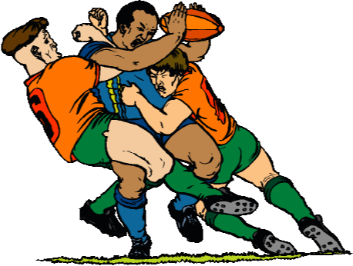
rugby

Slide 13
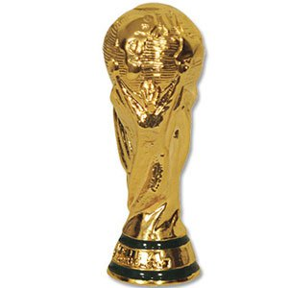



trophy

Slide 14
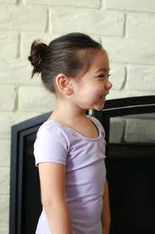
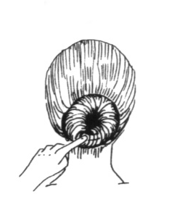
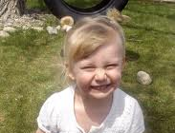
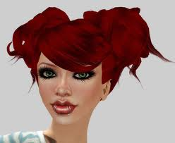
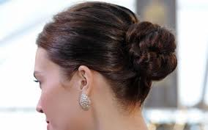
(hair) bun

