Slide 1
My Name is Yoon
1.5

Slide 2
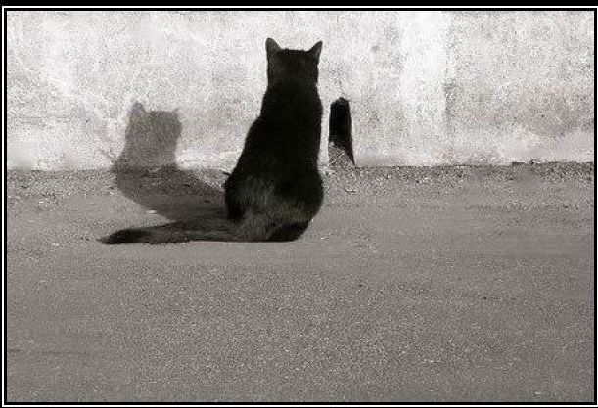
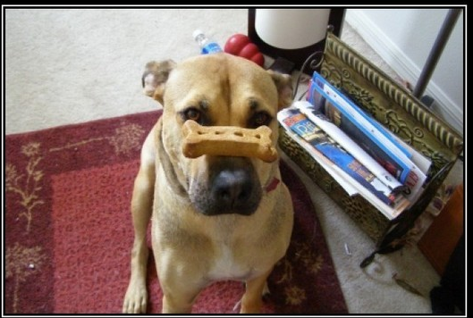
patient
You have to be patient. You will make friends after awhile.
Meaning: Being able to put up with problems or delays without getting angry or upset

Slide 3
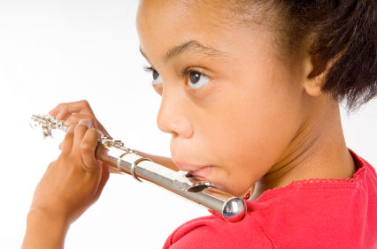
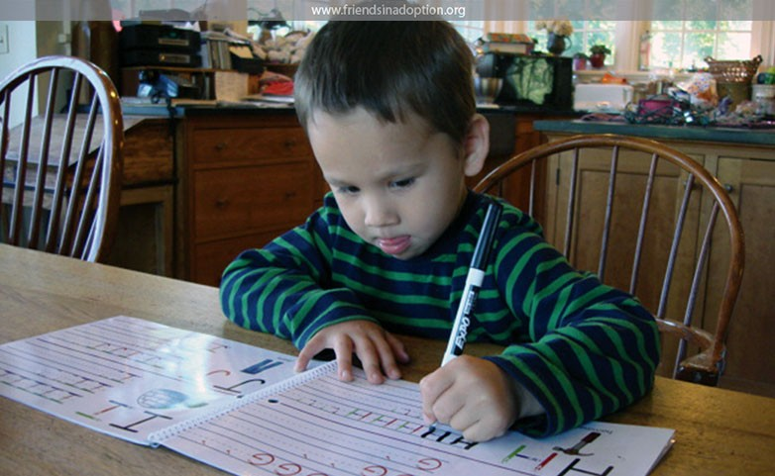
practiced
Yoon practiced writing the letters of the alphabet.
Meaning: Doing something again and again until you do it well
What else can you practice?

Slide 4
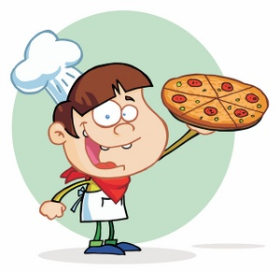
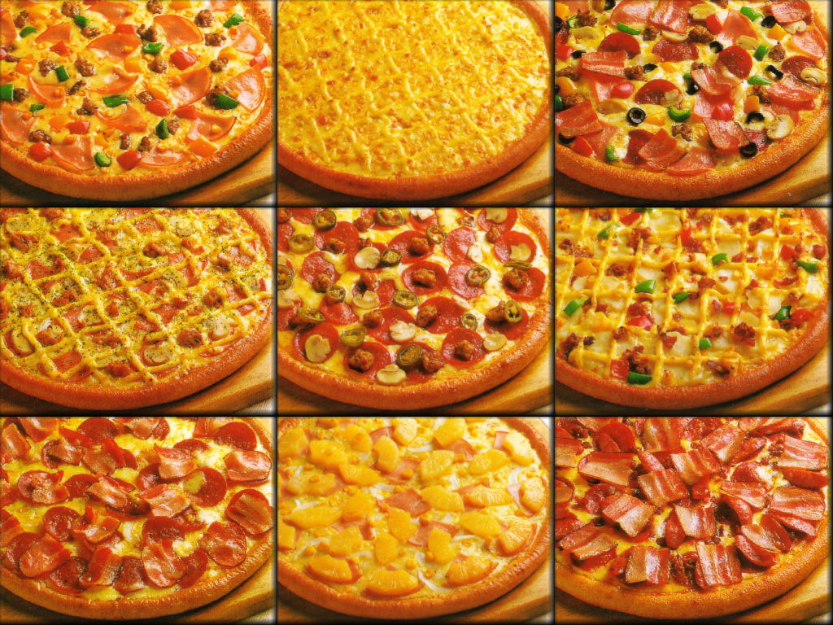
favorite
Meaning: A person or thing liked best
What is your favorite kind of pizza?
Make your own “Our Favorite Pizza” graph: http://nces.ed.gov/nceskids/createagraph/default.aspx?ID=66098f9cc4b24ce59581530f6822bf4d

Slide 5
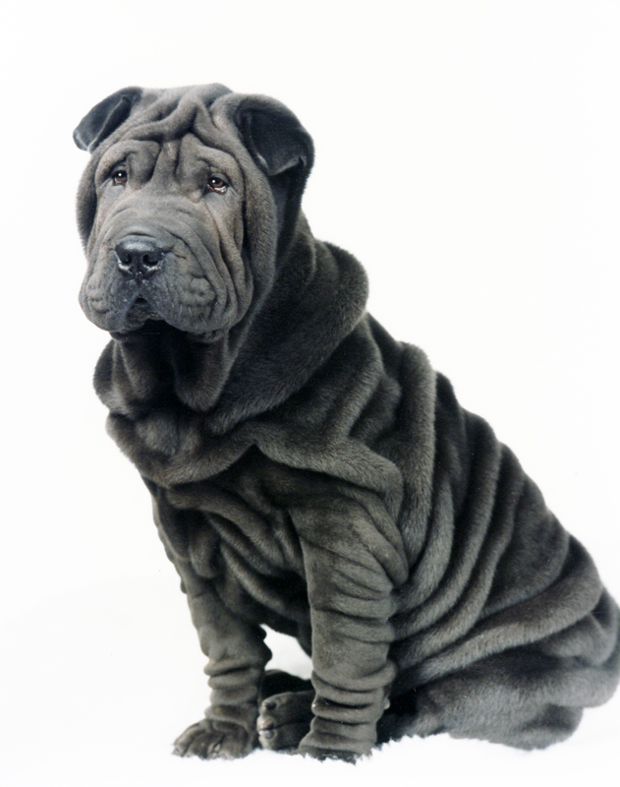
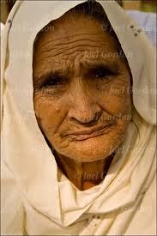
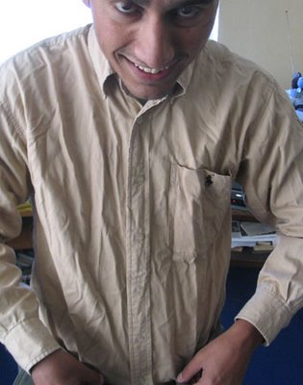
wrinkled
Made a fold, ridge or line in a smooth surface

Slide 6
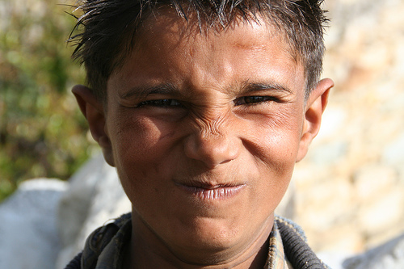
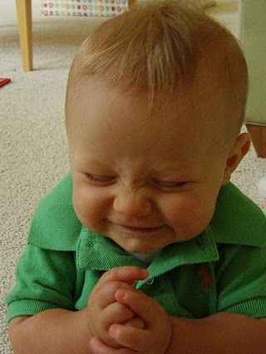
wrinkled (my nose)
I wrinkled my nose- I did not like how my name looked.

Slide 7
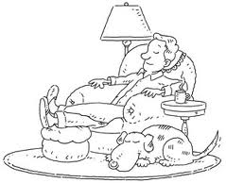
settled (in)
To make a home in a place

Slide 8
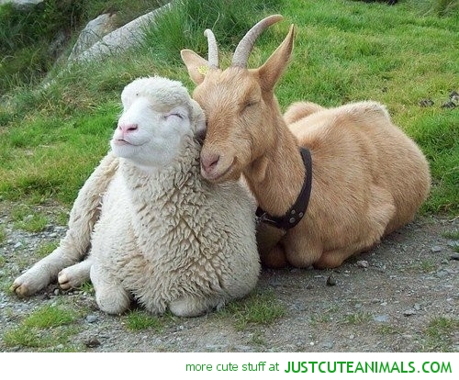
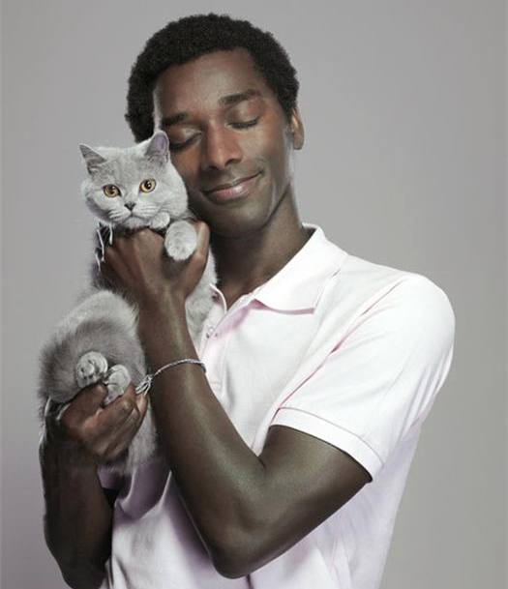
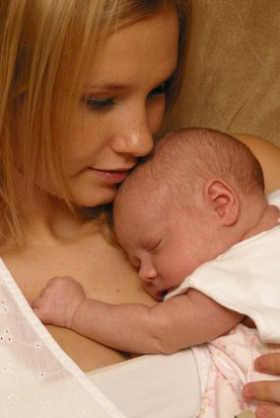
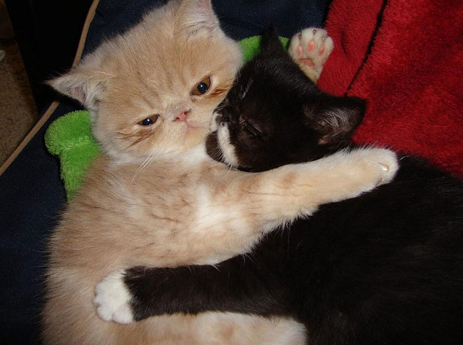
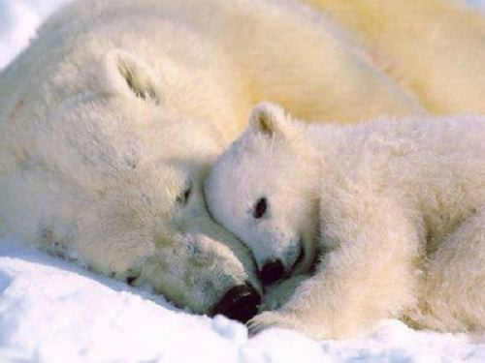
cuddle
To hold close in one’s arms

Slide 9
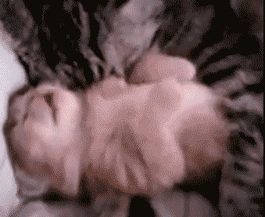
More cuddling
Sweet momma cat cuddling her baby
See the whole video here: {1:01} http://www.youtube.com/watch?v=2Eov3-BF7N4

Slide 10
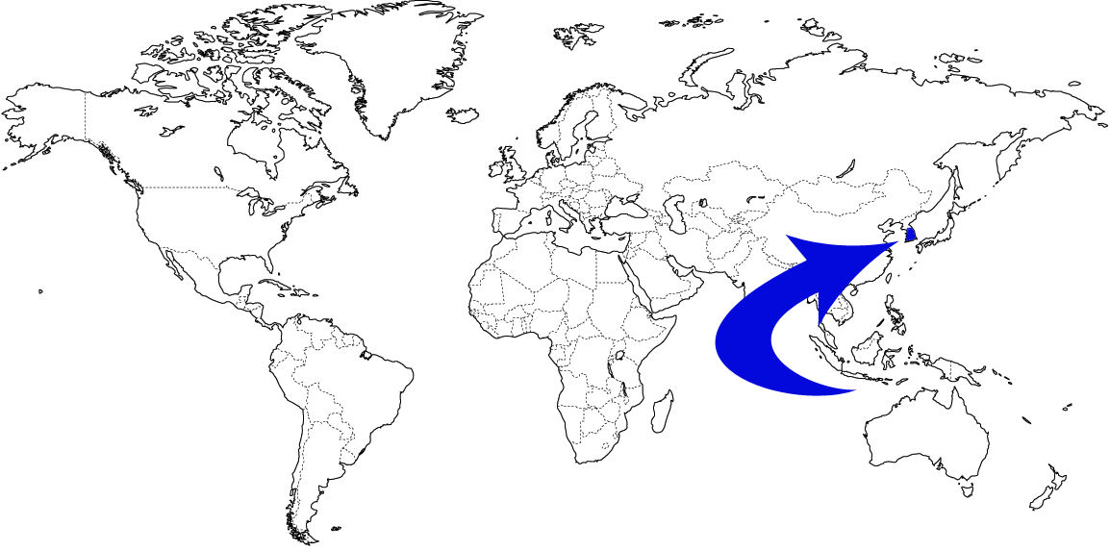
Korea

Slide 11
America/ The United States of America

Slide 12
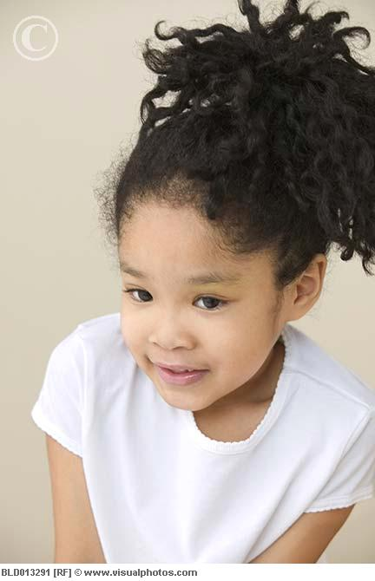
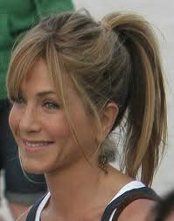
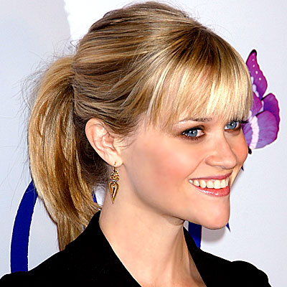
ponytail
I watch the ponytail girl sitting on the swing.

Slide 13
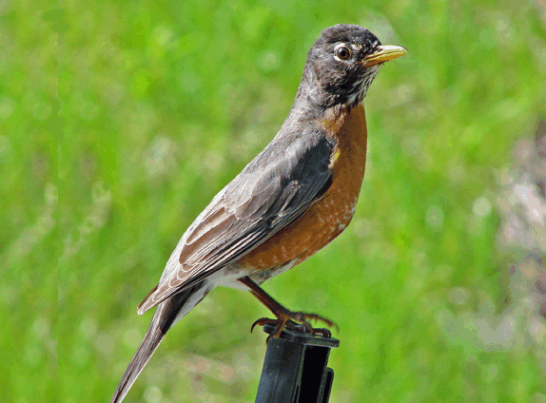
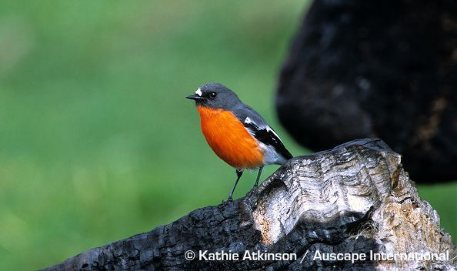
robin
I sit at the window and watch a little robin.

