Slide 1
A Trip to the Emergency Room
2.3

Slide 2


serious
Dangerous; not funny

Slide 3
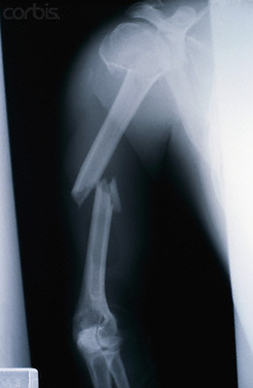

broken
To become well or healthy again

Slide 4
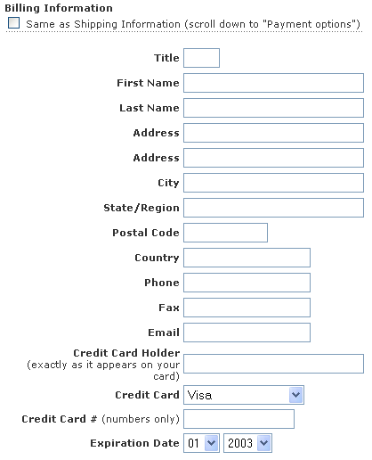
personal (information)
Having to do with a person

Slide 5

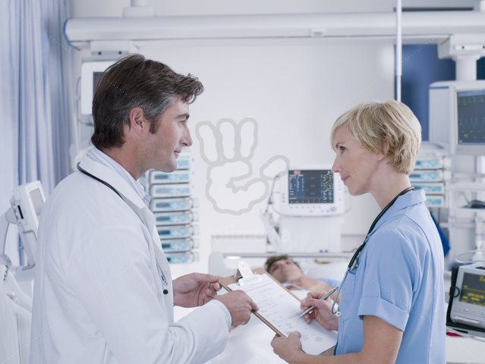
informs
Gives information to

Slide 6
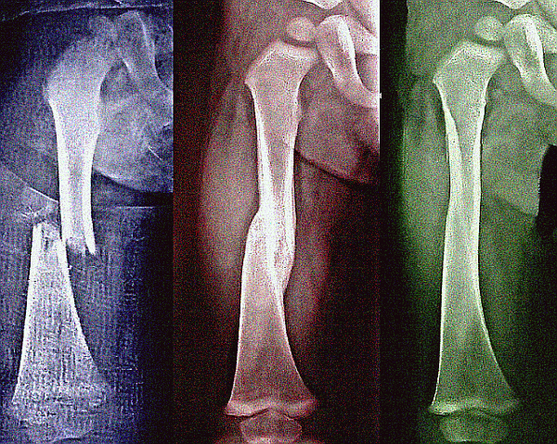
heal
To become well or healthy again

Slide 7
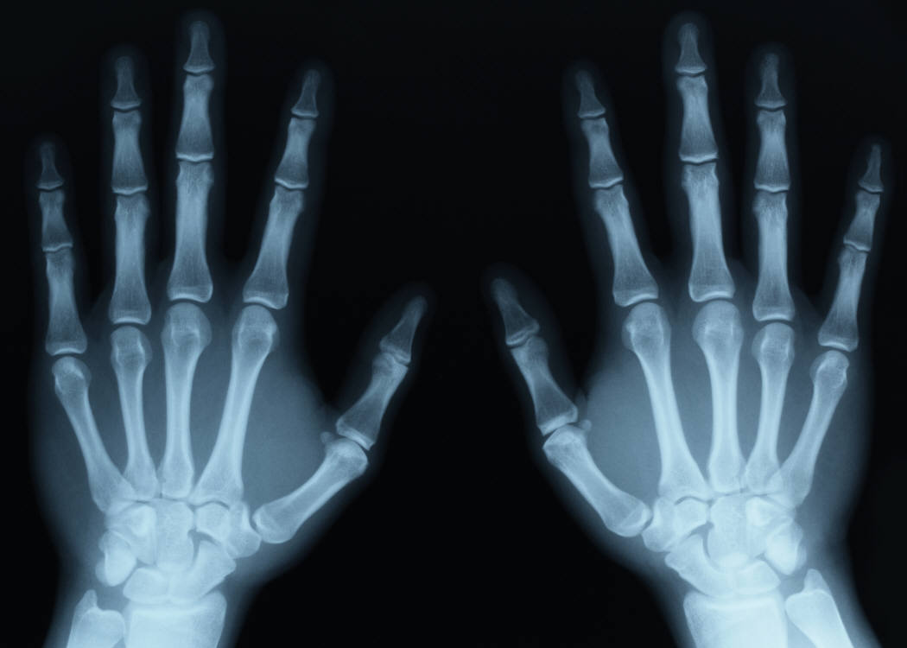
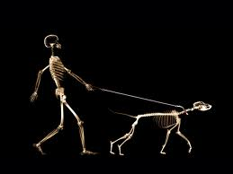
X-ray
What is an x-ray? http://app.discoveryeducation.com/player/view/assetGuid/DFA39EEF-FC55-4112-8A6C-EC8804D5DF43
Bill Nye talks about the discovery of the x-ray (4 min): http://app.discoveryeducation.com/player/view/assetGuid/81481AB8-E295-469F-A843-0A15F185E5F8

Slide 8
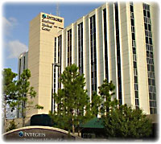
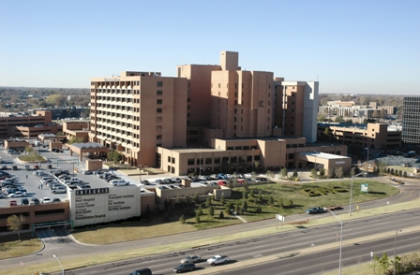
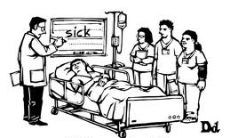
hospital
Southwest Medical Center Baptist Medical Center

Slide 9
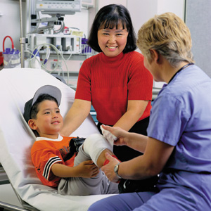
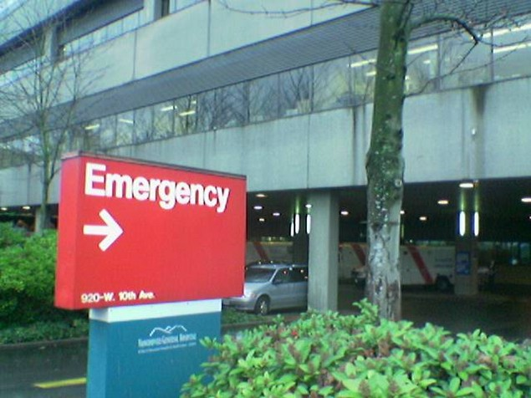
Emergency Room (E.R.)

Slide 10
ambulance

Slide 11
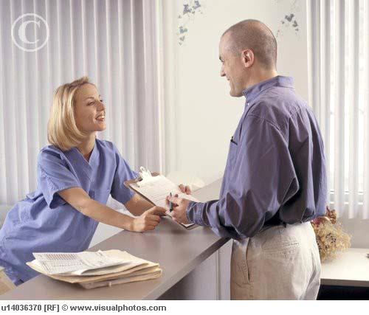
Admissions worker

Slide 12


nurse

Slide 13
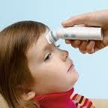
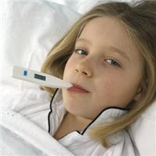
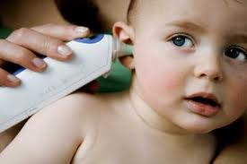
temperature

Slide 14
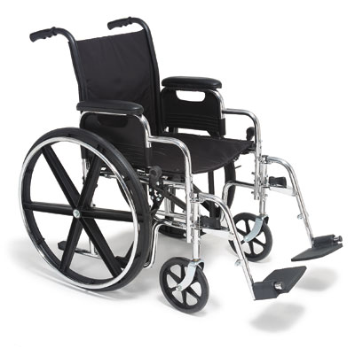
wheelchair

Slide 15



doctor

Slide 16
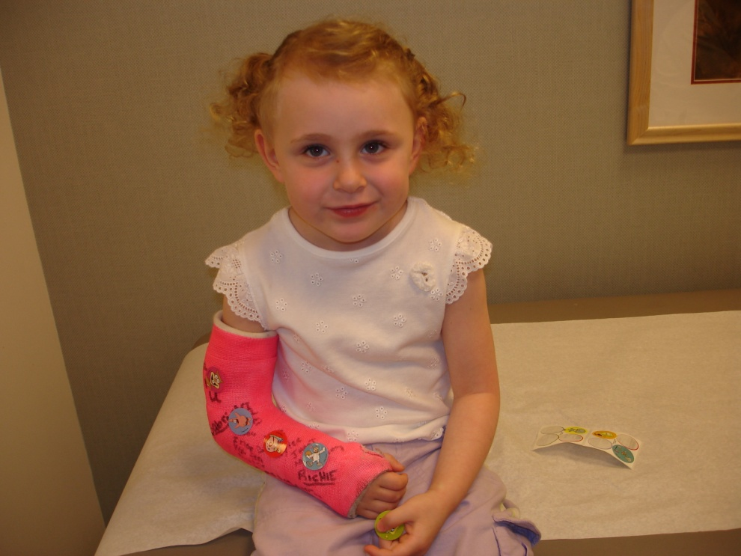
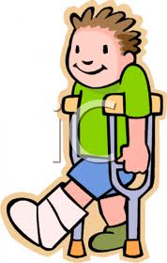
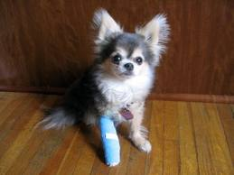
cast

