Slide 1
Farfallina & Marcel
2.4

Slide 2
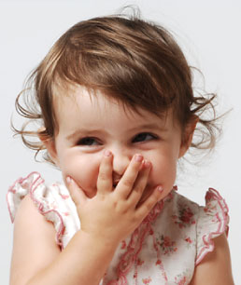
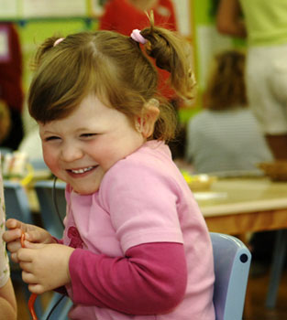
giggled
To laugh in a silly or nervous way
http://www1.teachertube.com/viewVideo.php?video_id=15733&title=Laughing_Baby

Slide 3
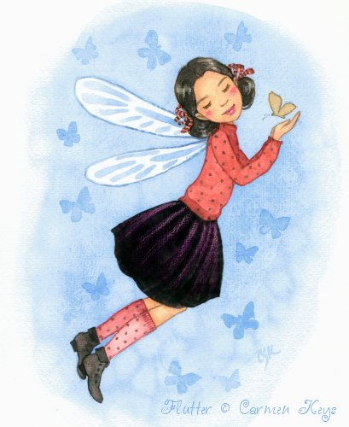
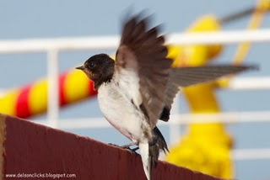
fluttered
Moved or flew with quick, light flapping movements

Slide 4
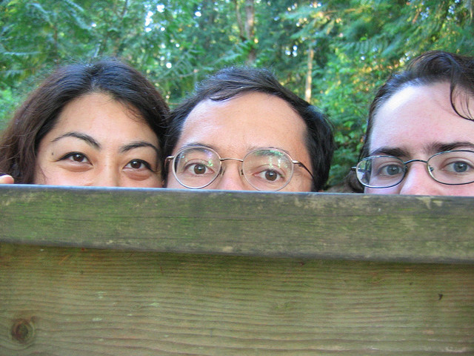
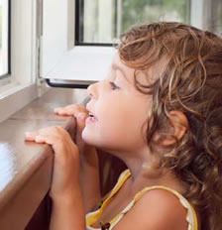
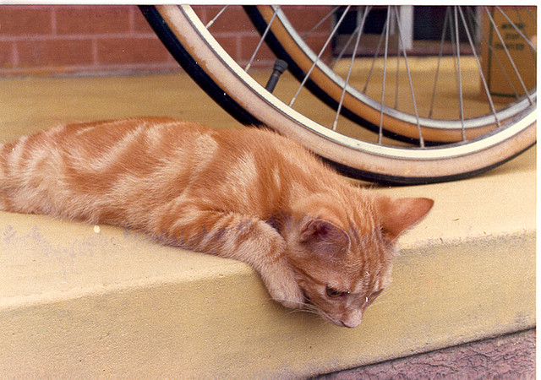
peered
Looked at closely to try to see something clearly

Slide 5
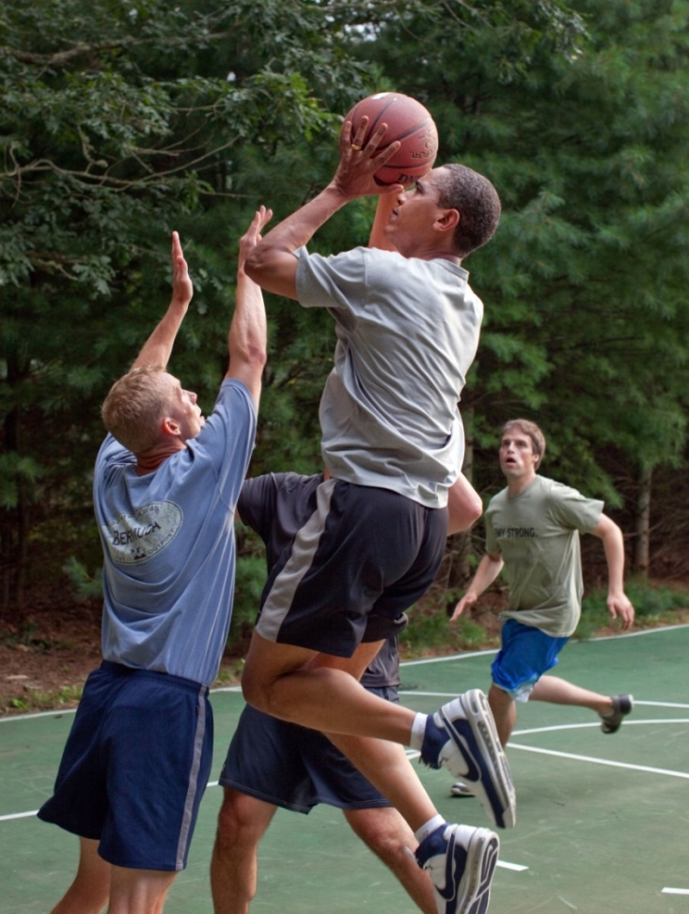
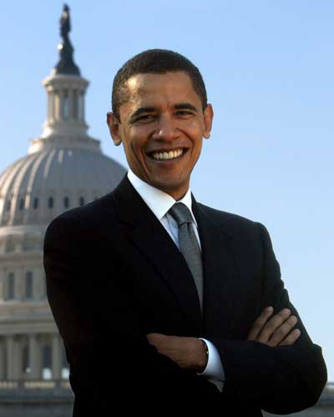
recognized
It’s harder to recognize President Obama when he is wearing shorts and playing basketball!

Slide 6
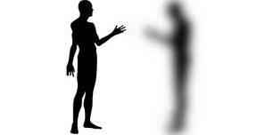
vanished

Slide 7
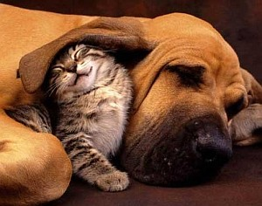
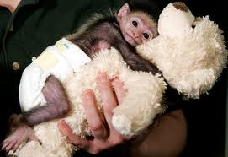
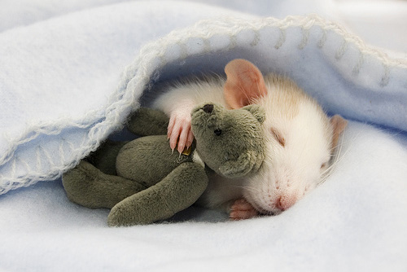
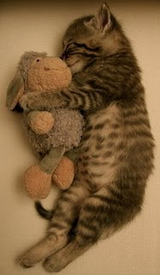
snuggled

Slide 8
pond

Slide 9

reflection

Slide 10


Slide 11
