Slide 1
Penguin chick
Genre: Narrative Nonfiction- a story or account about actual living things

Slide 2
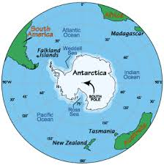
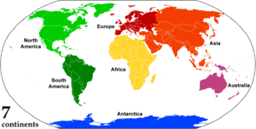
There are 7 continents
Antarctica is Earth's southernmost continent, containing the geographic South Pole

Slide 3
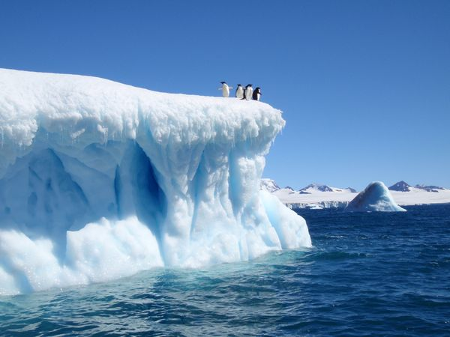
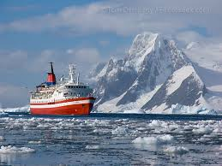
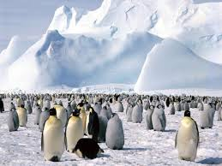
Facts about antarctica
Antarctica, almost 98% solid ice, was finally considered a continent in 1840, and not just a group of isolated islands.
Antarctica is the coldest and windiest spot on the planet. In fact, the lowest temperature ever recorded on Earth was recorded in Antarctica (-129.3ºF) and the mean winter temperatures range from -40º to -94ºF. Winds are commonly measured at up to 200 miles per hour

Slide 4
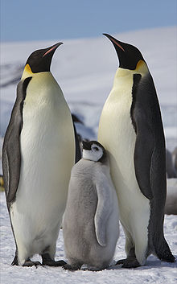
Emperor Penguin
Emperor penguins are the largest penguins, standing about 4 feet (1.2 meters) tall.
To learn more about penguins:
http://kids.nationalgeographic.com/kids/animals/creaturefeature/emperor-penguin/

Slide 5
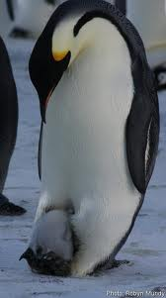
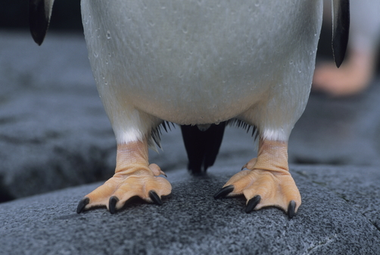
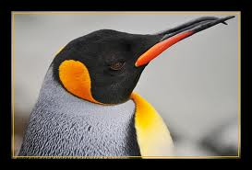
Penguin
Flippers
webbed feet
Brood patch
beak

Slide 6
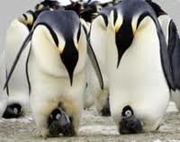
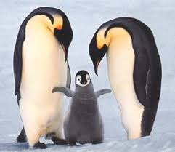
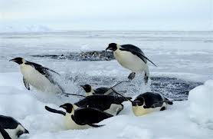
Now, let’s watch a video
Watch a video about Emperor Penguins in Antarctica. List 3 things you’ve learned about penguins
http://www.youtube.com/watch?v=xMBrWfSo68I

Slide 7
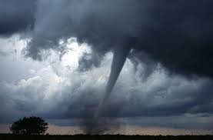
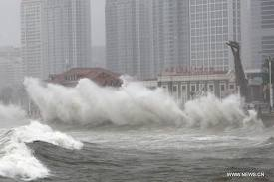
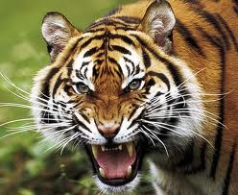
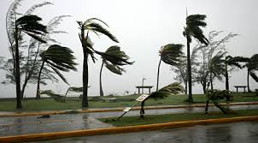
fierce
Strong, extremely bad, violent or severe

Slide 8
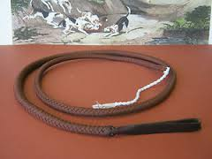
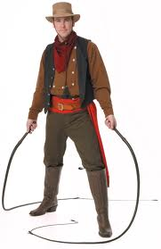
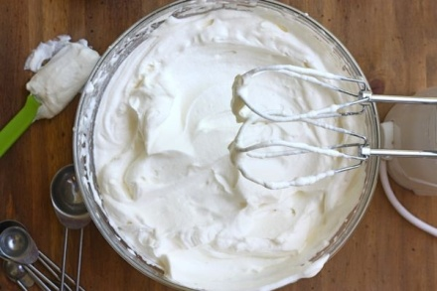
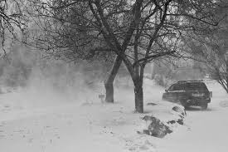
whip
To beat especially with a lash
To move something with force as if using a whip
whipped cream
wind whipping snow

Slide 9
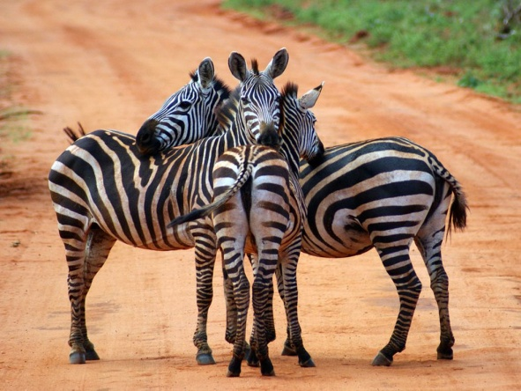
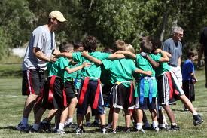
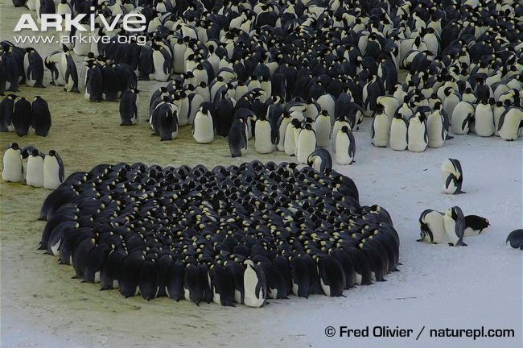
Huddle (verb, noun)
Verb:To crowd together, to curl up
Noun: Penguins stay in a group called “a huddle”. Why do you think they do that?
huddle

Slide 10
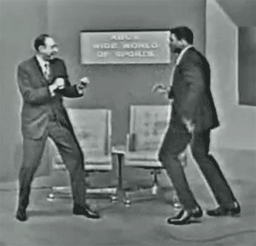
Shuffle your feet
Moving your feet back and forth without lifting them up.

Slide 11
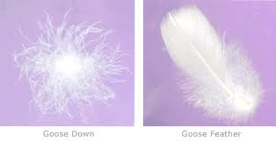
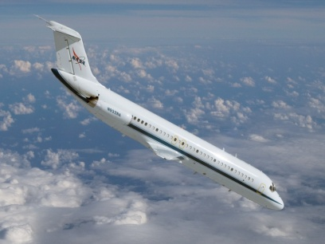
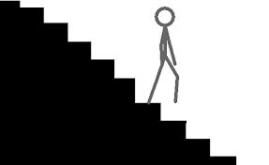
down
Homographs- words spelled the same way, but having different meanings like:
Down and Down
I am going down the stairs. Very soft and fluffy feathers
Penguin chicks are covered in down.

Slide 12
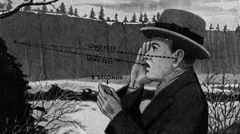
echo
the repetition of a sound caused by reflection of sound waves
http://www.youtube.com/watch?v=1ZGuTwkD1DM

Slide 13
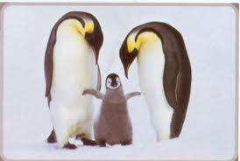
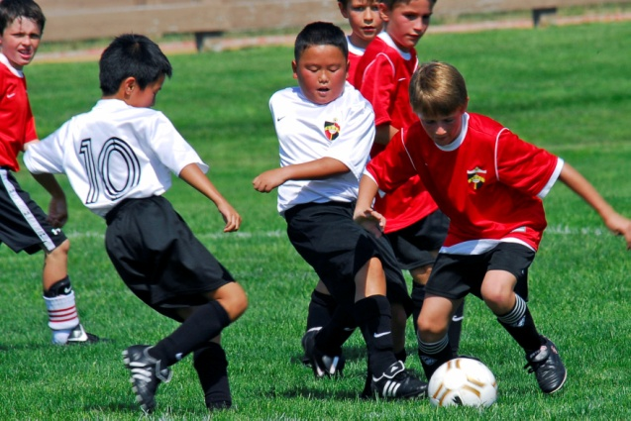
junior
Younger in age or rank
Junior penguin= baby penguin
Junior soccer championship

Slide 14
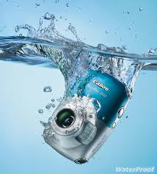
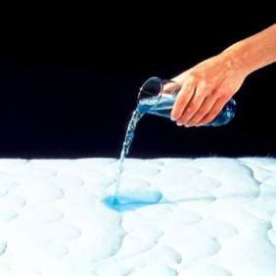
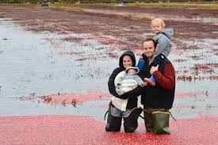
waterproof
Designed to keep the water out
Waterproof camera
Waterproof mattress cover
Waterproof pants

Slide 15
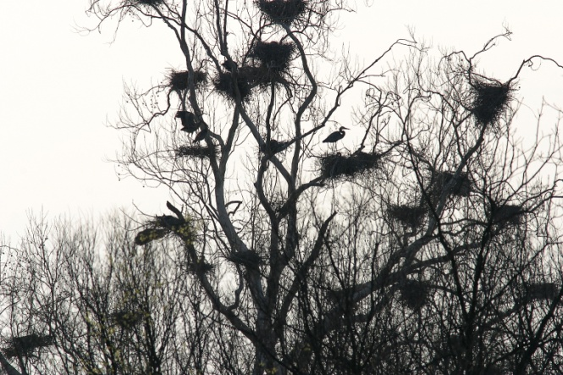
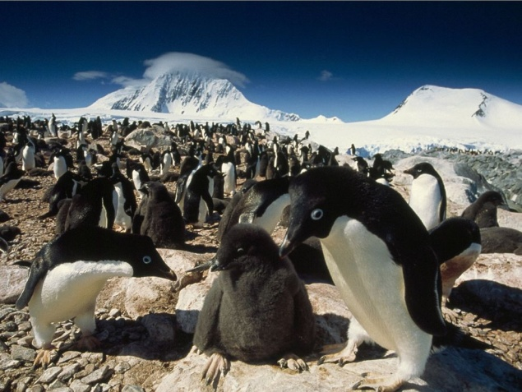
rookery
the place where a group of birds or social mammals (as penguins or seals) breed, nest, or raise their young

Slide 16
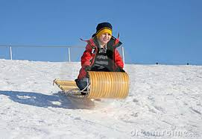
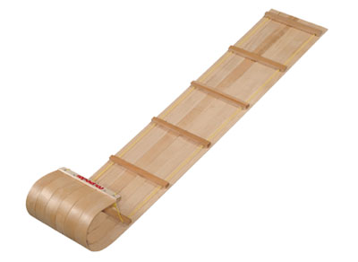
toboggan
a long light sled made without runners and curved up at the front

Slide 17
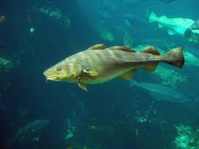
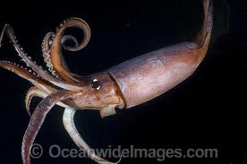
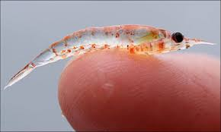
Fish, squid, krill
Food for Penguins:
Fish
Squid
Krill

Slide 18
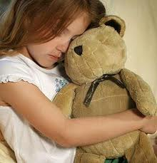
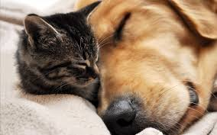
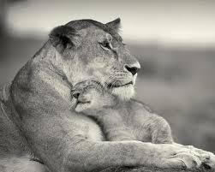
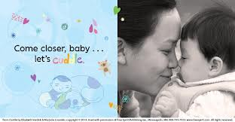
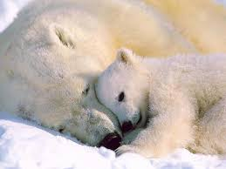
Cuddle/ snuggle
Cuddle -to hold close for warmth or comfort or in affection
Snuggle- to lie close

Slide 19
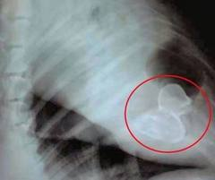
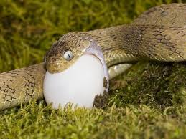
swallow
to take food into the stomach through the mouth and throat
Oh, no! What did my dog swallow?

