Slide 1
The perfect pet
Genre: humorous fiction- a made-up story written to make readers laugh.

Slide 2
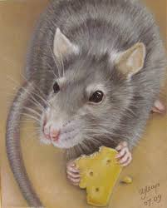
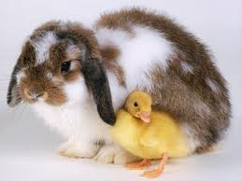
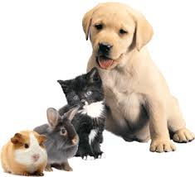
Building background
Share with a class or with a partner:
Do you have a pet?
If not, what pet would you like to have? Why?
What animals can be pets?
What responsibilities do you have with a pet?
Why would some parents not allow their kids to have a pet?
What makes a good pet?
I would like to have a….as a pet because…
If you have a pet you are responsible for…..
One of the reasons why some parents don’t allow their kids to have a pet is….
I believe a good pet should be….

Slide 3
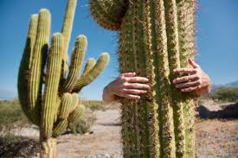
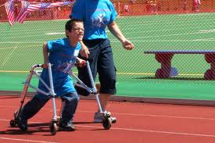
*challenge
A difficult task or problem. Something that is hard to do
He accepted the challenge to compete in the Special Olympics
Do you think that having a cactus as a pet would be a challenge? Why?

Slide 4
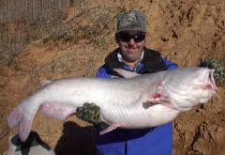
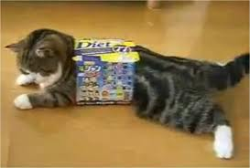
*manage
To succeed in doing something
How did he manage to catch such a big fish?
How did my cat manage to get in this small box?

Slide 5
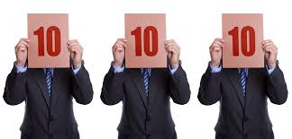
*perfect
Ideal, cannot be better
The athlete received the
perfect score from the judges. I have a perfect
report card

Slide 6
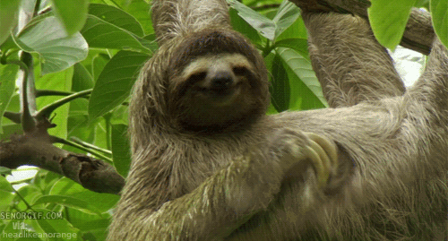
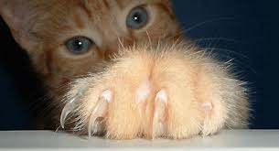
*scratch
(1)Scratch to scrape skin with your nails to help the itch
A sloth scratching
(2)Scratch- to erase, cancel, delete, strike out
(3) Scratch-to break the surface with something sharp

Slide 7
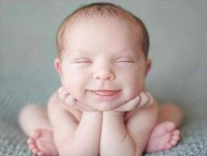
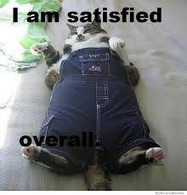
*Satisfy (appetite)
To make someone content (happy, pleased, full, etc)

Slide 8
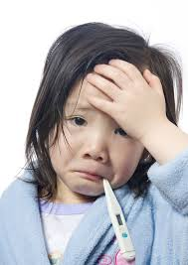
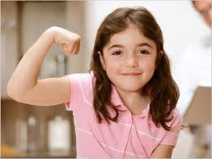
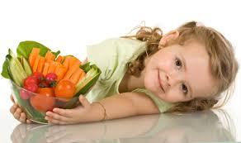
*healthy
Sick Healthy
Healthy foods

Slide 9
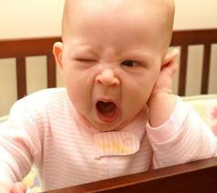
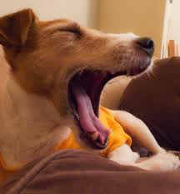
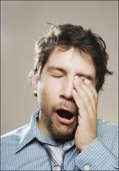
yawn

Slide 10
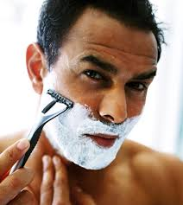
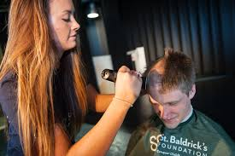
shave

Slide 11
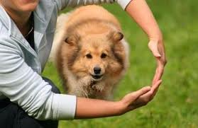
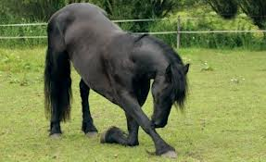
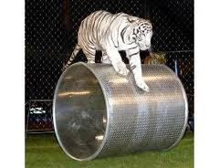
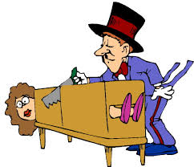
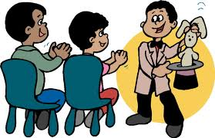
tricks
Amazing things animals can be trained to do
Magic tricks

Slide 12
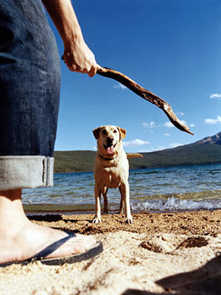
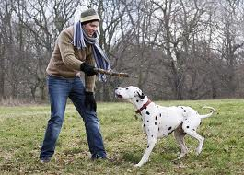
Play fetch

Slide 13
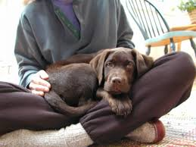
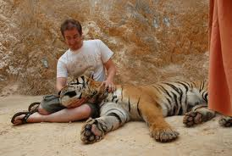
In my lap
Dog curled in my lap Tiger is resting his head in
in my lap

Slide 14
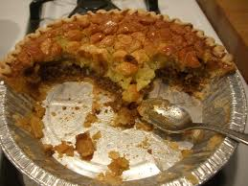
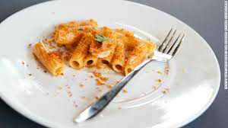
leftover
Something that is left from a large amount
Leftover pie leftover pasta

Slide 15
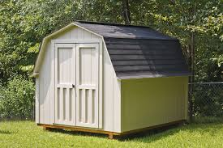
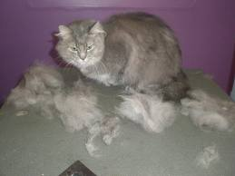
shed
(1)A small house usually used for keeping tools
(2) To shed- to drop off hair

Slide 16
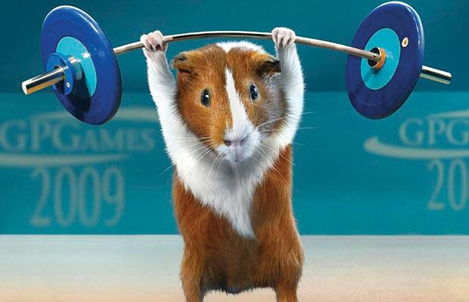
Guinea pig

Slide 17
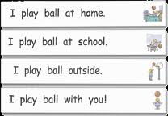
Decimal/period
A point .
If used at the end of sentence it is called a period.
How many periods are there?
If used in a number, it’s called a decimal point

