Slide 1
The strongest one
Genre: A play- a story that is intended to be performed on a stage

Slide 2
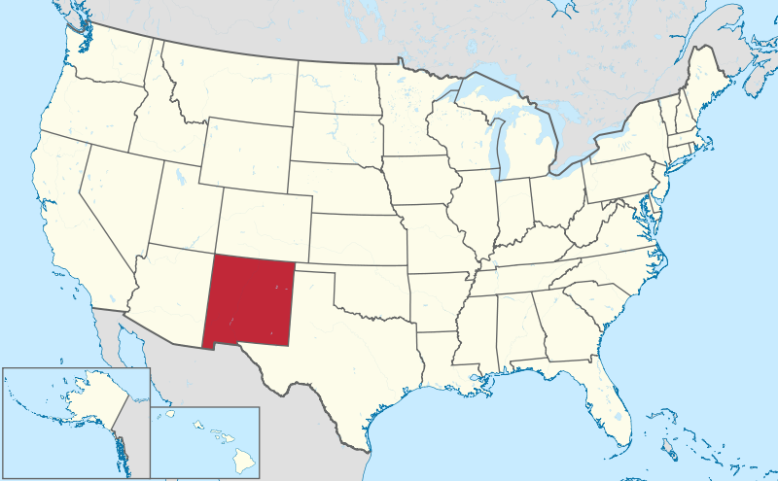
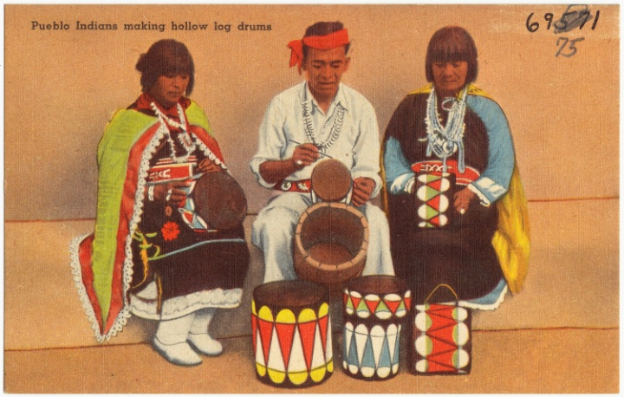
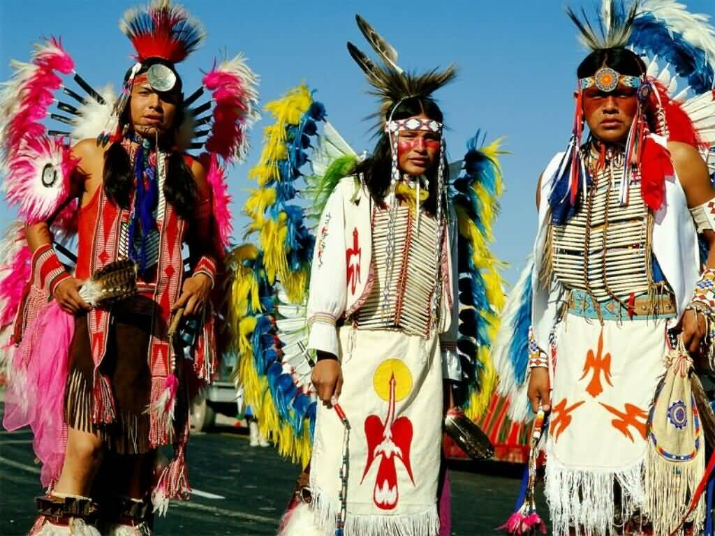
New Mexico
New Mexico is a state located in the southwest and western regions of the United States. It is inhabited by indigenous (native) people of America, mostly Navajo and Pueblo tribes.
Navajo Indians Pueblo Indians

Slide 3
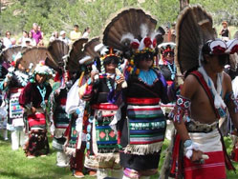
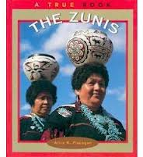
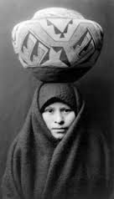
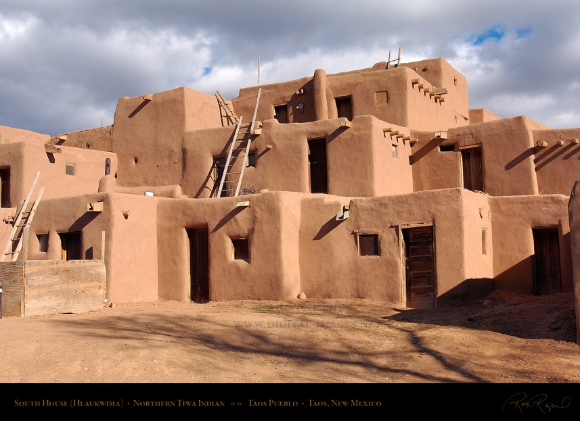
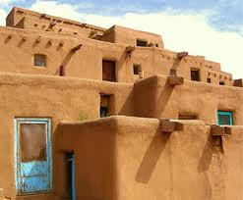
The Zunis
A Native American tribe that dwells (lives) in pueblos, compact villages, made up of multistoried buildings made of adobe bricks and beams

Slide 4
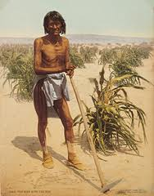
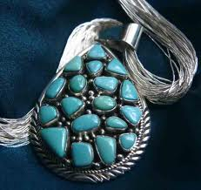
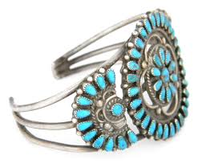
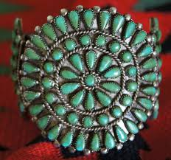
Zunis knew how to grow crops in the dry lands of Southwest. They were sophisticated (knowledgeable) farmers
Zunis were also well-known as
artists for their beautiful jewelry
made of silver and turquoise.

Slide 5
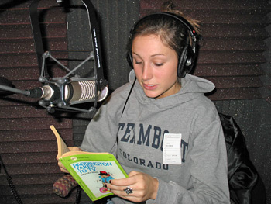
Narrator
A person who narrates (tells) a story

Slide 6
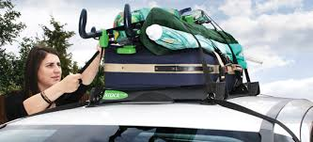
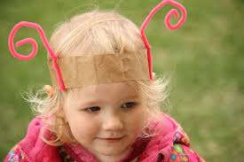
*securing
To make something safe by attaching it very firmly
Before you transport anything on the roof rack of your car you must secure it with straps.
The ants wear feelers suggested by securing red pipe cleaners around a headband.

Slide 7
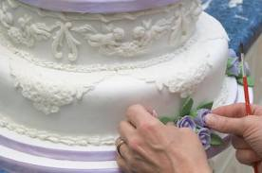
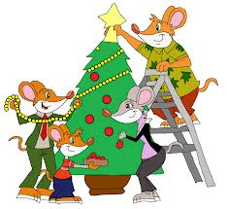
* decorated
To make something more beautiful by putting something on it
Cake decorating Christmas tree decorating

Slide 8
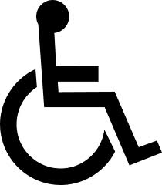
* symbol
a letter, group of letters, character, or picture that is used instead of a word
Recycling symbol Handicapped symbol
Can you name this symbol?

Slide 9
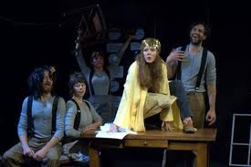
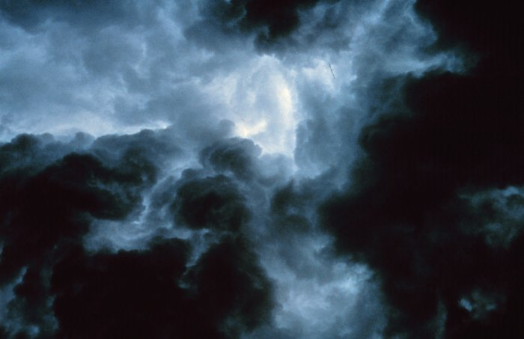
* darkened
To become dark
The actors came out on a darkened stage
The sky darkened before the storm

Slide 10
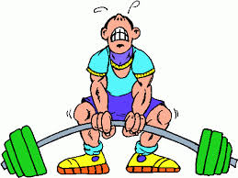
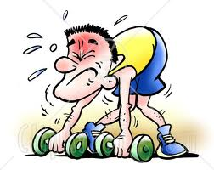
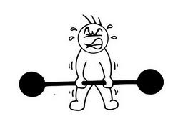
* weakest
Having the least power or strength
Weak weaker the weakest

Slide 11
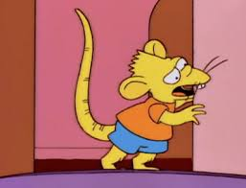
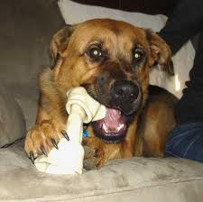
*gnaws
To bite or chew on something repeatedly
A mouse gnaws holes in the wall.
A dog gnaws on the bone.

Slide 12
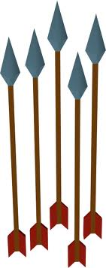
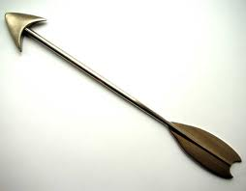
arrow

