Slide 1
Wolf!
Unit 2, Week 2

Slide 2
Story Background
Have you ever had a friend that liked to read more than he or she liked to play?
Do you like to read?

Slide 3
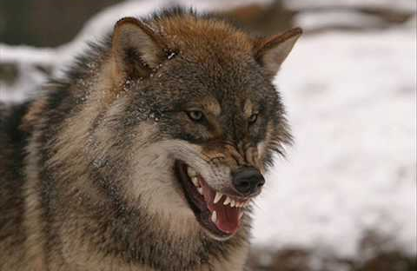
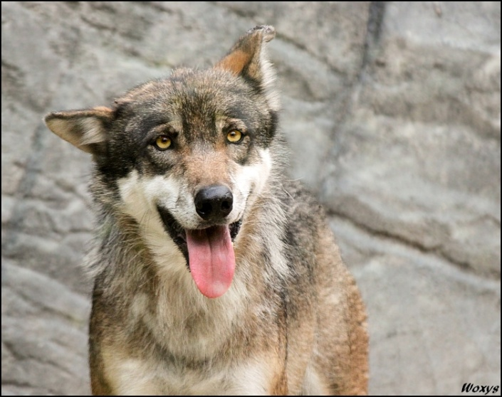
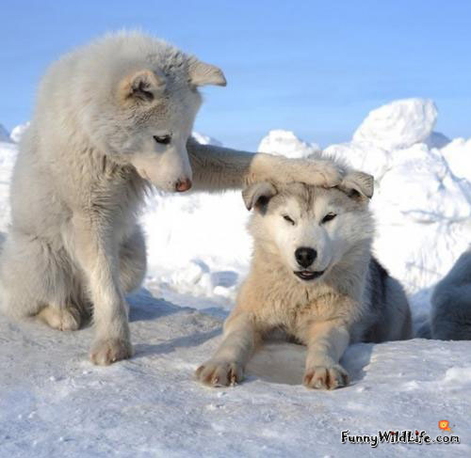
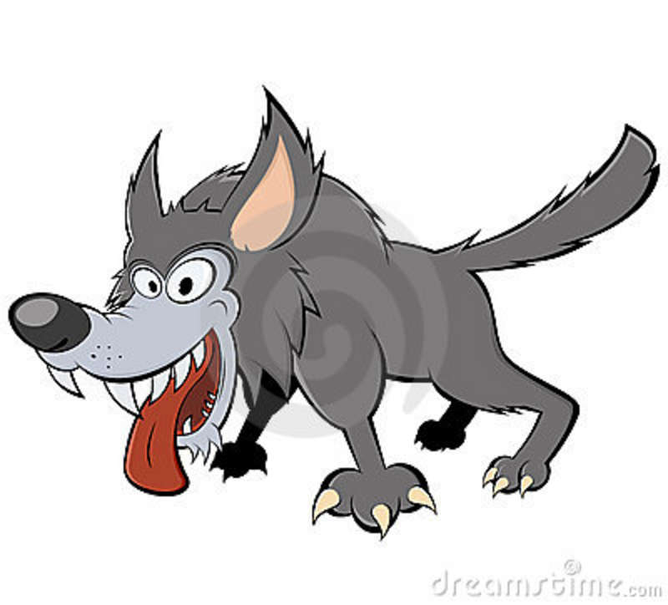
Story Background
Sometimes wolves are scary in a story.
Sometimes they are silly or funny.
They can also be cute!

Slide 4
Story background
What do you think the wolf is like in our story?

Slide 5
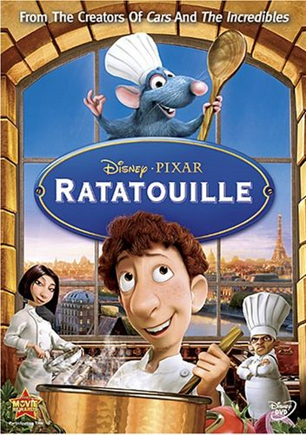
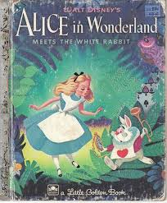
Genre: Fantasy
A story that couldn’t really happen.
What other fantasy stories do you know?

Slide 6
Suffixes in this story
Ached
An –ed ending means that it happened in the past.
Bothering
An –ing ending means something is happening right now.

Slide 7
ached
The wolf was tired and hungry, and his feet ached.
Meaning: to hurt

Slide 8
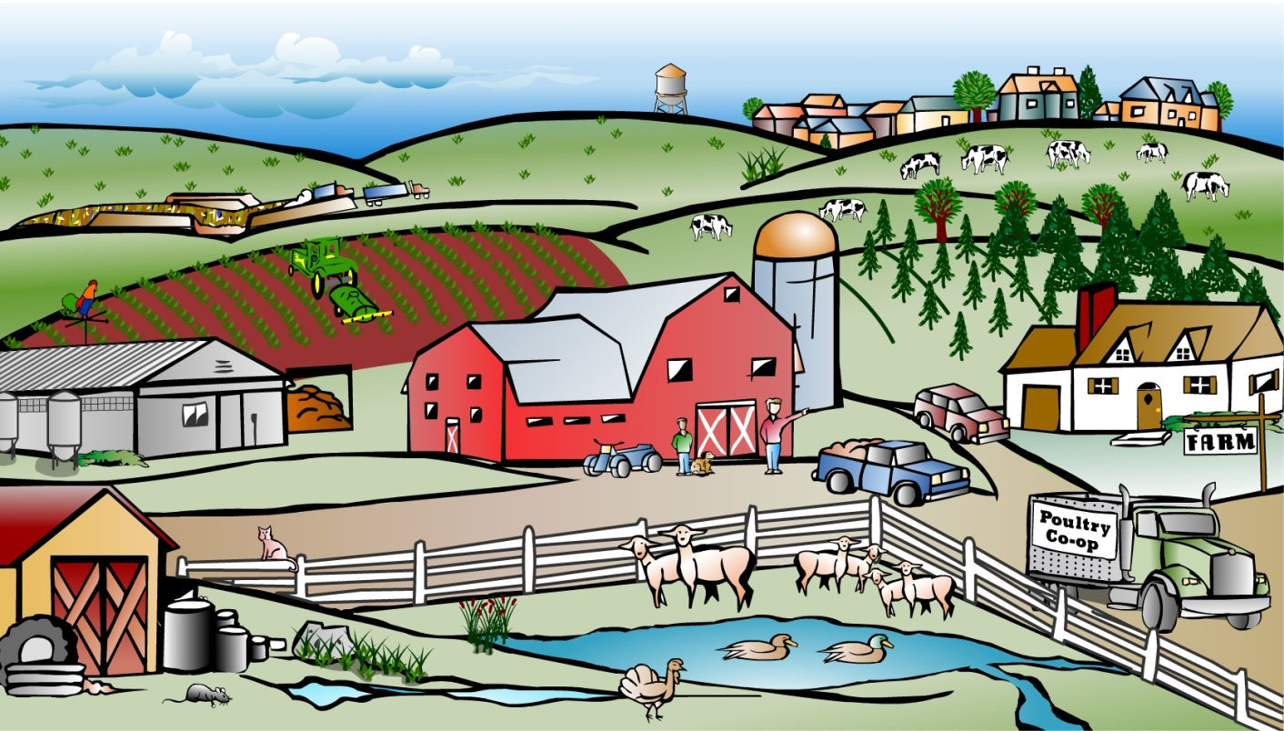
farm
The wolf decided to visit the farm outside the village.

Slide 9
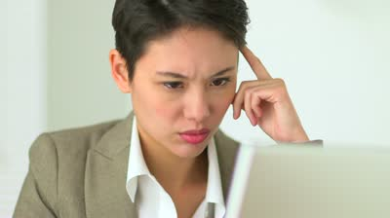
concentrate
“What is that awful noise?” complained the cow. “I can’t concentrate on my book.”
Meaning: to stay focused; to pay attention

Slide 10
Which student is concentrating? Which student is distracted?

Slide 11
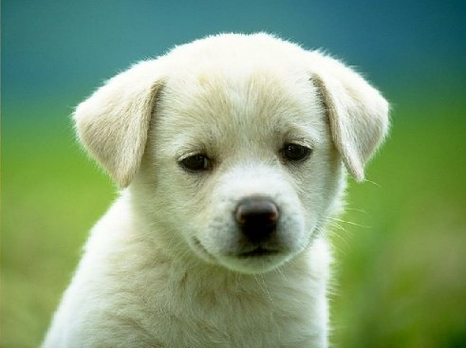
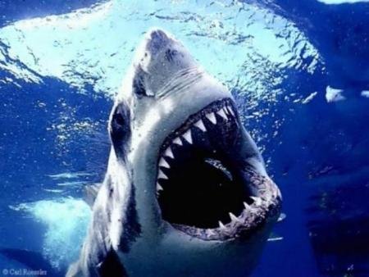
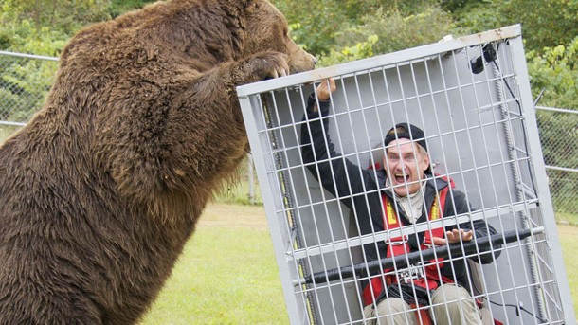
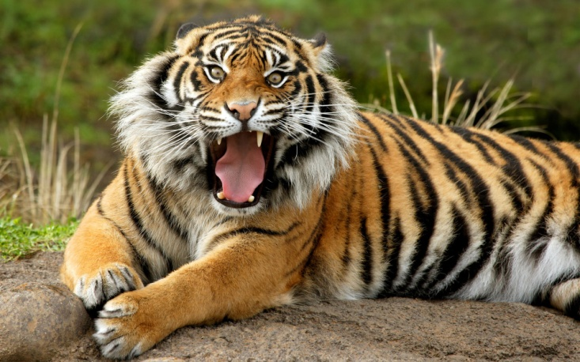
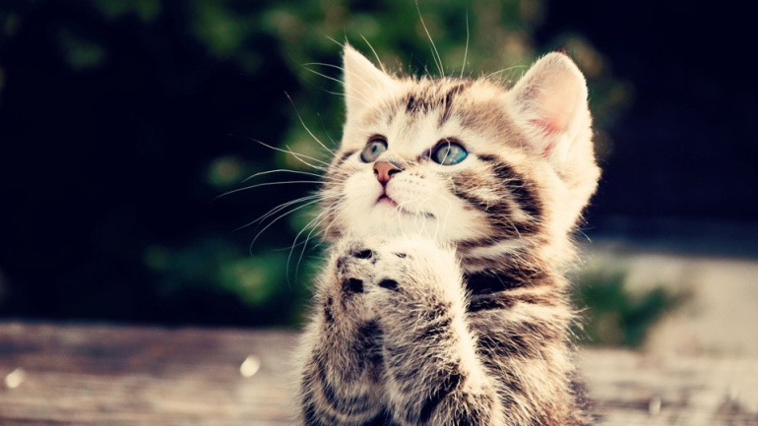
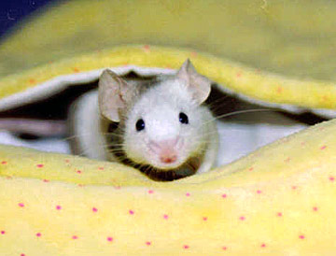
dangerous
“Can’t you see I’m a dangerous wolf?”
Meaning: not safe; an animal that could hurt you
Which animals are dangerous?

Slide 12
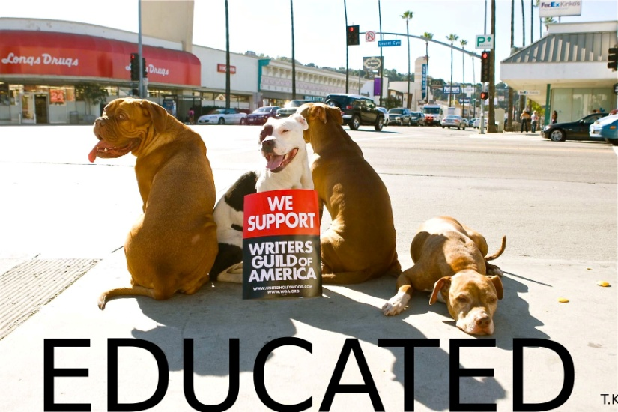
educated
“Can’t you see that we are educated animals?”
Meaning: to know a lot about school subjects (reading, math, and more)

Slide 13
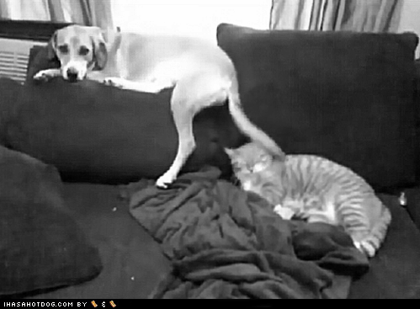
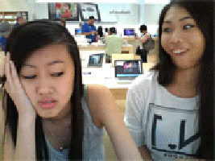
bothering
The duck said, “you are still not a very good reader” without bothering to look up.
Meaning: taking time to do something

Slide 14
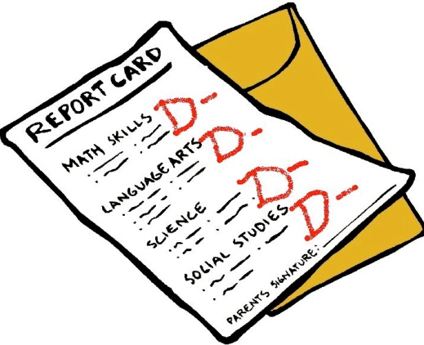
improved
“You have improved,” said the pig, “but you still need to work on your style.”
Meaning: to get better

Slide 15
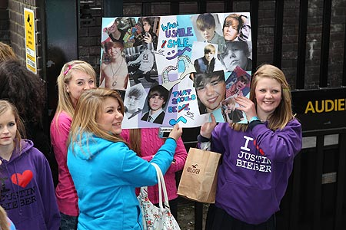
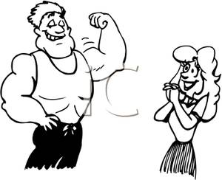
admire
The wolf wanted the other farm animals to admire him.
Meaning: to look up to someone

Slide 16
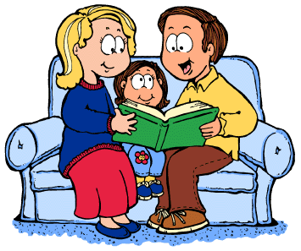
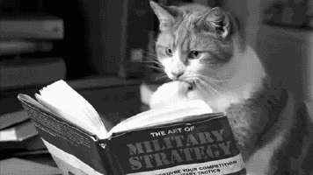
to read with passion
The wolf read with confidence and passion.
Meaning: a strong emotion (love or anger)

