Slide 1
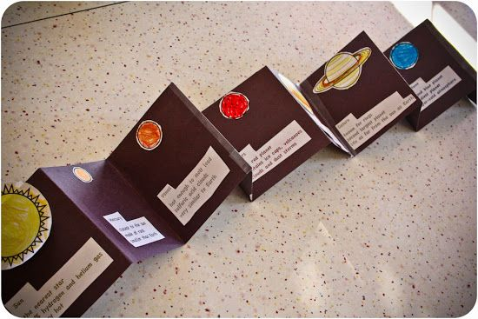
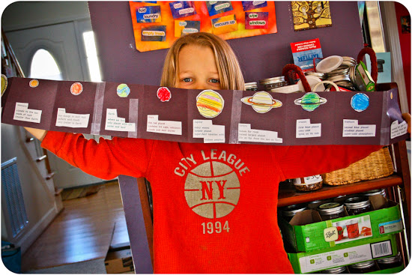
Ideas for teaching the Solar System (This slide is hidden)
Solar System Foldable: write 3 facts about each planet, color planets, glue to accordion foldable.
Color page: http://www.coloringcastle.com/pdfs/space/planets02.pdf

Slide 2
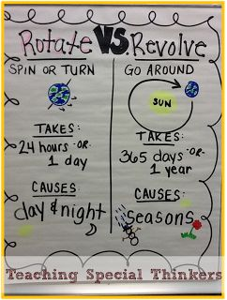
(This slide is hidden)

Slide 3
The Planets of Our Solar System
Grade 3, Unit 2.4

Slide 4
Solar System- planets and other things that move in a circle around the sun.
Type a brief overview or summary of your project here.

Slide 5
Solar System
Watch a short video about the solar system (United Streaming- 2:32)
http://app.discoveryeducation.com/search?Ntt=solar+system
View and play around with different views of the solar system: http://www.solarsystemscope.com/
Did you know that the planets move at different speeds? See it here: https://www.khanacademy.org/cs/the-solar-system/957249502
Notes:
You will need a log in for the United Streaming video. It isn’t the most amazing video, but better than many from YouTube. The 2nd link is awesome!! Play around with different views.

Slide 6
