Slide 1
Cook-a Doodle-Doo! 4.1
Genre: Humorous (funny) Fiction

Slide 2
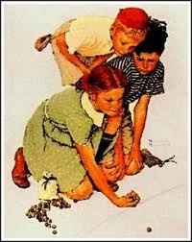
idiom
A phrase that means something different from what the words say:
lost your marbles
doesn’t mean you lost your marbles it means you have gone crazy

Slide 3
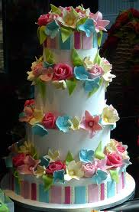
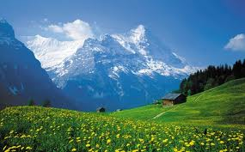
Magnificent
Wonderful, very beautiful, amazing

Slide 4
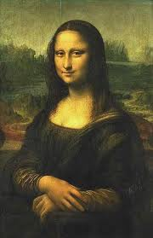
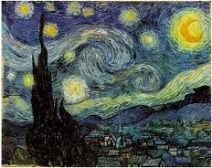
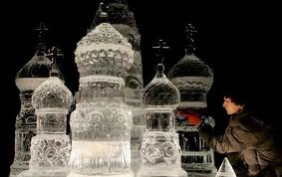
masterpiece
A person’s greatest piece of work (art)
Leonardo DaVinci Van Gogh
Ice sculpture masterpiece

Slide 5
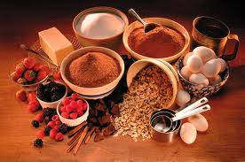
ingredient
Things that are needed to make a dish
Ingredients for a cake

Slide 6
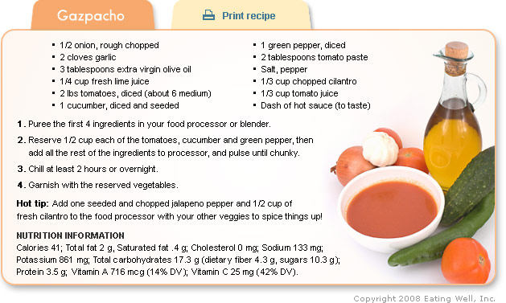
recipes
Instructions how to make a dish and what ingredients you will need

Slide 7
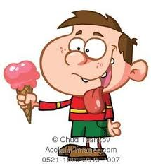
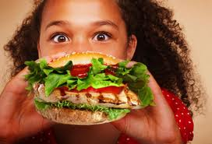
tasty
Yummy, delicious

Slide 8
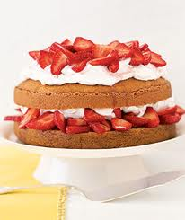
Strawberry shortcake

Slide 9
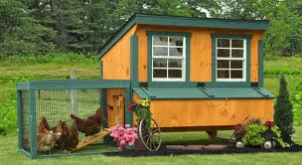
Chicken coop

Slide 10
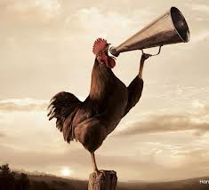
crow

Slide 11
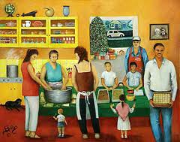
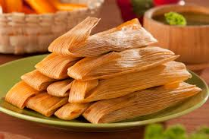
tradition
Something you always do at this particular time of the day/year
Making tamales is our family Christmas tradition

Slide 12
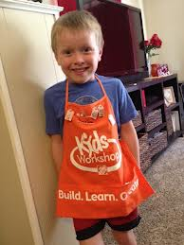
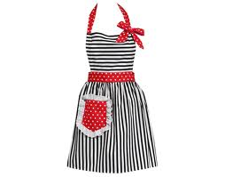
apron

Slide 13
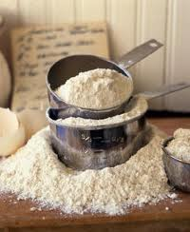
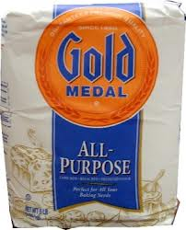
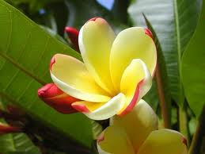
Flower-flour
Flower Flour
HOMOPHONES!!!

Slide 14
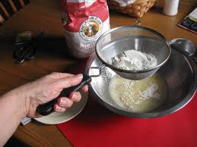
sift

Slide 15
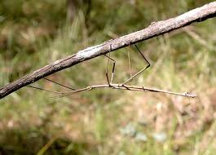
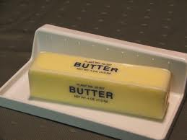
Stick- stick of butter
Stick stick of butter

Slide 16
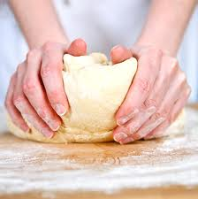
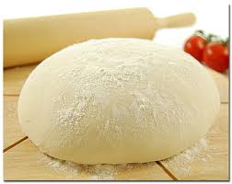
dough

