Slide 1
Seven Spools of Thread 2.4.2
Genre: Fable- a short story that teaches a moral.

Slide 2
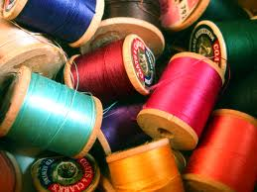
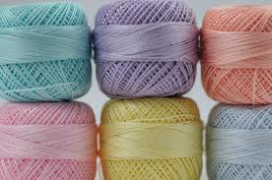
Spools of thread

Slide 3
1.Beamed
Shine (about light or sunshine)

Slide 4
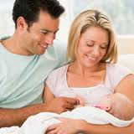
2. Beam (beaming smile)
Smile happily

Slide 5
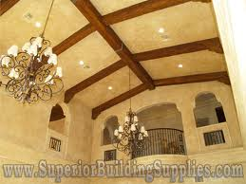
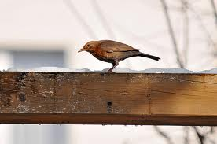
Beam (noun)
A long piece of metal, wood, stone used for support

Slide 6
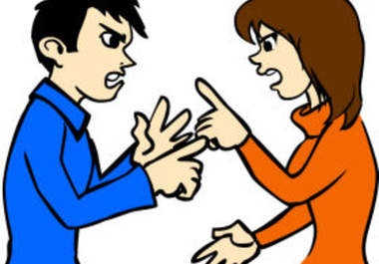
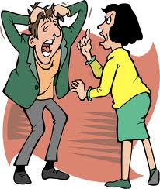
Argued
Try to prove you are right when another person disagrees with you

Slide 7
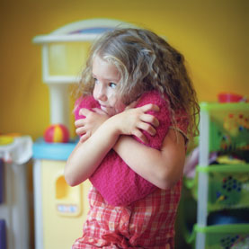
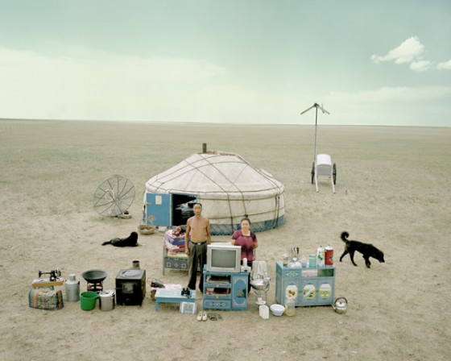
Possessions
Things that you own, your property

Slide 8
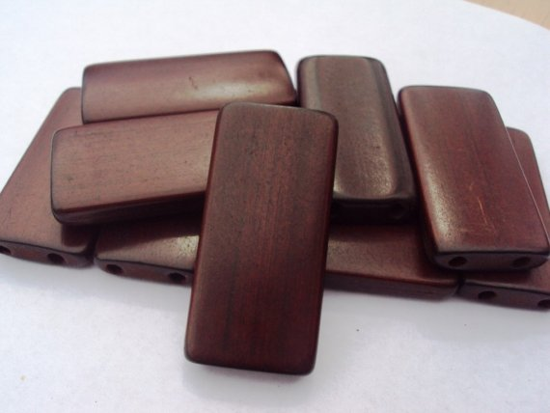
Mahogany wood

Slide 9
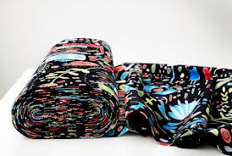
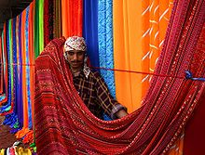
Fabric
Cloth
Bolt of fabric

Slide 10
Purchased
Buy (bought)

Slide 11
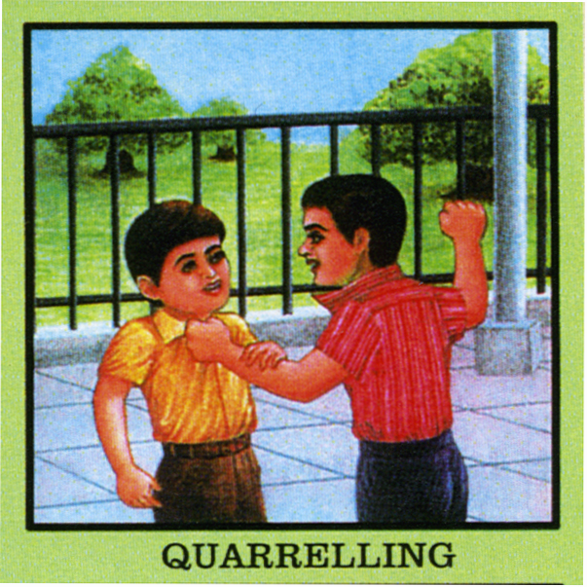
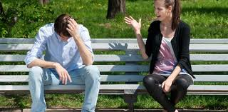
Quarrelling
Arguing, fighting

Slide 12
disappointment
Feeling sad because you didn’t get something you wanted

Slide 13
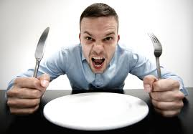
Starve
To feel very hungry

Slide 14
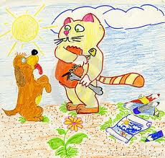
Greedy
Someone who always wants more and more (food, things, money) and doesn’t want to share

Slide 15
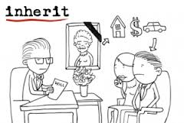
Inheritance
Money or property you get after your family member dies

Slide 16
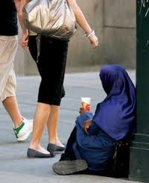
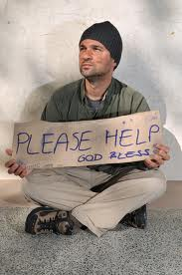
Beggars
A person begging for money on the street

Slide 17
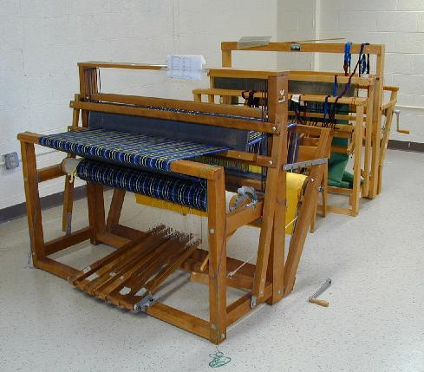
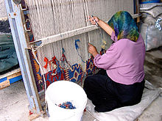
Loom
A machine for weaving fabric

Slide 18
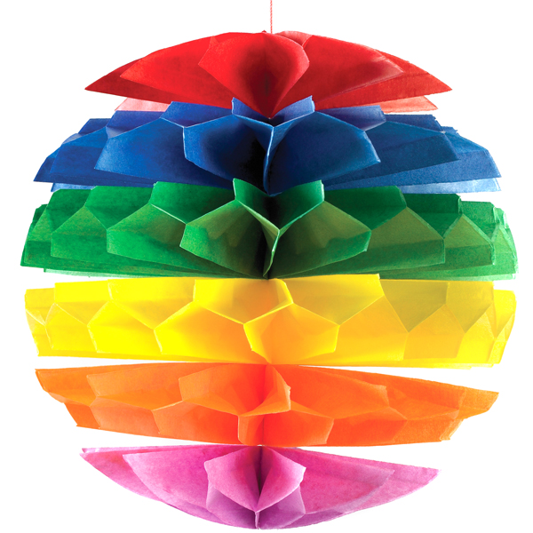
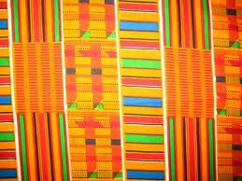
Multi-colored
Having many colors

Slide 19
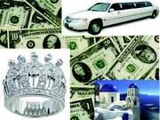
Prosper
To be successful in making money and earning things

