Slide 1
The Alvin Ailey Kids
3.4

Slide 2
students
People who go to a school

Slide 3
perform
To sing, act, or do something in public that takes skill

Slide 4
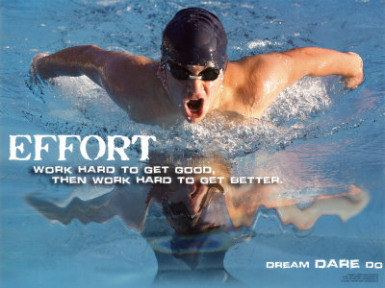
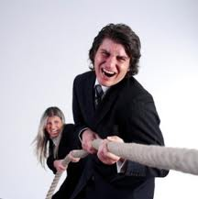
effort
Hard work

Slide 5
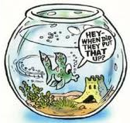
remember
To think of something again; to not forget

Slide 6






mood
The way that a person feels at a certain time

Slide 7
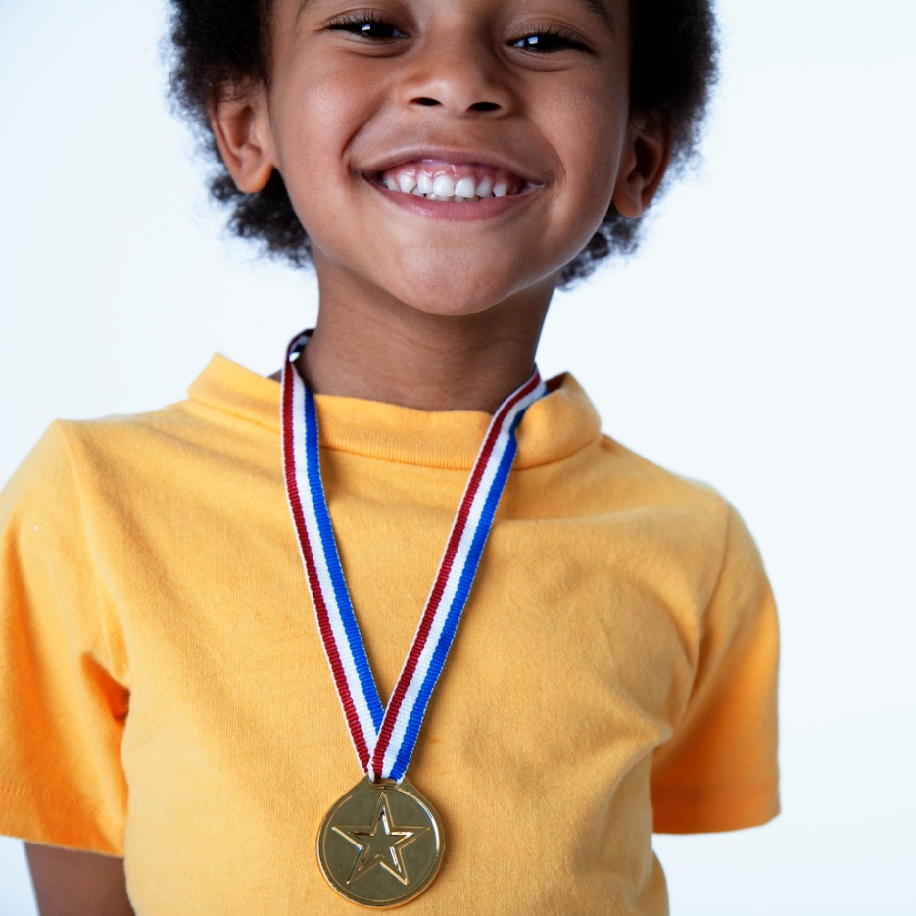
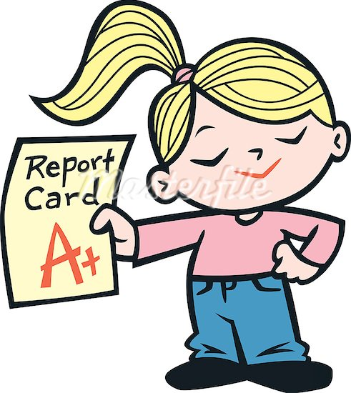
proud
Having a good feeling about something that you or someone else did

Slide 8
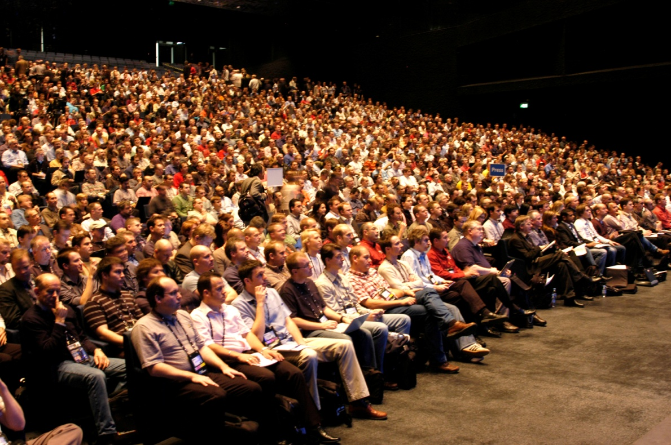
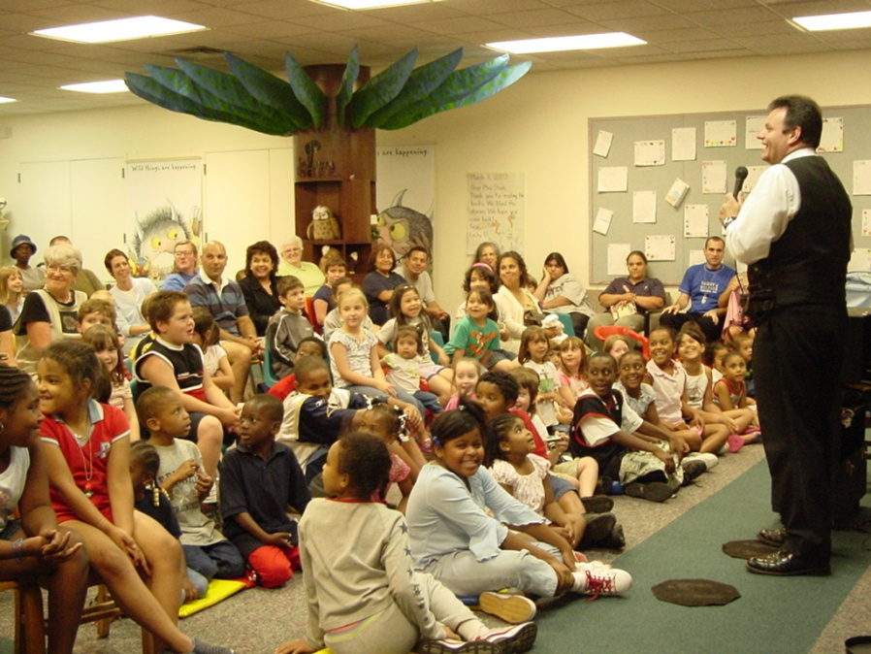
audience

Slide 9
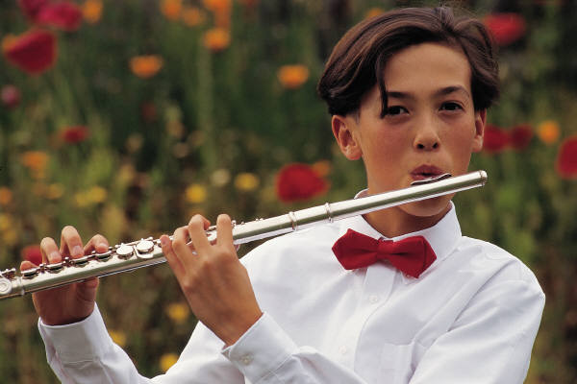
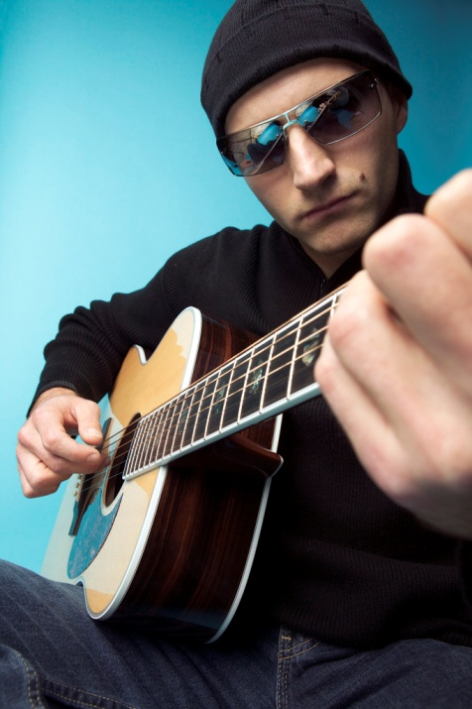
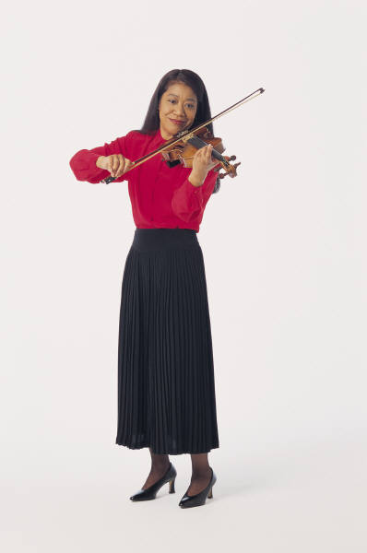
musician

Slide 10
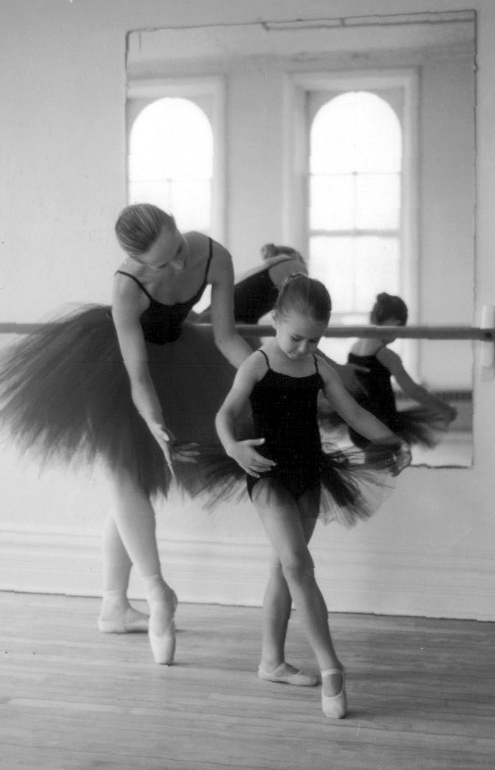
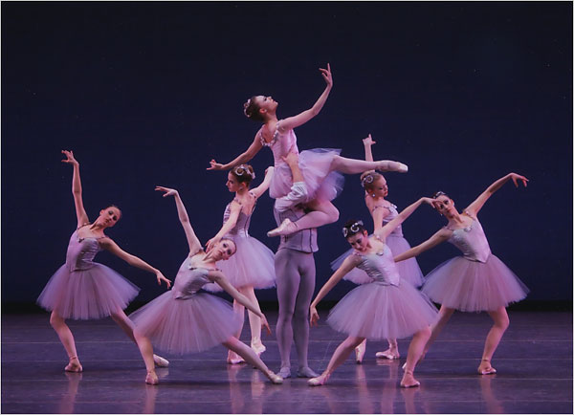
ballet

Slide 11
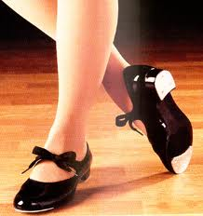
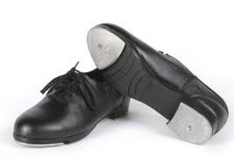
tap dance
Basic tap dancing http://www1.teachertube.com/viewVideo.php?video_id=143340
Awesome tap dancing! http://www1.teachertube.com/viewVideo.php?video_id=227879&title=Rare_Gregory_Hines_Tap_Dance_Footage&vpkey
(make sure sound is on!)
Tap shoes→

Slide 12
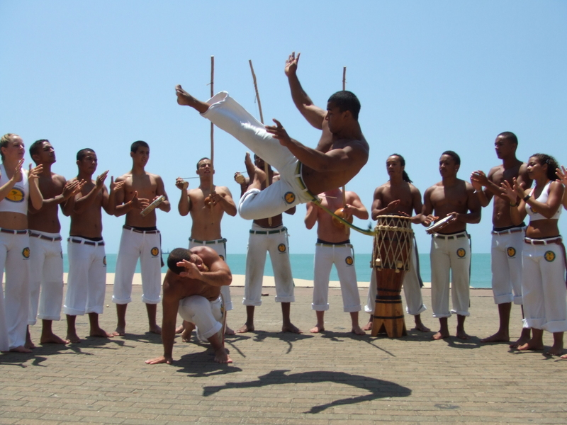
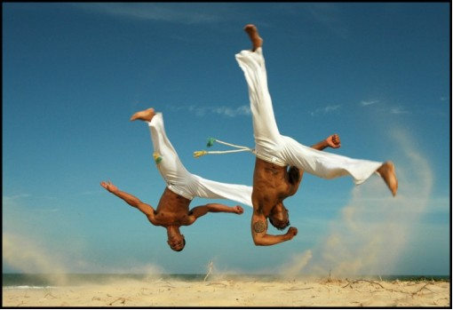
capoeira
http://www1.teachertube.com/viewVideo.php?title=Capoeira&video_id=166631
Brazilian dance-fighting

