Slide 1
Beatrice’s goat Unit5.2
Genre: Narrative Nonfiction- a story that gives facts about actual people or situations

Slide 2
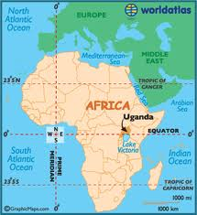
Uganda
Beatrice lives in Uganda- a country in eastern Africa

Slide 3
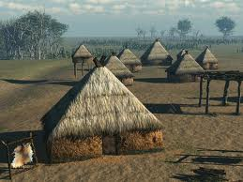
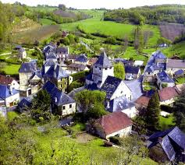
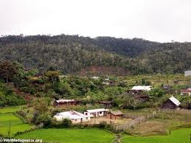
village
A small place (smaller than a city or town) where people live

Slide 4
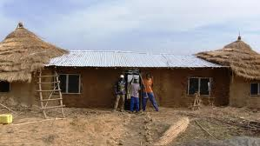
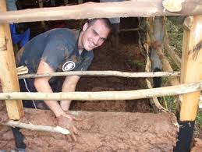
Mud house
Beatrice lives in a mud house with a steel roof steel (metal) roof
roof
How do you build a mud house?

Slide 5
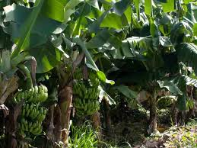
Banana grove
A group of banana trees

Slide 6
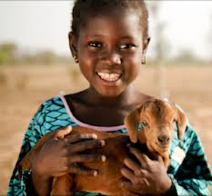
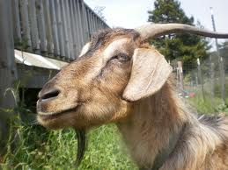
goat
horns
coarse (not soft)
coat (hair)
chin hair

Slide 7
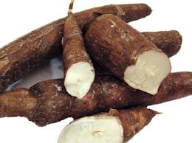
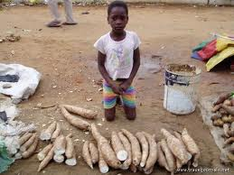
cassava
A woman is grinding cassava flour

Slide 8
To be puzzled
To be unsure, confused, not to know why

Slide 9
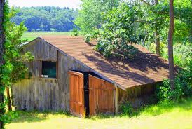
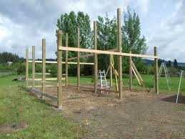
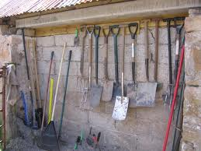
shed
A little house for tools and animals
You need posts to build a shed

Slide 10
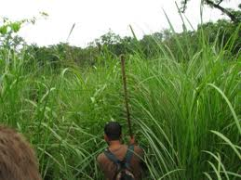
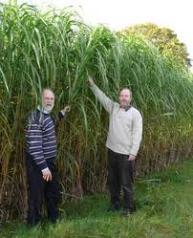
Elephant grass

Slide 11
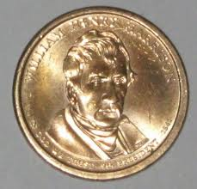
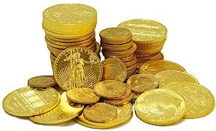
Shiny coin

Slide 12
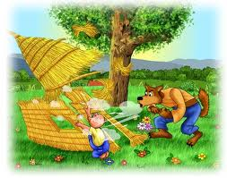
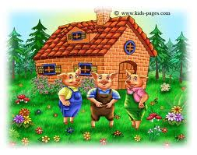
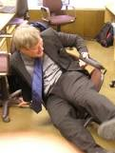
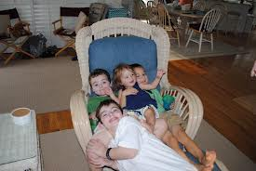
Sturdy
Strongly built (opposite- weak, flimsy)
Sturdy or flimsy?

Slide 13
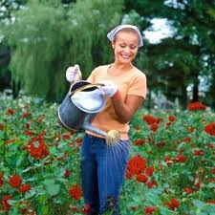
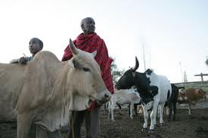
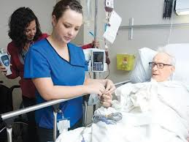
tend
To care for, look after
What are they tending?

Slide 14
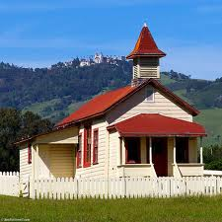
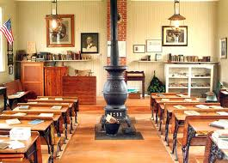
Schoolhouse
A building for school

Slide 15
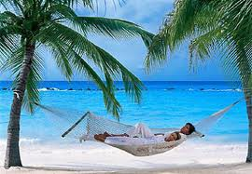
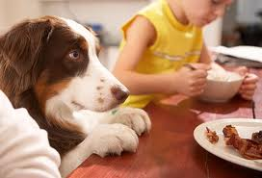
Yearn for
To really want something, have a strong wish or desire
I yearn for a vacation by the ocean
What does he yearn for?

Slide 16
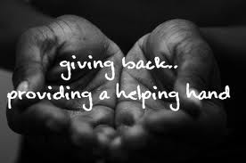
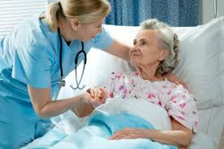
kindhearted
Having a kind heart, being kind

Slide 17
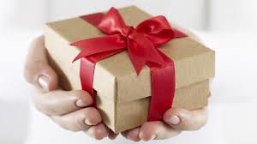
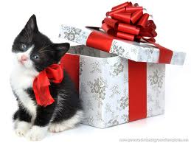
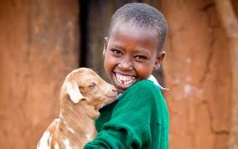
gift
Present

Slide 18
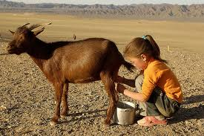
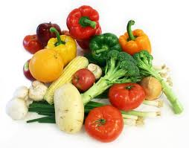
produce
To produce (verb)- pruh-’doos- to make, create
My goat produces a lot of milk.
Produce (noun)- ‘pro doos- something that is produced, product

Slide 19
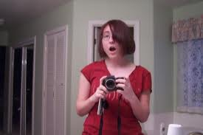
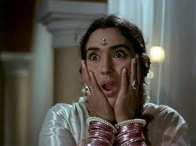
gasped
To show surprise

Slide 20
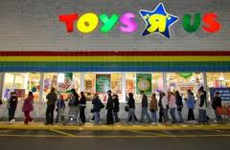
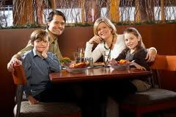
customers
People who buy your product.
Toys R Us customers line up to get in the store
Are these people customers? Why do you think that?

