Slide 1
An American Hero Flies Again
Genre: Nonfiction-gives information about real people, places, or things.

Slide 2
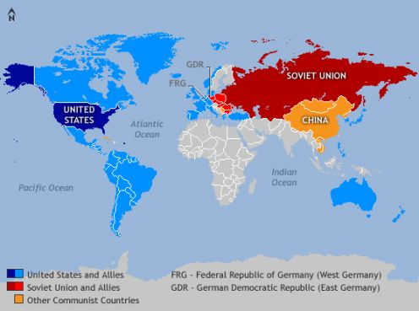
The Soviet Union
A country that existed between 1922-1991. The largest country in the word covering 1/6 of the world’s land area. A large part of it is now called Russia.

Slide 3
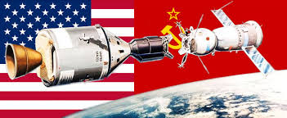
Space race
A competition between the Soviet Union and the USA over the exploration of space

Slide 4
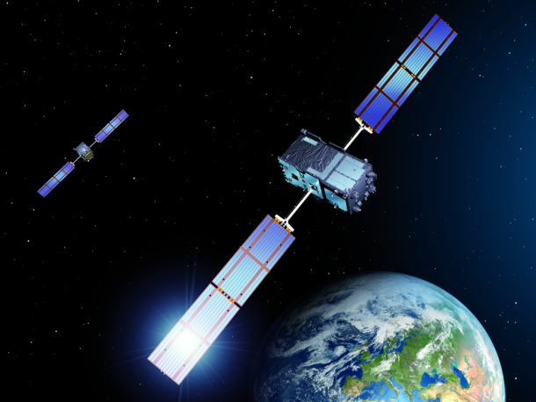
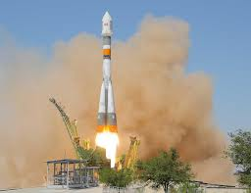
Launch a satellite
To send a ship in the air
Satellite

Slide 5
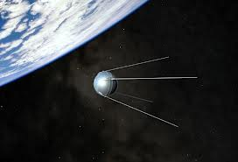
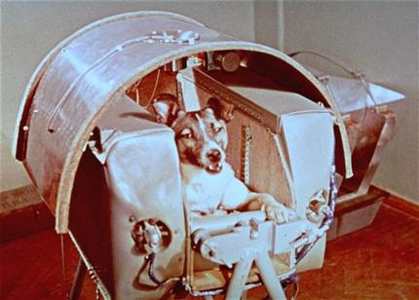
Sputnik
Sputnik 1 and Sputnik 2 were the first satellites launched into space by the Soviet Union in 1957.
Sputnik 2 carried a dog named Laika. Laika became the first animal in space

Slide 6
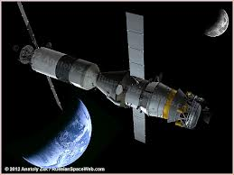
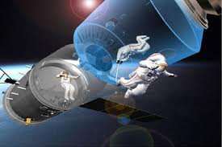
Manned spacecraft
A spaceship that has people on board

Slide 7
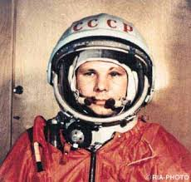
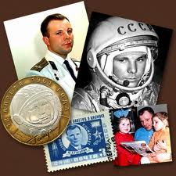
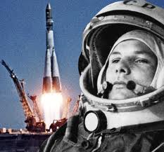
Yuri Gagarin- a Soviet cosmonaut. First man in space 1961

Slide 8
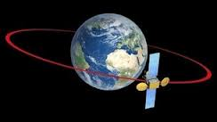
Orbit the Earth
Go around the Earth

Slide 9
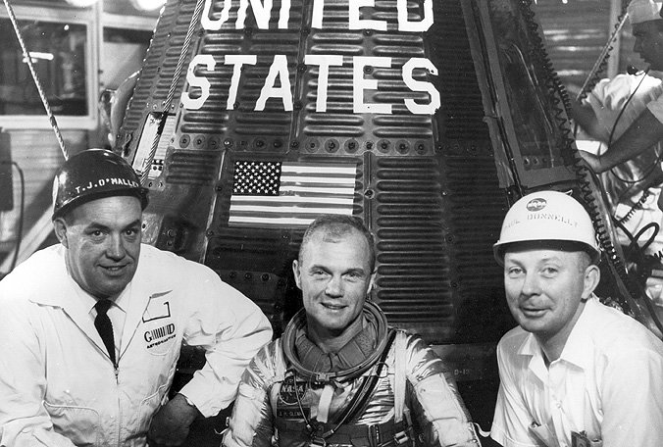
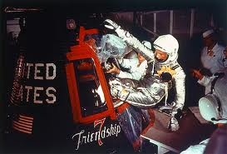
John Glenn was the first American to orbit the Earth on board of spaceship Friendship 7

Slide 10
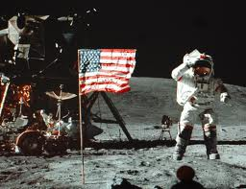
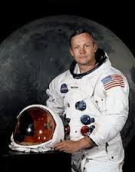
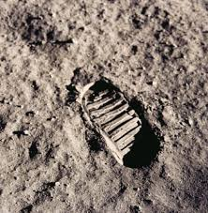
Neil Armstrong- first man on the Moon July 20, 1969

Slide 11
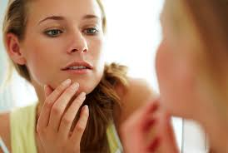
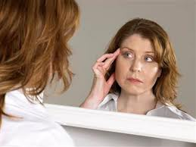
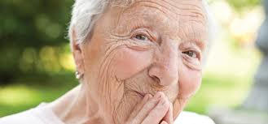
Aging process
The process of getting older

Slide 12
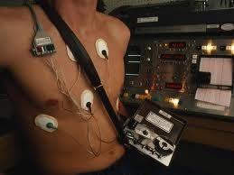
Heart monitors
A device for measuring the heart rhythm

Slide 13
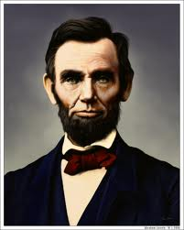
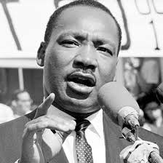
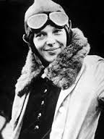
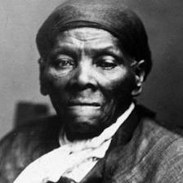
Historical
Related to history
Can you name these historical characters?

Slide 14
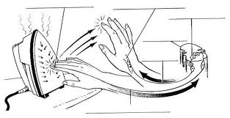
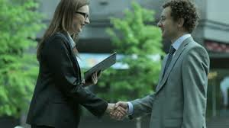
automatically
Doing something by habit or without much thinking or effort
When we touch a hot object, we automatically pull our hand away.
- How are you?
-I’m fine (sometimes we answer automatically- without much thinking)

Slide 15
requirements
Something that must be done
Check out the OKCPS requirements for graduation

Slide 16
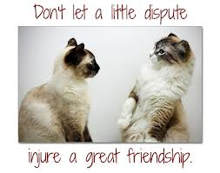
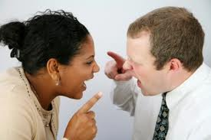
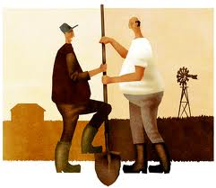
dispute
Disagreement or argument
What is their dispute about?

