Slide 1
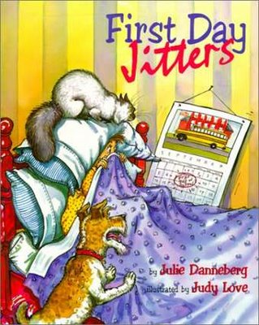
First Day Jitters
Genre: Humorous Fiction- a made-up story written to make the reader laugh

Slide 2
*chuckled
Laugh softly

Slide 3
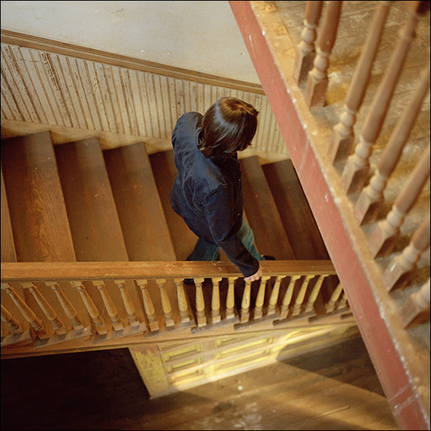
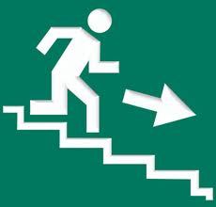
*downstairs
upstairs
downstairs

Slide 4
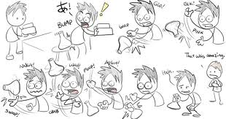
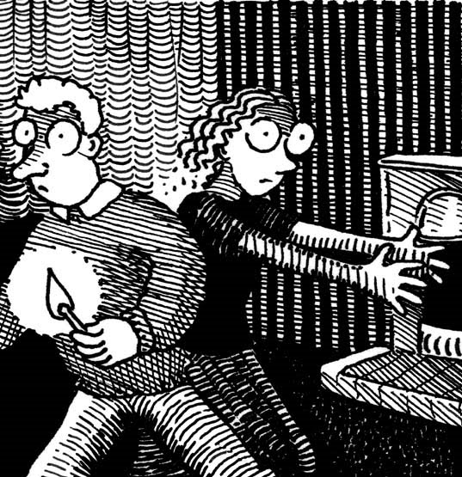
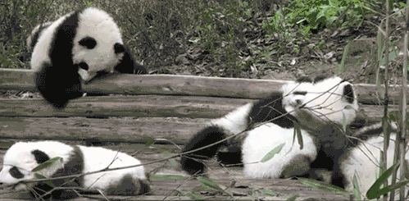
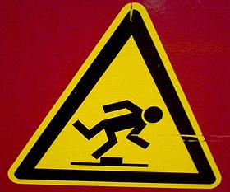
*fumbled
To feel your way or move awkwardly
Tumbled (out of bed)- fall down bumping into things or rolling over and over
Stumbled – trip over something

Slide 5
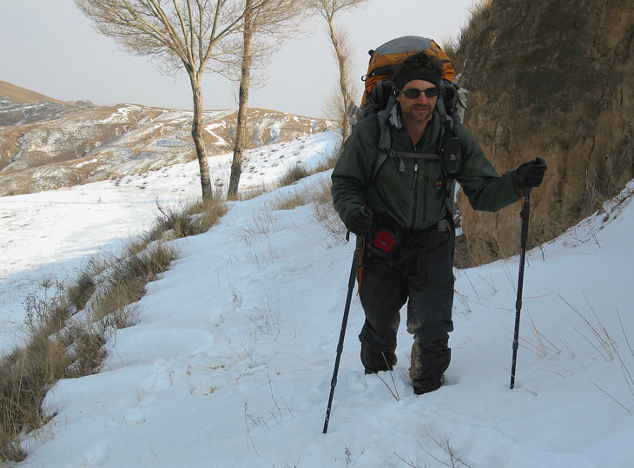
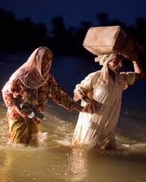
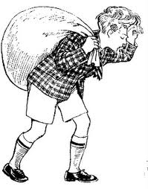
*trudged
To walk slowly and with difficulty as if through snow, water, or mud

Slide 6
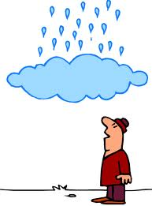
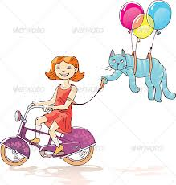
*nonsense
Something that doesn’t make sense

Slide 7
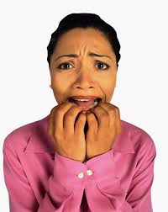
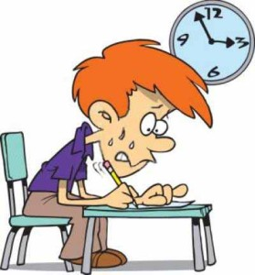
*nervous
Very worried
What makes you more nervous taking a test or going to a dentist?

Slide 8
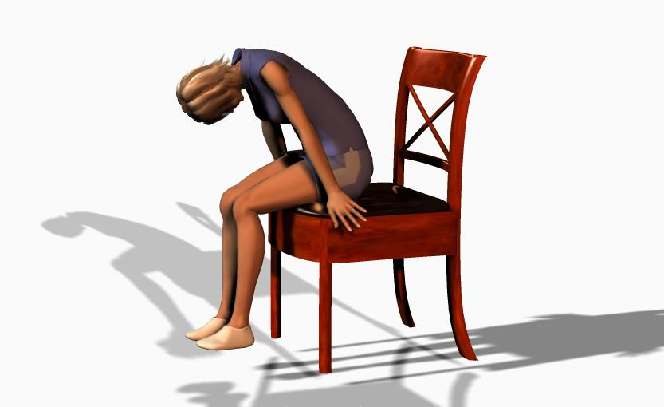
slumped down

Slide 9
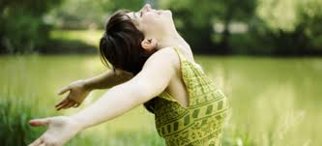
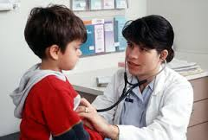
breathe
Inhale and exhale air

Slide 10
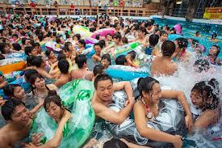
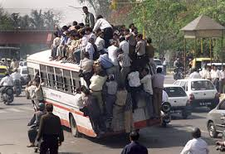
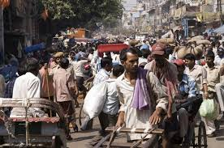
crowded
Full of people
crowded pool
crowded bus crowded street

