Slide 1
The Mystery of the Missing lunch
Genre: Mystery- a story in which the characters and the reader must use clues to find an explanation for a troubling event.

Slide 2
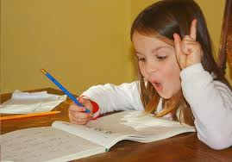
*assignments
Work or task. Something you have to do.
Ex. Homework assignment.
Summer assignments-work you have to do over the summer: learn your multiplication facts, read a certain number of books, etc

Slide 3
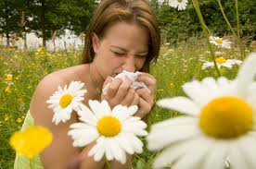
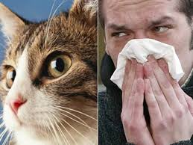
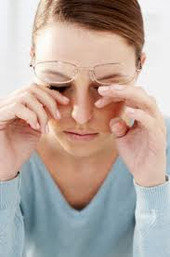
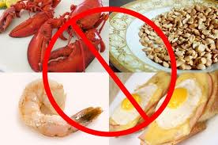
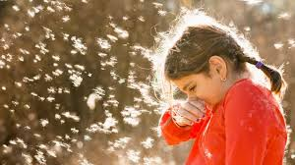
*Allergies
A reaction some people have to smells, dust, cats, pollen, food and other substances when your eyes, nose, or throat itch and you want to sneeze.
Do you have any allergies?

Slide 4
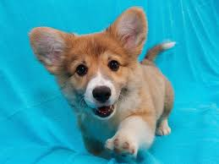
*consideration
Carefully thinking about something. From the verb “consider” – seriously think about something
After a serious consideration Anna decided to get a puppy.

Slide 5
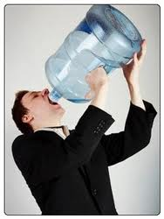
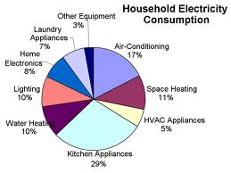
*consume
To use something up, to eat or drink up (all of it)
How much water do you consume a day?
What consumes the most electricity?

Slide 6
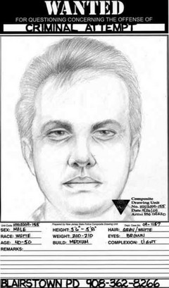
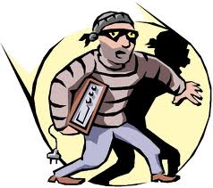
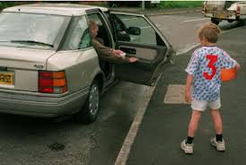
*Suspicious/ suspect
Suspicious : looking like you might have committed a crime or done something wrong.
Do these men look suspicious? Why?
Suspect- a person who is suspected of committing a crime.

Slide 7
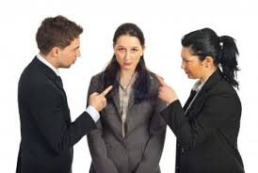
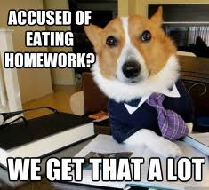
*accuse
To blame somebody for a misdeed or a crime

Slide 8
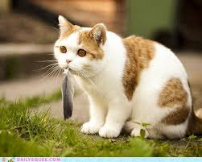
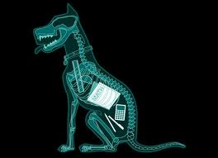
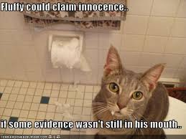
*evidence
Proof that a person is guilty.
You need evidence to accuse a person of a crime
This X-Ray is the evidence of what?

Slide 9
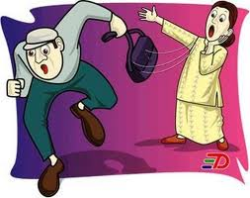
culprit
Person responsible for trouble or one who committed the crime.

Slide 10
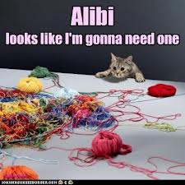
alibi
An excuse a person who is suspected in a crime can use to prove he/she is innocent

Slide 11
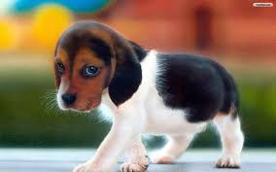
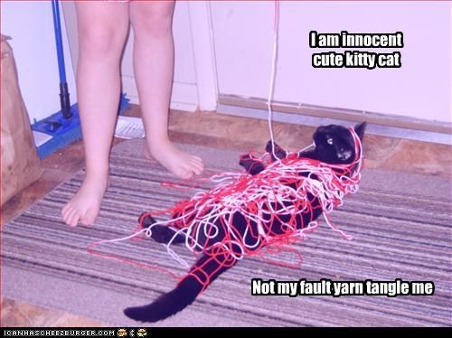
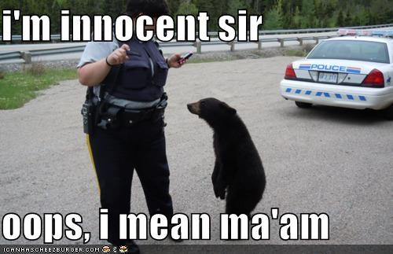
innocent
Not guilty. I didn’t do it!

Slide 12
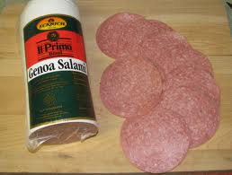
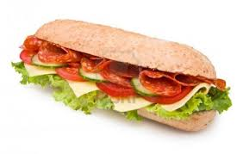
Salami
Salami Sandwich

Slide 13
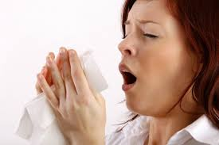
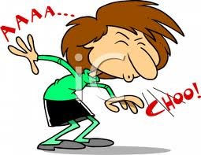
sneeze

Slide 14
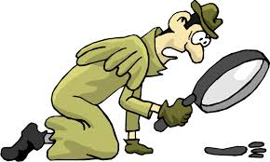
clues
Anything that helps you solve a mystery

Slide 15
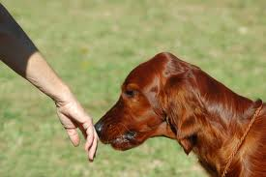
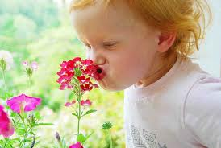
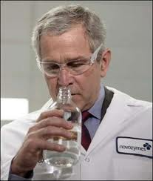
sniff

Slide 16
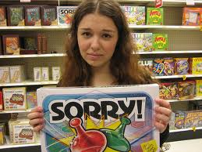
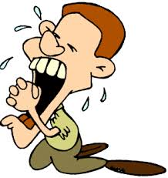
apologetically
Made from the word apologize= say you are sorry
When you do something apologetically it means you are saying “I am sorry!”

Slide 17
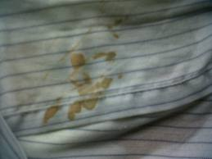
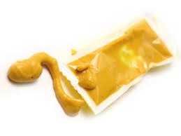
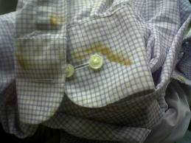
Mustard Brown smudge

Slide 18
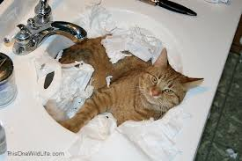
100% certain
Absolutely sure
I am 100% certain about who the culprit is.

Slide 19
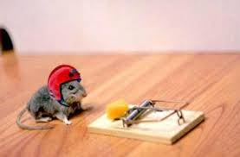
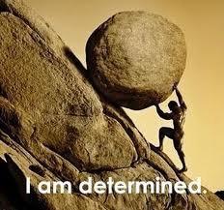
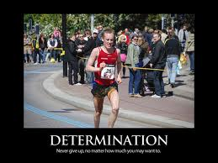
determined
Somebody who is sticking with his/her decision

Slide 20
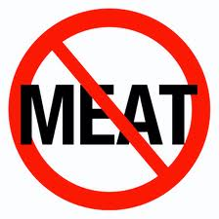
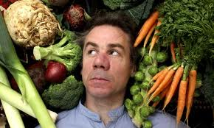
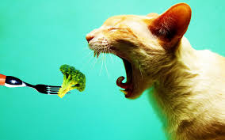
vegetarians
People who do not eat meat.
Can a cat be a vegetarian?

