Slide 1
A Walk in the Desert
4.1.2

Slide 2
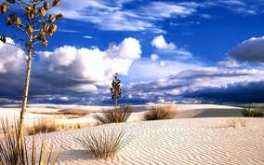
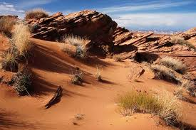
desert
Deserts have a very dry climate.
Deserts (:42) http://app.discoveryeducation.com/player/view/assetGuid/96C6F14A-BABD-4910-A643-8E045A8B6CE4
desert (noun)-A dry, often sandy region of little rainfall, extreme temperatures, and few plants

Slide 3
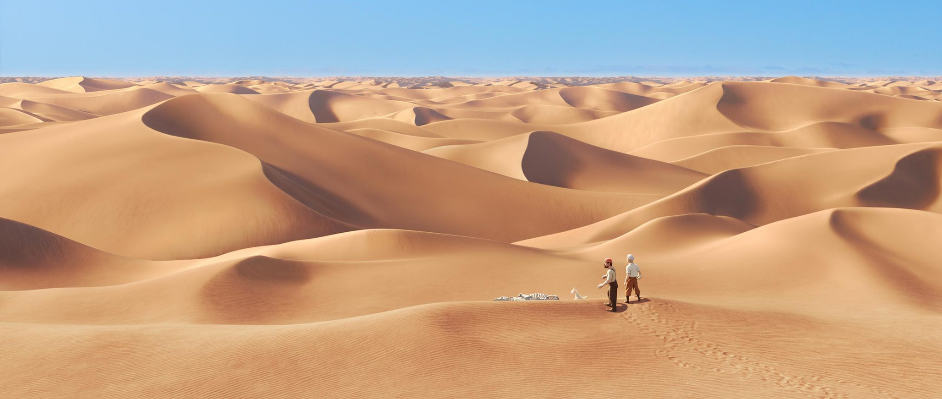
desert photos

Slide 4
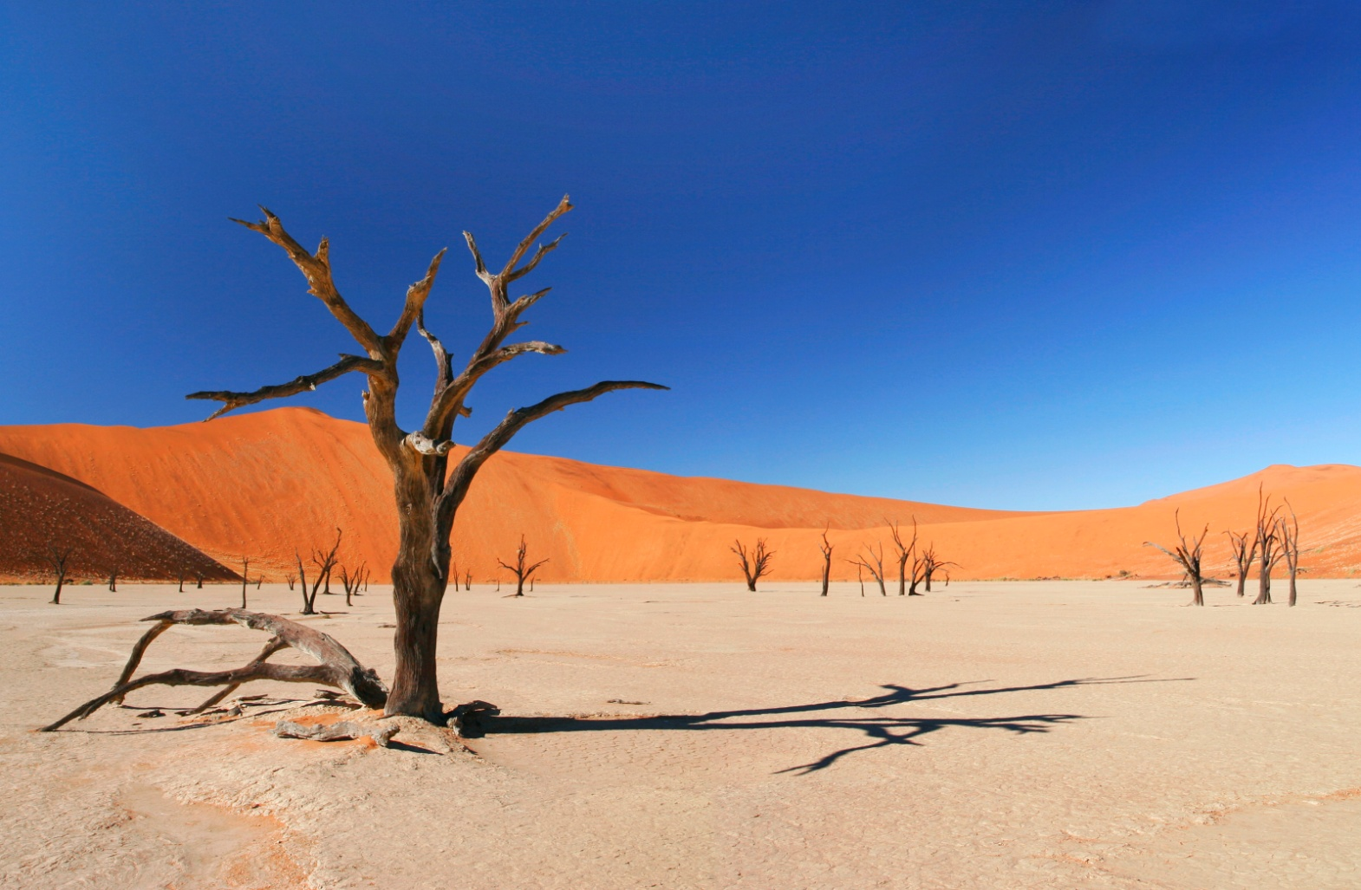
desert photos

Slide 5
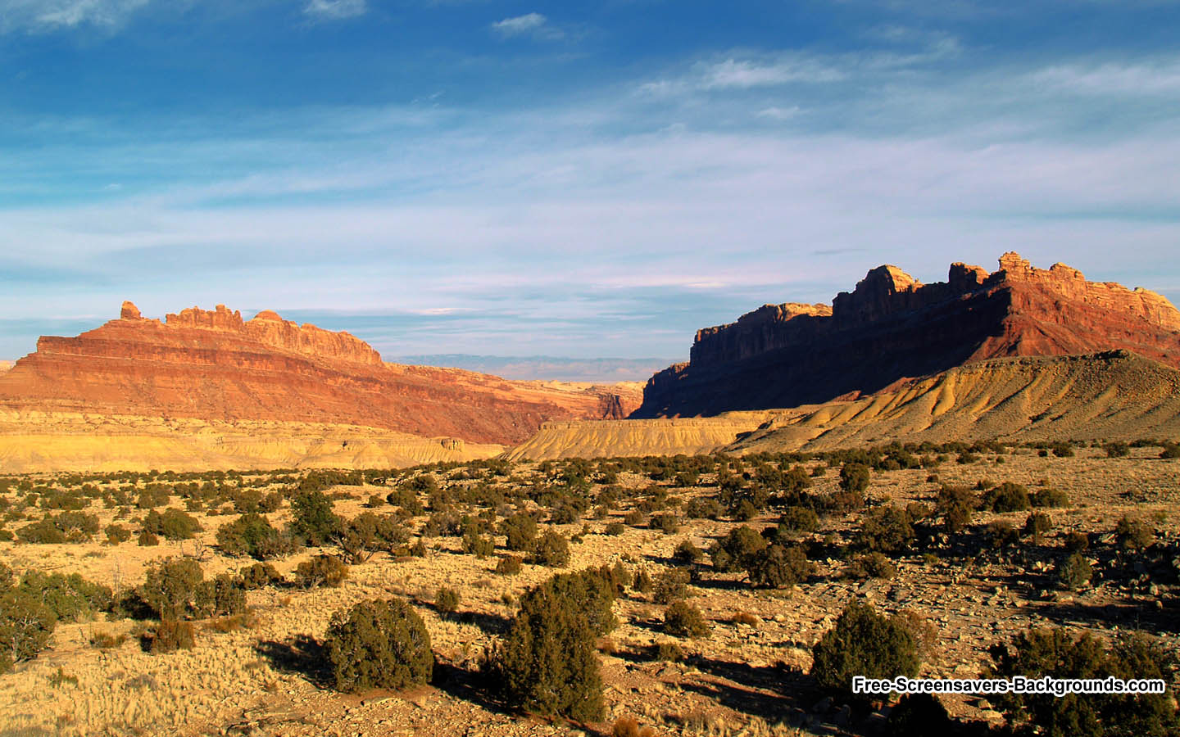
desert photos

Slide 6
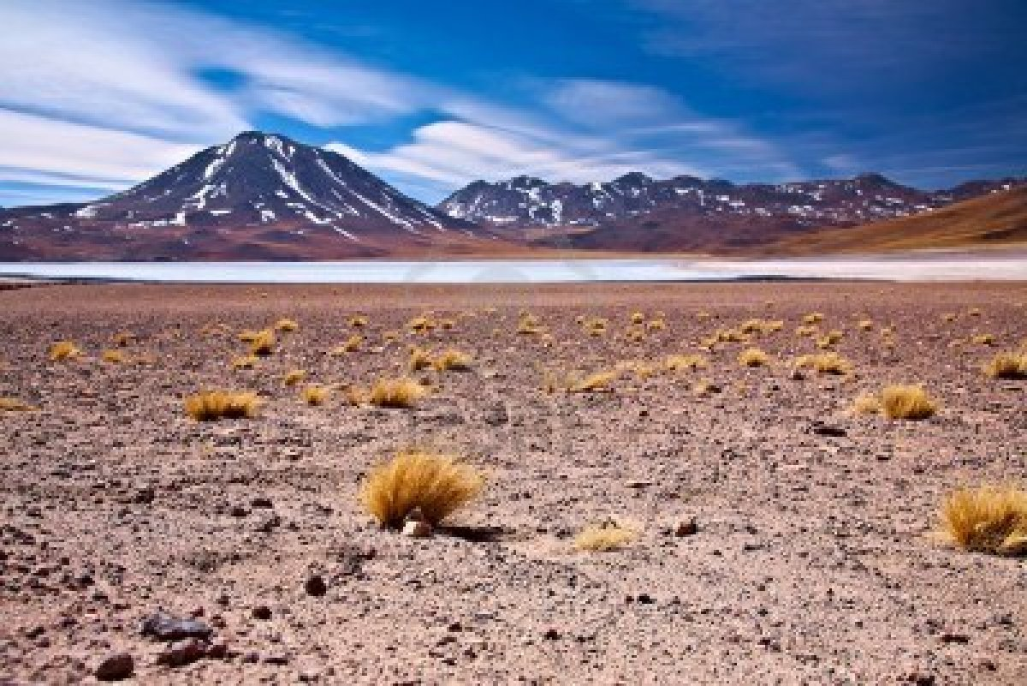
desert photos

Slide 7
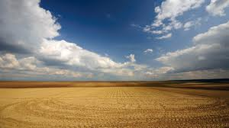
desert photos

Slide 8
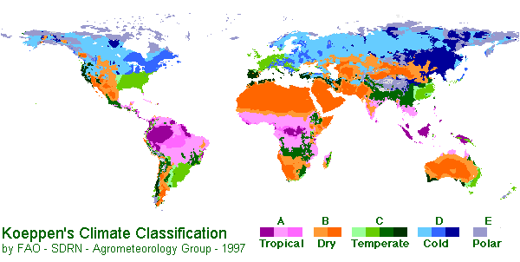
climate
A biome’s climate, soil, plants and animals are all connected.
climate (noun)-A region of the earth having particular weather conditions (hot, cold, dry, humid)

Slide 9
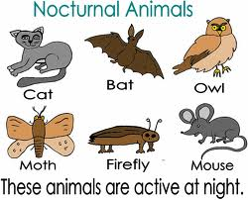
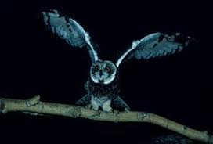
nocturnal
Many desert animals are nocturnal.
nocturnal (adjective)- most active at night

Slide 10
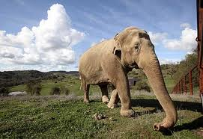
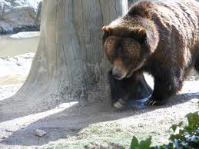
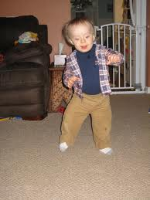
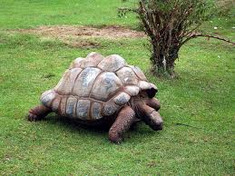
lumbering
In one small patch of desert, you could see many different animals, including lumbering Gila monsters.
Lumber (verb)- to move aimlessly

Slide 11
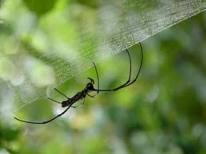
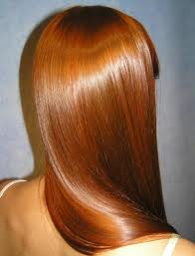
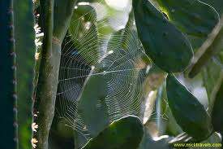
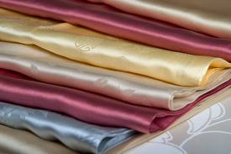
silken
Grasshoppers spin silken webs among cactus spines.
silken hair silk silken webs
silken (adjective)-like silk in smoothness, softness, glossiness, or delicateness

Slide 12
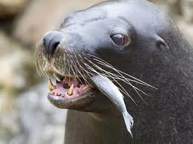
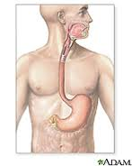
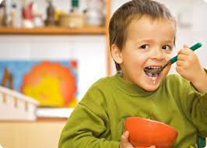
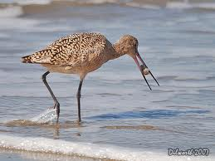
swallows
The roadrunner catches the lizard by its tail and swallows it in one gulp.
swallow (verb) to take into the stomach by drawing through the mouth and throat with a voluntary muscular action, as food or drink.

Slide 13
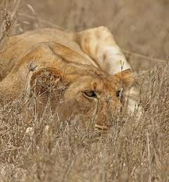
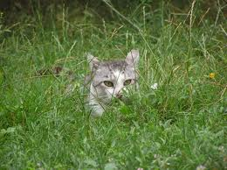
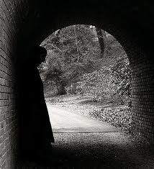
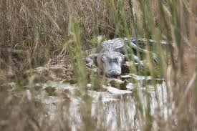
lurk
Scorpions often lurk in crevices under rocks during the day.
lurk (verb)-
to lie in wait

Slide 14
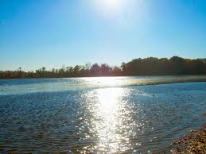
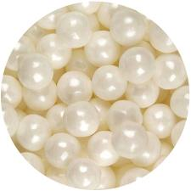
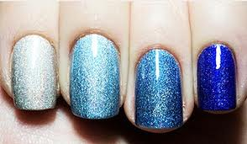
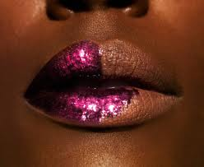
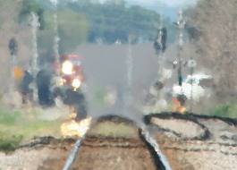
shimmer
Heat waves shimmer above the landscape.
shimmer (verb)
to shine with or reflect light

Slide 15
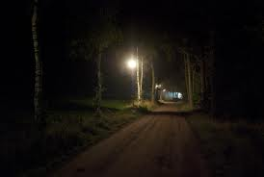
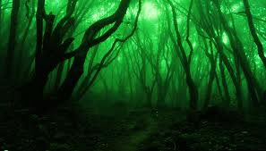
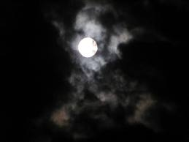
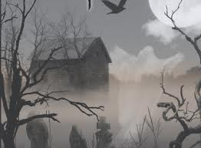
eerie
Coyotes join voices in an eerie song.
eerie (adjective)
weird and scary

