Slide 2
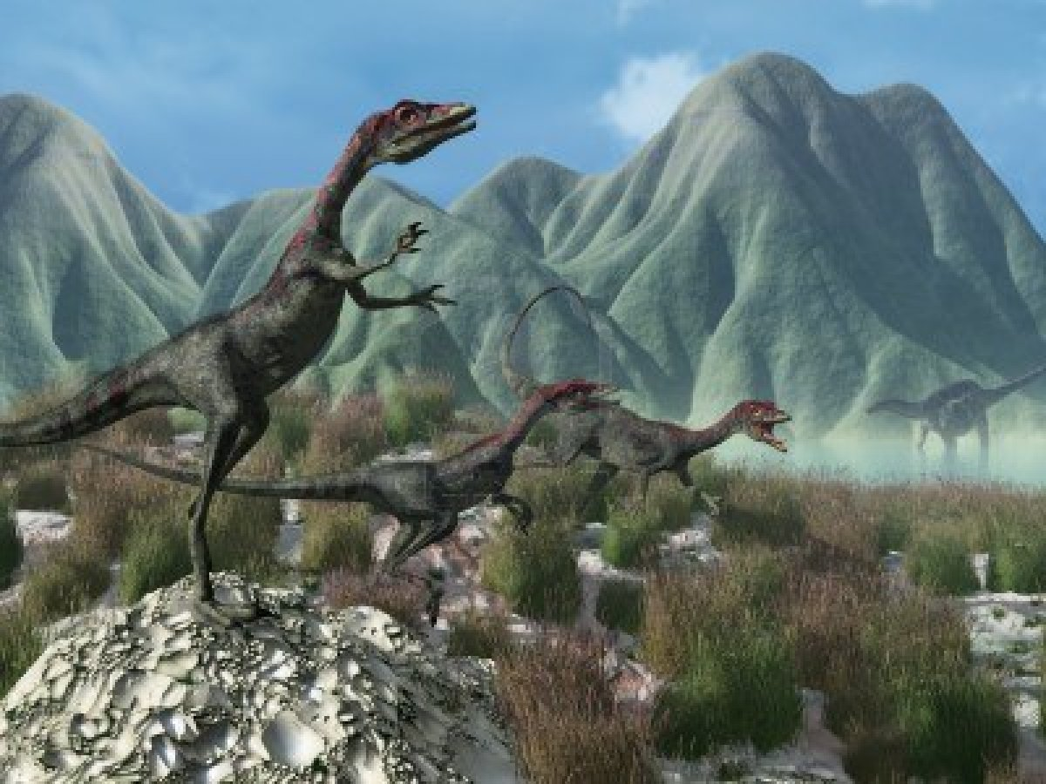
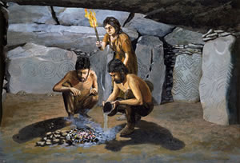
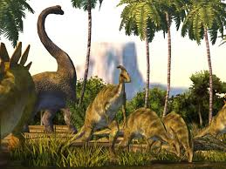
prehistoric
People visit the park to see prehistoric trees.
Meaning: time before recorded history

Slide 3
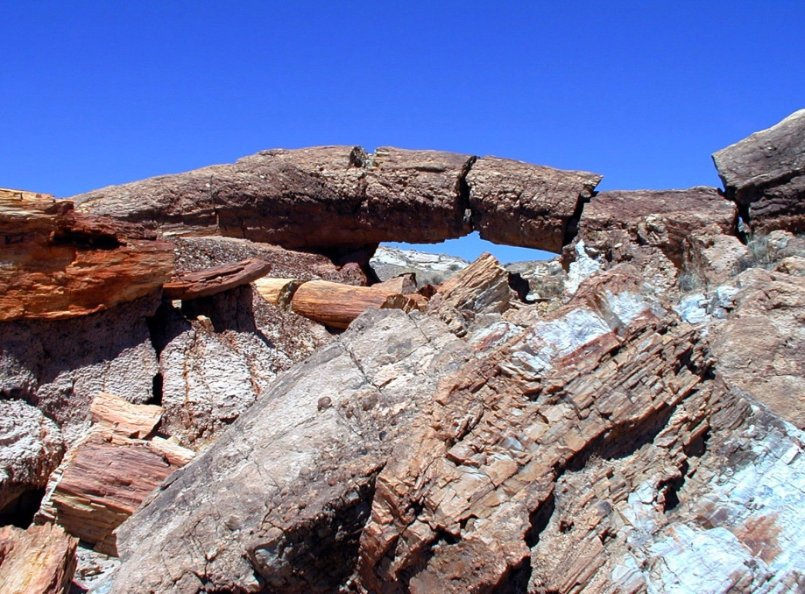
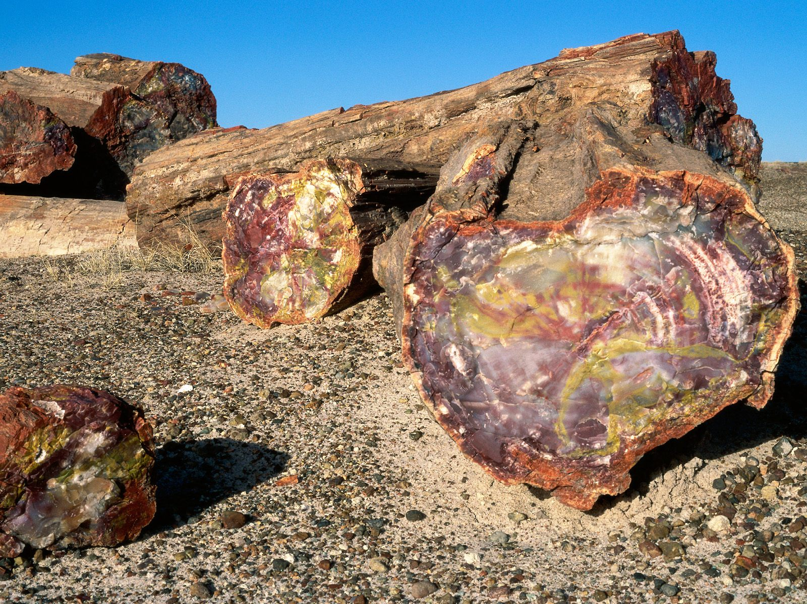
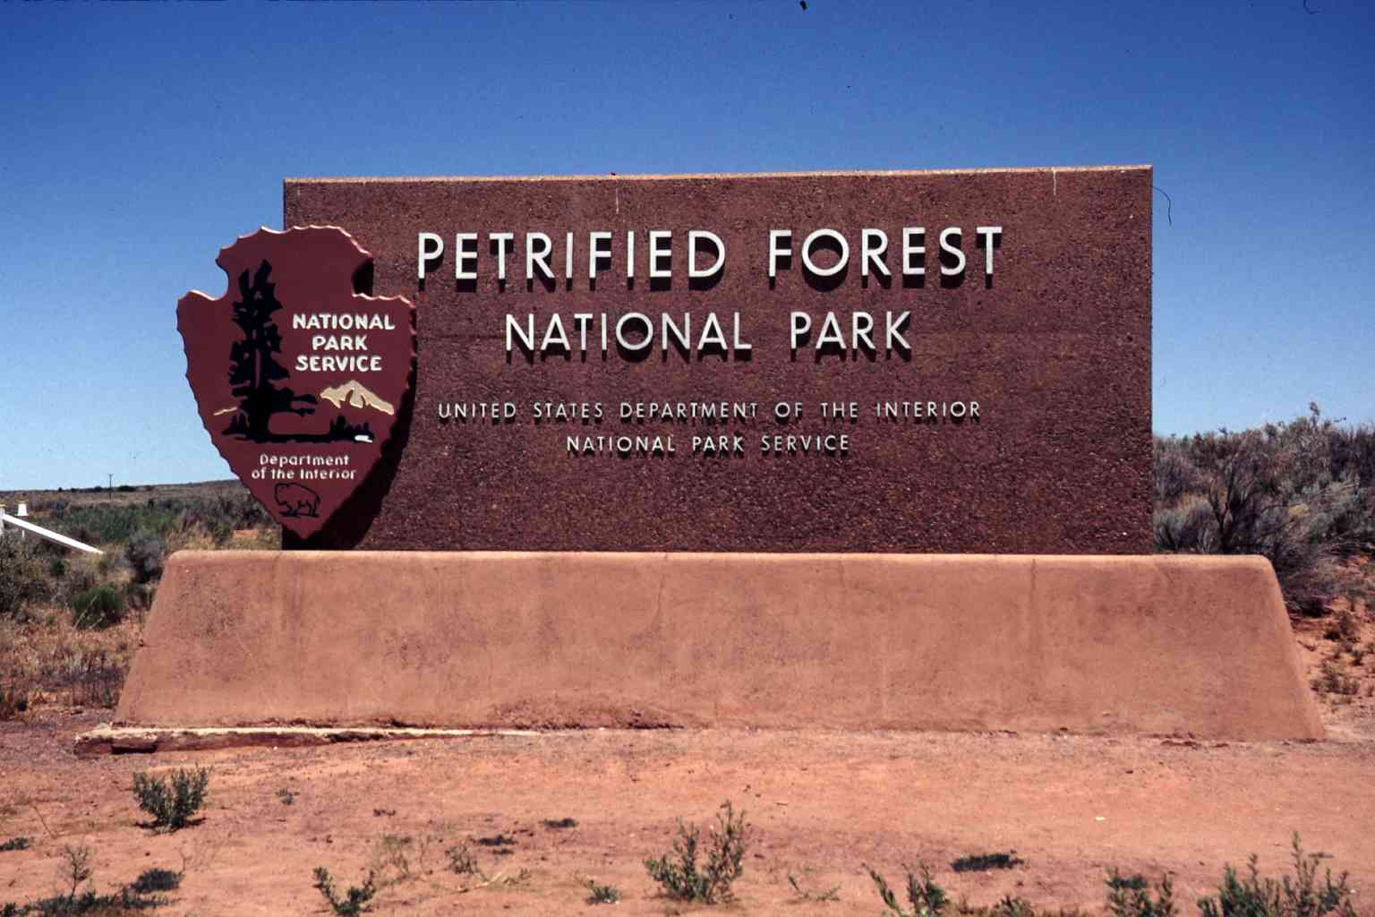
Petrified Forest National Park

Slide 4
Animals Come Home to Our Natural Parks
4.1.3

Slide 5
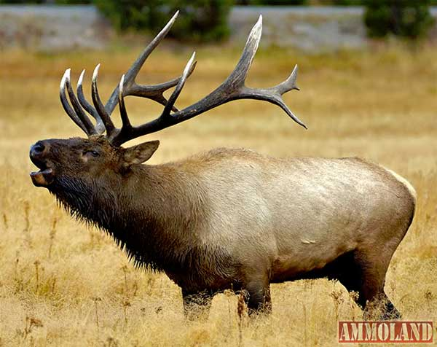
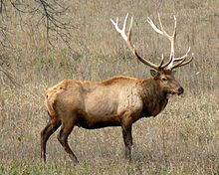
elk
Elk are coming home to their natural homes.

Slide 6
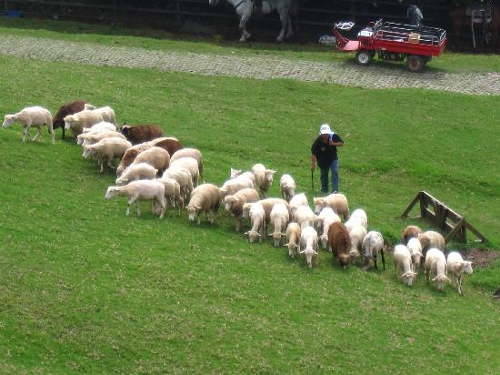
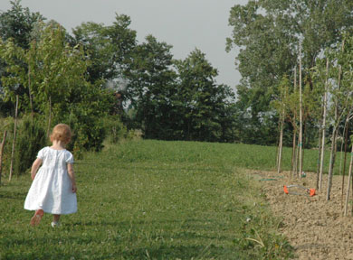
roamed
More than 200 million years ago dinosaurs roamed the earth.
Meaning: walked around

Slide 7
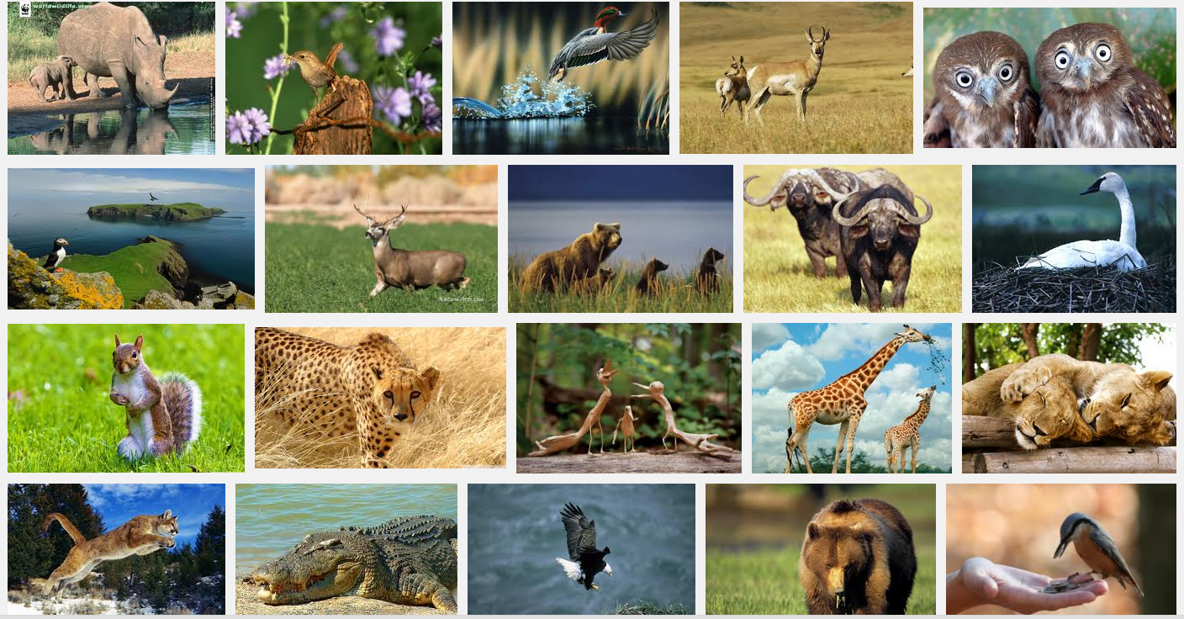
wildlife
National parks protect wildlife, history and culture.
Meaning: animals living in the wild (not pets)

Slide 8
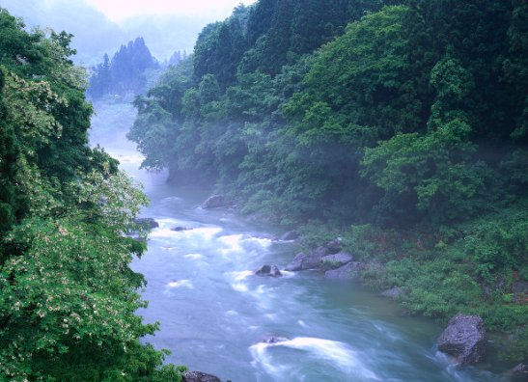
Natural
Park rangers are bringing animals back to their natural environments.
Meaning: formed by nature
Where do fish live?
Natural: Not natural:

Slide 9
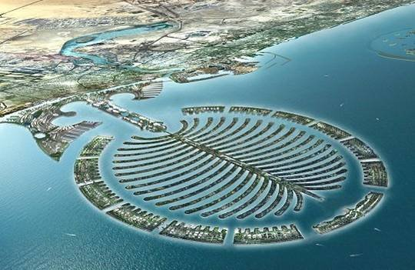
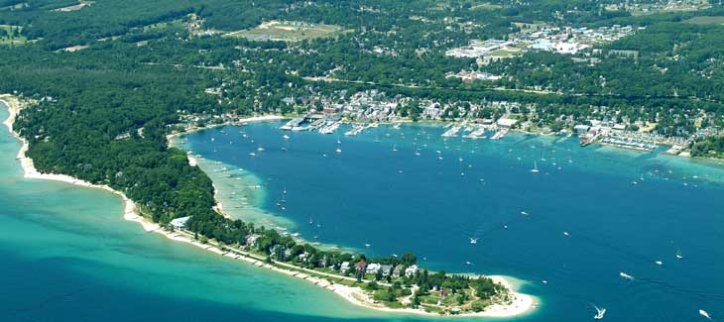
Natural
Meaning: formed by nature
What does a harbor look like?
Natural: Not natural (man made)

Slide 10
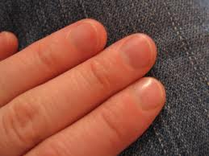
Natural
Meaning: formed by nature
Fingernails
Natural: Not natural (man made)

Slide 11
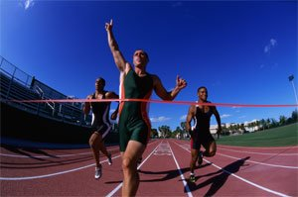
completed
It was a cold morning in January when 28 elk finally completed a long journey.
Meaning: finished
completing
completing a book
a race

Slide 12
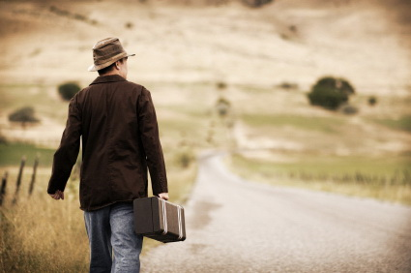
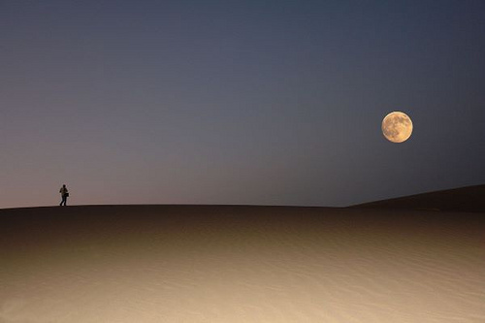
journey
It was a cold morning in January when 28 elk finally completed a long journey.
Meaning: finished

