Slide 1
The Astronaut and the Onion
4.4.1

Slide 2
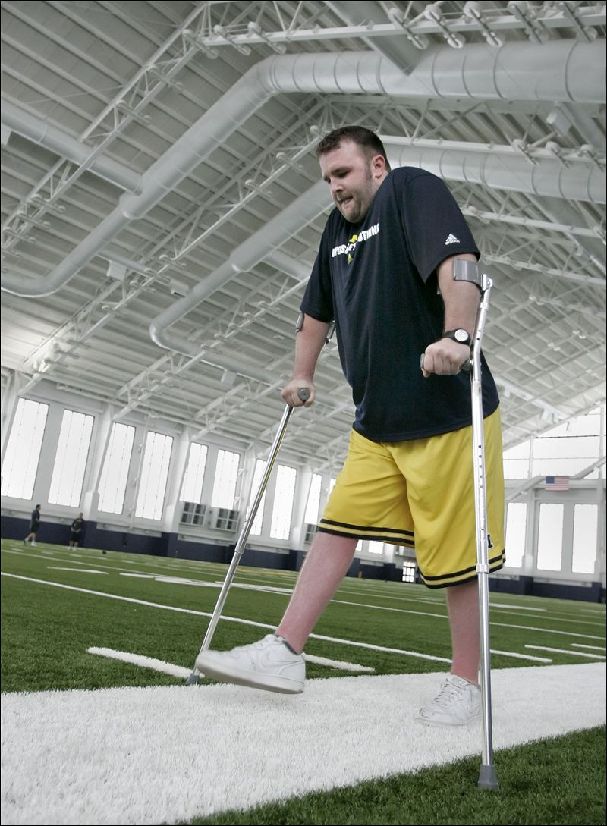
paralyzed
I was paralyzed. I couldn’t move.
paralyzed leg →
Paralyzed- unable to move

Slide 3
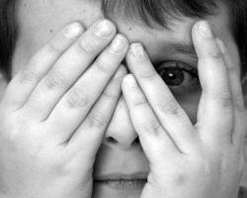
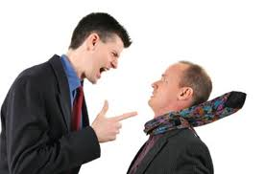
paralyzed with fear
Being paralyzed means that you cannot move because of an injury.
Being paralyzed with fear means you are too afraid to move.

Slide 4
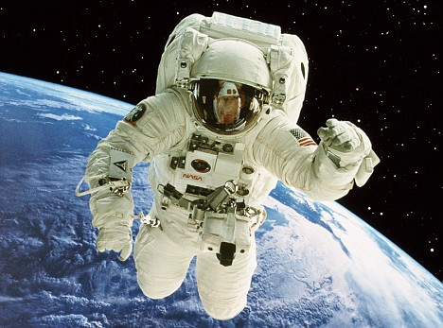
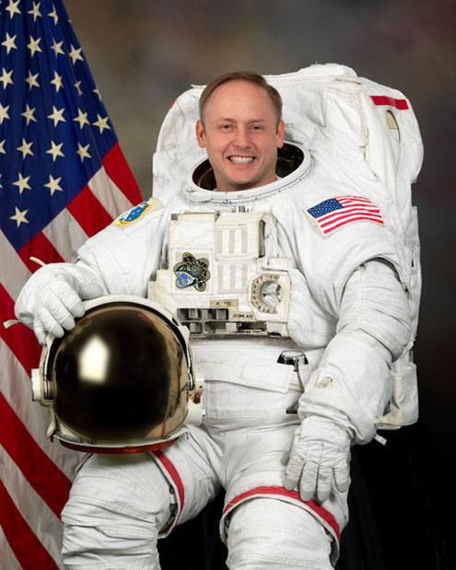
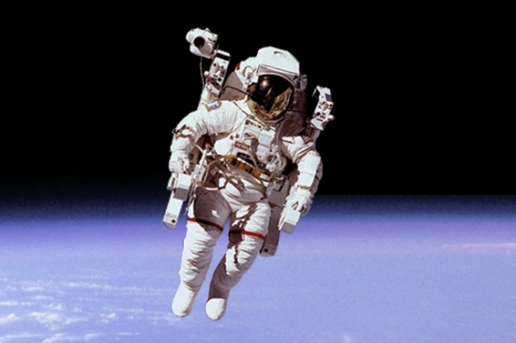
astronaut
Are you Dr. Grace Street, the astronaut?

Slide 5
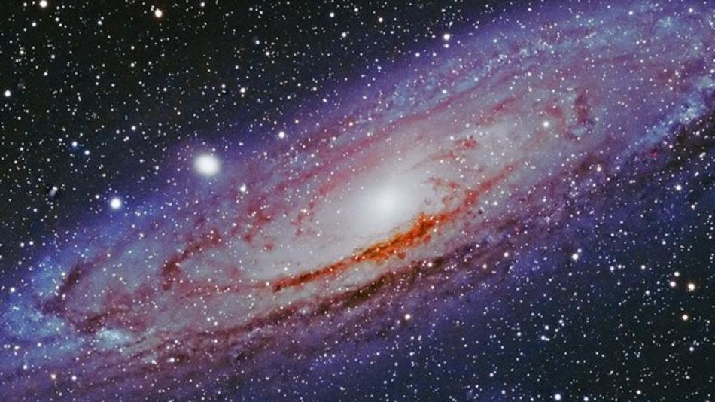
universe
We floated in our space suits, staring out into the universe.
The universe is our earth, the solar system and all of outer space.

Slide 6
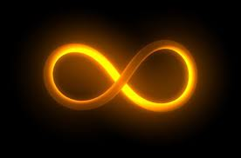
endless
The universe was calling us to go on an endless journey.
Endless- without an end/ without stopping

Slide 7
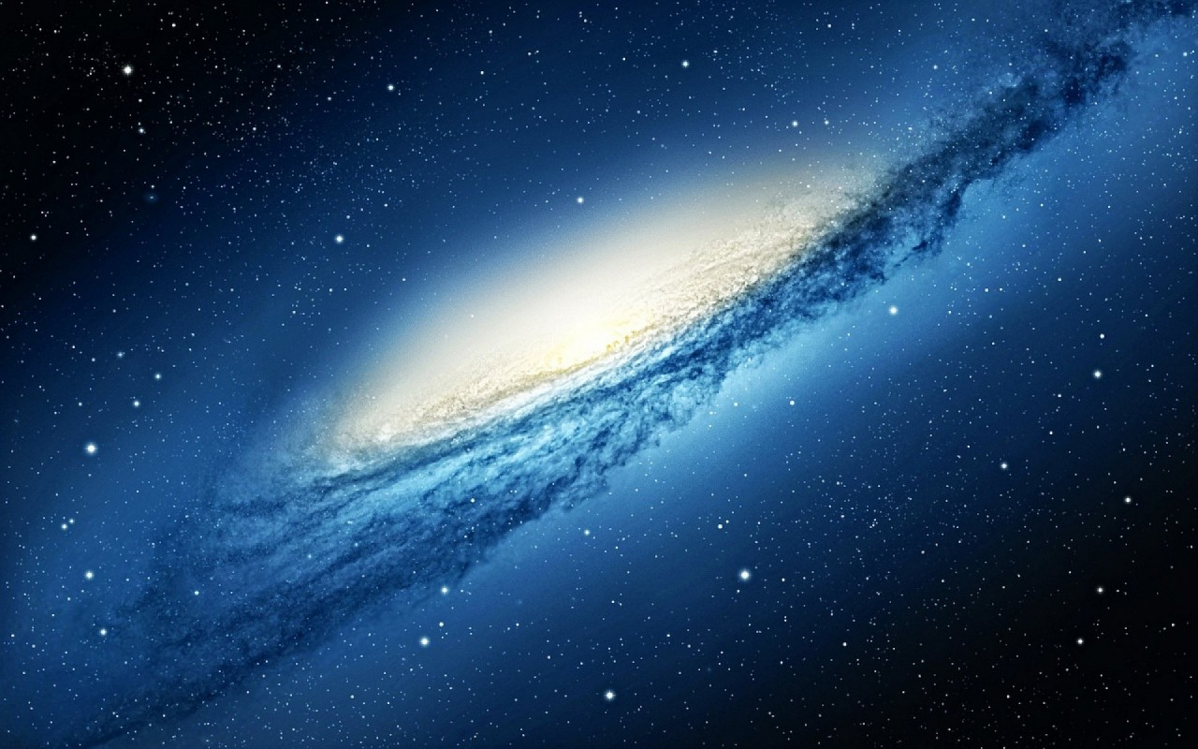
As far as we know, the universe is endless.

Slide 8
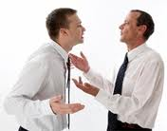
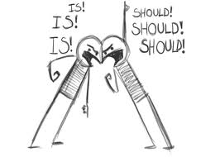
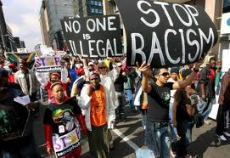
protested
“But maybe I can’t!” I protested.
Protesting as part of Protesting for a
an argument cause

Slide 9
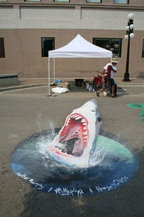
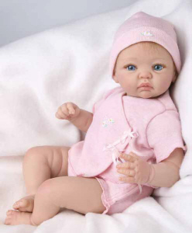
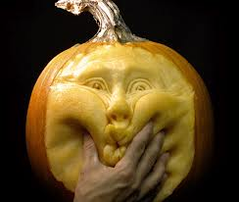
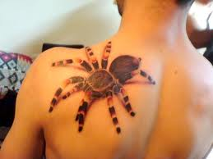
realistic
“Anyhow – saying ‘Maybe I can’t’ is different. It’s okay. It’s realistic.”
Do these look real?
Tattoo carving doll sidewalk art
Realistic- close to real

Slide 10
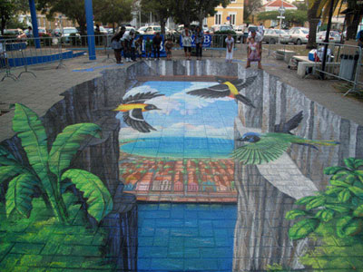
More realistic sidewalk art

Slide 11
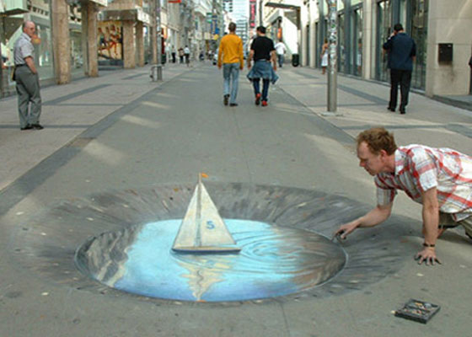
More realistic sidewalk art

Slide 12
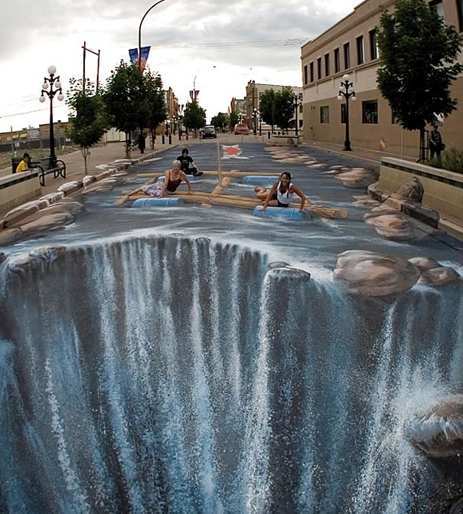
More realistic sidewalk art

Slide 13
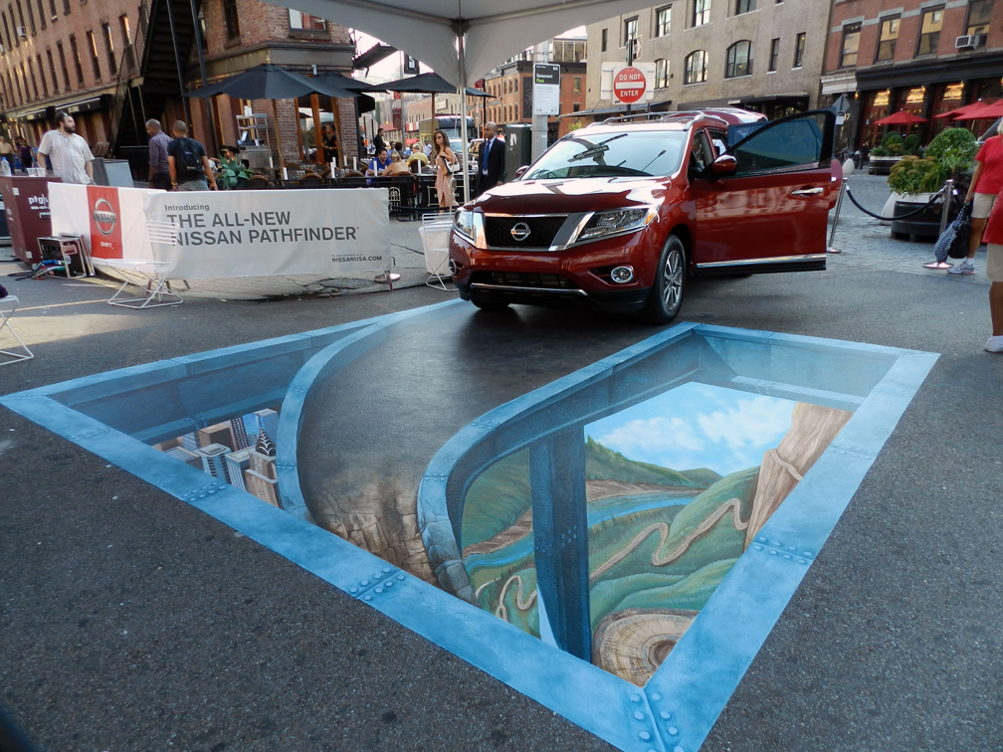
More realistic sidewalk art

Slide 14
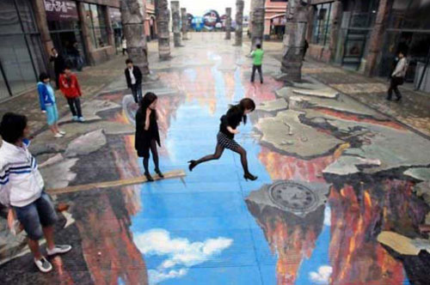
More realistic sidewalk art

Slide 15
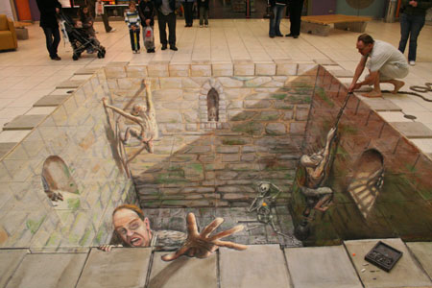
More realistic sidewalk art

Slide 16
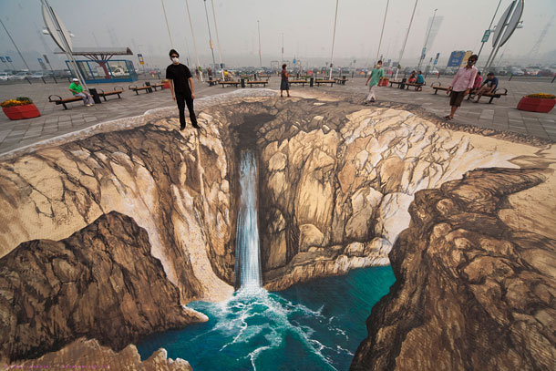
More realistic sidewalk art

Slide 17
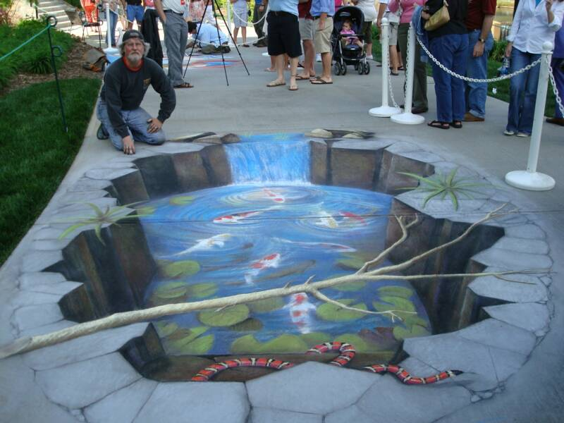
More realistic sidewalk art

Slide 18
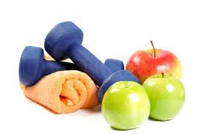
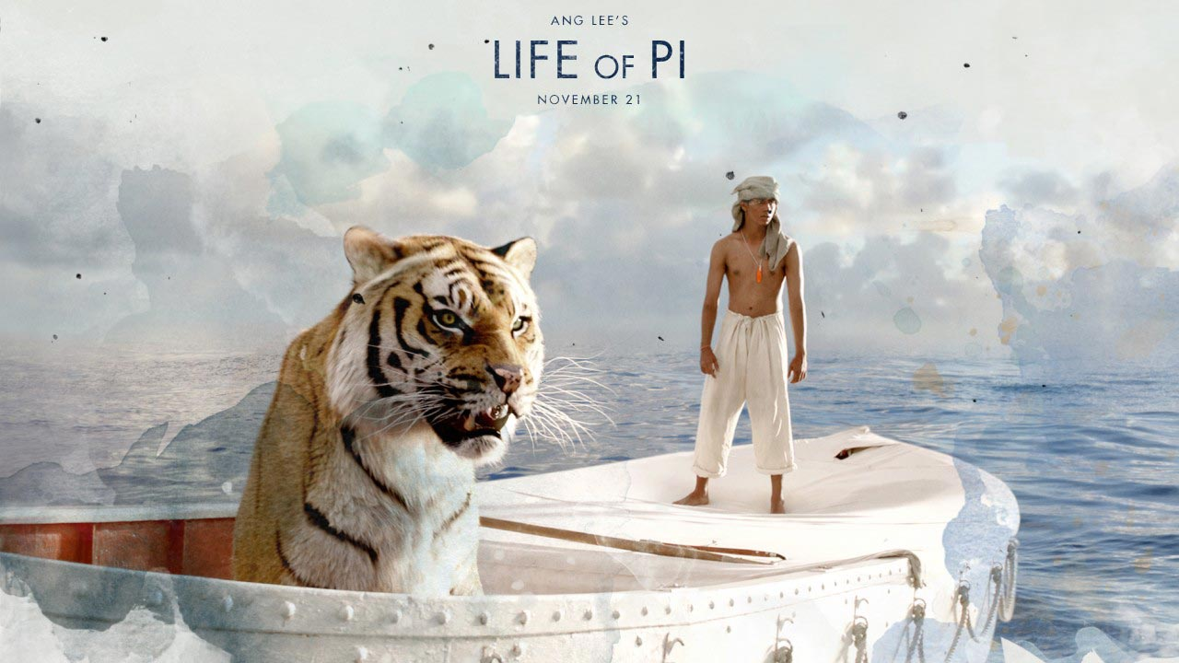
sensible
“Even ‘I can’t’ can be a good, sensible thing to say.”
Sensible- a good choice
Which pictures show sensible ideas?

Slide 19
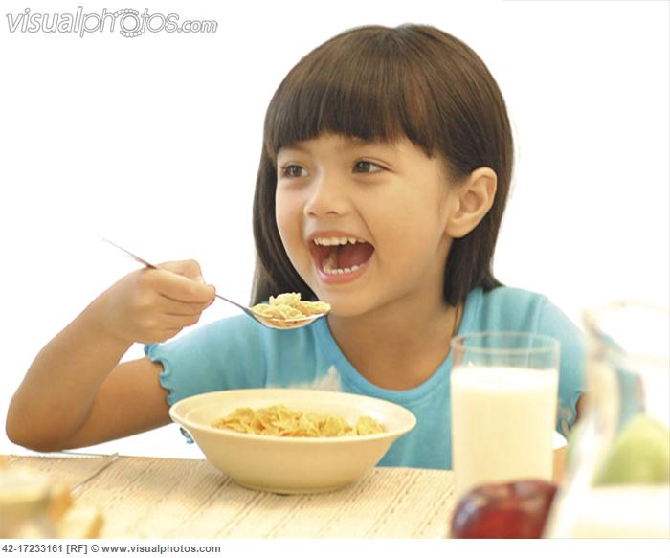
Sensible choice or bad idea?
Eating a good breakfast

Slide 20
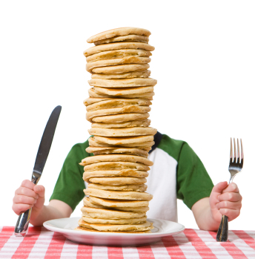
Sensible or bad idea?
Eating a HUGE, unhealthy breakfast

Slide 21
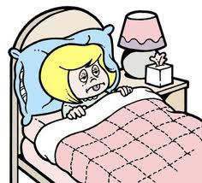
You’ll get a stomachache after eating all those pancakes!

Slide 22
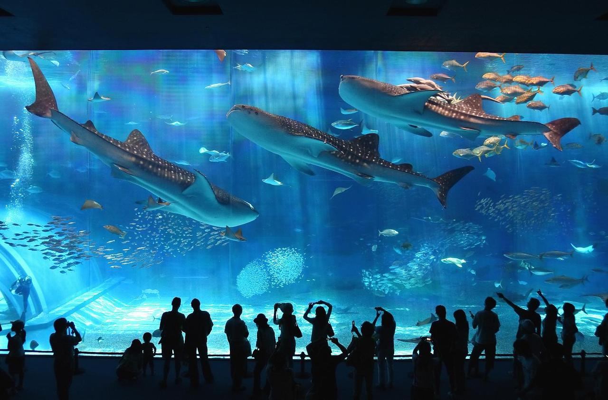
Sensible or bad idea?
Going to an aquarium to see sharks

Slide 23
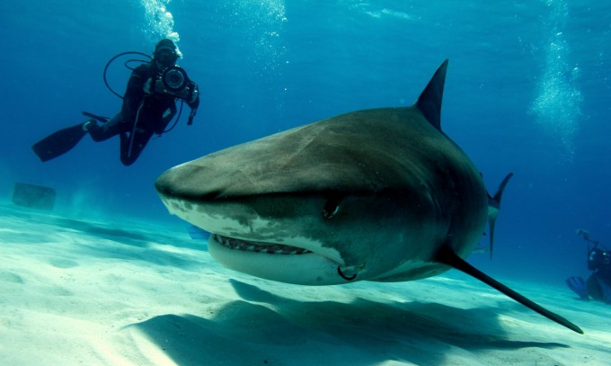
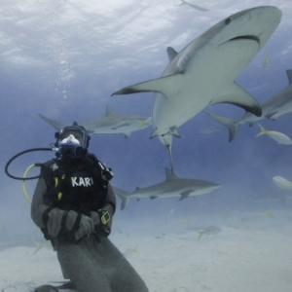
Sensible or bad idea?
Swimming with a shark

Slide 24
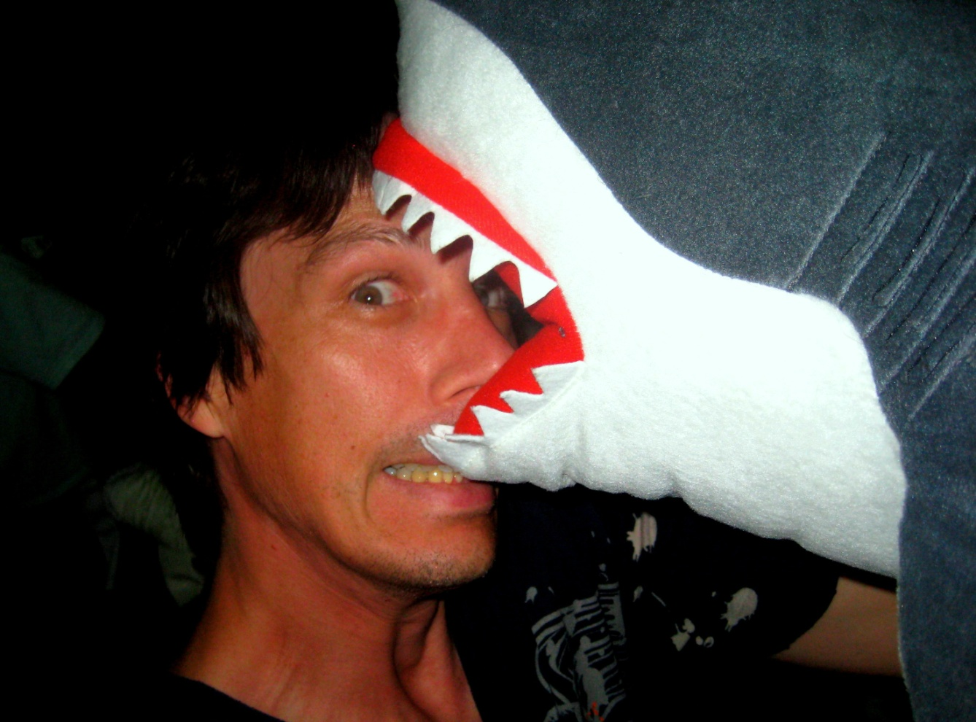
You might get bitten!
(not a real shark)

