Slide 1
Mighty Jackie-The strike-out queen
Genre: Historical Fiction-set in the real time and place in the past. It may include real people and events that actually happened along with fictional characters and events.

Slide 2
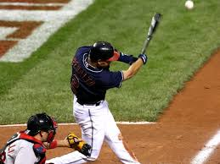
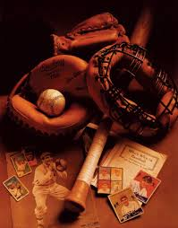
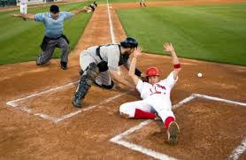
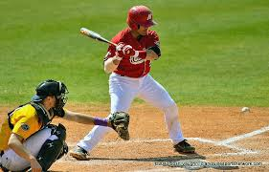
Building background
Share with a class what you know about baseball

Slide 3
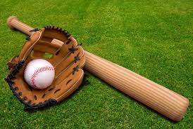
Baseball words to know
Major-league baseball (MLB)-is one of the four major professional sport leagues of the United States and Canada (the rest are :NBA, NFL, and NHL). It is composed of 30 teams — twenty-nine in the United States and one in Canada .
Mitt
Baseball Bat

Slide 4
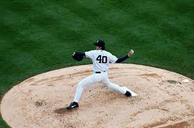
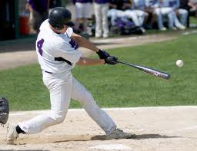
Baseball words to know
Pitcher- is the player who throws the baseball from the pitcher’s mound toward the catcher to begin each play.
Pitcher’s mound
Batter
Batter swinging the bat

Slide 5
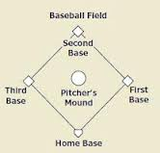
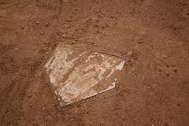
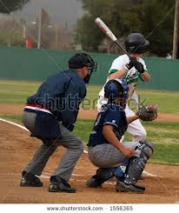
Base
Home Base
Catcher is a position for a baseball player when a batter takes his turn to hit, the catcher crouches behind home plate, in front of the (home) umpire, and receives the ball from the pitcher.
Batter
Umpire
Catcher

Slide 6
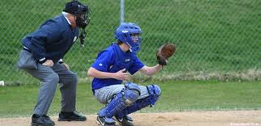
In baseball, the umpire is the person charged with officiating the game, including beginning and ending the game, enforcing the rules of the game and the grounds, making judgment calls on plays, and handling the disciplinary actions
Umpire What is
this guy?

Slide 7
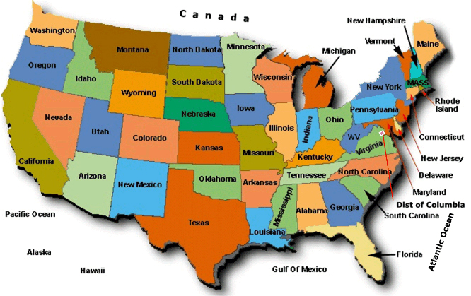
Chattanooga, TN
Chattanooga is the fourth-largest city in the US state of Tennessee.
Tennessee

Slide 8
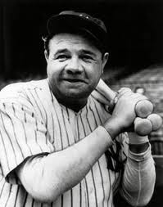
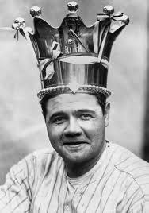
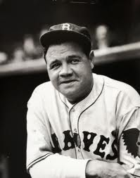
The New York Yankees
Babe Ruth- George Herman "Babe" Ruth, Jr. (February 6, 1895 – August 16, 1948), nicknamed "the Bambino" and "the Sultan of Swat", was an American professional Baseball player. He was a Major League Baseball (MLB) pitcher and outfielder who played for 22 seasons on three teams, from 1914 through 1935.

Slide 9
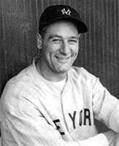
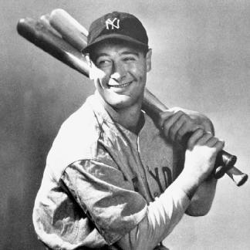
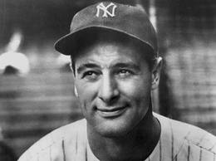
Lou Gehrig
Henry Louis "Lou" or "Buster”Gehrig (June 19, 1903 – June 2, 1941) was an American baseball first baseman who played 17 seasons in Major League Baseball(MLB) for the New York Yankees (1923–1939).
Gehrig was renowned for his prowess as a hitter and for his durability, a trait which earned him his nickname "The Iron Horse".

Slide 10
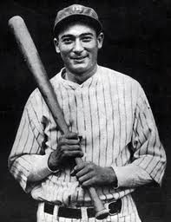
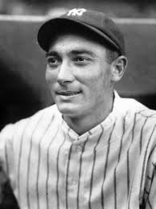
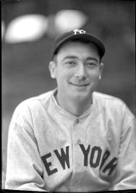
Tony Lazzeri
Anthony Michael "Tony" Lazzeri (December 6, 1903 – August 6, 1946) was an American Professional Baseball player during the 1920s and 1930s, predominantly with the New York Yankees of Major League Baseball.

Slide 11
Chattanooga Lookouts
Jackie Mitchell

Slide 12
*legendary

Slide 13
*insult

Slide 14
*muttered

Slide 15
*gaped

Slide 16
*flinched

Slide 17
*snickering

Slide 18
*fluke

Slide 19
seal

Slide 20
Ached callused

Slide 21
delicate

Slide 22
stunned

Slide 23
glare

Slide 24
Now let’s watch a video about Jackie Mitchell
http://www.youtube.com/watch?v=qeDnHg7nubE

