Slide 1
My diary: from here to there
Genre: Realistic Fiction-a made-up story that could have happened in real life.

Slide 2
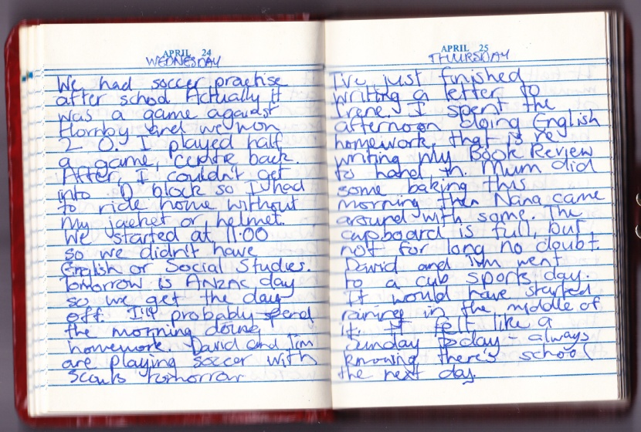
diary
a book in which you write down your personal experiences and thoughts each day
Do you keep a diary?

Slide 3
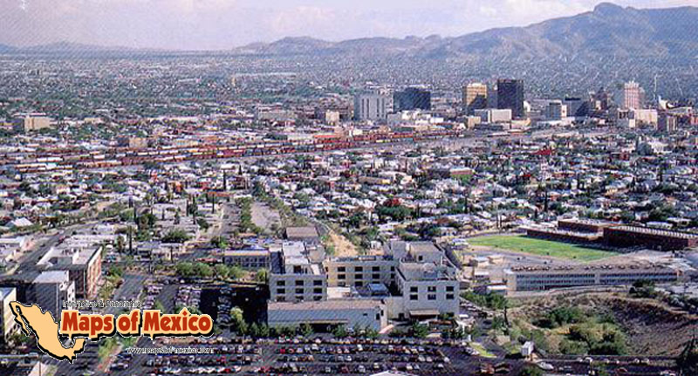
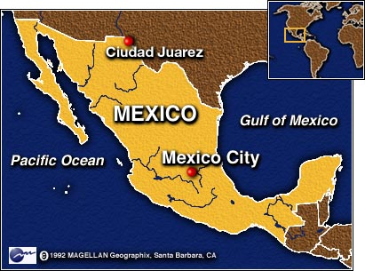
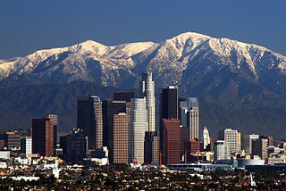
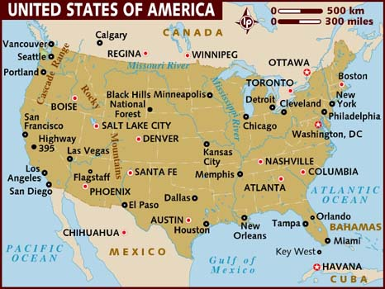
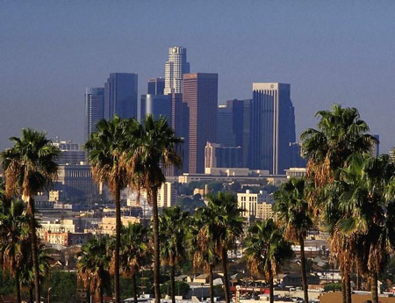
Juarez, Mexico- a city in the Mexican state of
Chihuahua. Located south of El Paso, TX
Los Angeles,CA-second most populous(3,792,621) city in the USA after New York

Slide 4
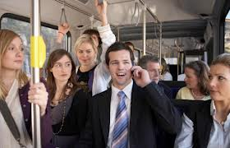
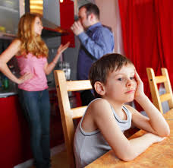
*overheard (past of overhear)
To hear what was said to another person by accident
I overheard Mama and Papa whispering.

Slide 5
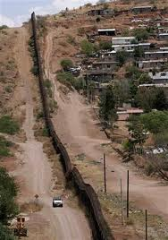
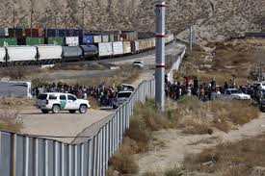
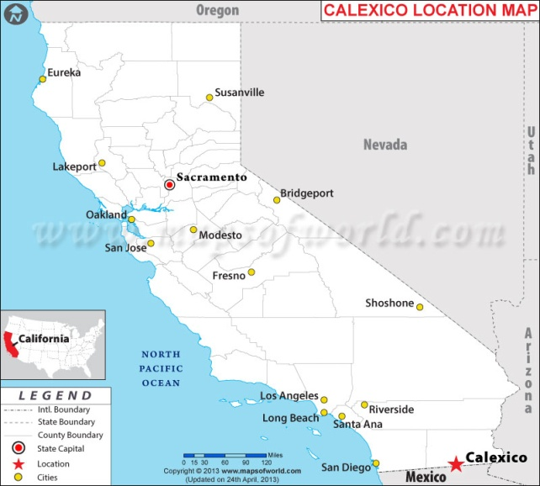
*border
A strip of land that separates two countries
In two weeks we’ll leave for my grandparent’s house in Mexicali, right across the border from Calexico, California.

Slide 6
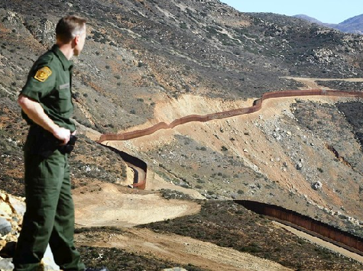
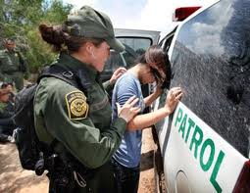
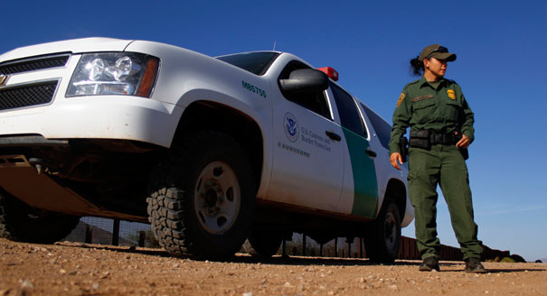
Immigration (border) patrol
Officers that protect the border

Slide 7
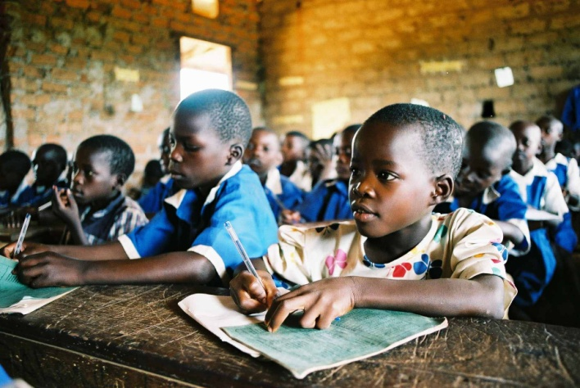
*opportunities
A good chance for success
With the opening of a new school African children received an opportunity to learn.
Studying hard at school will give you an opportunity to go to college.

Slide 8
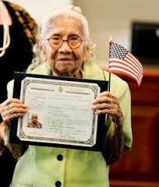
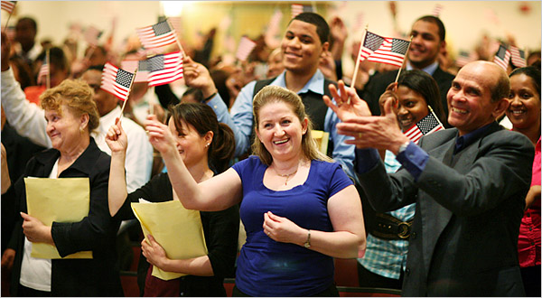
*citizen
a person who legally belongs to a country and has the rights and protection of that country
If you are born in the USA, you are an American citizen. If you were born in another country you can become an American citizen later in life after your paperwork is approved by the government.

Slide 9
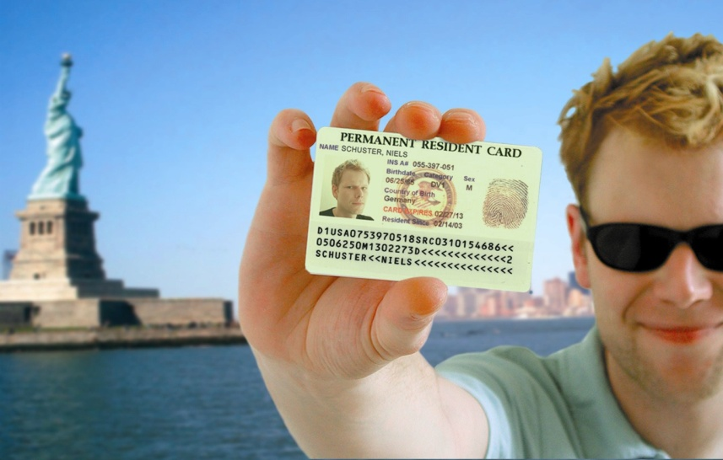
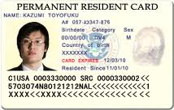
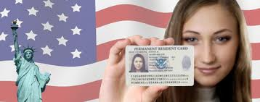
Green card
A card that is given to immigrants to the US to show that they live in the country legally (without breaking the law)

Slide 10
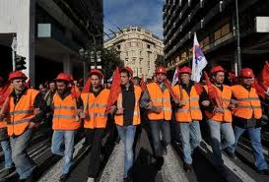
*Unions
an organization formed by workers to protect their rights and interests.

Slide 11
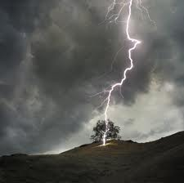
*strikes
1)strike (verb)- to hit something. The lightning strikes the tree
2) to go on a strike (noun)- to protest against something publicly

Slide 12
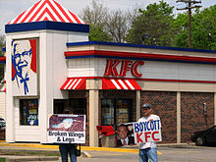
*boycotts
to refuse to buy, use, or participate in (something) as a way of protesting
These people are boycotting KFC because they believe their chickens are treated inhumanely (cruelly).

Slide 13
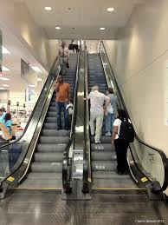
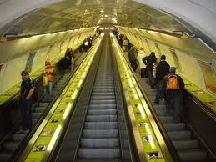
escalators
Moving stairs

Slide 14
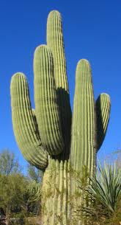
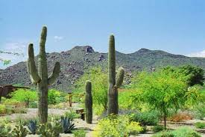
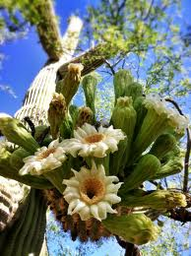
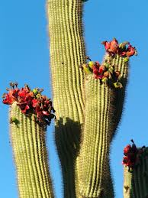
Giant saguaros
Cactus of dry areas of the southwestern United States and Mexico that bears white flowers and a scaly reddish edible fruit and that may attain a height of up to 50 feet

Slide 15
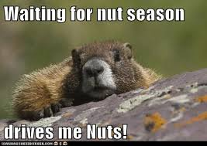
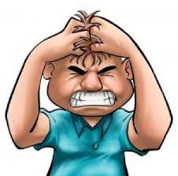
They drive me nuts!
They drive me crazy!

Slide 16
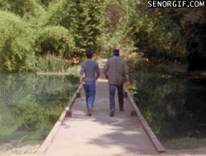
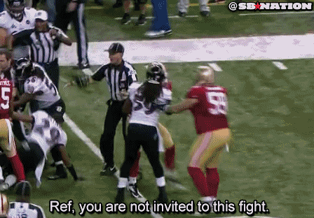
Pushing and shoving

