Slide 1
Stealing Beauty Genre:A nonfiction article in a newspaper or magazine tells a true story
4.2.3

Slide 2
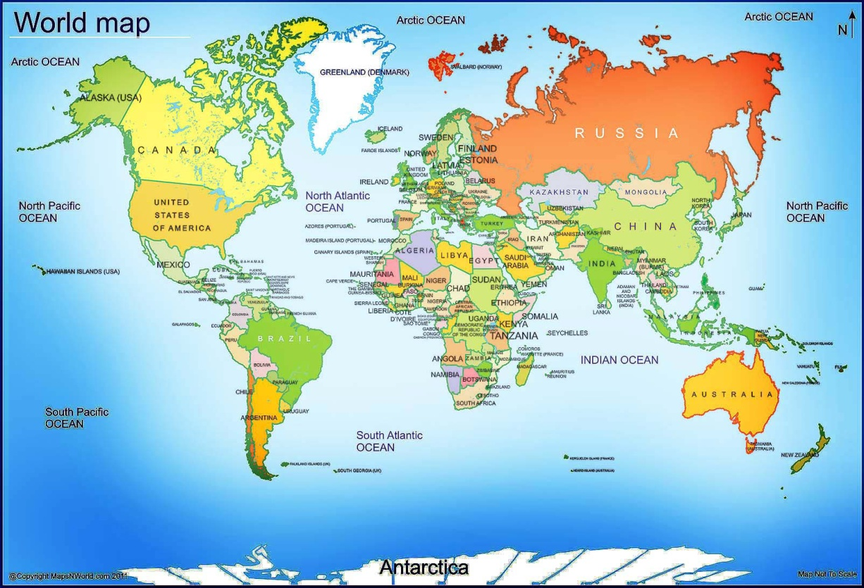
China
China is a huge country. It’s easy to find it on the map. Can you find China?

Slide 3
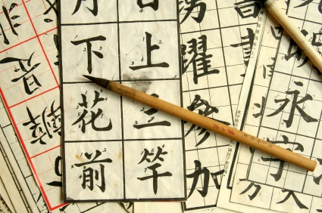
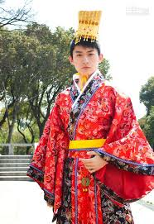
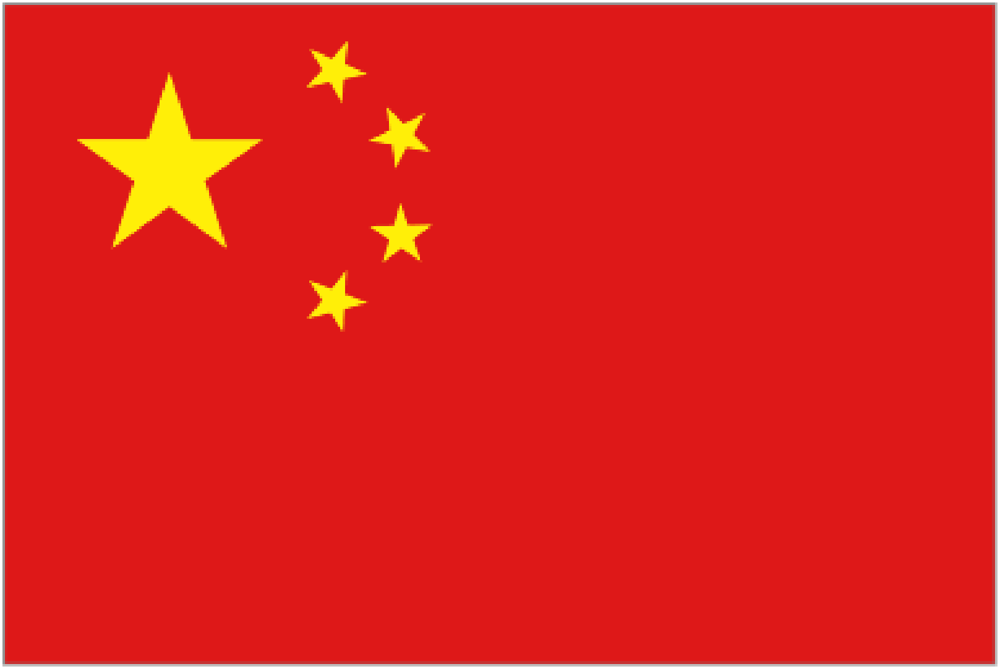
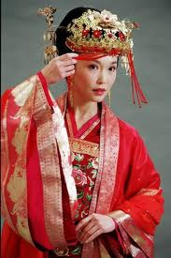
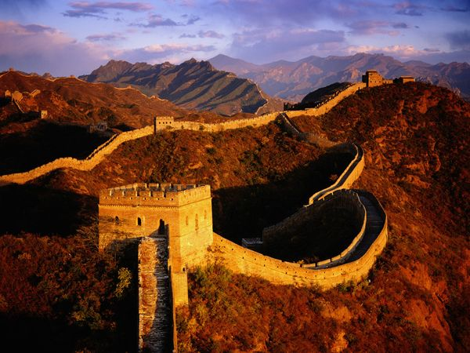
China
It is the world's most populous country, with a population of over 1.35 billion!!!.
1 out of 5 people in the world is Chinese.
Chinese flag The Great Wall of China

Slide 4
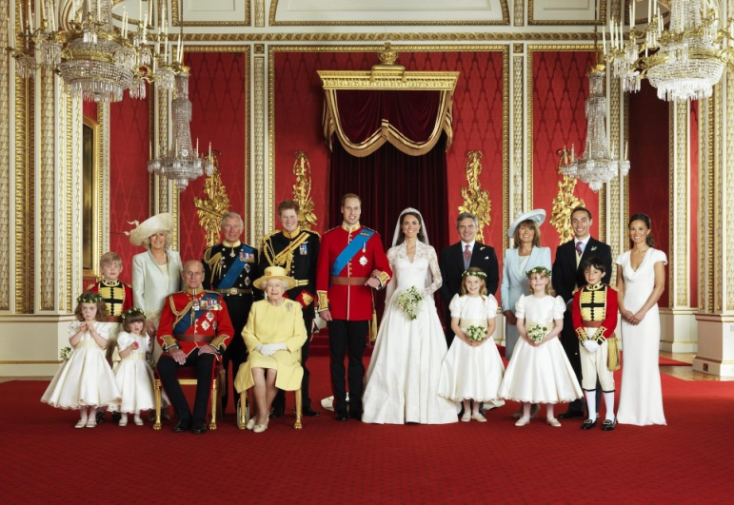
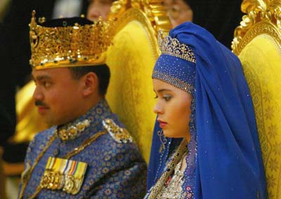
Royalty
People who rule the country ( king, queen, emperor. etc)
Royalty of Brunei Royalty of Great Britain

Slide 5
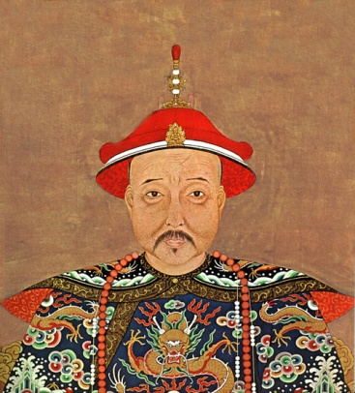
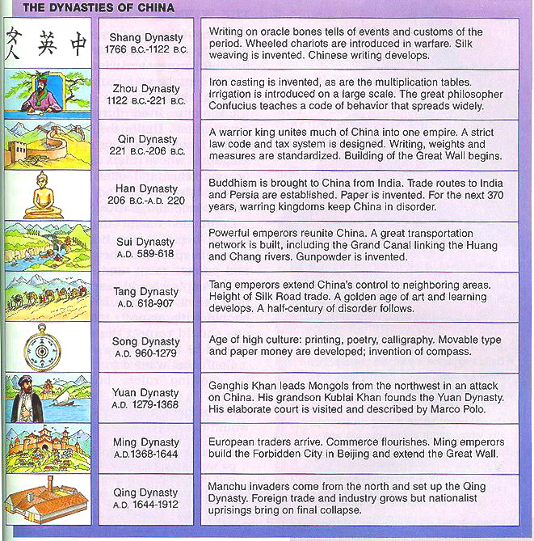
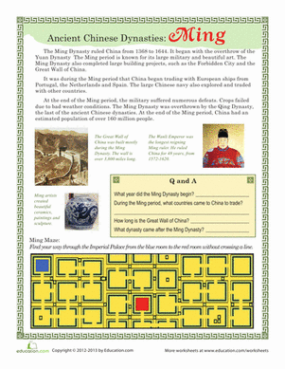
*dynasties
There were many ancient dynasties in Chinese history.
Meaning: many generations of a royal family
Kangxi, 2nd Emperor of the Qing Dynasty (1662-1722 A.D.).

Slide 6
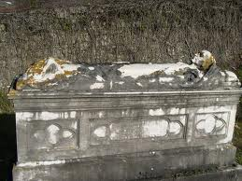
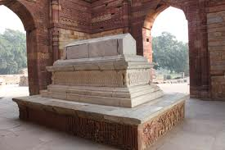
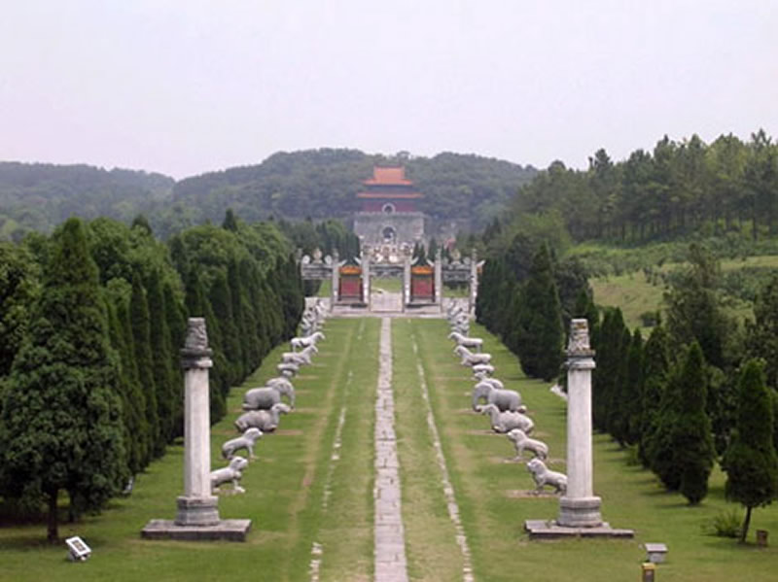
Tomb
As place where a person is buried
13 Tombs of the
Ming Dynasty

Slide 7
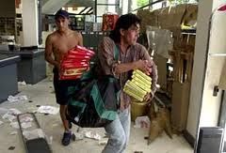
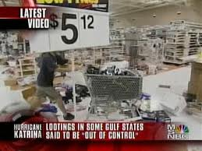
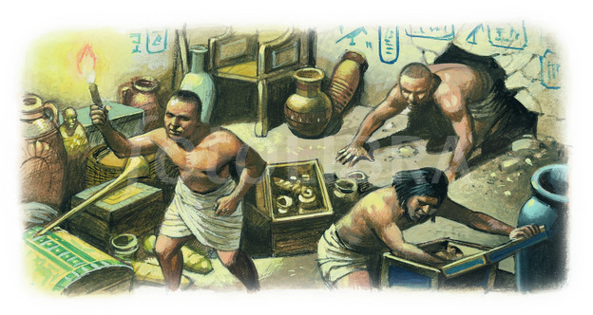
looting
Stealing, esp. from a place that is not guarded.
Ex. Looting a store after a disaster (tornado, earthquake, war, etc)
Tomb looting

Slide 8
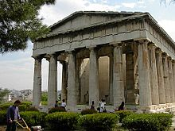
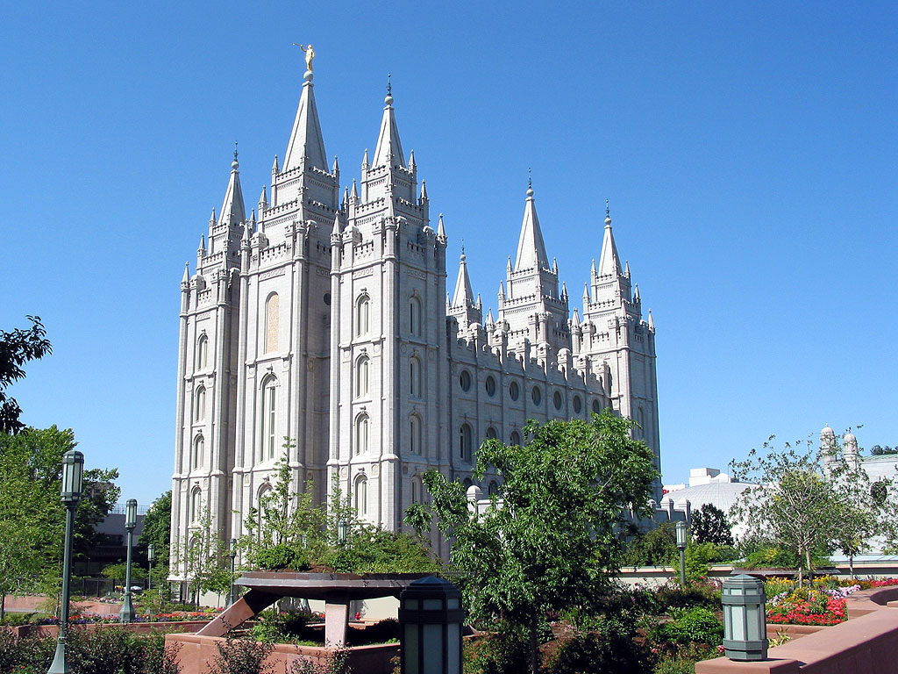
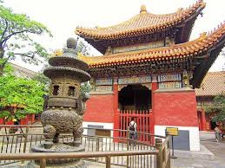
*temples
China has busy cities where ancient temples stand beside ancient temples.
Meaning: a place of worship

Slide 9
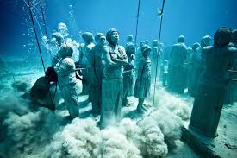
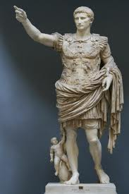
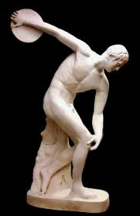
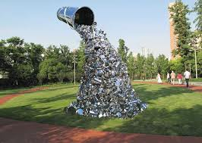
sculptures
Work of art created by carving figures out stone, molding out of clay or welding out of metal
Underwater sculptures (Cancun, Mexico)
Roman sculpture Greek sculpture
Modern sculpture

Slide 10
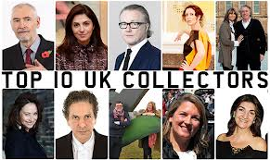
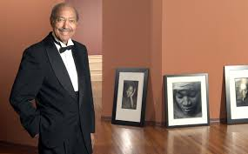
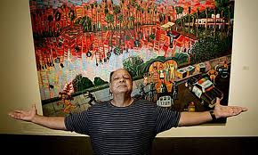
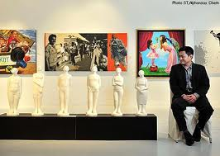
Art Collectors
Wealthy people who pay a lot of money to collect art

Slide 11
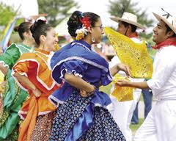
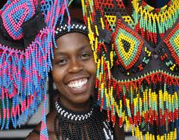
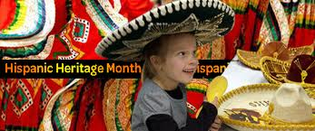
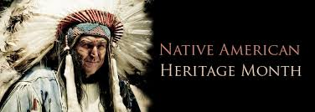
*heritage
We must protect our heritage.
Meaning: cultural history

Slide 12
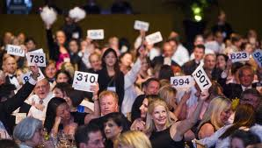
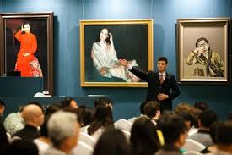
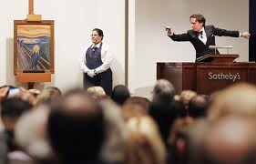
auction
a sale at which things are sold to those who offer to pay the most

Slide 13
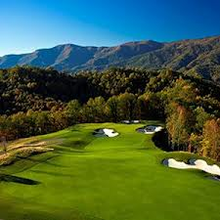
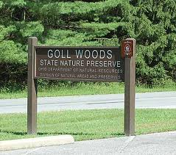
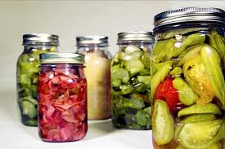
*preserve
To protect, to keep safe from harm or loss
Luckily, the auction sale was stopped in time to preserve some of China’s history
We can preserve food or Nature

Slide 14
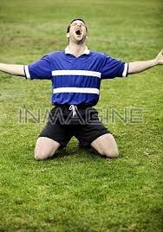
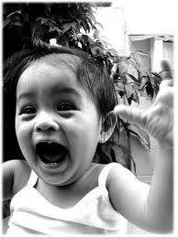
*overjoyed
Feeling great joy, being very happy
What can make you feel overjoyed?

