Slide 1
Ben Franklin Stole the Lightning
Genre: Biography-a story about a life of a real person written by someone else.

Slide 2
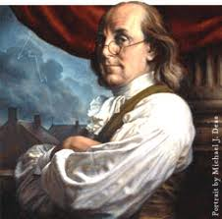
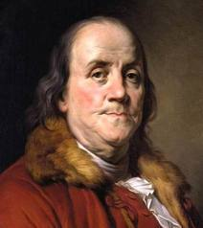
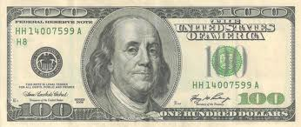
Benjamin Franklin
Benjamin Franklin (January 17, 1706– April 17, 1790 )was born in Boston,Massachussets.
He was one of twenty children.
Franklin’s father Josiah had ten children by his first marriage and ten by his second. Benjamin was the fifteenth child. He also happened to be the youngest boy.
Franklin was only able to attend two years of schooling but continued his own education by reading.
At the age of 12, he became apprenticed (student) to his brother James who was a printer. When his brother did not allow him to write for his newspaper, Franklin fled to Philadelphia.

Slide 3
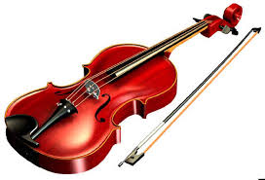
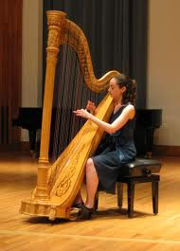
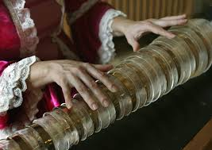
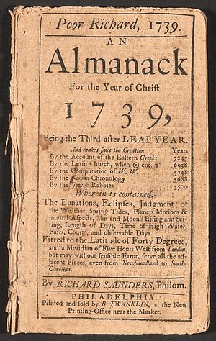
Benjamin Franklin was a
leading author (“Poor Richard’s Almanack “ was like a magazine that had seasonal weather forecasts, practical household hints, puzzles, proverbs/sayings, and other amusements) Also drafted the Declaration of Independence.
musician (played the violin, the harp, the guitar. Invented glass
harmonica

Slide 4
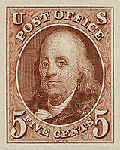
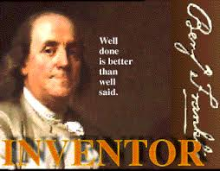
Benjamin Franklin was a
Printer/publisher/cartoonist
politician (Governor of Pennsylvania),
postmaster (United States Postmaster General. He was in charge of the US Post Office)
scientist
inventor,
civic activist (freed his slaves and was a very prominent abolitionist)
and diplomat (first US Ambassador to France 1776–1785)

Slide 5
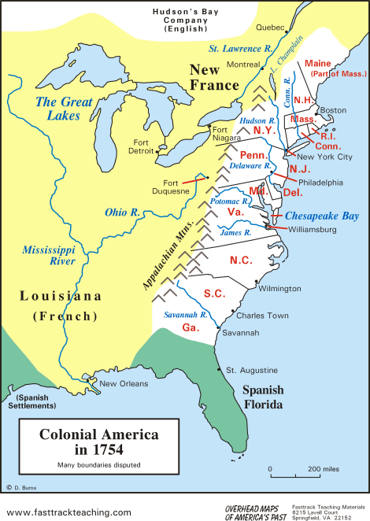
Colonial America
1607-1783 The 13 original colonies that belonged to Great Britain: Delaware, Pennsylvania, New Jersey, Georgia, Connesticutt, Massachusetts Bay, Maryland,South Carolina, New Hampshire,Virginia,New York, North Carolina,and Rhode Island and the Providence Plantations.

Slide 6
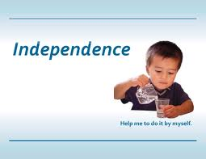
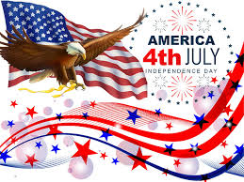
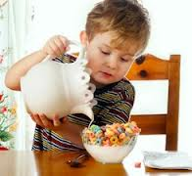
*Independence
freedom from outside control or support (you are your own boss: you do not depend on anyone for help)

Slide 7
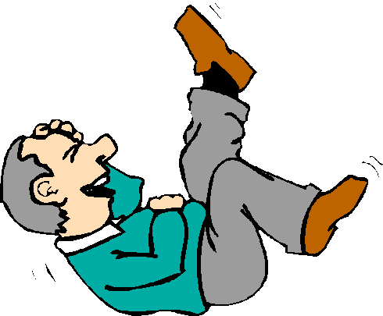
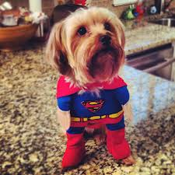
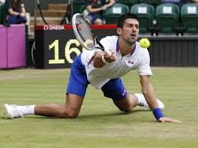
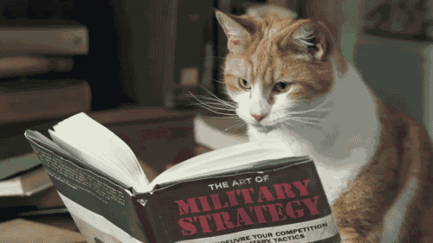
*hilarious
Extremely funny
Hilarious Halloween costume Hilarious picture
http://www.youtube.com/watch?v=uXGg9Dd17G8

Slide 8
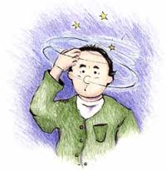
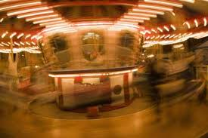
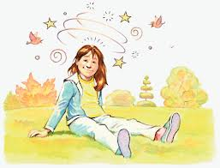
*dizzy
feeling that you are turning around in circles and are going to fall even though you are standing still

Slide 9
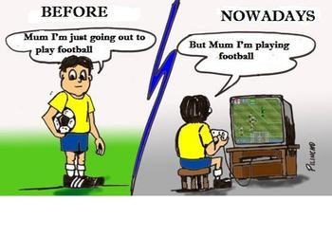
*nowadays
At the present time

Slide 10
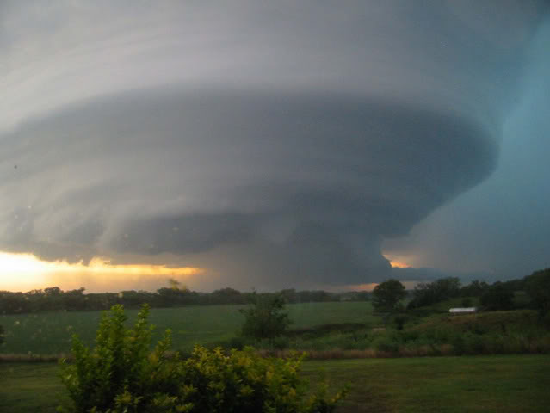
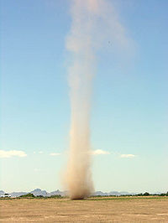
*whirlwind
a wind that moves in a spinning or swirling motion and that can damage buildings, trees, etc
There are 2 types of whirlwinds:
Major whirlwind(strong) Minor whirlwinds (weak)
tornadoes dust devils (dust devils)

Slide 11
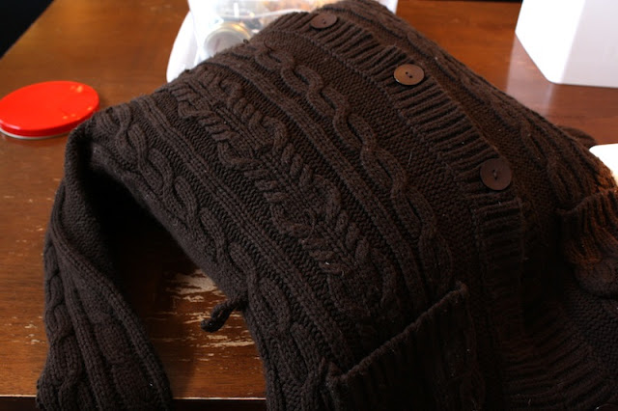
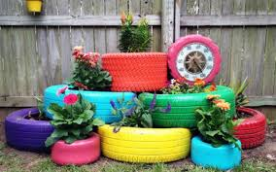
*Come in handy
Become useful
My old sweater came in handy. I decided to make a pillow cover out of it.
How did these old tires
come in handy?

Slide 12
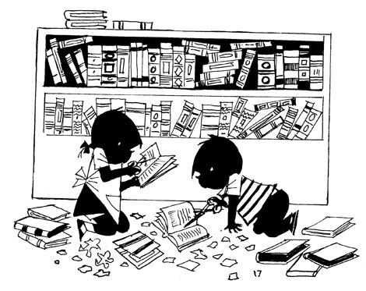
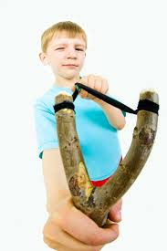
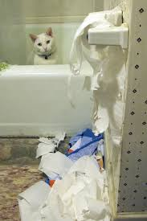
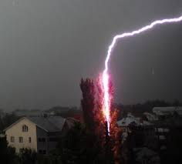
*mischief
Harm, trouble, damage
Franklin’s idea was to pull lightning safely out of the sky before it could do any mischief.

Slide 13
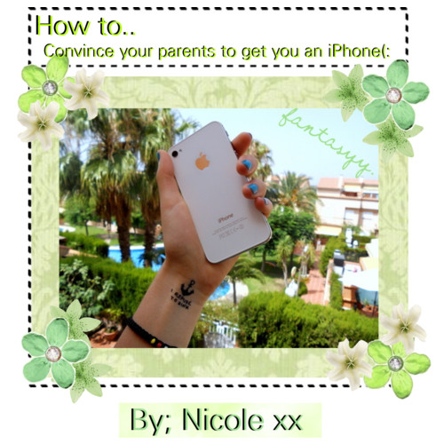
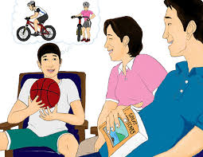
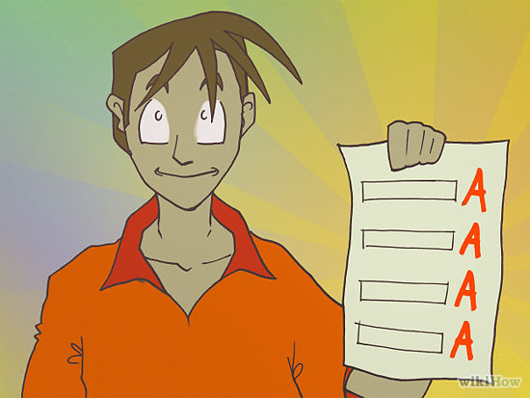
*convince
To make someone agree to do something
I tried to convince my parents to
buy me a bike.

Slide 14
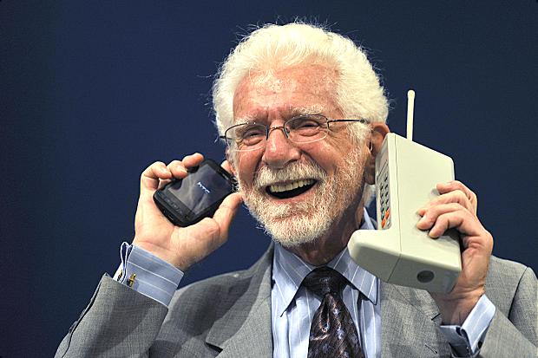
Invent
To create something useful for the first time
Martin Cooper is the inventor of the first mobile phone.
A mobile phone is his invention.

Slide 15
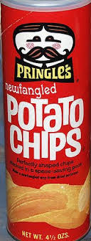
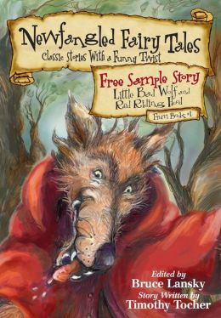
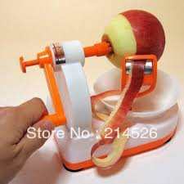
Newfangled
recently invented or developed and hard to understand Ben Franklin always came up with newfangled ways to help people: he built first lending library and started a post office.

Slide 16
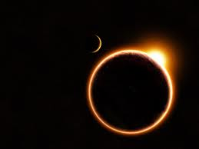
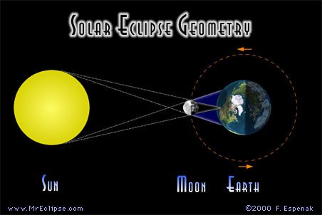
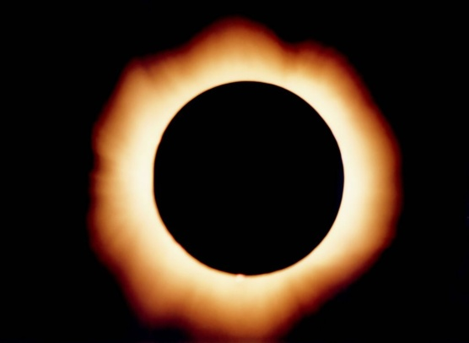
eclipse
an occasion when the sun looks like it is completely or partially covered with a dark circle because the moon is between the sun and the Earth

Slide 17
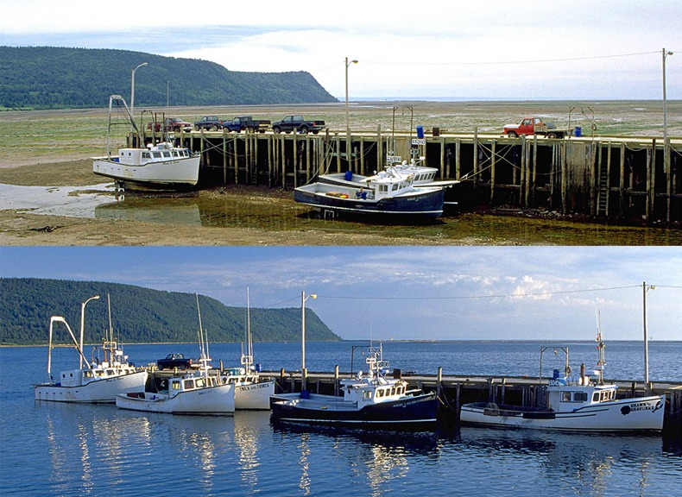
tide
the regular upward and downward movement of the level of the ocean that is caused by the pull of the Sun and the Moon on the Earth
Low tide
High tide

Slide 18
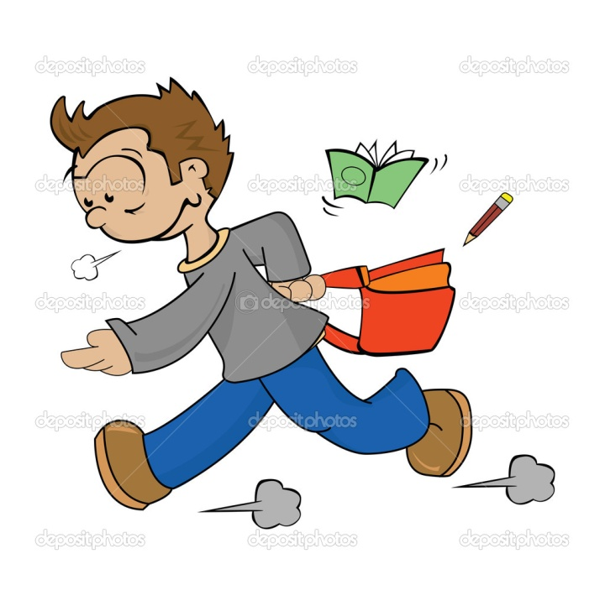
Lickety-split
Very quickly
I was late for school, so I ran out the door lickety-split.

Slide 19
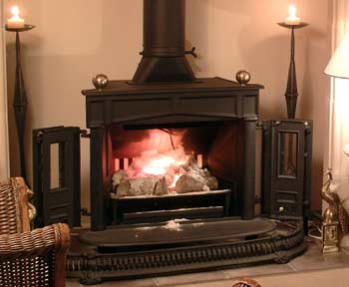
Franklin stove
Ben came up with a Franklin stove that could warm up rooms faster and use a lot less wood than old stoves.

Slide 20
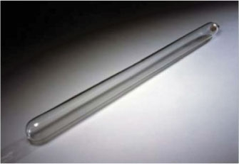
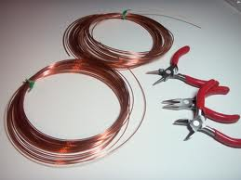
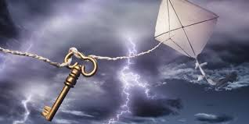
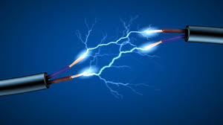
Experiments with electricity
electric tube wire
sparkles

Slide 21
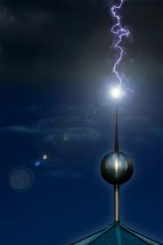
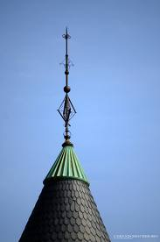
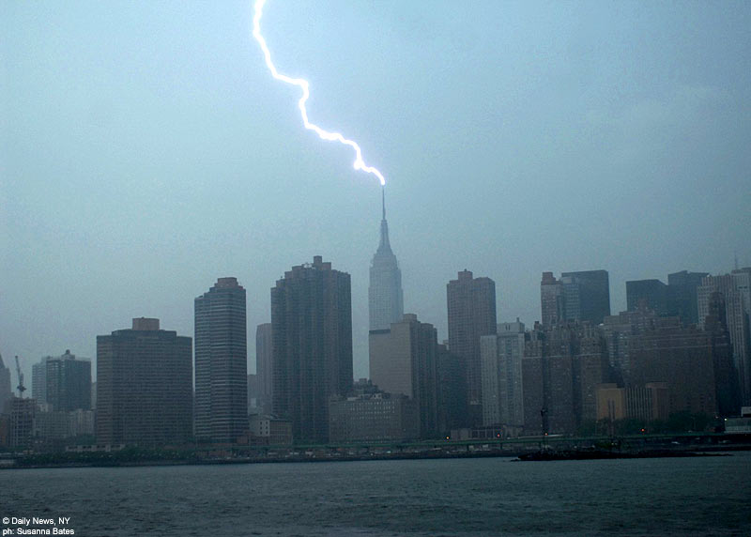
Lightning rod
a metal rod that is placed on a building and connected with the ground below to protect the building from being damaged by lightning

