Slide 1
My Brother Martin
4.3.2

Slide 2
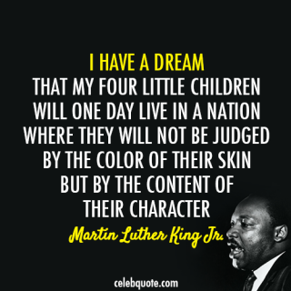

Slide 3
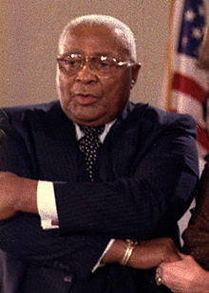
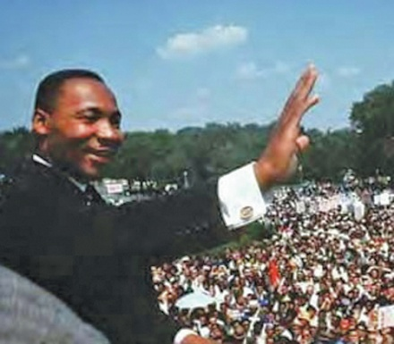
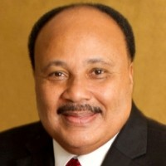
Martin Luther King Sr. (Senior)
1899-1984
Martin Luther King Jr. (Junior)
1929-1968
Martin Luther King III (the third)
1957-

Slide 4
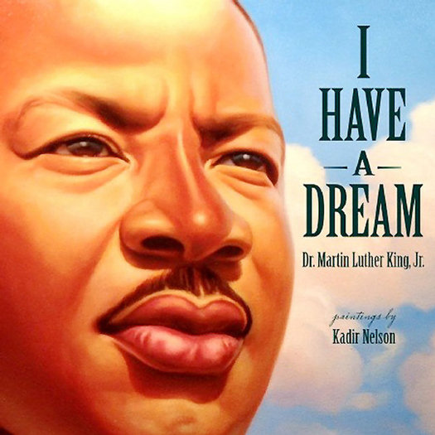
Dr. Martin Luther King, Jr.
Who was he?
{9:06 + video quiz} http://app.discoveryeducation.com/player/view/assetGuid/CDDC26F3-B37F-43FB-BB45-76B75A877576
{3:21} http://www.youtube.com/watch?v=k6Au81aHuSg

Slide 5
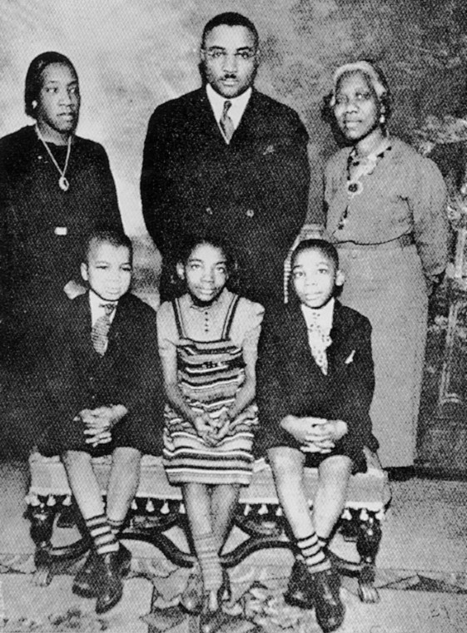
Martin Luther King Jr’s Family
Martin Luther King Sr
Alberta King
Martin Luther King Jr.
Christine King
* author of this book
Alfred Daniel King

Slide 6
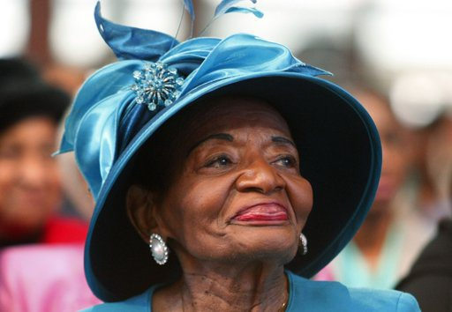
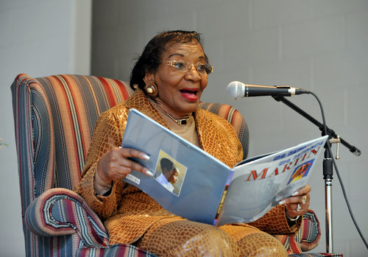
Christine King Farris

Slide 7
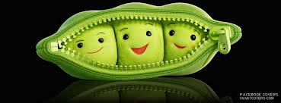
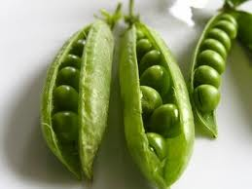
three peas in a pod
Like three peas in a pod, we grew together.

Slide 8
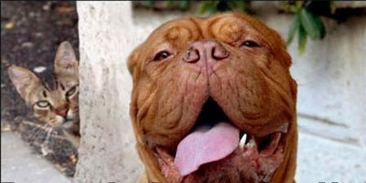
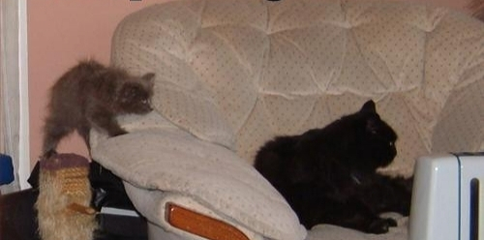
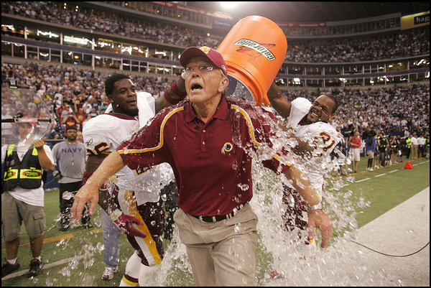
unsuspecting
We liked to play a prank on an unsuspecting passerby.

Slide 9
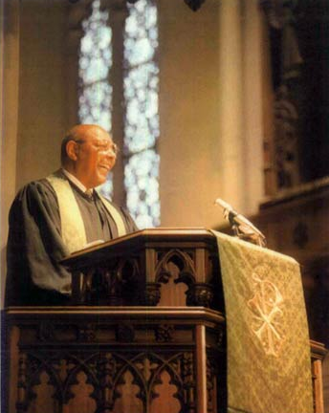
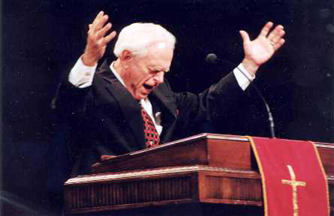
minister
Our Daddy was an important minister.

Slide 10
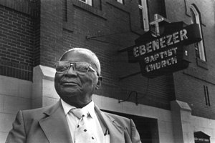
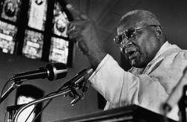
Martin Luther King, Sr.
Martin Luther King Sr. was a Baptist minister.

Slide 11
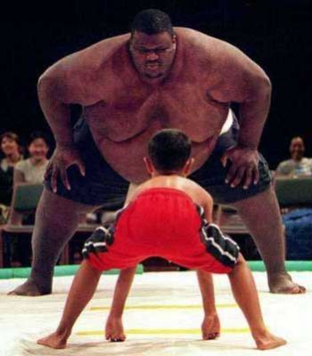
unfair
At that time, our country had unfair laws against black people.

Slide 12
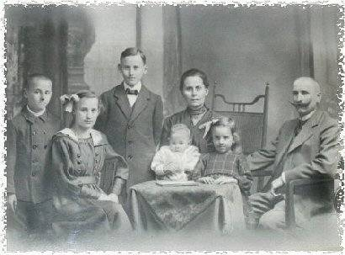
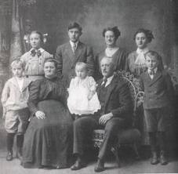
ancestors
Our ancestors had been captured in far-off Africa and brought to America as slaves.
Ancestors are members of our families who lived long ago. (see the next slide)

Slide 13
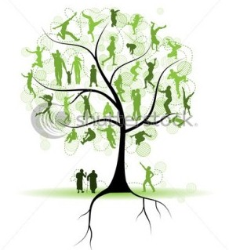
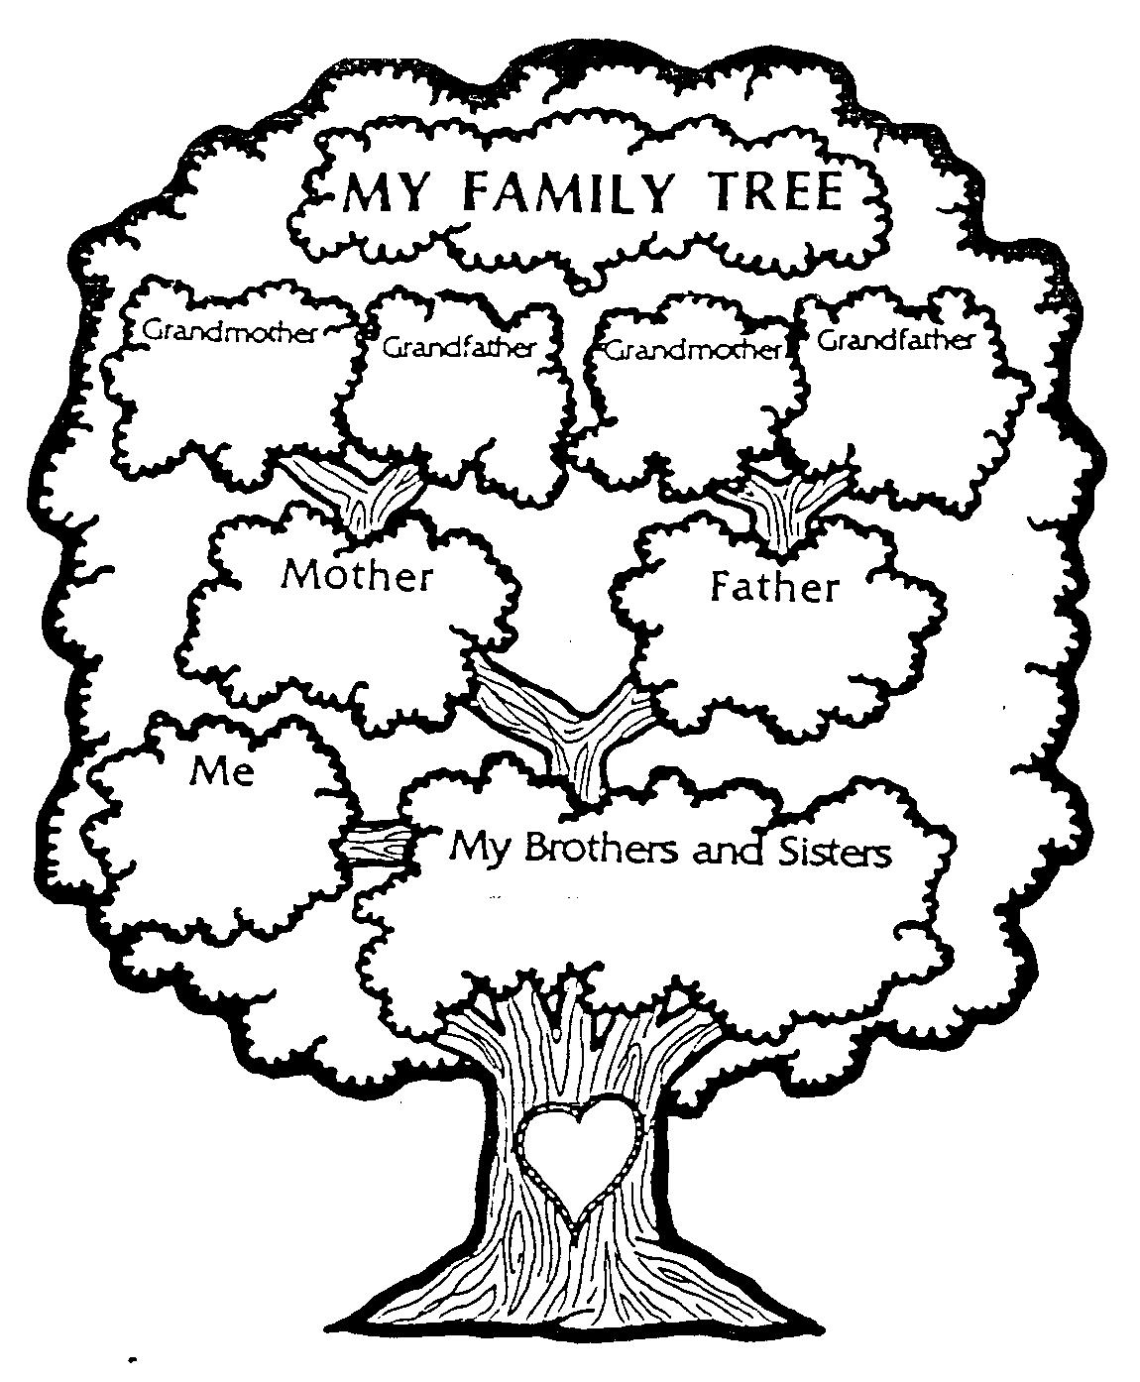
ancestors
A family tree is a way to think about all of our ancestors.
The people at the top
of the tree are
ancestors.
Print this page →
http://freepages.genealogy.rootsweb.ancestry.com/~archibald/Pedigree-tree.jpg

Slide 14
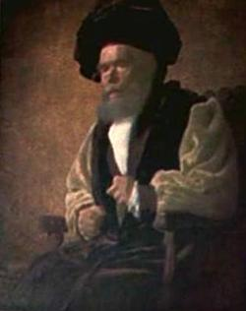
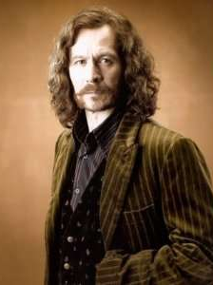
In the Harry Potter books, Phieas Nigellus Black was an ancestor of Sirius Black.

Slide 15
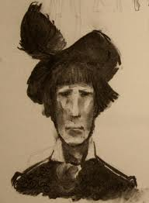
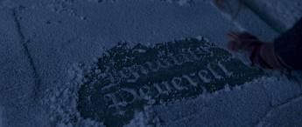
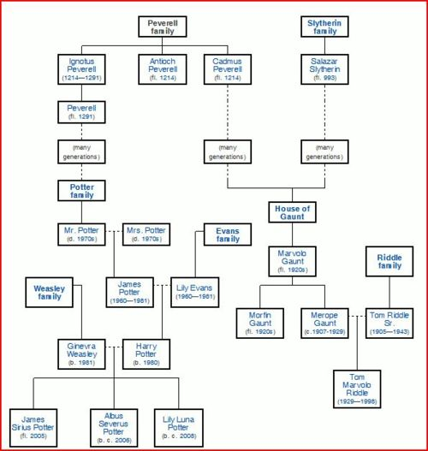
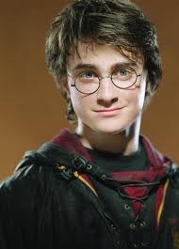
In the Harry Potter books, Ignotus Peverell was an ancestor of Harry.

Slide 16
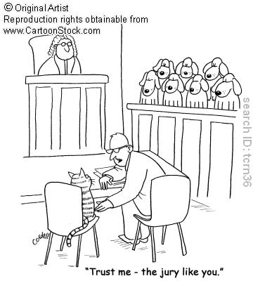
injustice
It was only a matter of time before the generations of cruelty and injustice finally broke through.
Injustice is unfairness.
Is this a fair trial? →

Slide 17
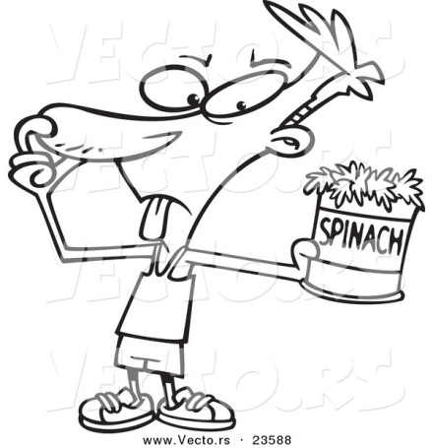
avoid
Her words explained why our family avoided places marked whites only.
Have you ever avoided homework?
To avoid is to stay away from something.

Slide 18
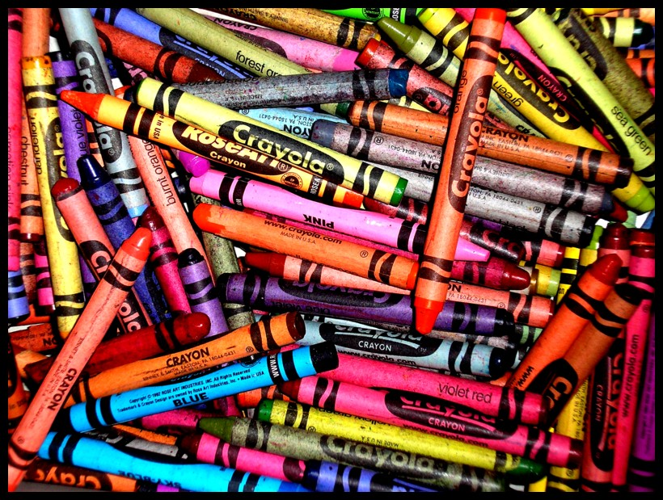
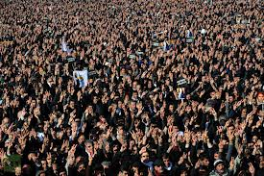
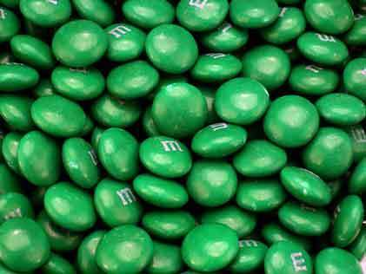
numerous
There were numerous speeches and marches.
Numerous means a lot.
numerous crayons
numerous people
numerous candies

Slide 19
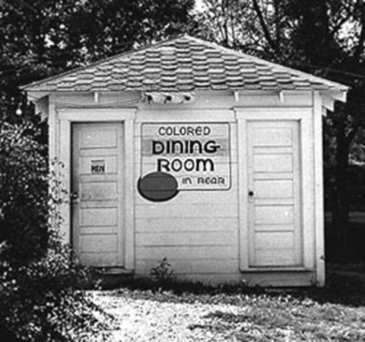
segregation
Segregation was a way to keep black people separate from others. It was unjust and unfair.

Slide 20
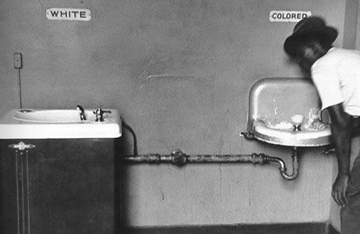
An unfair law: segregation

Slide 21
An unfair law: segregation

Slide 22
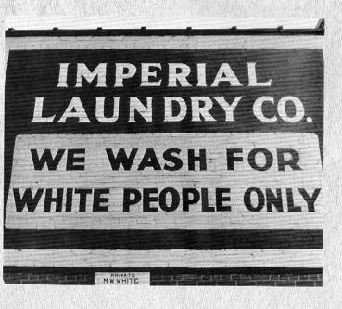
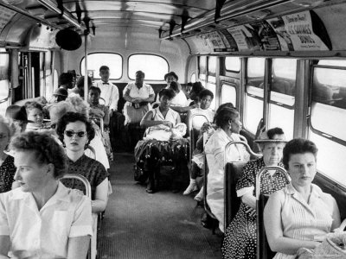
An unfair law: segregation

Slide 23
