Slide 1
Kid Reporters at Work
4.3.3

Slide 2
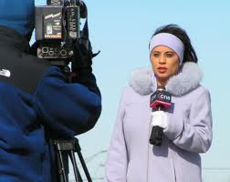
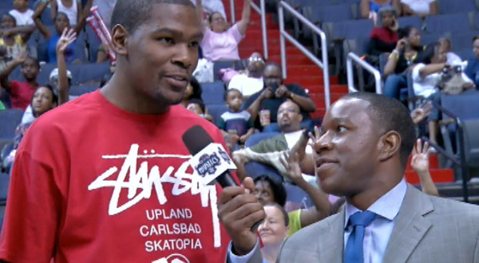
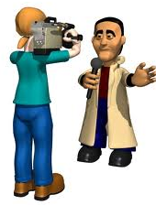
reporters
Reporters tell or write about what is going on in the world.

Slide 3
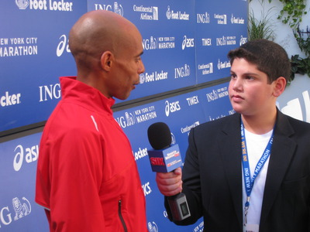
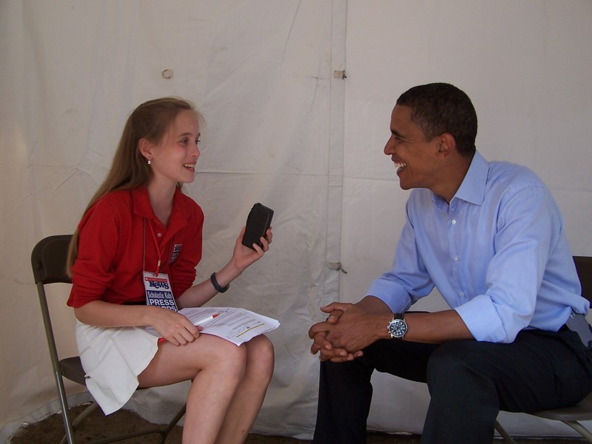
kid reporters
Terrence Cheromcka and Martin Jacobs are kid reporters.

Slide 4
identified
The UN special session identified three high-priority issues.

Slide 5
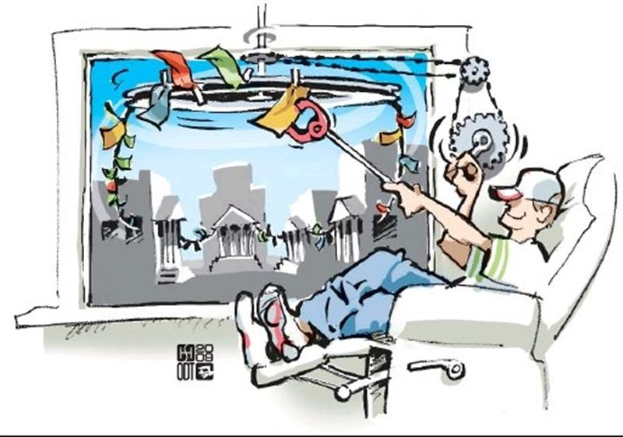
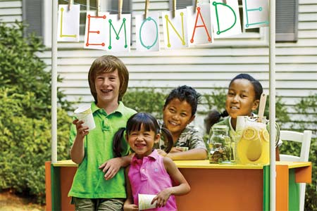
enterprising
These enterprising kids are not professional journalists, but they can show that they are qualified for the job.
Enterprising (adjective)- a person who is eager to take on new projects

Slide 6
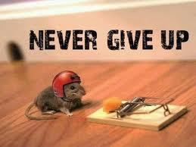
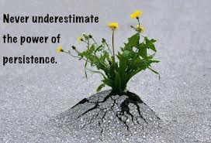
persistence
Kid reporters must have persistence in tracking down a story.

Slide 7
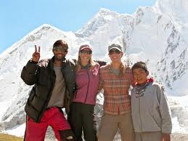
venture
The brothers started this venture in order to help improve the lives of children.
Venture (noun)- starting something new

