Slide 1
Mystic Horse
Genre: Legend-a story that has been handed down by people for many years, and that often has some basis in fact.

Slide 2
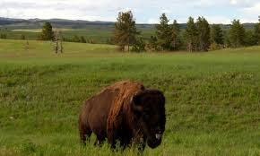
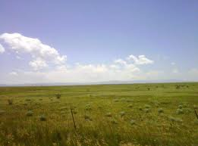
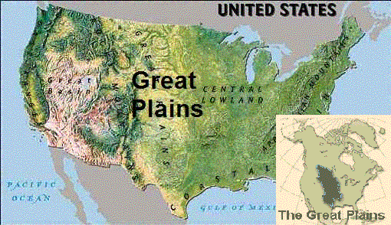
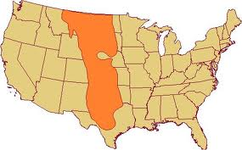
The Great Plains
The Great Plains are a broad expanse of flat land, much of it covered in prairie, steppe and grassland, which lies west of the Mississippi river and east of the Rocky Mountains in the United Stated and Canada. This area covers parts of the U.S. States of Colorado, Kansas, Montana, Nebraska, New Mexico, North Dakota, Oklahoma, South Dakota, Texas, and Wyoming.

Slide 3
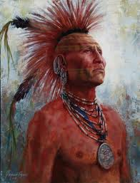
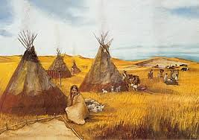
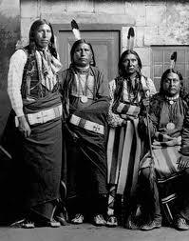
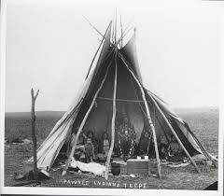
Pawnee People
Pawnee people (also Paneassa, Pari, Pariki) are a Cadoan -speaking Native American tribe. They are federally recognized as the Pawnee Nation of Oklahoma.
In the early 19th century, the Pawnee numbered about 10,000 people and were one of the largest and most powerful tribes on the Great Plains. By 1859, their numbers were reduced to about 1,400; however, by 1874 they were back up to 2,000.
Currently, there are approximately 3,240 enrolled Pawnee, with 1,791 living in Oklahoma.
Pawnee Flag

Slide 4
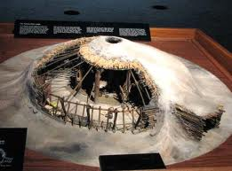
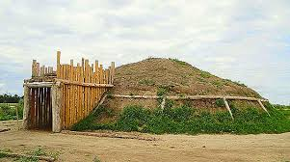
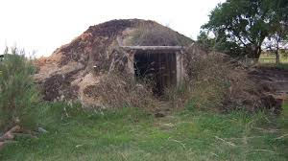
Earth-lodge villages
Pawnee lived in earth-lodged villages. An earth lodge is a semi-subterranean (partially underground)building covered partially or completely with earth, best known from the Native American cultures of the Great Plains and Eastern Woodlands. Most earth lodges are circular in construction with a dome-like roof, often with a central smoke hole at the apex (top) of the dome.

Slide 5
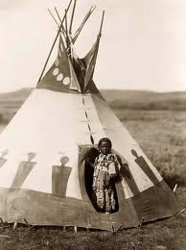
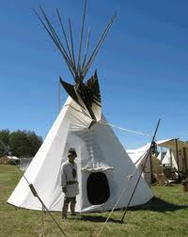
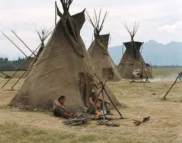
Tipis
A tipi (also tepee and teepee) is a conical tent, traditionally made of animal skins, and wooden poles. The tipi was used by the nomadic (moving from place to place)tribes of the Great Plains.
The tipi is durable (lasts for a long time), provides warmth and comfort in winter, is cool in the heat of summer, and is dry during heavy rains.Tipis could be disassembled and packed away quickly when a tribe decided to move and could be reconstructed quickly upon settling in a new area.[

Slide 6
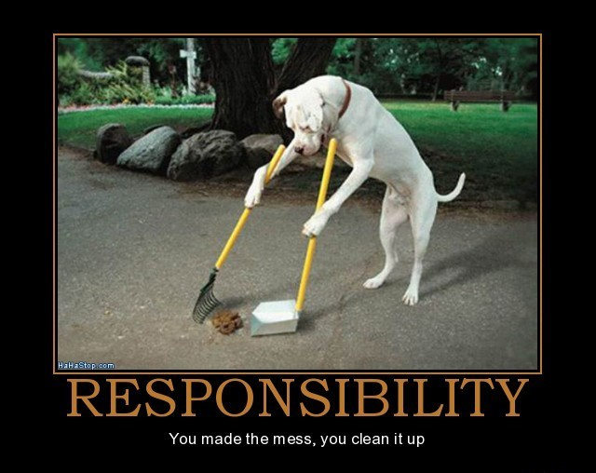
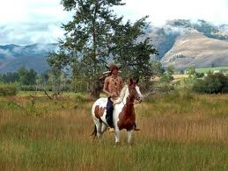
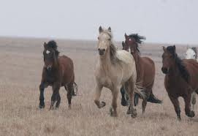
* responsibility
a duty or task that you are required or expected to do
It was the responsibility of the older boys, the young men, to look after the herds of horses.

Slide 7
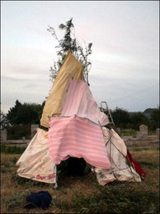
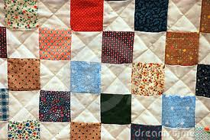
* patchwork
something that is made up of different pieces of scrap fabric
Their only shelter was made of sticks and a patchwork of pieces of old tipi covers that people had thrown away.

Slide 8
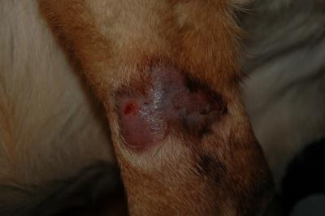
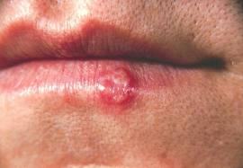
* sores
a sore or painful spot on the body
One day they came upon a sad and sickly worn-out horse. He was terribly thin with sores on his back.

Slide 9
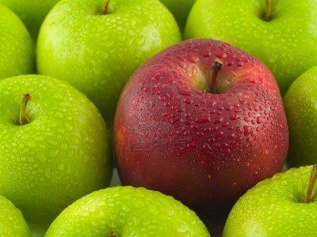
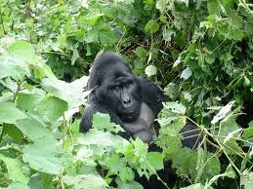
*midst
The middle area
One red apple in the midst of green ones Gorilla in the midst of jungle

Slide 10
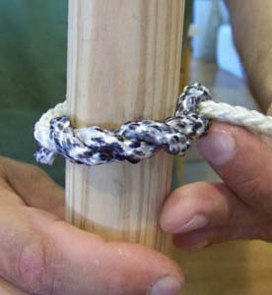
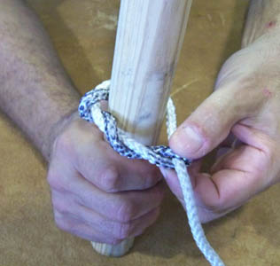
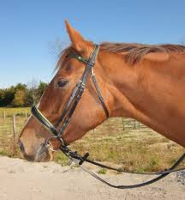
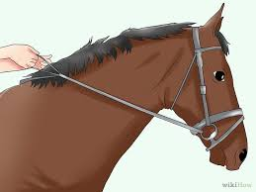
*loosened
to make (something) less tight or firm
Tight knot Loosen the knot means making it less tight
Which picture shows loosened reins?
Do you tighten or loosen reins when you
want to stop the horse?

Slide 11
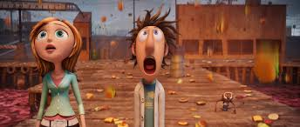
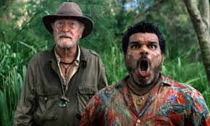
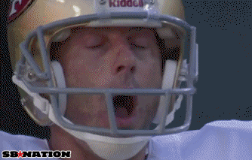
*amazement
a feeling of being very surprised or amazed
Men watched the boy with amazement

Slide 12
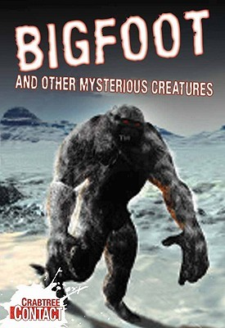
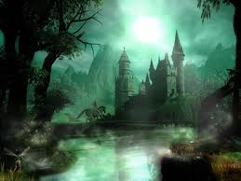
*mysterious
strange, unknown, or difficult to understand
What makes this place mysterious? What other mysterious creatures do you
know?

Slide 13
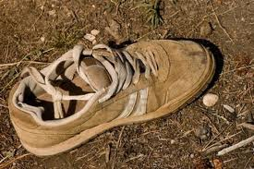
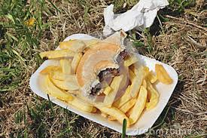
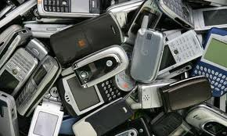
discarded
Thrown away, not needed anymore
Food Scraps

Slide 14
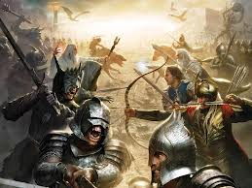
enemy
a group of people (such as a nation) against whom another group is fighting a war
enemy

Slide 15
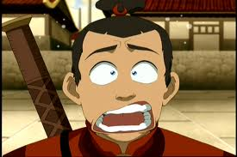
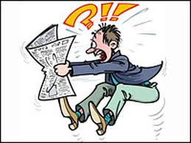
alarmed
Worried or frightened
The boy was alarmed to hear the horse speak.

Slide 16
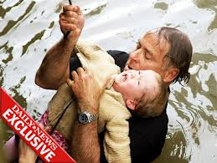
without hesitation
With no delay or doubt, to do something right away
Without hesitation, the man jumped in the cold water to save the little boy.

Slide 17
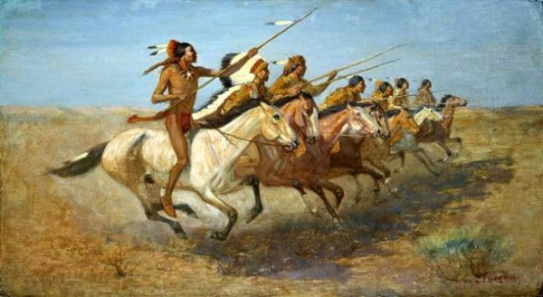
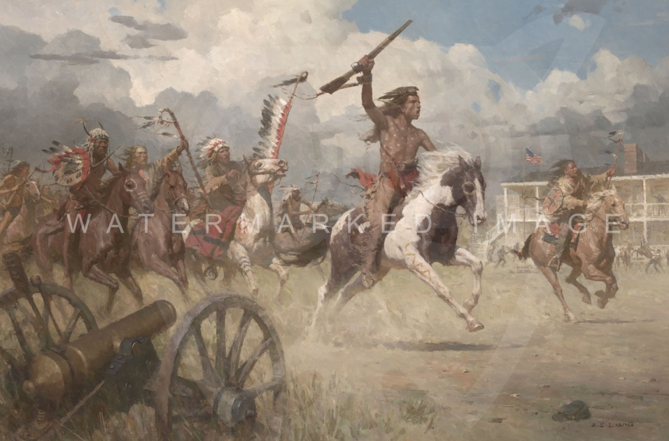
Charged
To rush forward
Four times the boy charged back and forth, and each time he hit one of the enemy.

Slide 18
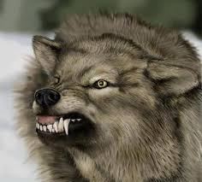
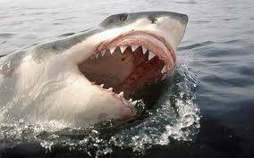
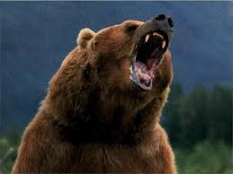
fearsome
Scary, frightening
What other creatures do you find fearsome?

Slide 19
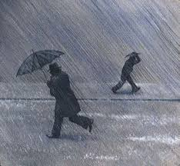
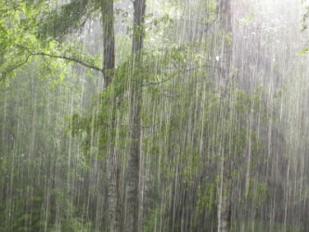
downpour
a sudden heavy rain

