Slide 1
Genre: Biography- a story about a life of a real person written by someone else
Snowflake Bentley

Slide 2
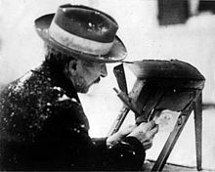
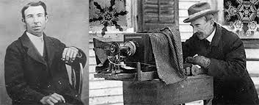
Wilson Alwyn "Snowflake" Bentley (February 9, 1865 – December 23, 1931), born in Jericho, Vermont, is one of the first known photographers of snowflakes. He perfected a process of catching flakes on black velvet in such a way that their images could be captured before they melted.

Slide 3
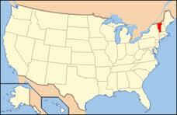
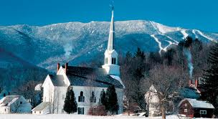
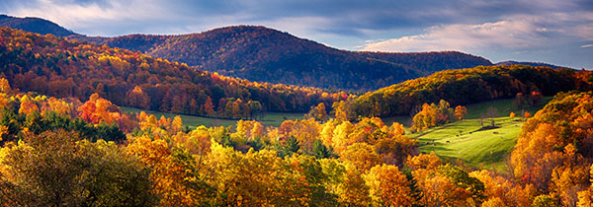
Vermont
Wilson Bentley was born February 9, 1865 on a farm in Jericho, Vermont

Slide 4
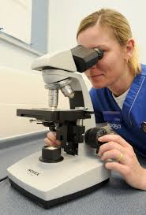
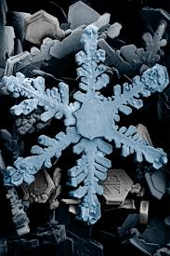
*microscope
a device used for producing a much larger view of very small objects so that they can be seen clearly
snowflake under microscope

Slide 5
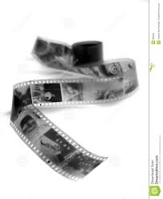
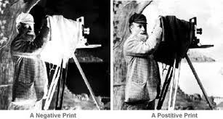
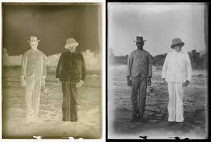
*negatives
A print on film that has the light and dark parts opposite to those of the original photographic subject

Slide 6
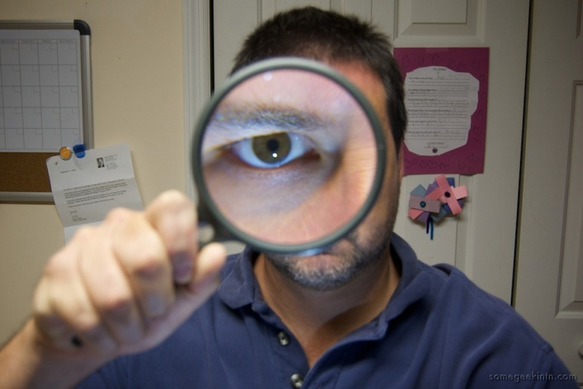
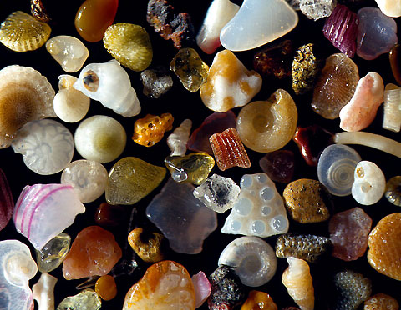
* magnify
To make something appear larger
A magnifying glass is used to magnify the object or image
Grains of sand magnified 250 times

Slide 7
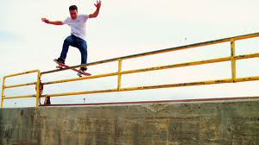
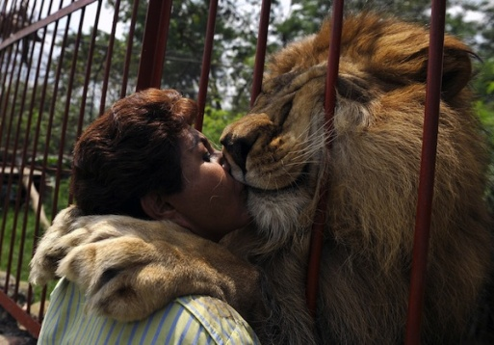
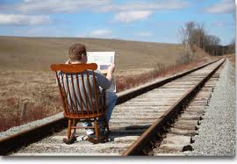
*foolishness
Foolish behavior, silliness
Are these examples of foolishness? Why do you think that?

Slide 8
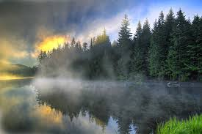
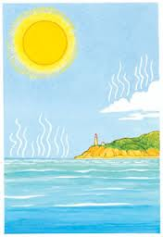
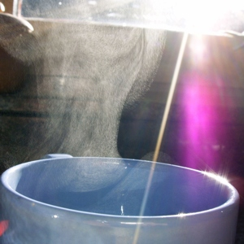
* evaporate
1) to change from a liquid into a gas
2) to go away suddenly : to disappear or vanish
Look at the pictures: Do you
know why water evaporates?

Slide 9
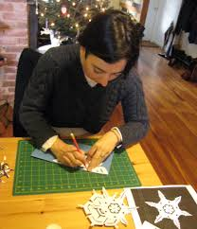
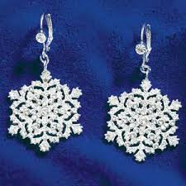
*inspire
to make (someone) want to do something : to give (someone) an idea about what to do or create
Artists and designers used Willie’s photographs to inspire their own work.

Slide 10
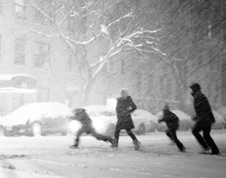
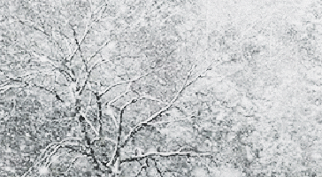
*blizzard
a severe snowstorm that goes on for a long time

Slide 11
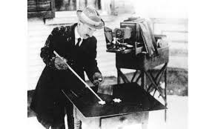
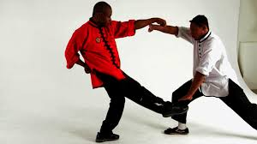
* technique
a way of doing something by using special knowledge or skill
For 50 years, a simple farmer, Wilson Bentley developed his technique of microphotography to reveal the world the mystery of a snowflake.
Kung Fu technique

Slide 12
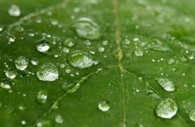
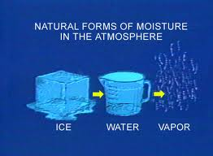
Moisture
a small amount of a liquid (such as water) that makes something wet or moist

Slide 13
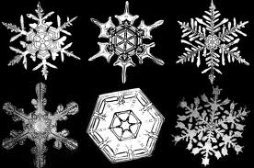
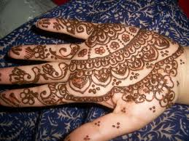
Intricate
Having many interconnected parts and elements, complex,
Each snowflake has an intricate pattern
Intricate henna design

Slide 14
Process of snowflake formation

Slide 15
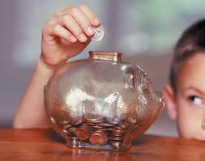
Savings
Money you have saved
When Willie was 17 his parents spent their savings and bought him the camera.

Slide 16
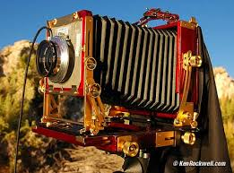
Camera lens
Willie used a very small camera lens opening which let only a little light reach the negative
Lens opening
Lens

Slide 17
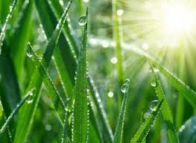
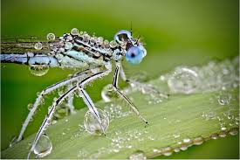
dew
drops of water that form outside at night on grass, trees, etc.
Willie would gently tie a grasshopper to a flower so in the morning he could photograph a dew-covered insect.

Slide 18
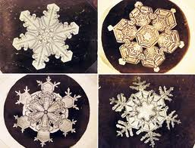
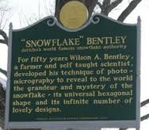
Watch a video about Snowflake Bentley
http://www.youtube.com/watch?v=ptLmA263hlk

