Slide 1
Stormy Weather
Unit 4.3

Slide 2
Nonfiction Article
A nonfiction article gives information about a topic.

Slide 3
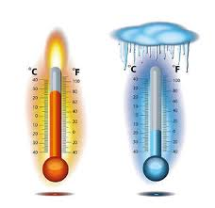
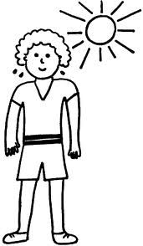
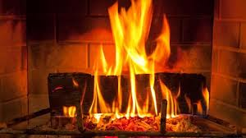
warm
It can hail when it is warm or cold.

Slide 4
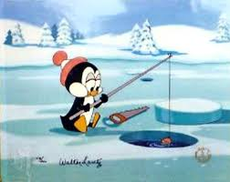
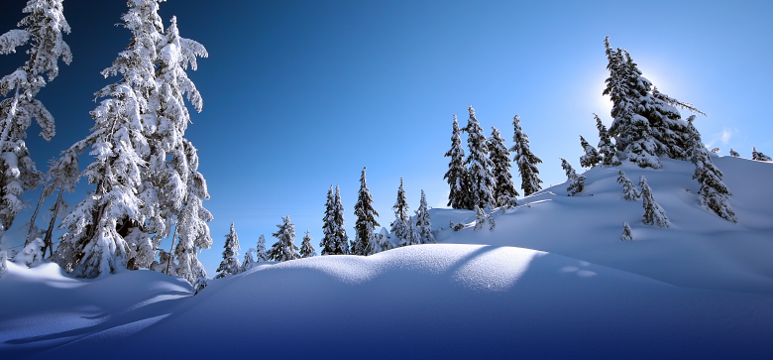
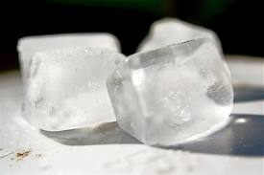
cold
It can hail when it is warm or cold.

Slide 5
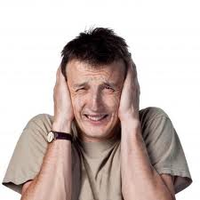
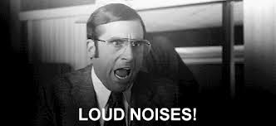
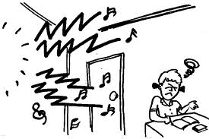
sound
After that comes a loud sound. That is thunder!

Slide 6
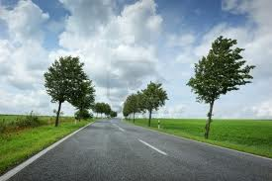
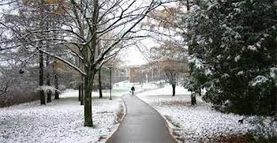
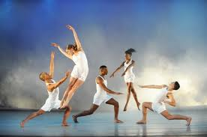
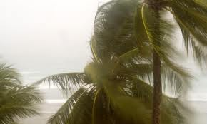
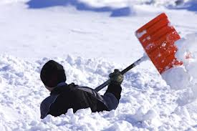
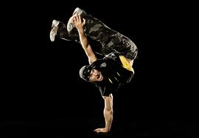
extreme
Some storms have extreme winds. Tornadoes are made of very fast winds that spin. Extreme wind: http://www.youtube.com/watch?v=IX95cTbKbmE
wind snow dance
extreme wind extreme snow extreme dance

Slide 7
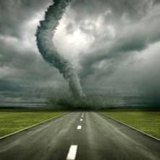
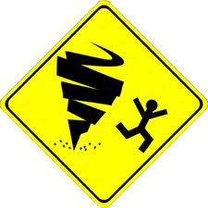
tornado
Tornadoes are made of very fast winds that spin. The winds can pick up trucks and homes!

Slide 8
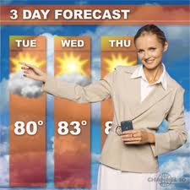
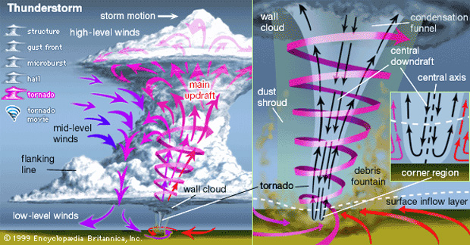
predict
Scientists have ways to predict when tornadoes will come.

Slide 9
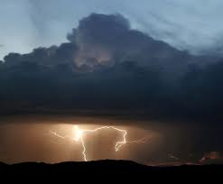
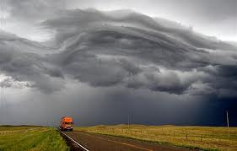
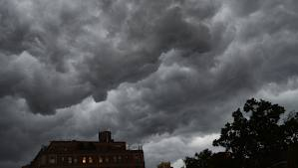
storm
On some days, the sky is gray. That could mean a storm is on its way.

Slide 10
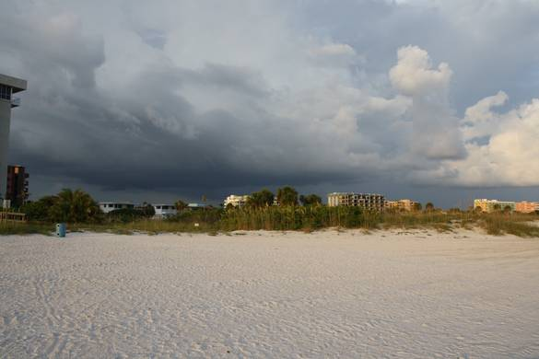
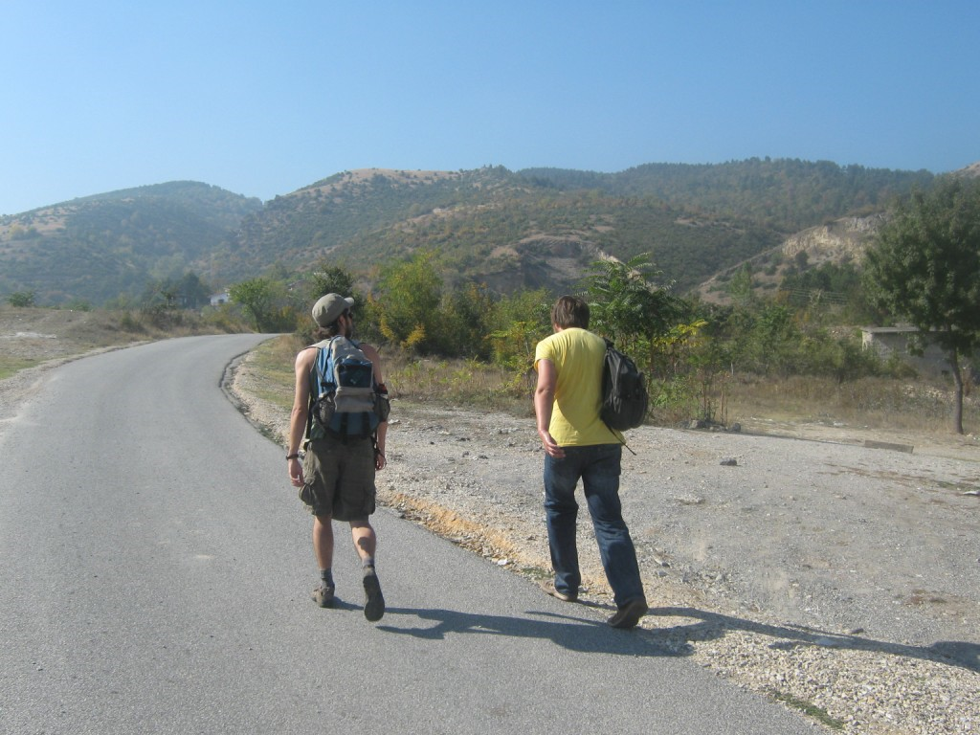
on the way
A storm might be on the way.
A storm is on the way!
They are on the way to the mountain.

Slide 11
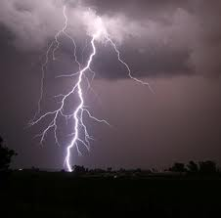
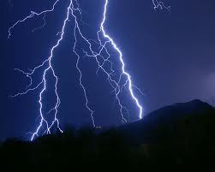
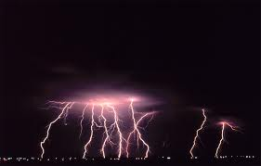
lightning
You may see great flashes of lightning.

Slide 12
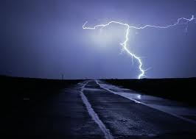
thunder
After the lightning comes a loud sound. That is thunder. Time to go inside!
Listen to rain and thunder:
http://www.youtube.com/watch?v=BISMT2WAHB0

Slide 13
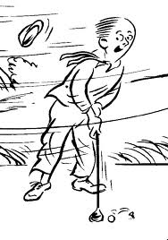
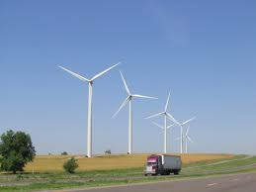
wind

Slide 14
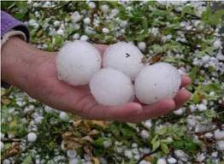
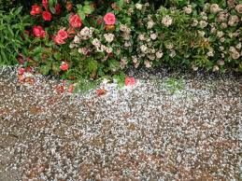
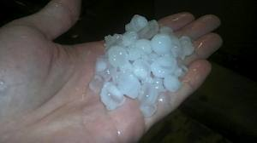
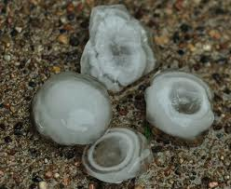
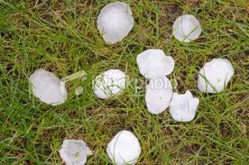
hail
Balls of ice may come down. This is called hail.
See a major hailstorm (1:30): http://www.youtube.com/watch?v=DuMX9AM9BrE

Slide 15
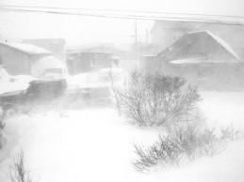
blizzard
It can snow so much you can’t see! This is called a blizzard.
News story about a blizzard: http://youtu.be/Do0nygwBBzE
Time lapse footage of a blizzard:
http://www.youtube.com/watch?v=fNiPUm6g_d4

Slide 16
Sight Words
their
Then people can get out of their way.
know
How many kinds of storms do you know about?
great
You may see great flashed of lightning.

