Slide 1
Dear Mrs. LaRue
4.4.1

Slide 2
obedience
Newspaper title: Local Dog Enters Obedience School

Slide 3
obedience school

Slide 4
at my wit’s end
“I was at my wit’s end!” said Mrs. LaRue.

Slide 5
mistreated
From Ike: I am being horribly mistreated.

Slide 6
warden
The way my warden barks orders is shocking.

Slide 7
ill
I hate to tell you this, but I am really ill.

Slide 8
risks
Is it really wise to take risks with one’s health?

Slide 9
appreciated
How sad it is not to be appreciated!

Slide 10
desperate
Such is the life of a desperate outlaw.

Slide 11
escape
Headline: LaRue Escapes Doggy Detention

Slide 12
bluffing
“To be honest, I thought he was bluffing when he told me that he was planning to escape,” said Mrs. LaRue.

Slide 13
endured
You would scarcely believe the misery I’ve endured.

Slide 14
misunderstood
Your misunderstood friend,
Ike

Slide 15
neglected
Apparently she neglected to look both ways before stepping into traffic.

Slide 16
Discussion before reading:
Can there be two sides to a story?
Suggested readings:
What are the two sides of this story?

Slide 17
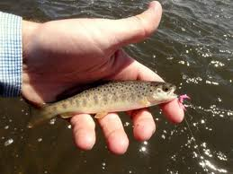
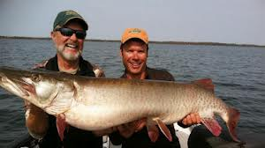
Discussion before reading
Have you ever told a story one way, but someone else told it a different way?
Sometimes when we tell a story, we might exaggerate.
How it happened: How I remember:

Slide 18
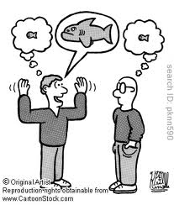
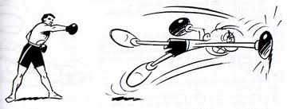
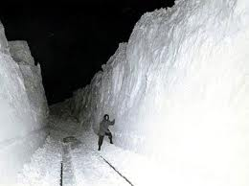
Exaggerating
When we exaggerate, we tell a story as BIGGER or BETTER than it really was.

Slide 19
Discussion after reading:
Can there be two sides to a story?
Does Ike believe that he is suffering more than he really is?
Which

