Slide 1
The Blind Hunter
4.4.2

Slide 2
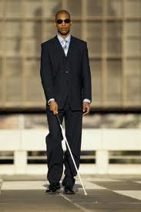
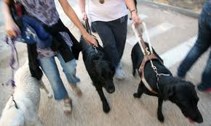
Questions for Discussion
If you were blind, how would you sense the world?
What does it mean to “see with your ears”?

Slide 3
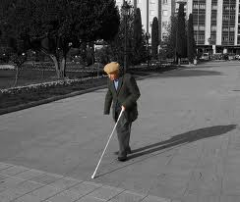
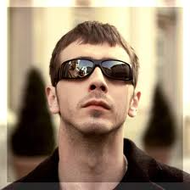
blind
Title: the blind hunter
The young man laughed and said, “I will not hunt with a man that cannot see!”

Slide 4
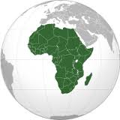
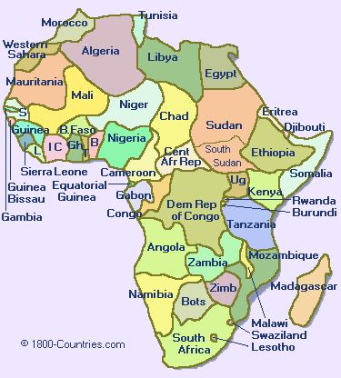
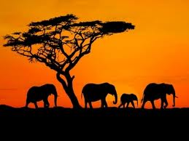
Africa
In Africa a man named Chirobo lived all by himself in a village of round huts.

Slide 5
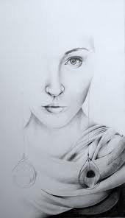
fade
“Before my eyes began to fade, I, too was a great hunter,” said Chirobo.
fading colors
Which picture is faded?

Slide 6
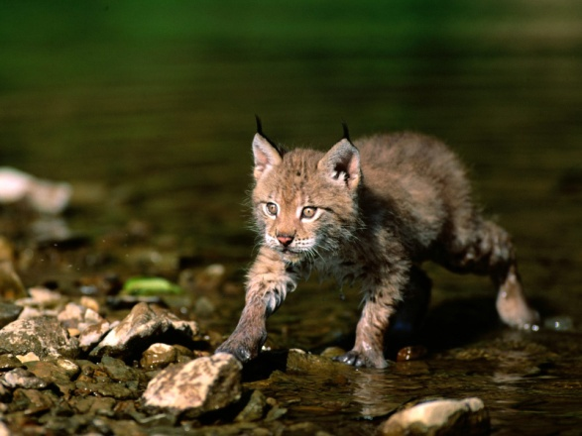
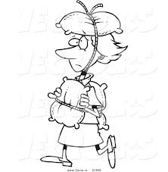
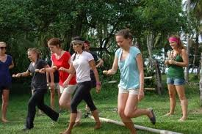
cautiously
Cautiously, he pushed aside the dense bushes and looked around.
This bobcat is walking cautiously so he doesn’t get his fur wet.
Carry an egg on a spoon cautiously in this race!

Slide 7
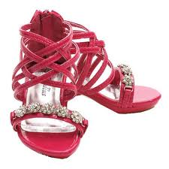
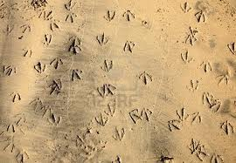
criscrossed
Countless tracks of birds crisscrossed the soft, muddy bank.

Slide 8
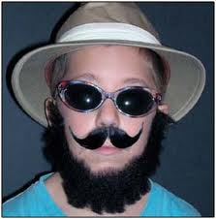
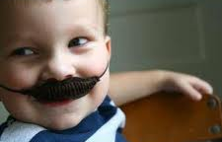
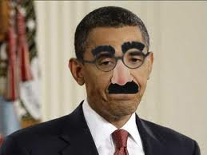
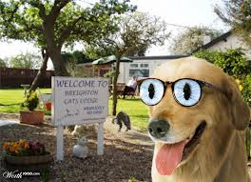
disguised
The young hunter disguised both traps.
A disguise is something you wear to make you look different.

Slide 9
disguise
In a very popular YouTube video, a guy disguises himself as the seat in his car to make it look like there is no driver!

Slide 10
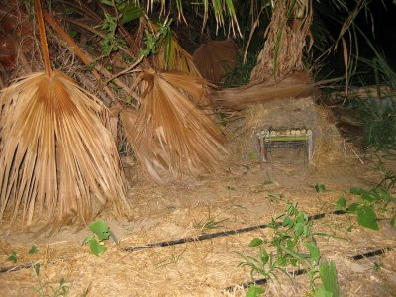
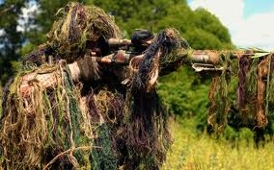
disguised
The young hunter disguised both traps.
You can also disguise an object to make it look different.

Slide 11
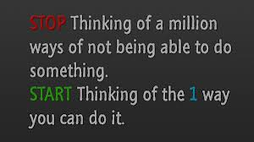
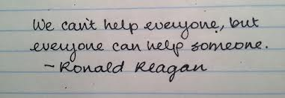
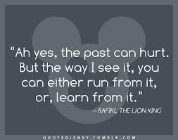
wisdom
Muteye grew to admire the blind man’s wisdom.

Slide 12
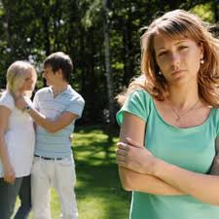
jealousy
As he kneeled down to look inside, his heart filled with jealousy.
What are these people jealous of?

Slide 13
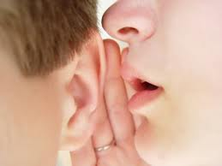
faint
In a faint voice, Muteye asked, “How does a man who has been unkind earn the forgiveness of his friend?”
Faint drawing: hard to see
Faint voice: hard to hear

Slide 14
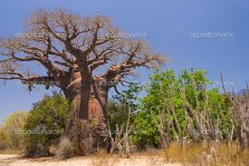
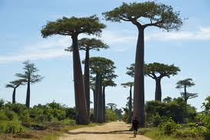
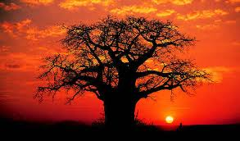
baobab
In silence they walked and walked, until they came to rest under a baobab tree.

Slide 15
bountiful
“Your crops are as beautiful as they are bountiful!” he exclaimed.
Bountiful is a way of saying there were plenty of crops.

Slide 16
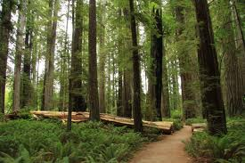
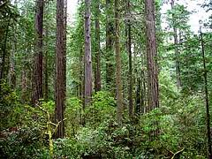
groves
They walked along a narrow path that wound through groves of crooked trees.

Slide 17
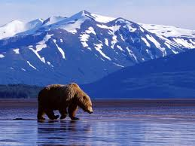
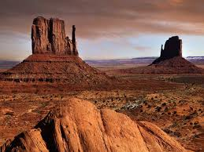
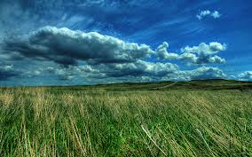
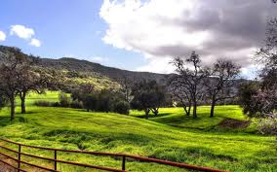
landscape
Cautiously, he pushed aside the dense bushes and scanned the surrounding landscape.

Slide 18
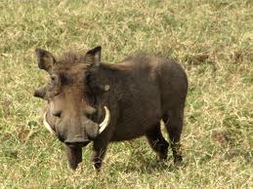
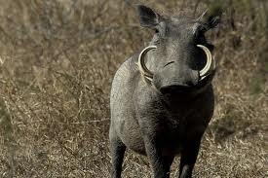
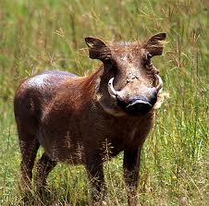
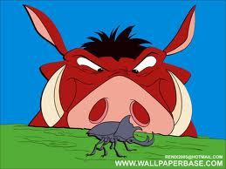
warthogs
“We must be careful,” he warned. “There are warthogs around.”

