Slide 1
The Power of Oil
4.4.3

Slide 2
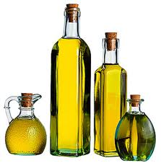
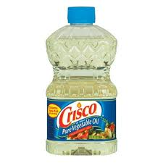
oil
There are many kinds of oil!
You can eat olive oil, vegetable oil, and other kinds of oil made from food.

Slide 3
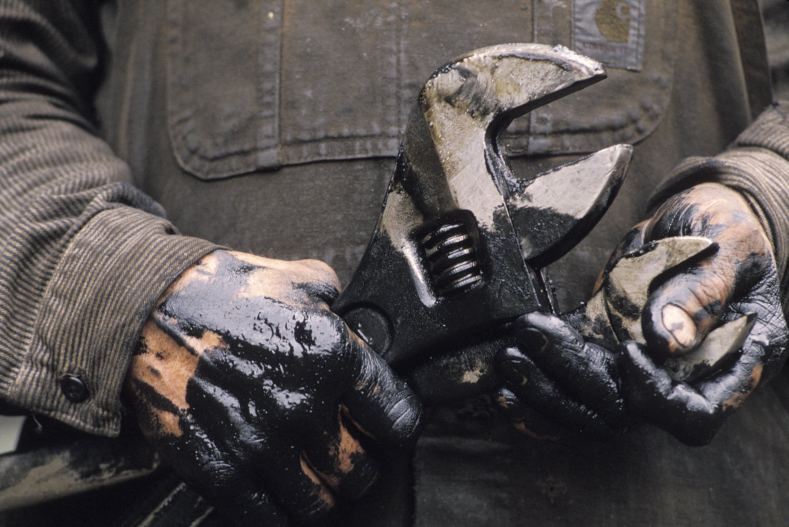
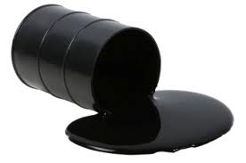
oil
Petroleum oil, which is the kind of oil that is in our reading story, cannot be eaten. Yuck!

Slide 4
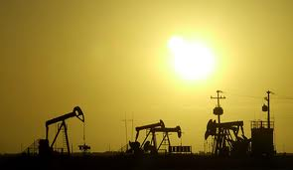
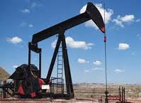
Where does oil come from?
Oil comes out of the ground. There are a lot of places in Oklahoma where oil is found. Have you ever seen an oil rig?

Slide 5
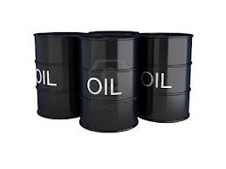
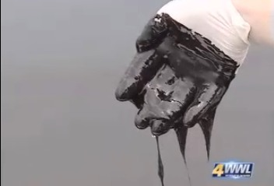
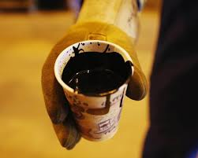
oil
Oil is a very important fuel because it helps power cars, trucks, planes, and electrical plants.

Slide 6
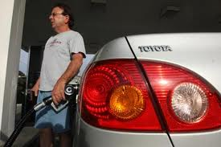
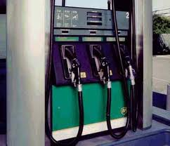
Oil is important and helpful.
We use oil to make gasoline for cars and trucks.

Slide 7
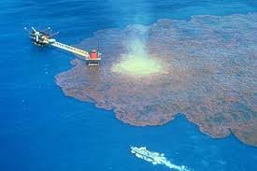
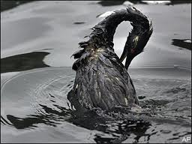
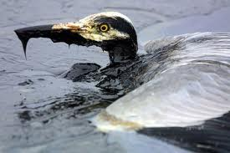
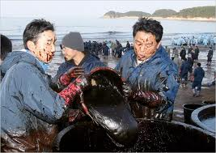
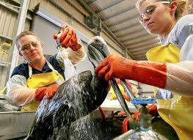
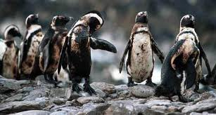
But, if we are not careful, petroleum oil can be harmful.
Spilling oil in the ocean can hurt animals.
cleaning up an oil spill affected animals
The animals will be okay if people help them clean off the oil, but they cannot do it themselves.

Slide 8
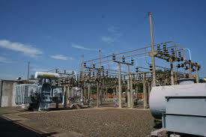
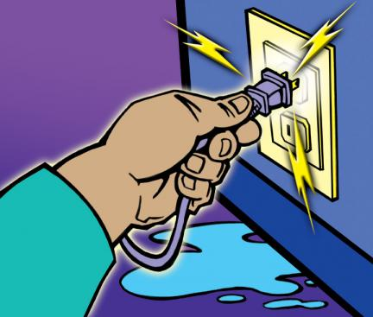
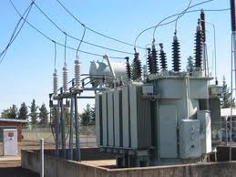
electrical
Oil is a very important fuel because it helps power cars, trucks, planes, and electrical plants.
electricity electrical plant
An electrical plant is where fuel becomes electricity.

Slide 9
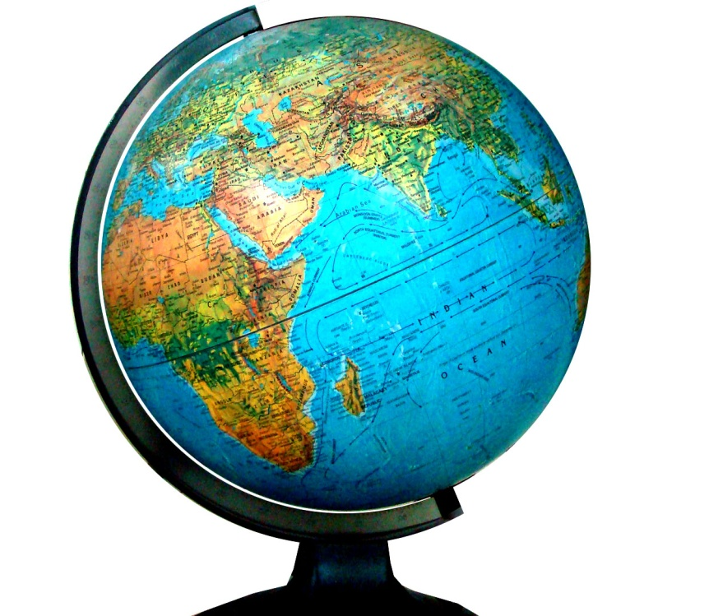
globe
The United States uses more oil than any other country on the globe.
A globe is a round map of the world.

Slide 10
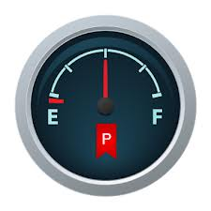
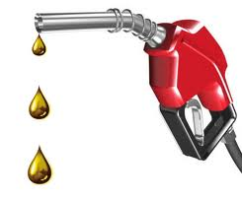
fuels
Decayed animals turned into oil, which we use to make fuels.

Slide 11
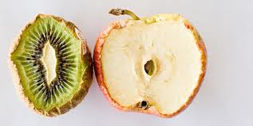
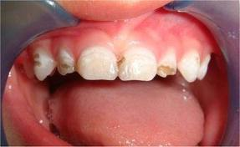
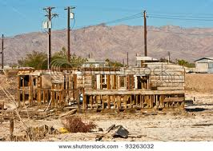
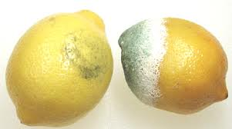
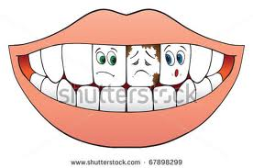
decayed
Over the ages, plant and animal remains decayed.
decaying buildings decaying fruit Brush your teeth or
they will decay!
Decay: to break down over time

