Slide 1
Adelina’s Whales
4.4.4

Slide 2
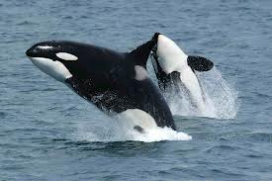
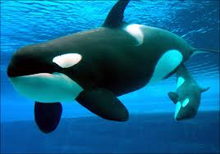
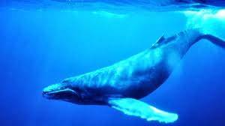
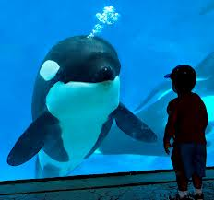
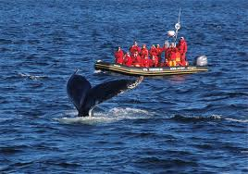
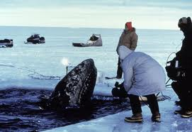
whales
When a whale surfaced, I couldn’t believe how big it was!
There are different kinds of whales.
Killer whale {Orca} (not really dangerous to people)
humpback whale

Slide 3
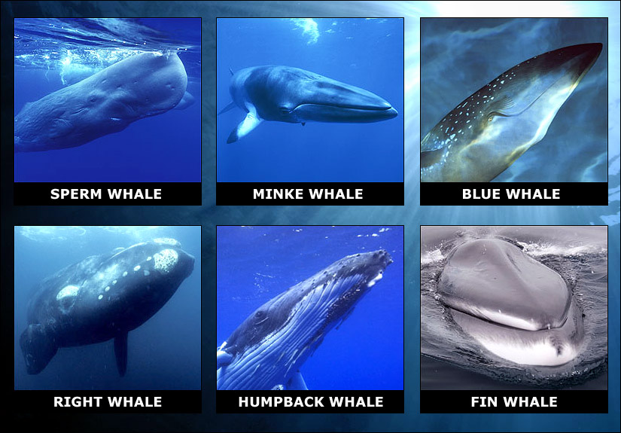

Slide 4
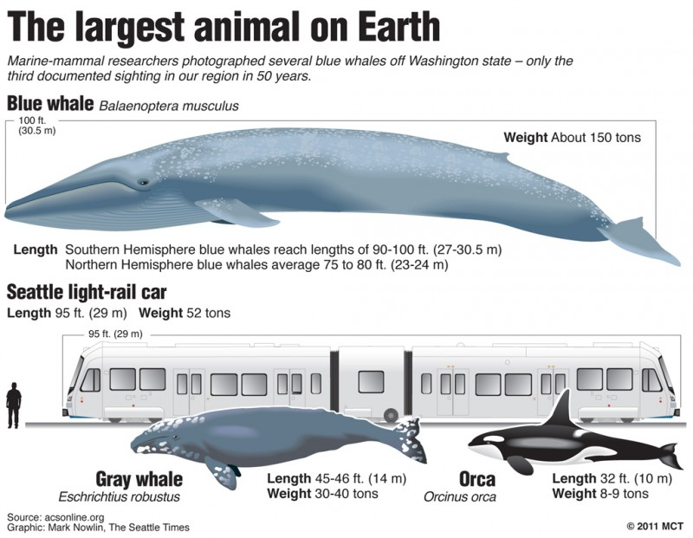

Slide 5
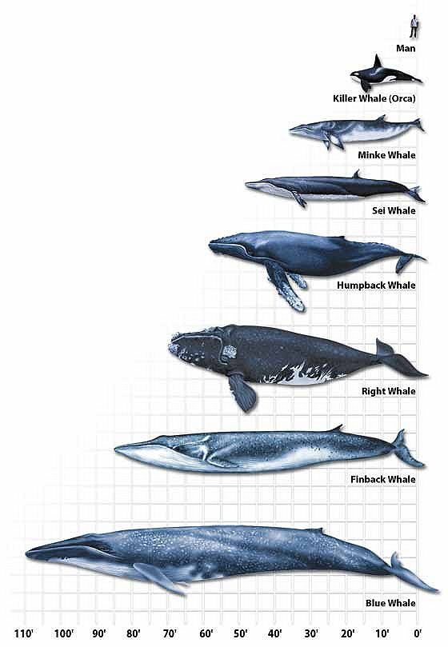

Slide 6
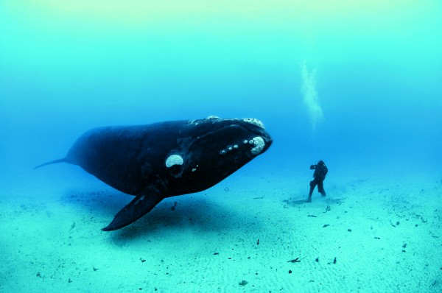

Slide 7
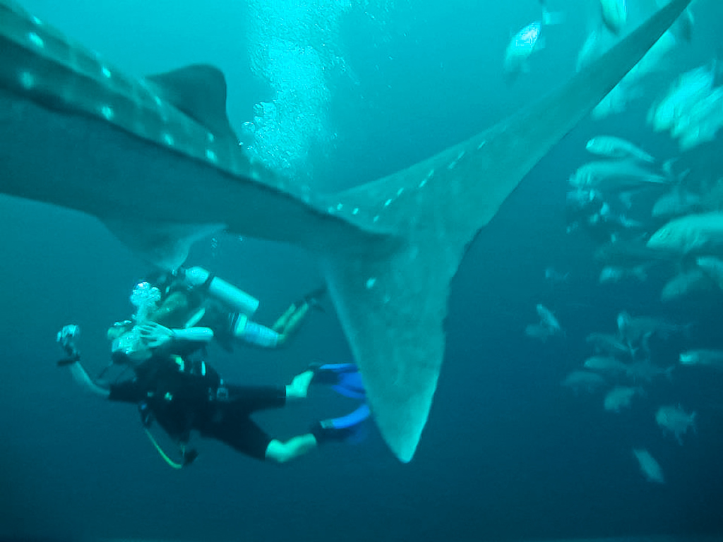

Slide 8
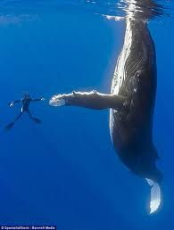
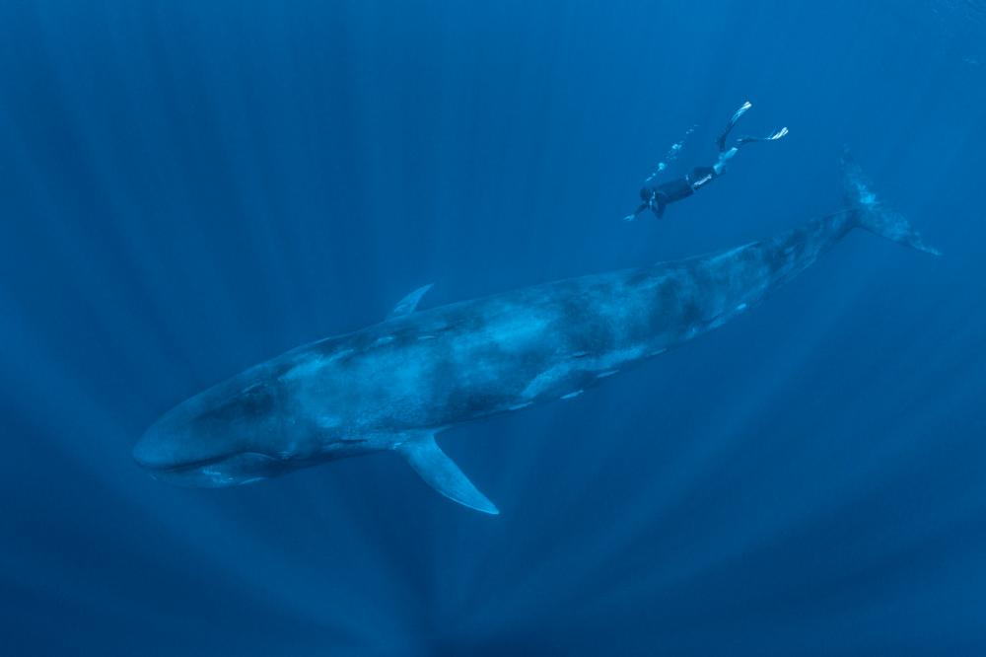

Slide 9
All about whales
Have you ever seen a whale?
You might have seen a whale in a movie, in an aquarium, or even in a book!

Slide 10
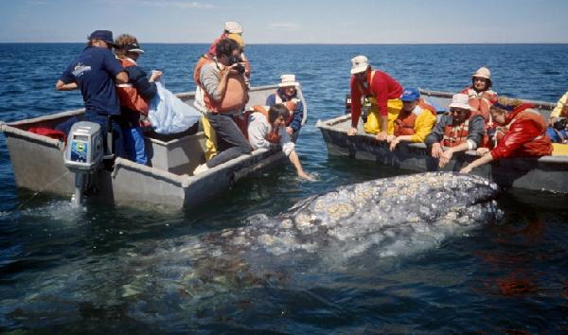
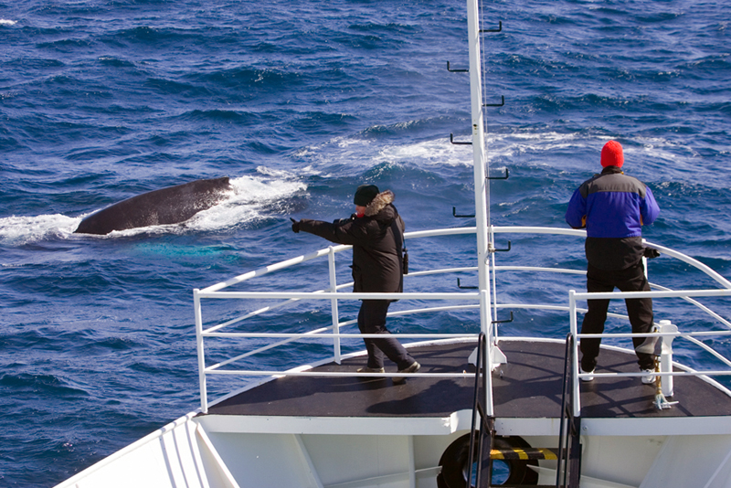
Whale sightings
Our story is about a special place where you can go to see whales in the ocean.
Would you want to see whales?
What other animal would you want to see in its natural home?

Slide 11
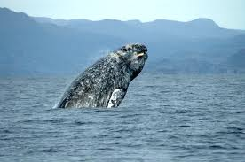
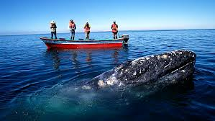
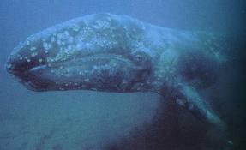
gray whales
Every afternoon in late January, Adelina walks to the beach to see if the gray whales have returned.

Slide 12
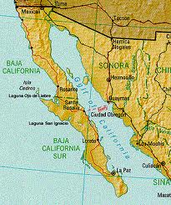
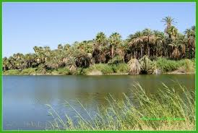
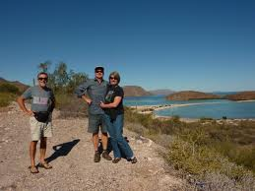
Laguna San Ignacio
La Laguna is the name of a quiet, dusty fishing village in Laguna San Ignacio, Baja California.
Baja California is a state in Mexico.
Laguna San Ignacio

Slide 13
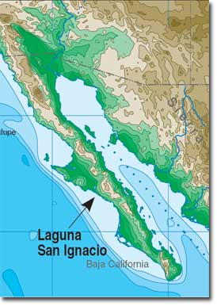
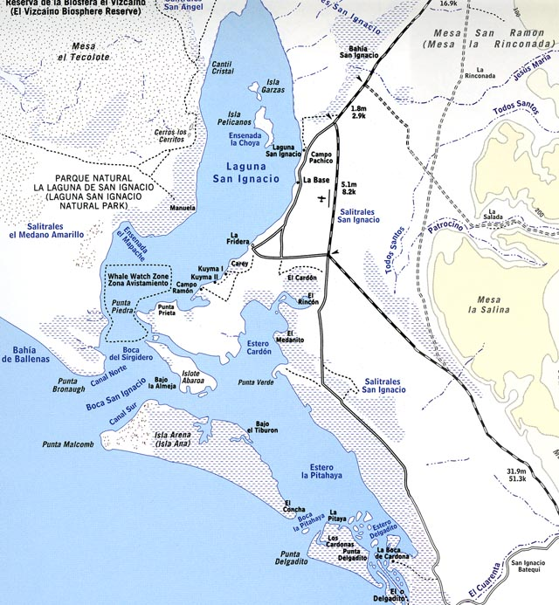
Laguna San Ignacio
Only in Laguna San Ignacio do whales ever stop to say hello to humans.
Mexico - The state of Baja California Laguna San Ignacio

Slide 14
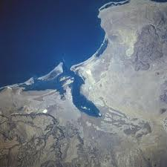
Laguna San Ignacio (from above)

Slide 15
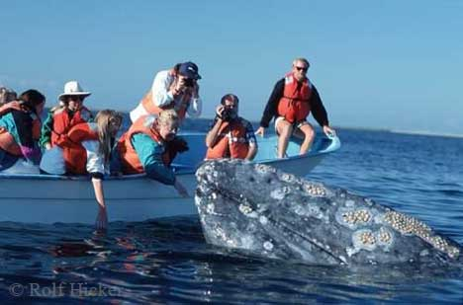
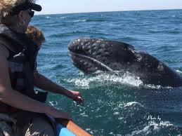
gray whales
Amazing video of a mother gray whale and her calf (baby) in Laguna San Ignacio {2:27}:
http://www.youtube.com/watch?v=Tu3KC4r_hcI

Slide 16
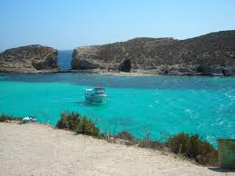
lagoon
The waters of the protected lagoon are warm and shallow.
A lagoon is a shallow body of water separated from a larger body of water by barrier islands or reefs
Spanish: laguna

Slide 17
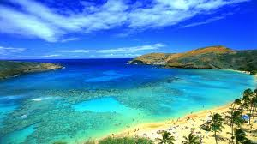
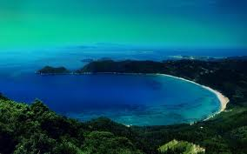
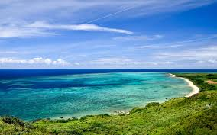
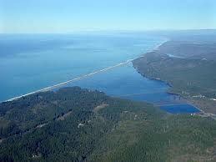
lagoon

Slide 18
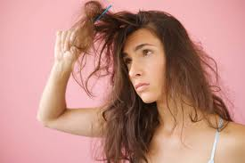
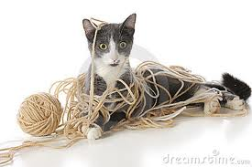
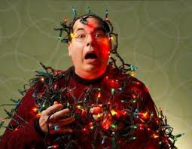
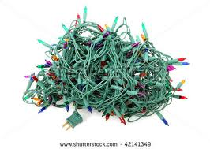
tangles
The wind blows her long, dark hair into tangles.
tangled hair This kitty is tangled with his yarn!
Be careful! The lights might tangle up!

Slide 19
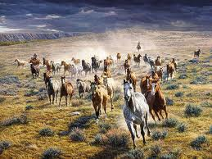
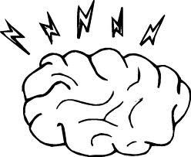
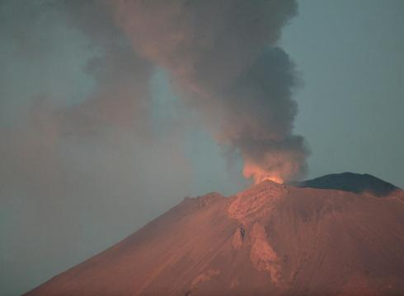
rumbling
One night Adelina was awakened by a loud, low rumbling noise.
Click for sound
The rumble of thunder

Slide 20
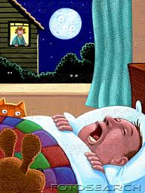
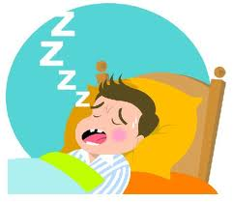
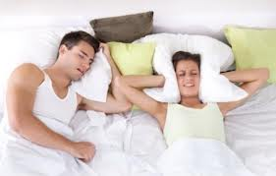
snoring
She could hear the sounds of the whales breathing and snoring outside her window.
See a baby scared by her dad’s snoring: http://www.youtube.com/watch?v=5bBmIhOxxmk

Slide 21
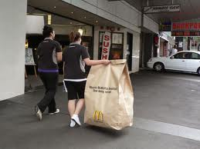
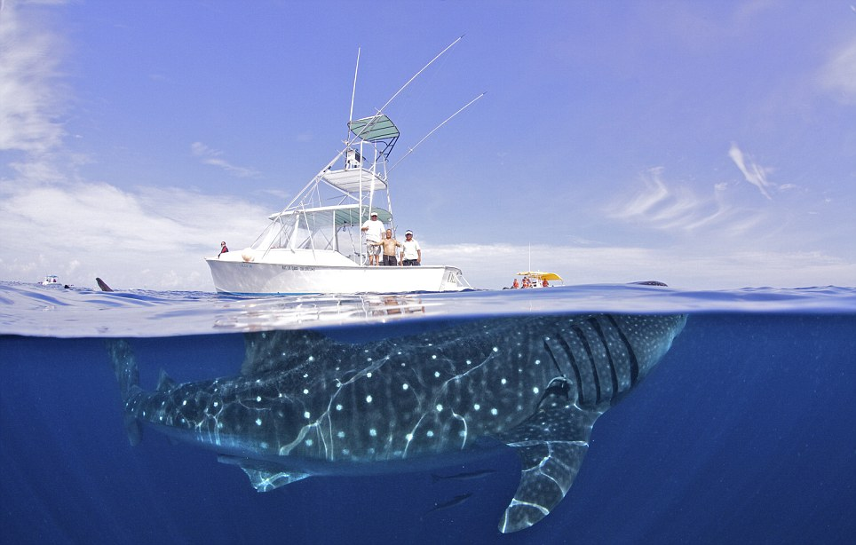
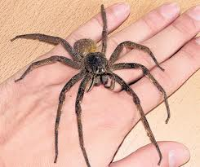
massive
The whales raised their massive heads up out of the water.
Massive means huge.

Slide 22
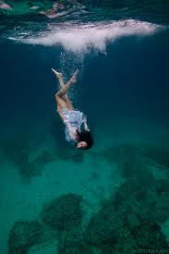
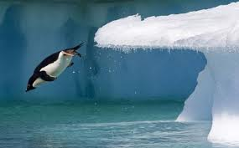
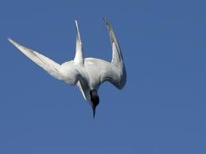
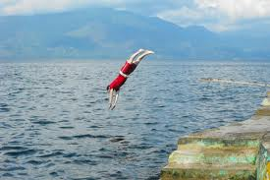
dove
The whale dove below them and surfaced again on the opposite side of the boat.

Slide 23
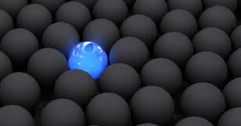
unique
People heard about the unique encounter between the whale and the fishing boat.

Slide 24
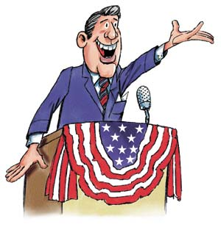
politicians
Some of Adelina’s friends are politicians.

