Slide 1
At Home in the Coral Reef
4.4.5

Slide 2
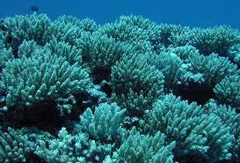
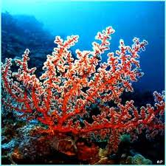
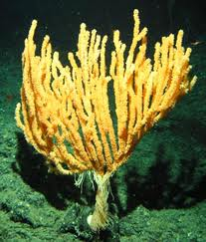
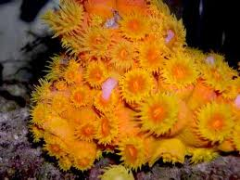
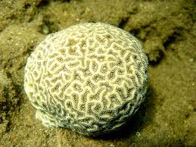
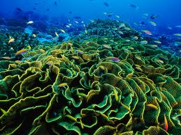
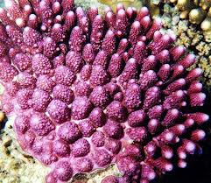
coral
Down in the beautiful tropical sea lives a coral reef.
coral (noun)
A rocklike deposit consisting of the skeletons left by tiny sea animals. Coral deposits often build up to form reefs or islands in warm seas.

Slide 3
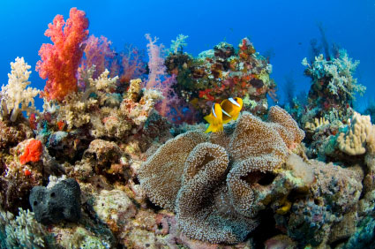
reef
The coral reef is a wonderful home for hundreds of kinds of fish.
coral reef (noun)
An accumulation (gathering) of many kinds of coral in a warm ocean

Slide 4
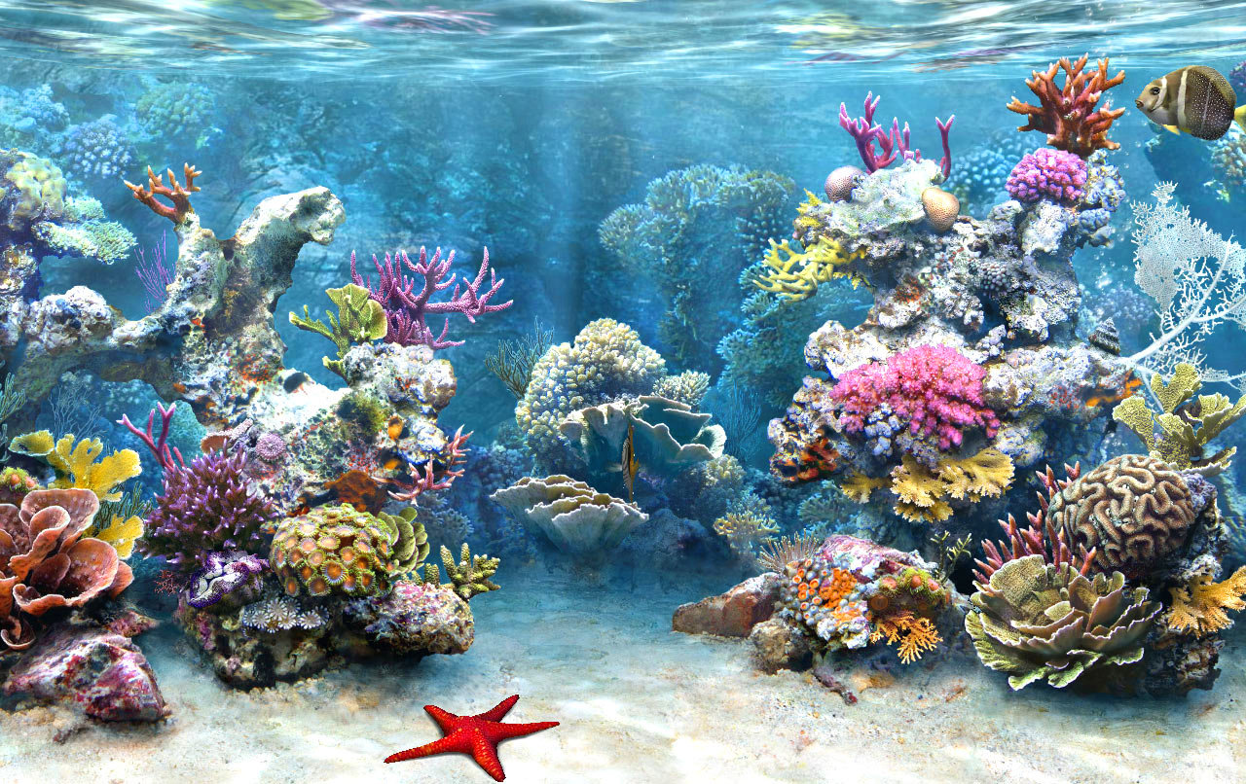
Coral Reefs

Slide 5
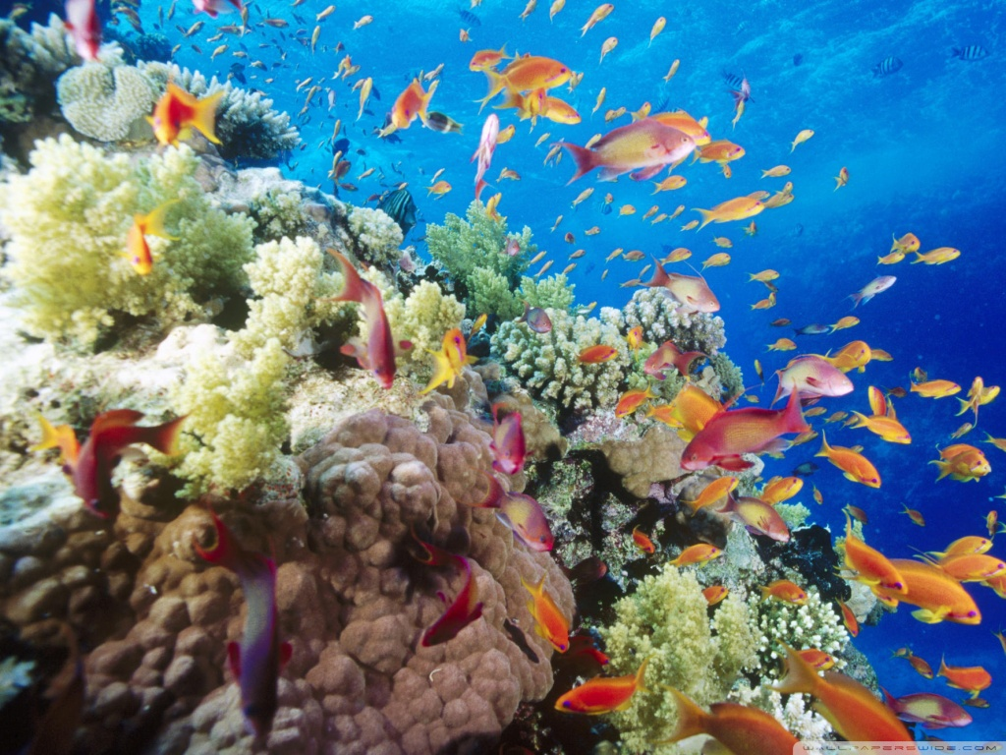
Coral Reefs

Slide 6
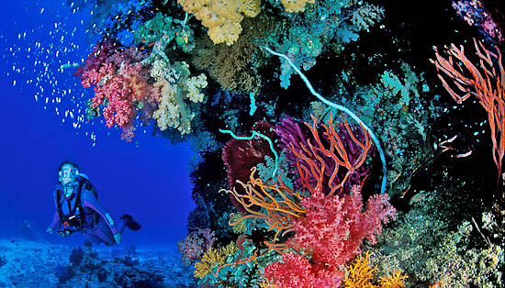
Coral Reefs

Slide 7
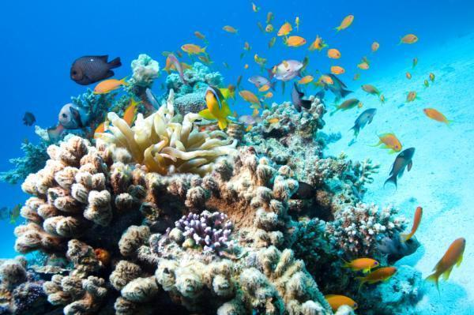
Coral Reefs

Slide 8
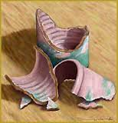
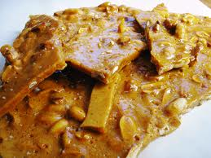
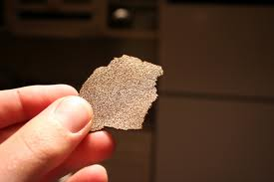
brittle
Brittle stars flash to scare away lobsters and crabs.
Peanut brittle is a kind of candy that is so hard that you have to break it apart before eating it.
brittle (adjective)
hard and rigid but not flexible; easy to break or damage

Slide 9
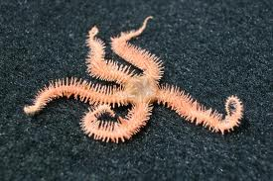
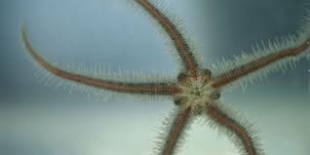
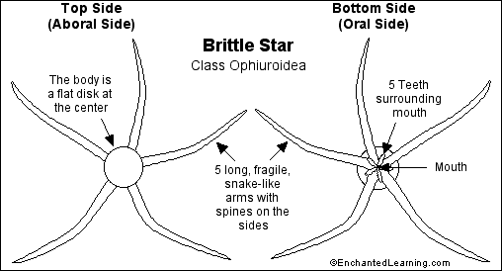
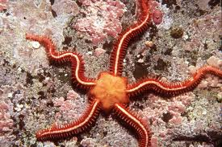
brittle star
Brittle stars flash to scare away lobsters and crabs.
brittle star (noun)
a spiny, hard-skinned, long-armed animal that lives on the rocky sea floor, from shallow waters to great depths. Brittle stars are NOT fish, but are related to sea stars.

Slide 10
eventually
Eventually, the bits formed so many grains of sand that they covered the bottom of the lagoon and washed up on shore to over the beach.
Eventually, the dog’s owners will come home so they can go for a walk.
eventually (adverb)
finally; ultimately; at some later time

Slide 11
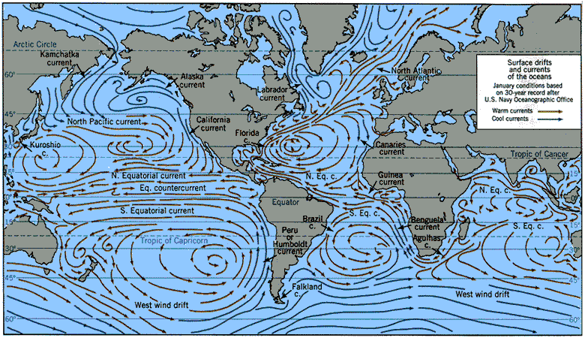
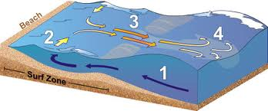
current
The planula catches a current to deeper water.
current (noun)
the movement of water in an ocean, river or stream

Slide 12
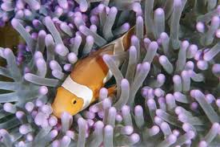
partnership
This partnership helps the coral grow big enough to form reefs.
partnership (noun)
two people or animals working together for the same reason

Slide 13
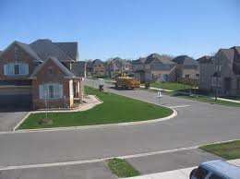
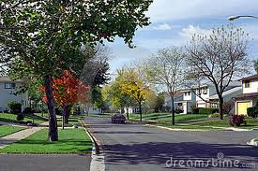
suburbs
We all use water, on our farms, in our suburbs, and in our cities.
Moore and Yukon are suburbs of Oklahoma City.
suburb (noun)
A neighborhood or area outside of a city or town

Slide 14
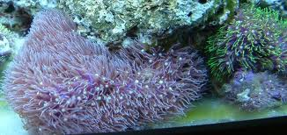
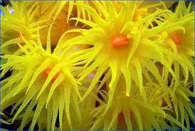
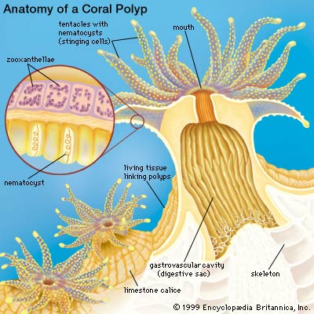
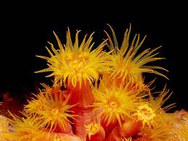
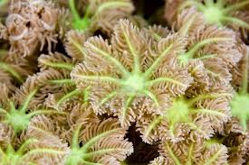
coral polyp
Each tiny coral polyp catches food with its little arms, called tentacles.
coral polyp (noun)
small marine (water) animals that usually live in large colonies

Slide 15
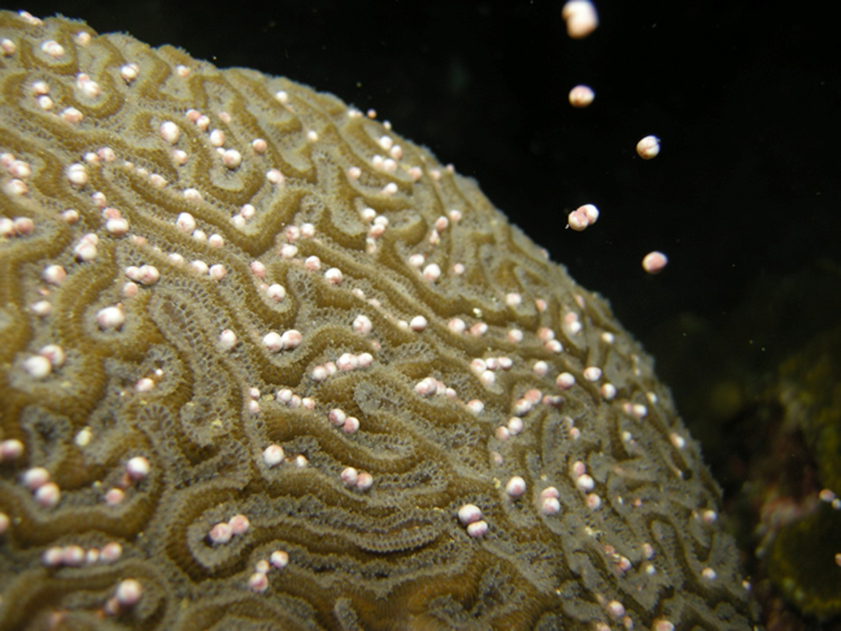
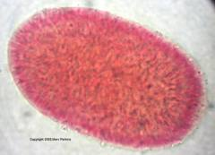
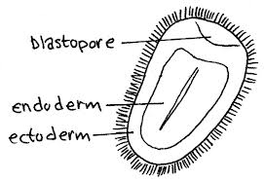
planula
The planula is completely covered by little hairs.
planula (noun)
small larva released by coral in order to reproduce

Slide 16
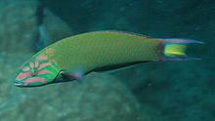
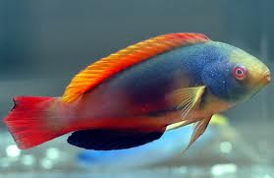
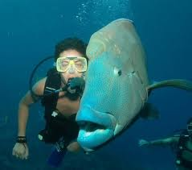
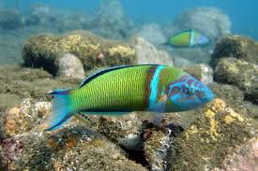
wrasse
Watch out for those hungry wrasses!
Wrasse (noun)
An ocean-dwelling fish that is usually colorful; they can be as small as 8 inches long or as large as 8 feet!

Slide 17
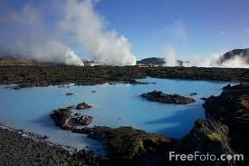
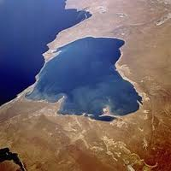
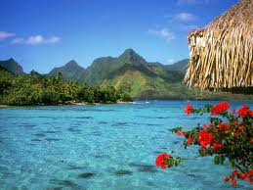
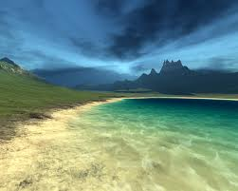
lagoon
The water in the lagoon is calm.
lagoon (noun)
an area of shallow water separated from the sea by low sandy dunes

