Slide 1
Meet Ben Franklin
Unit 4.4

Slide 2
Biography
A biography is the true story of a person’s life.

Slide 3
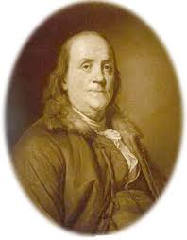
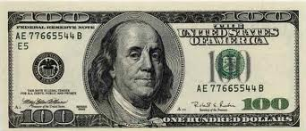
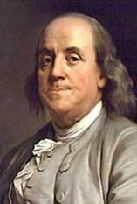
Benjamin Franklin
One of the founding fathers of the United States (but never president)
Inventions: bifocal glasses, lightning rod
Developed what became the post office system and the idea of “paying it forward”

Slide 4
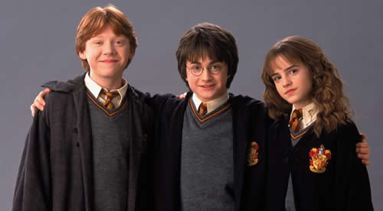
friends
“Ben! Ben!” his friends called.

Slide 5
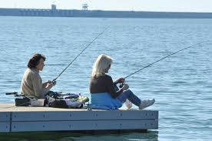
dock
Ben was sitting on the dock.

Slide 6
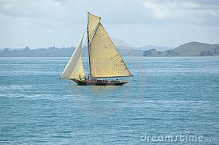
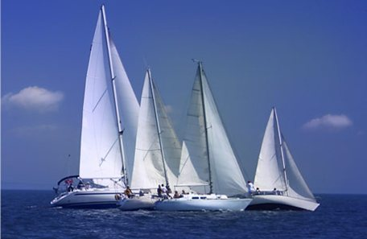
sails
Ben was looking at the big ships. He liked the way the wind filled the sails.

Slide 7
curious
Ben was a curious boy. He liked to dream and he liked to make things.

Slide 8
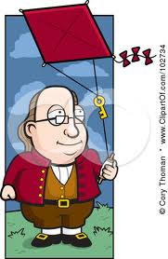
kite
One day, Ben made a red kite.

Slide 9
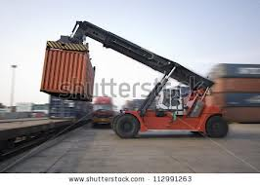
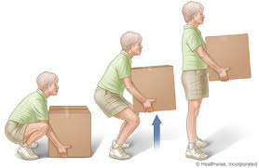
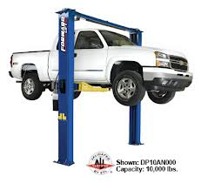
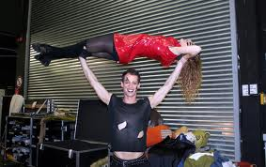
lift
The wind lifted the kite.

Slide 10
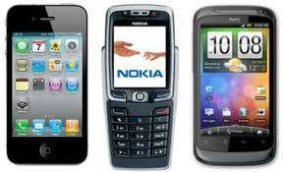
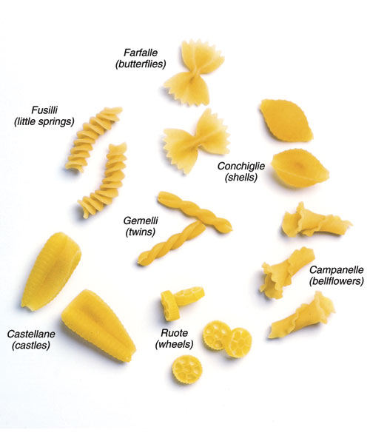
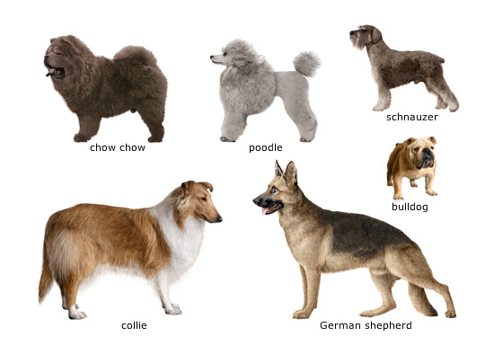
kind
He made a new kind of stove.
There are many different kinds of
dogs, pasta and cell phones.

Slide 11
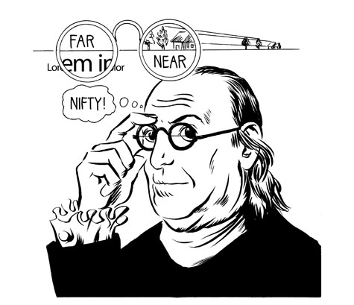
glasses (bifocals)
Ben made a new kind of glasses. They helped people see up close and far away.

Slide 12
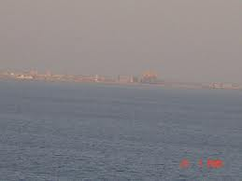
far
Ben made a new kind of glasses. They helped people see up close and far away.

Slide 13
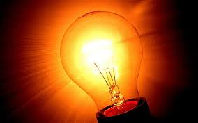
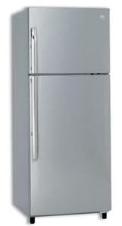
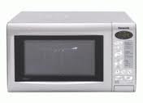
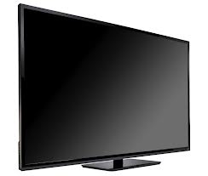
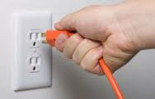
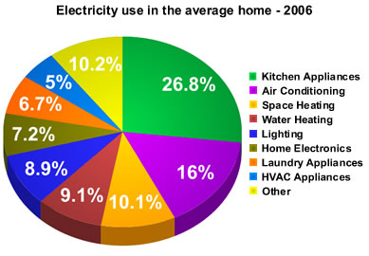
electricity
When Ben lived, people did not know much about electricity. Ben was curious about it.

Slide 14
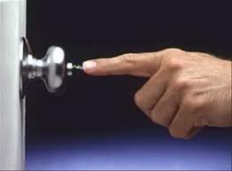
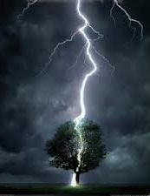
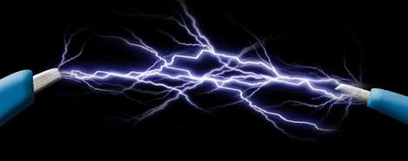
sparks
Ben knew electricity could make sparks.

Slide 15
idea
Ben had an idea.

Slide 16
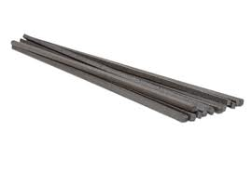
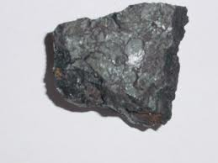
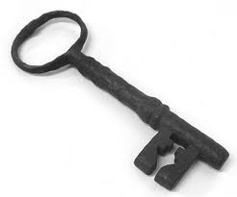
iron
Ben put an iron key on the kite string.
He put an iron rod on top of his house.
iron rods iron ore iron key

Slide 17
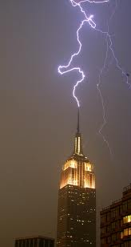
lightning rod

Slide 18
Sight Words
by
Time went by. Ben grew up.
knew
He knew that electricity could make sparks.

