Slide 1
Ranita, the Frog Princess
4.5.2

Slide 2
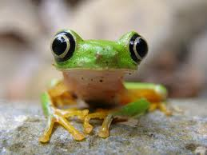
Ranita
From the Spanish word rana, or frog

Slide 3
cranky
Vieja Sabia is a wise but cranky old woman.
Vieja- old
Sabia- wise woman

Slide 4
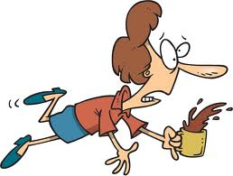
bumbling
Pepe is my bumbling servant.
See a clumsy, bumbling man in this commercial (:30)- http://www.youtube.com/watch?v=SoUmL3vzFjo
Here is a bumbling reporter that should be more careful: http://www.youtube.com/watch?v=Py805hYfopw

Slide 5
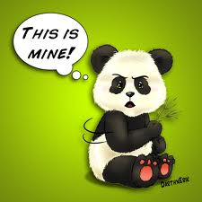
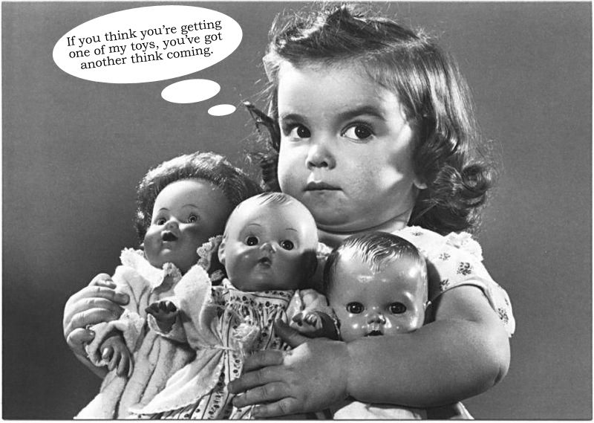
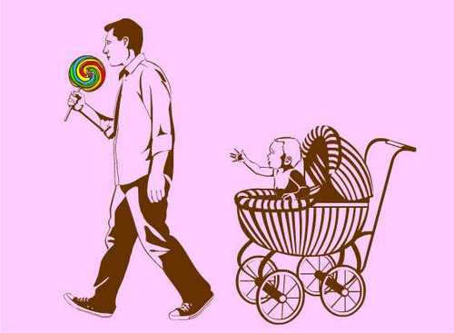
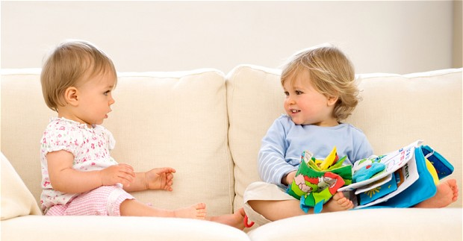
selfish
I was a selfish child then.

Slide 6
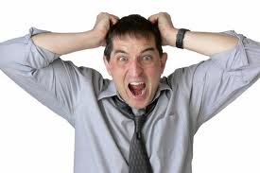
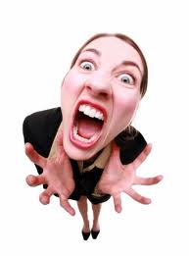
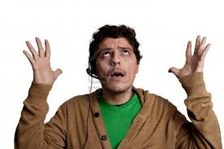
exasperated
The Viceroy was exasperated.

Slide 7
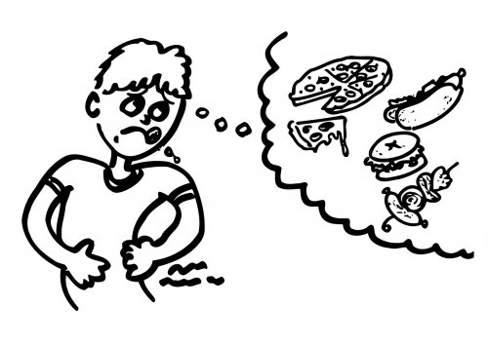
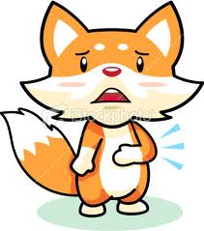
famished
Felipe: I am famished. What a day I’ve had today!

Slide 8
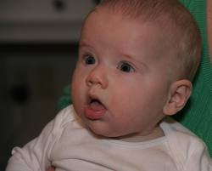
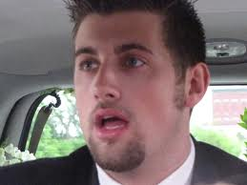
Slack-jawed
Felipe: (slack-jawed)– Frog.

Slide 9
commotion
A commotion follows as the cooks and the servants chase Ranita.

Slide 10
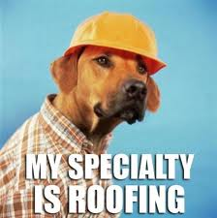
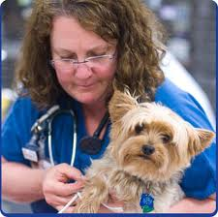
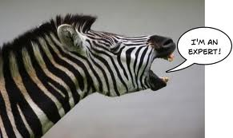
specialty
Well, that is my specialty!
A specialty is something you’re really good at, such as roofing, taking care of animals, or being a zebra!

Slide 11
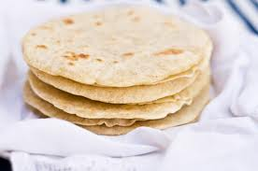
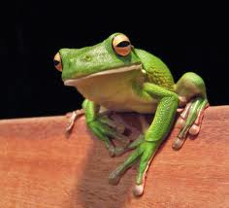
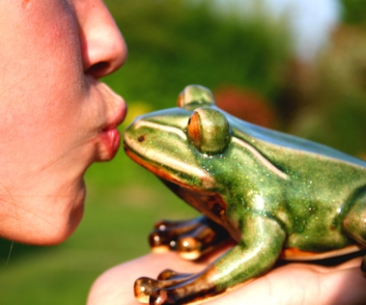
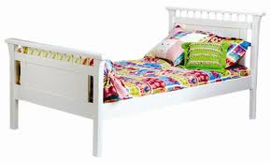
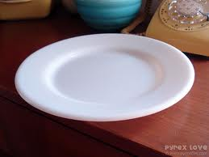
Spanish words from Ranita
Tortilla- tortilla
Señor- sir
Rana- frog
Plato- plate
Cama- bed
Beso- kiss

Slide 12
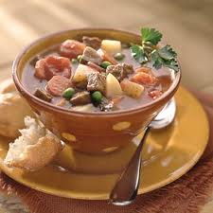
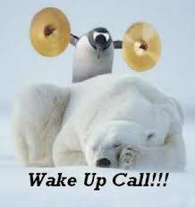
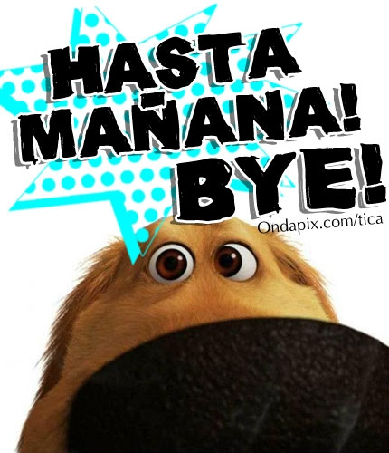
Spanish words from Ranita
Espera!- wait!
Sopa- soup
Basta- enough!
Hasta mañana- until (see you) tomorrow
Despierta- wake up!

