Slide 1
Exploring the Undersea Territories
4.5.3

Slide 2
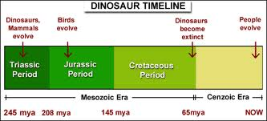
period
Today we are in another period of ocean-based exploration.
Time periods (eras) of dinosaurs

Slide 3
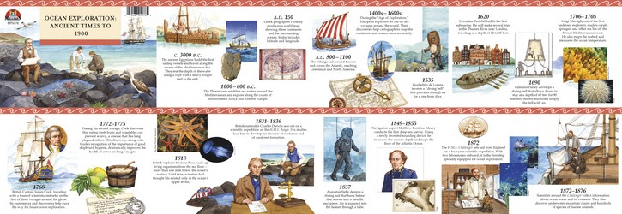
period
Here are some periods of ocean-based explorations.
What might happen next?

Slide 4
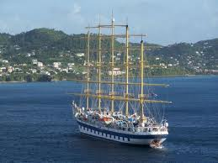
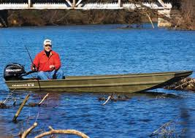
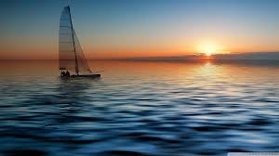
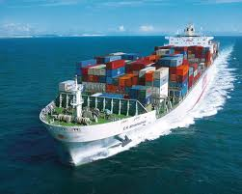
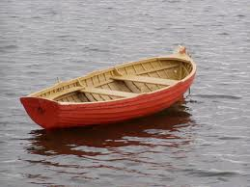
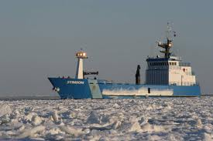
vessel
However, modern explorers have vessels equipped with technologies that sea captains of the past could never have imagined.
A vessel is a boat or ship.

Slide 5
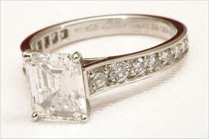
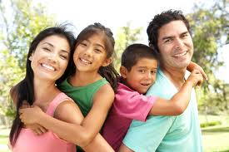
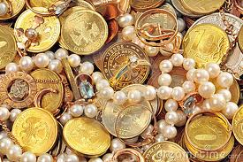
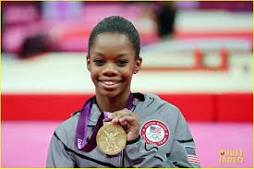
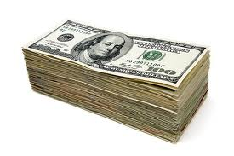
valuable
The ocean is a resource that is very valuable to life on Earth.
cost worth
family, friends
If you won an Olympic medal,
would you sell it?
Valuable: having a lot of cost or worth

Slide 6
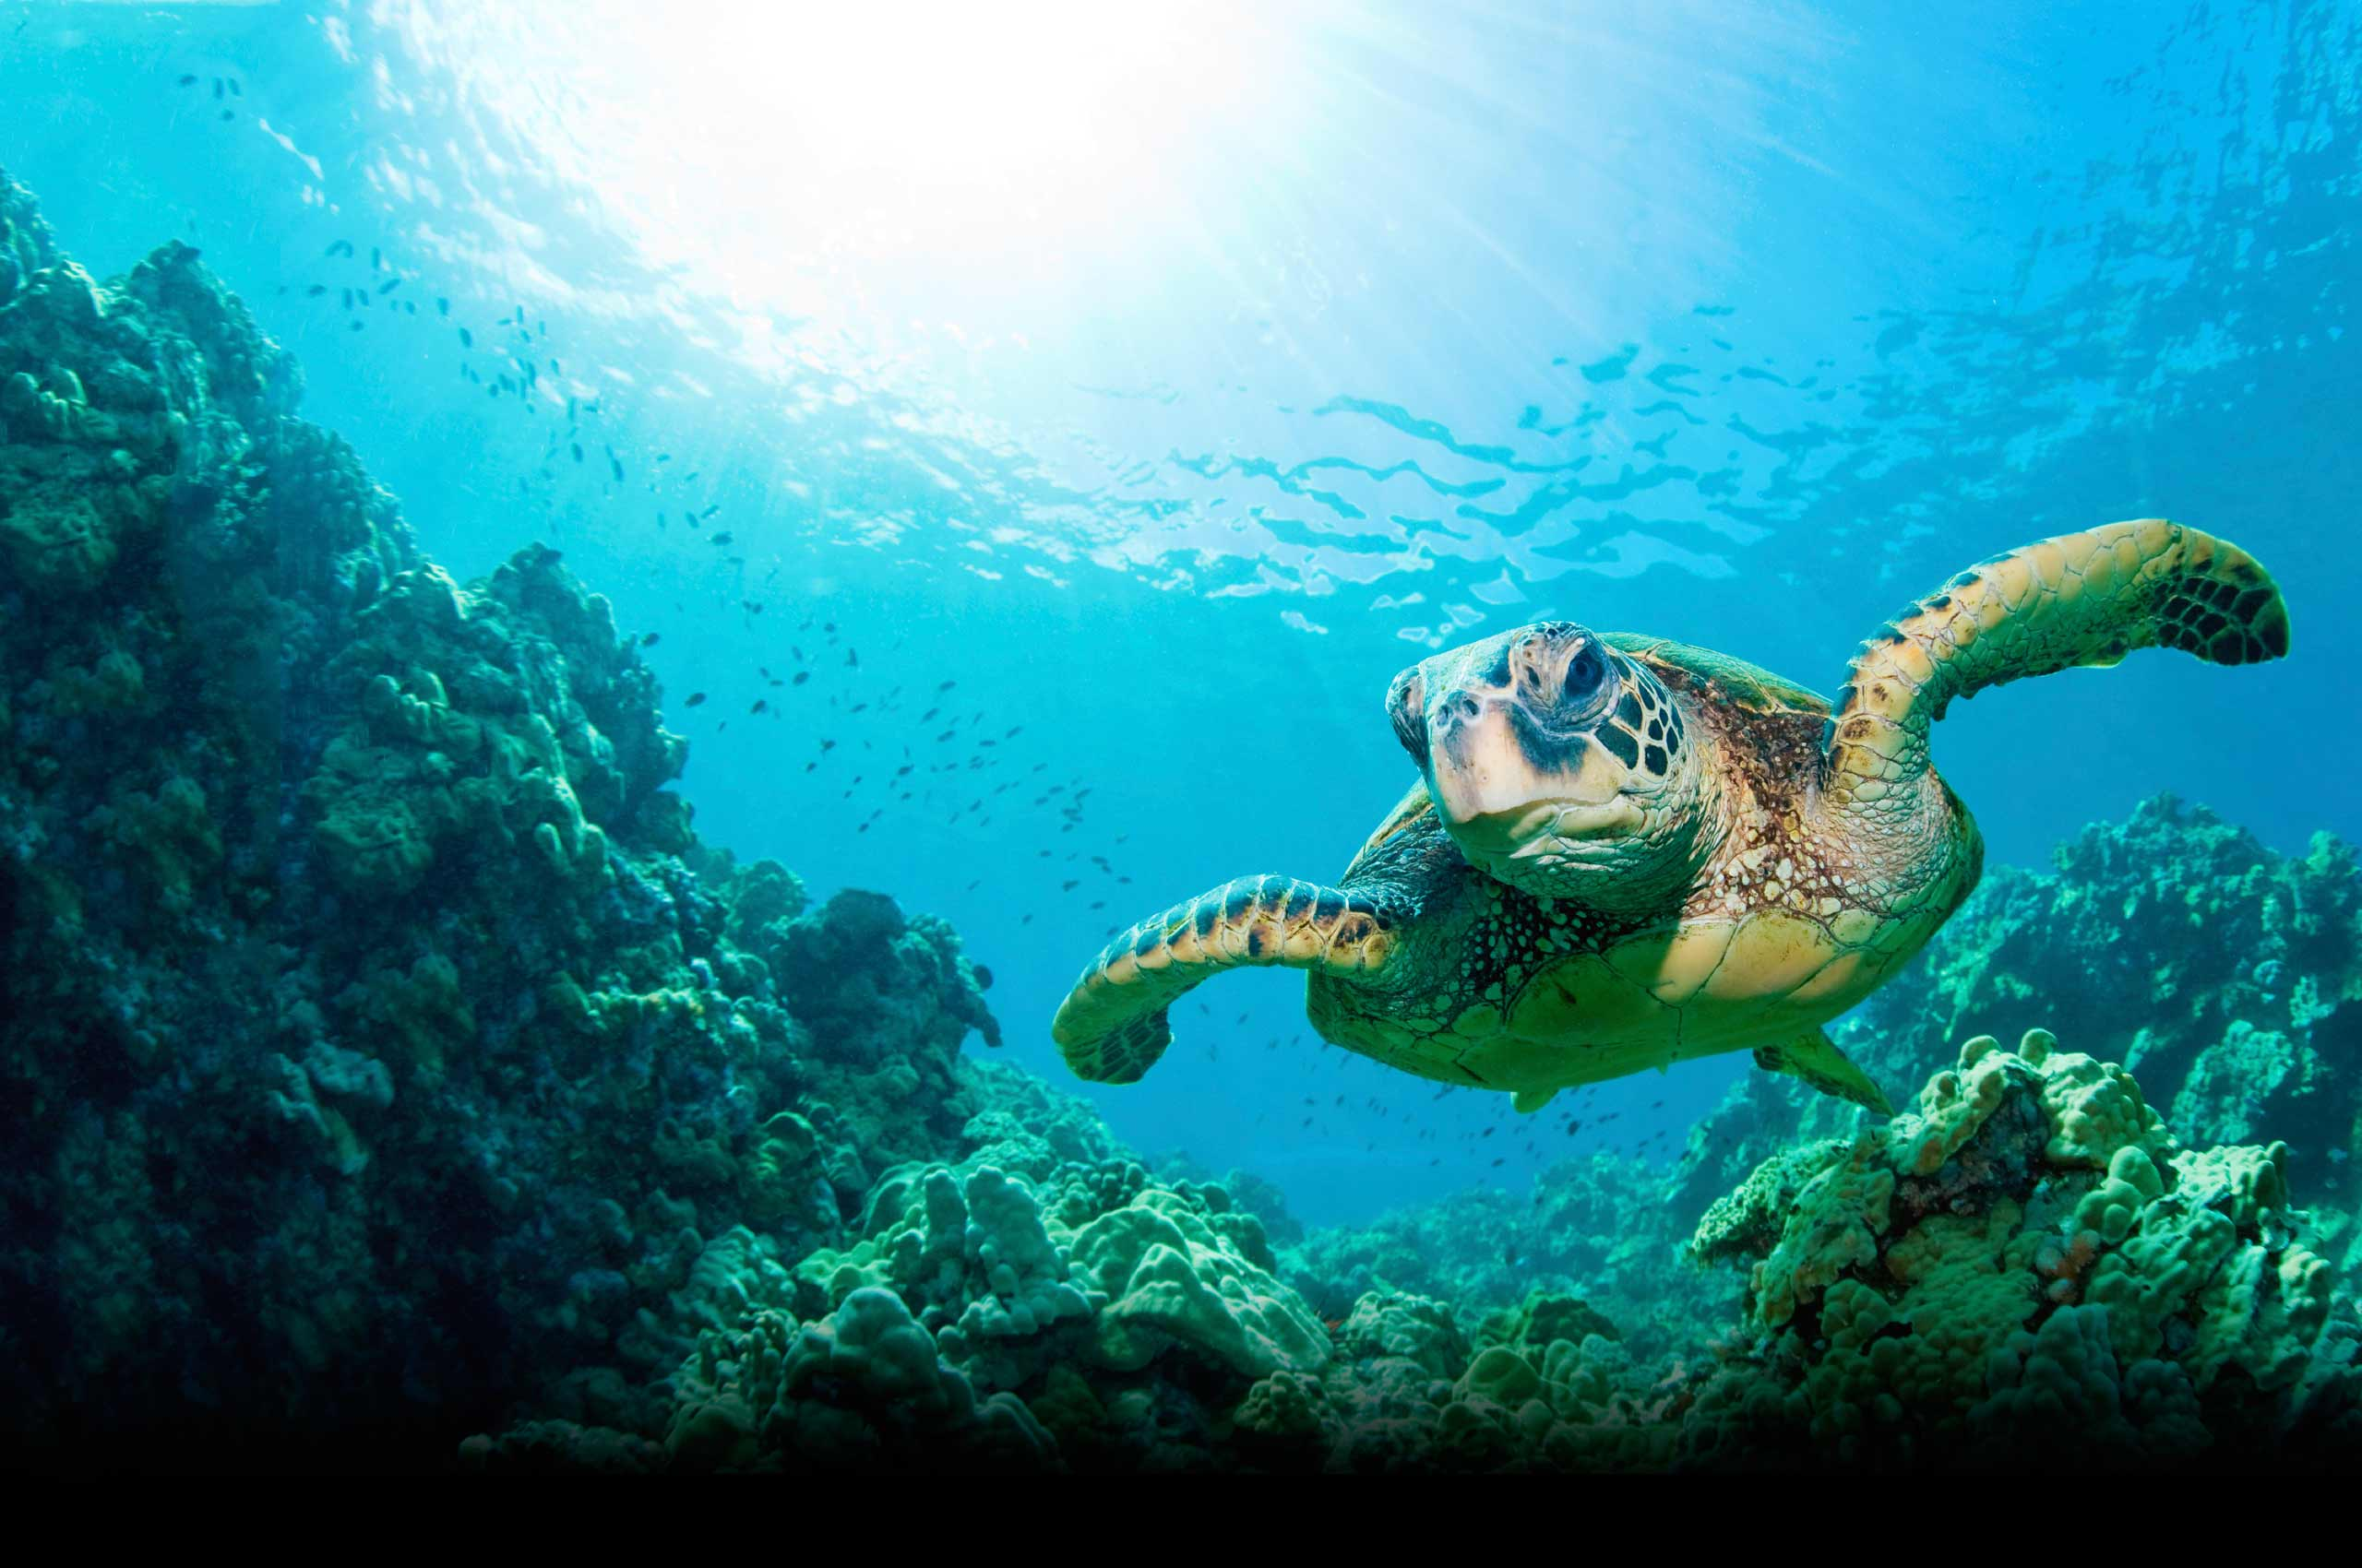
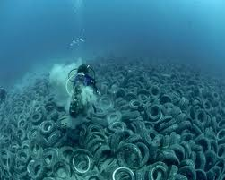
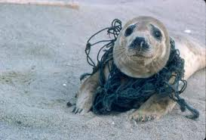
valuable
Why is the ocean valuable? What might happen if we don’t keep it clean?

Slide 7
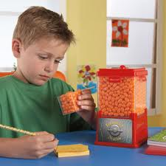
estimated
It is estimated that more than 100 shipwrecks still sit at the bottom of the lake.
Estimating is making an educated
guess based on what you already know.
If there are 100 jelly beans in the small cube, how many do you estimate might be in the big jar?

Slide 8
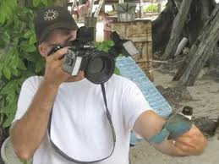
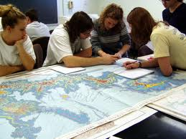
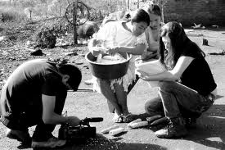
documenting
Ballard believes that finding and documenting shipwrecks is important.
Documenting is writing down (or recording) what you find out so you remember it later.

Slide 9
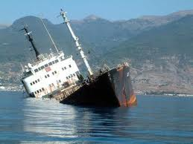
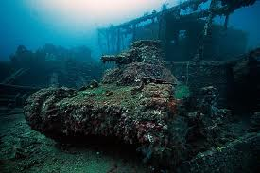
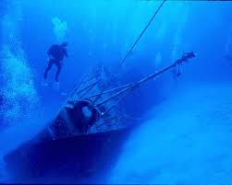
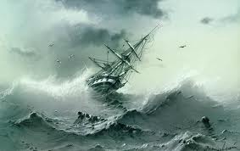
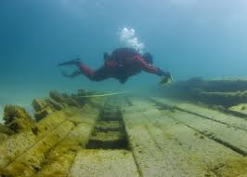
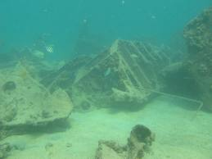
shipwreck
When a ship crashes, it sinks! We can study sunken ships at the bottom of the ocedan.

Slide 10
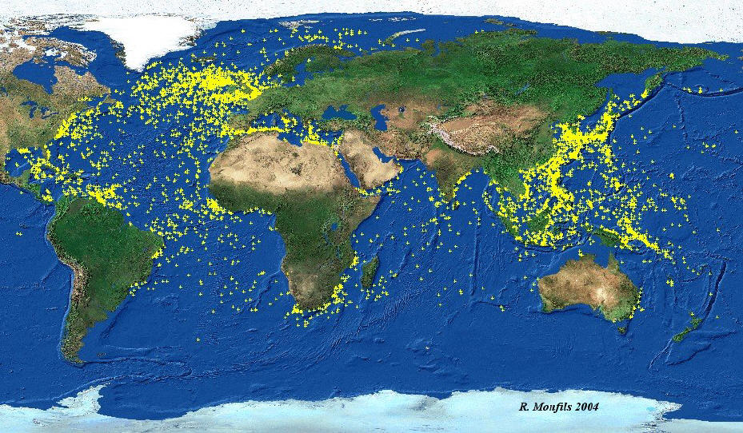
Shipwrecks around the world

