Slide 1
Note: Due to its size, this presentation has been broken into 2 parts.
This is part 1 of 2.

Slide 2
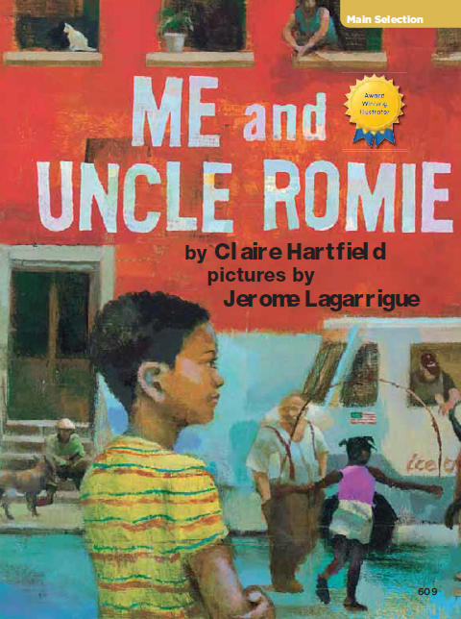
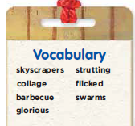
Me and
Uncle Romie
Part1 of 2
4.5.4

Slide 3
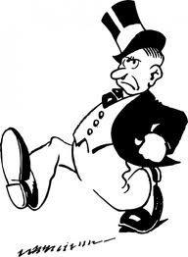
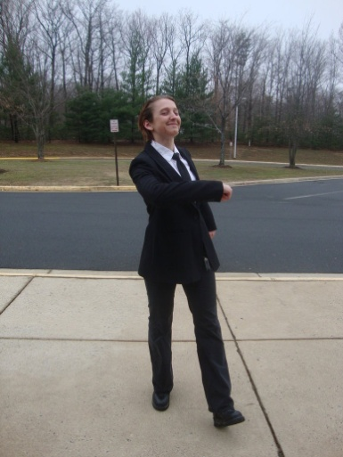
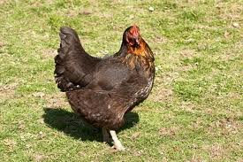
strutting
I watched chickens strutting across the yards.
Strut- to walk proudly

Slide 4
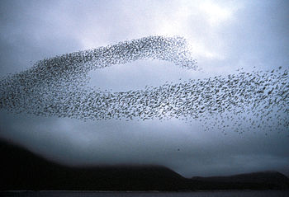
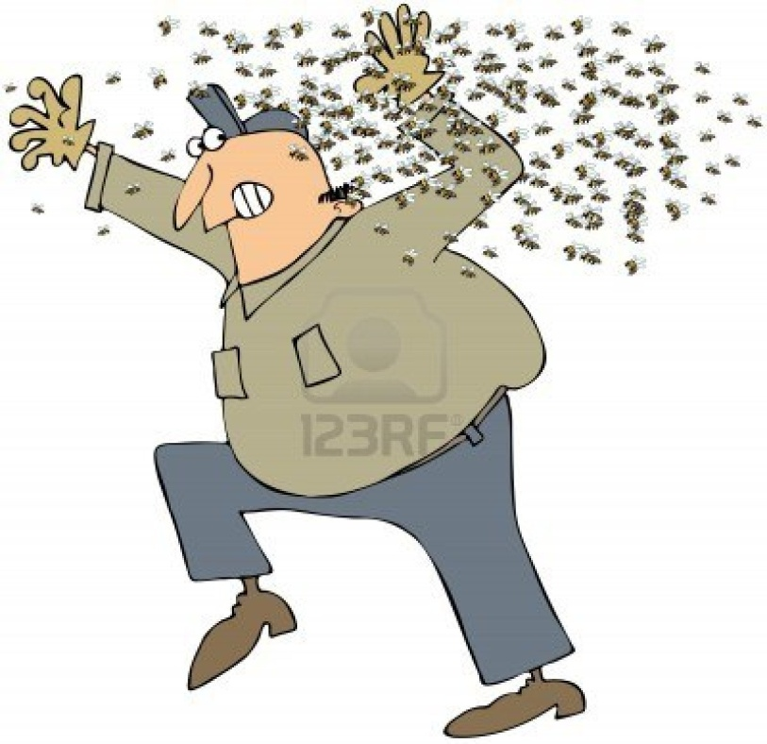
swarms
Swarms of people rushed by.
Swarm (noun)- a group of people, animals or insects moving together.

Slide 5
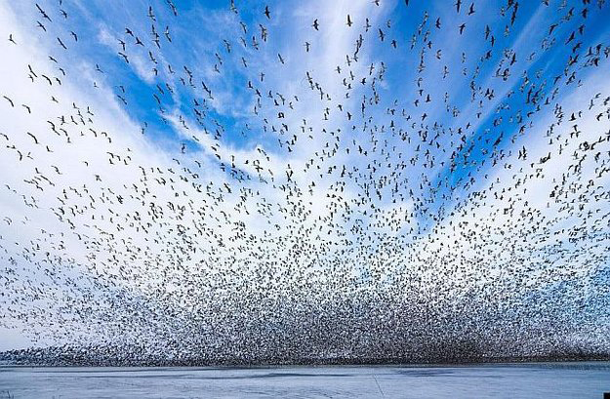
a swarm of birds

Slide 6
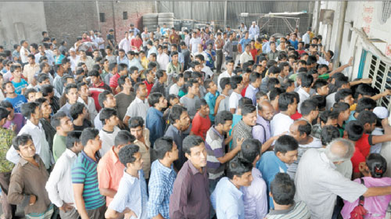
a swarm of people

Slide 7
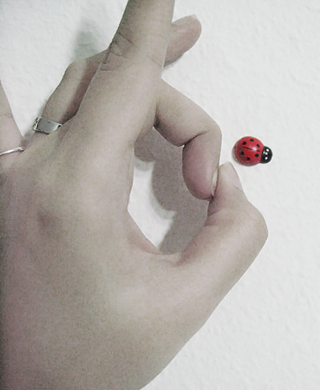
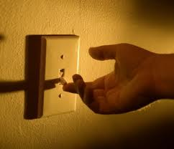
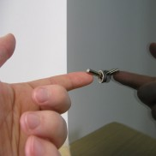
flicked
I tried to catch my breath while Aunt Nanette flicked on the lights.
flick (verb)- a short, quick movement

Slide 8
collage
“Uncle Romie is a collage artist,” Auny Nanette explained. “He uses paints, photographs, newspaper and cloth.”
{click for collages}
Collage (noun)- a kind of art in which the artist puts pictures or other things together in a new way to make one picture

Slide 9


Slide 10
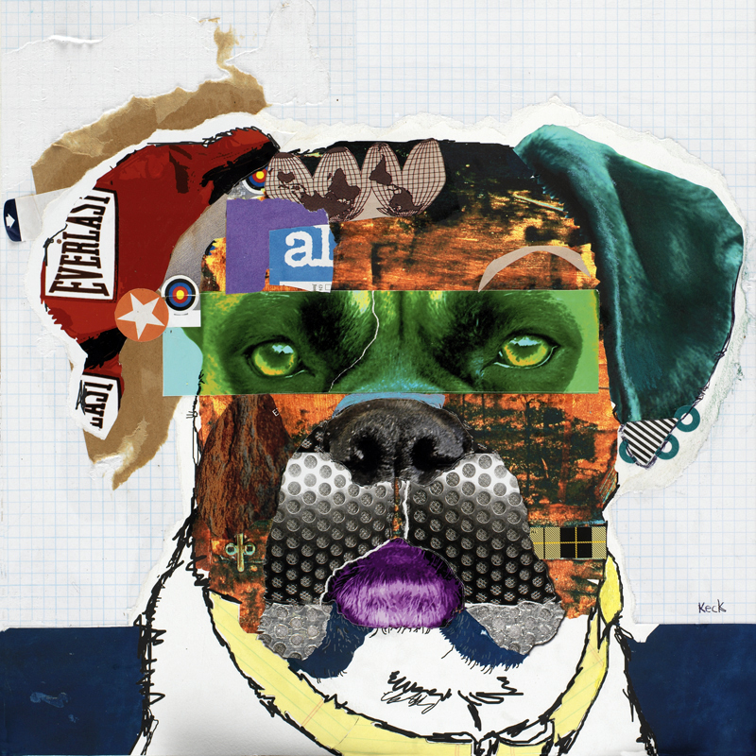

Slide 11
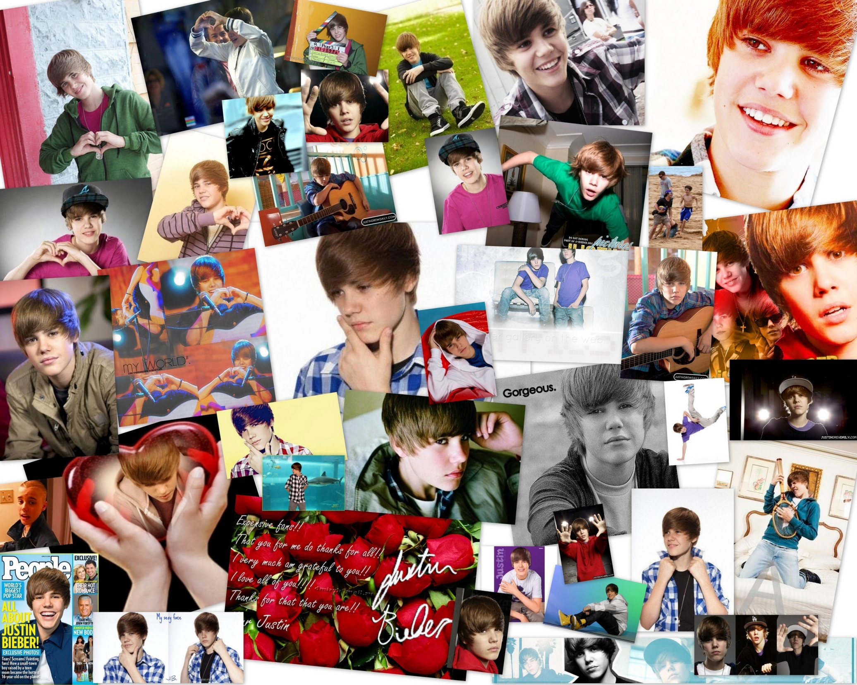

Slide 12
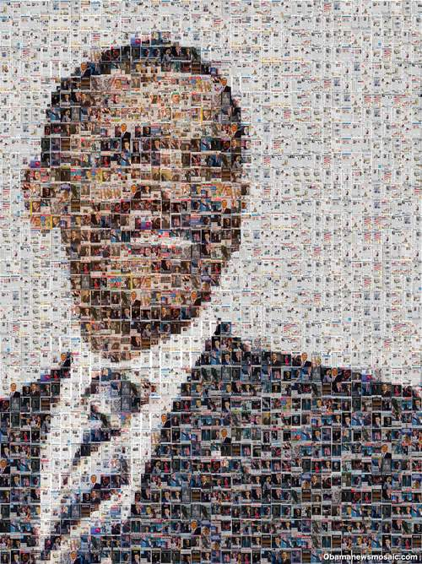

Slide 13
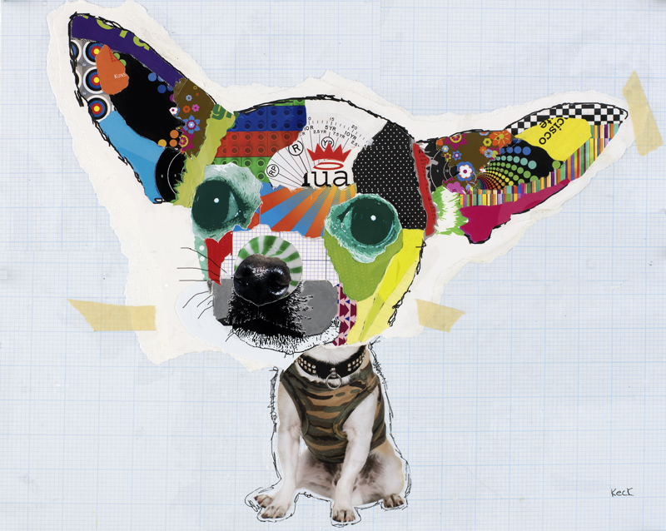

Slide 14
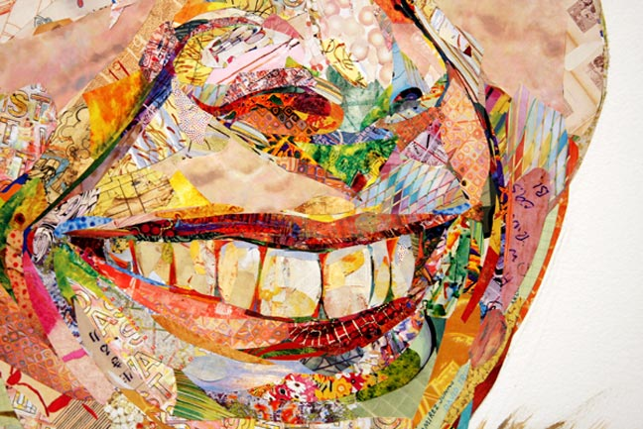

Slide 15
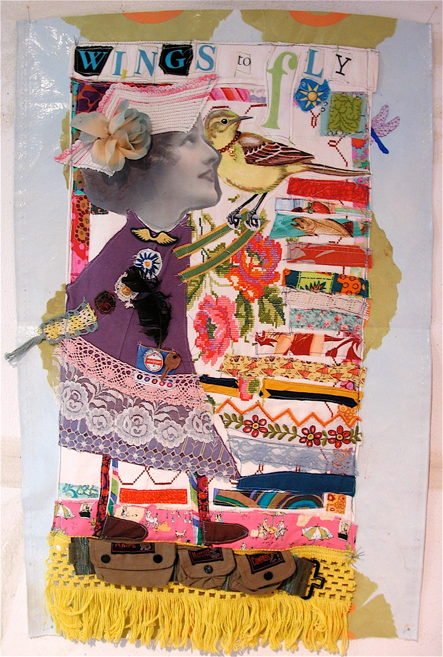

Slide 16
