Slide 1
Note: Due to its size, this presentation has been broken into 2 parts. This is part 2 of 2.

Slide 2
Me and Uncle Romie Part 2 of 2
4.5.4

Slide 3
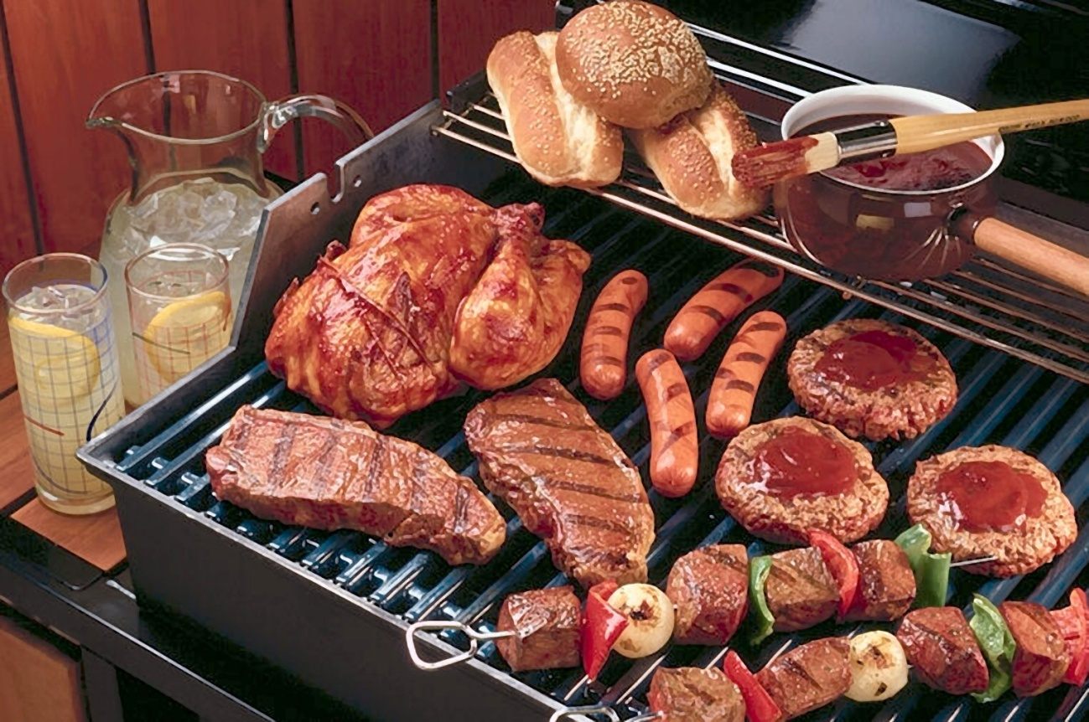
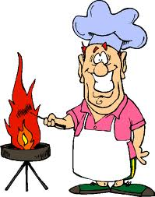
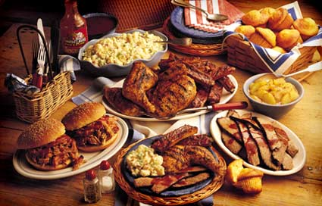
barbecue (bar-b-q)
Later we shared some barbeque on a rooftop.

Slide 4
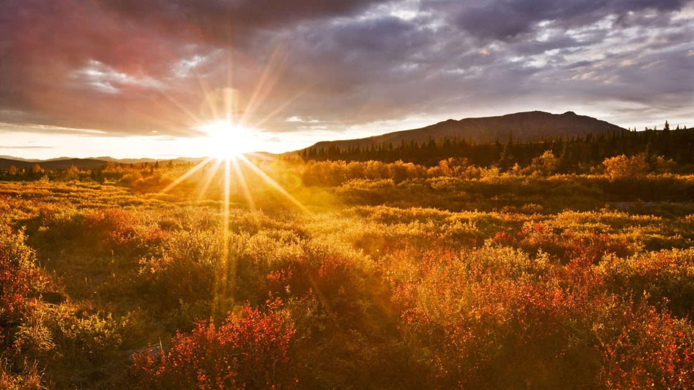
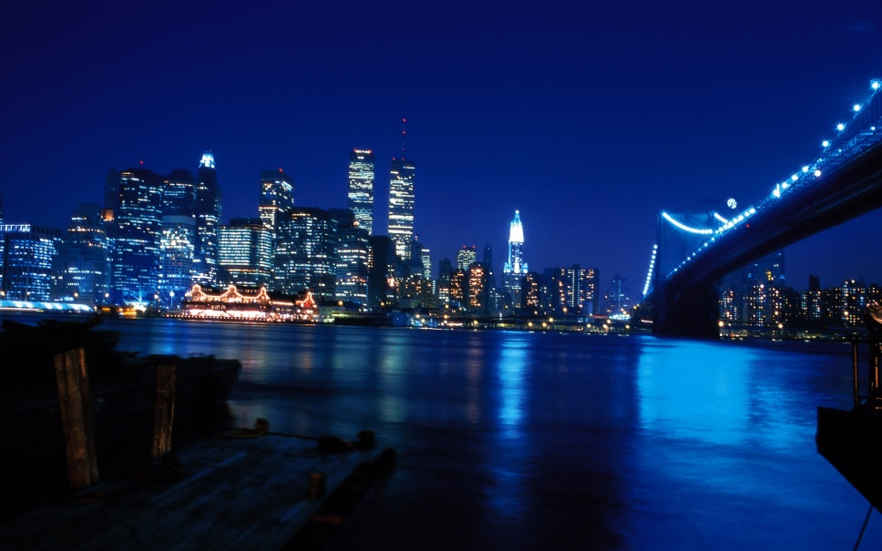
glorious
What a glorious mess!
Glorious (adjective)- beautiful or wonderful
Click for examples of a glorious mess.

Slide 5
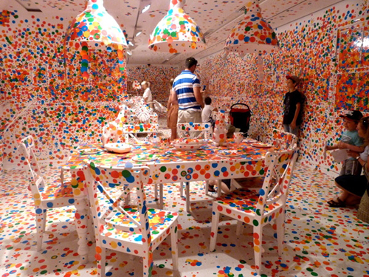
a glorious mess

Slide 6
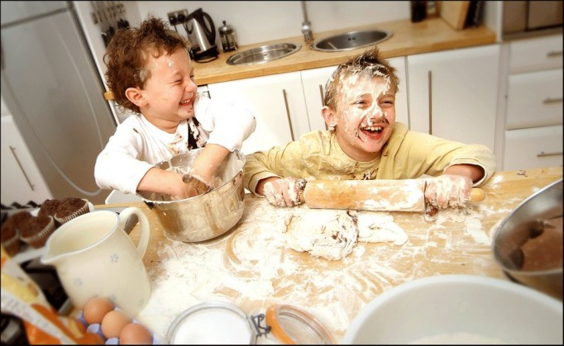
a glorious mess

Slide 7
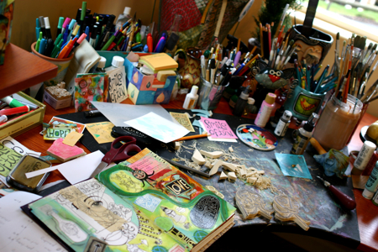
a glorious mess

Slide 8
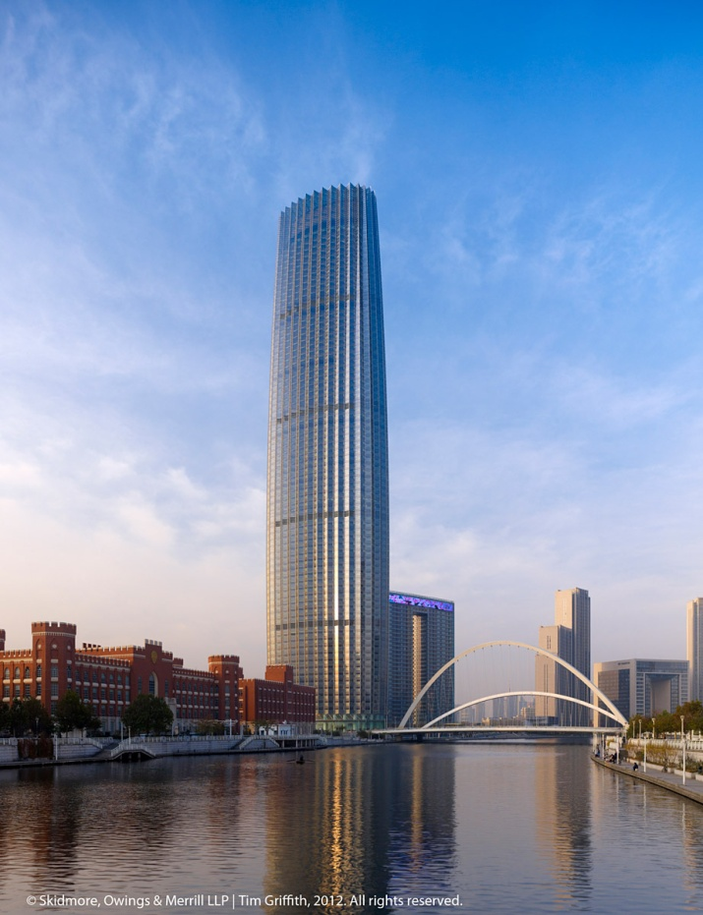
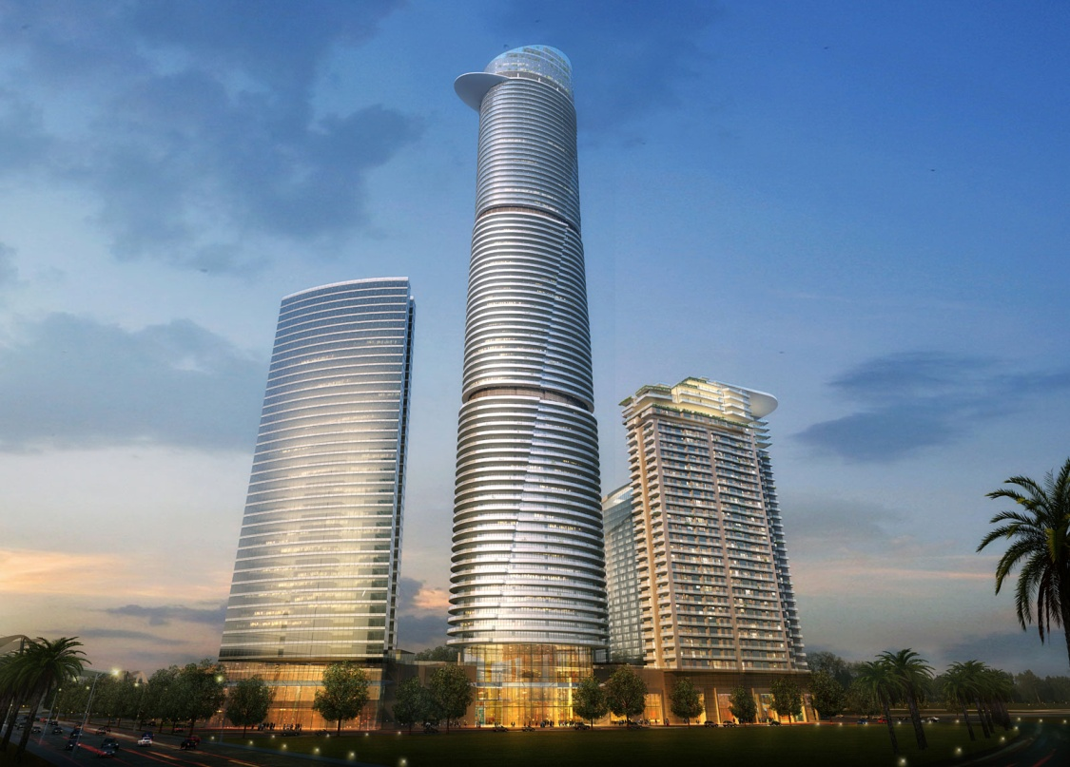
skyscrapers
There were skyscrapers in the collage.
Skyscraper (noun)- a very tall building

Slide 9
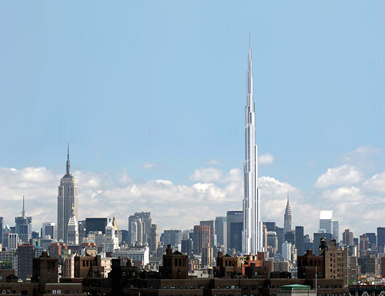
skyscraper

Slide 10
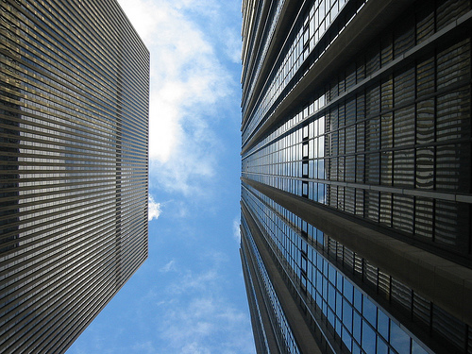
skyscraper

Slide 11
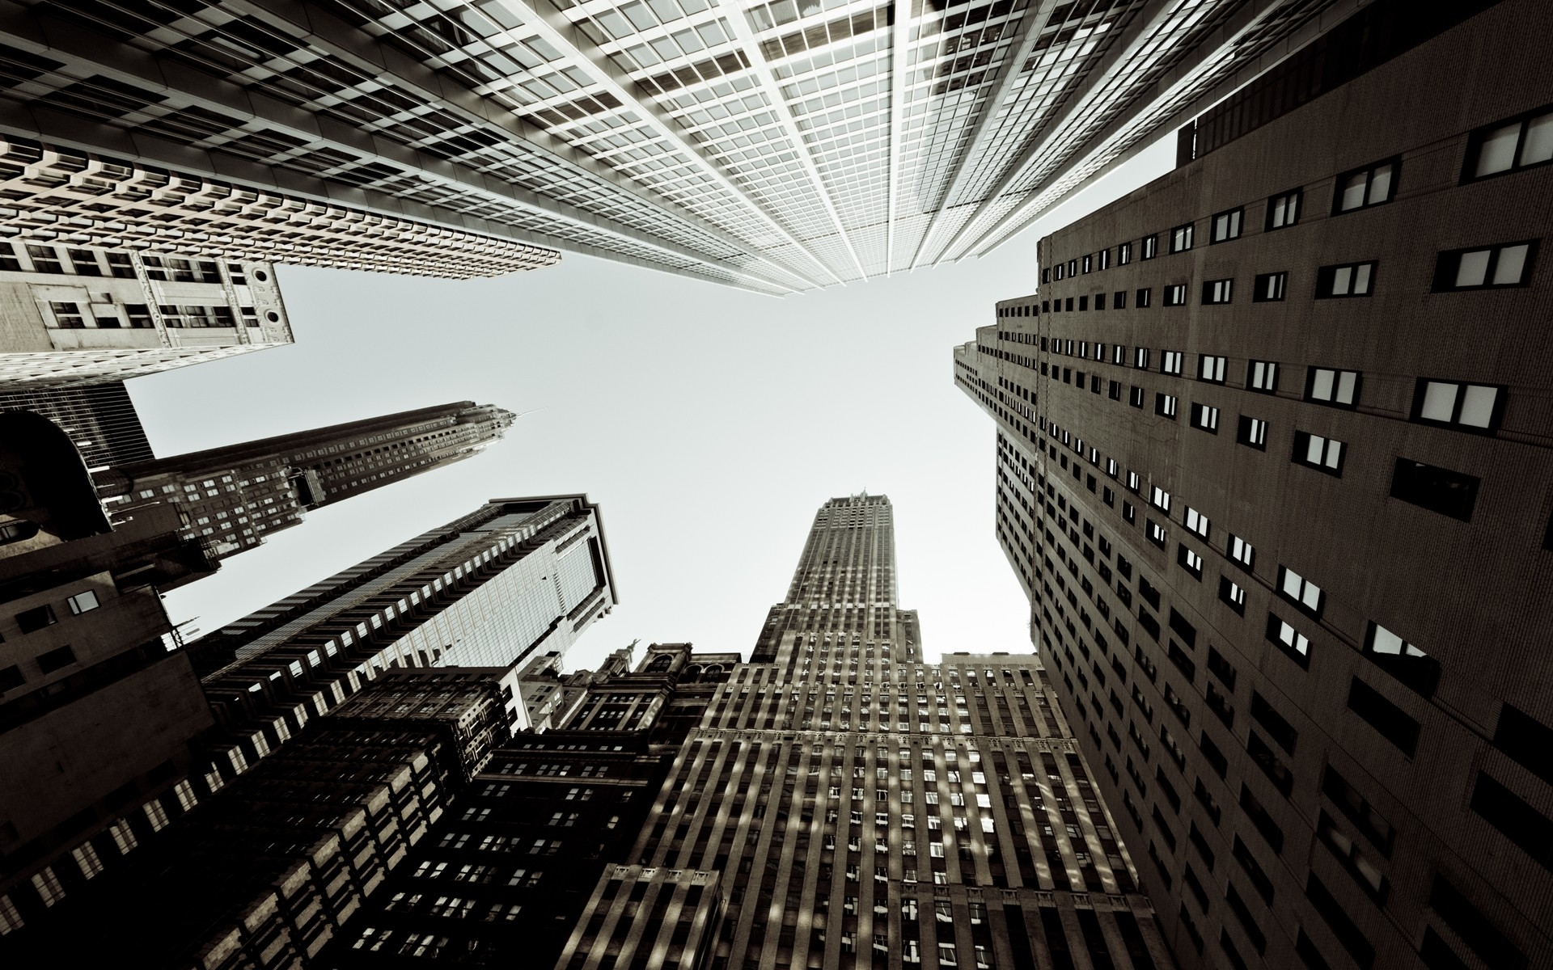
skyscraper

Slide 12
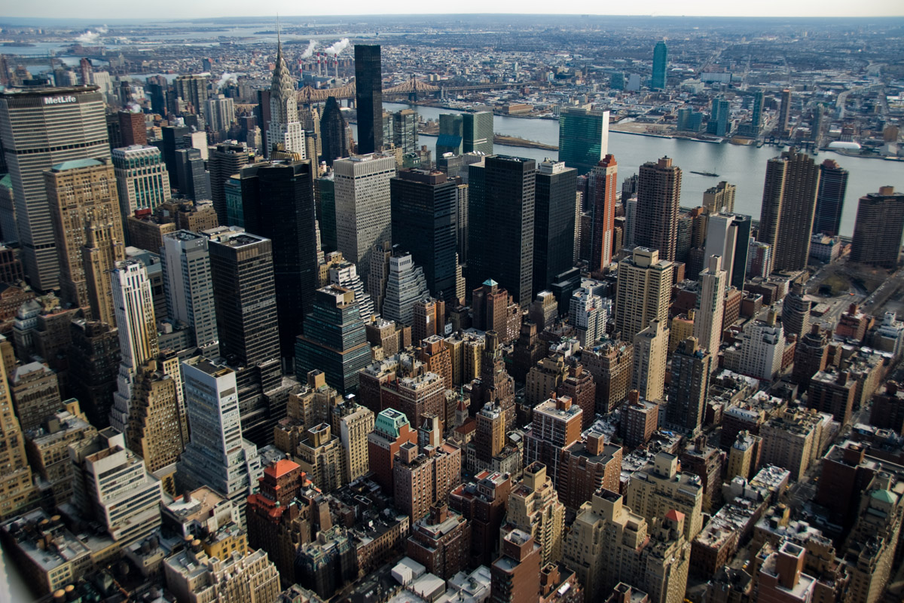
There are many skyscrapers in New York City.

Slide 13
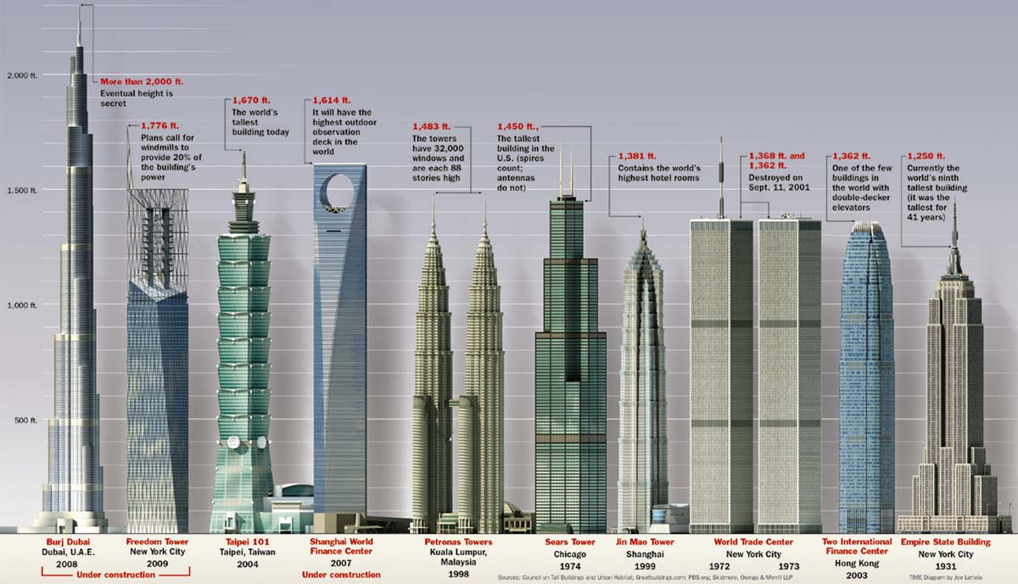
Ten tallest buildings in the world

Slide 14
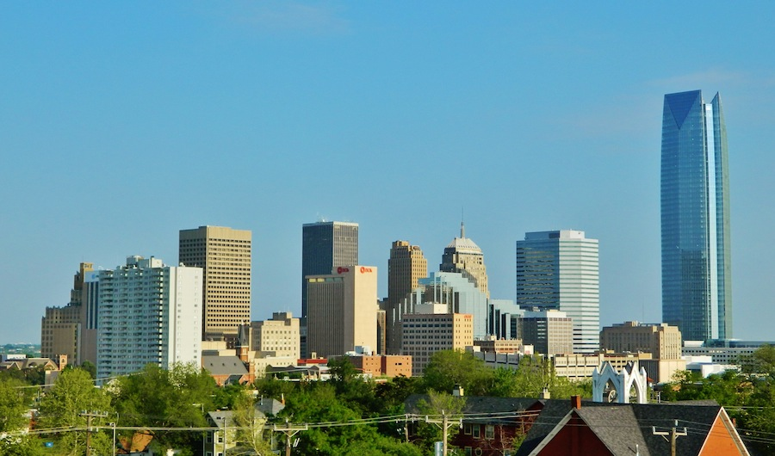
We even have a skyscraper in Oklahoma City!
The Devon Tower

Slide 15
The Devon tower compared to the ten tallest buildings in the world
The Devon Tower is 925 feet tall.

Slide 16
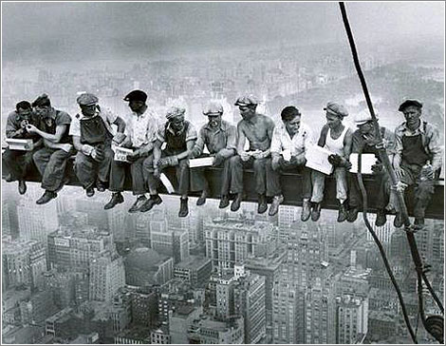
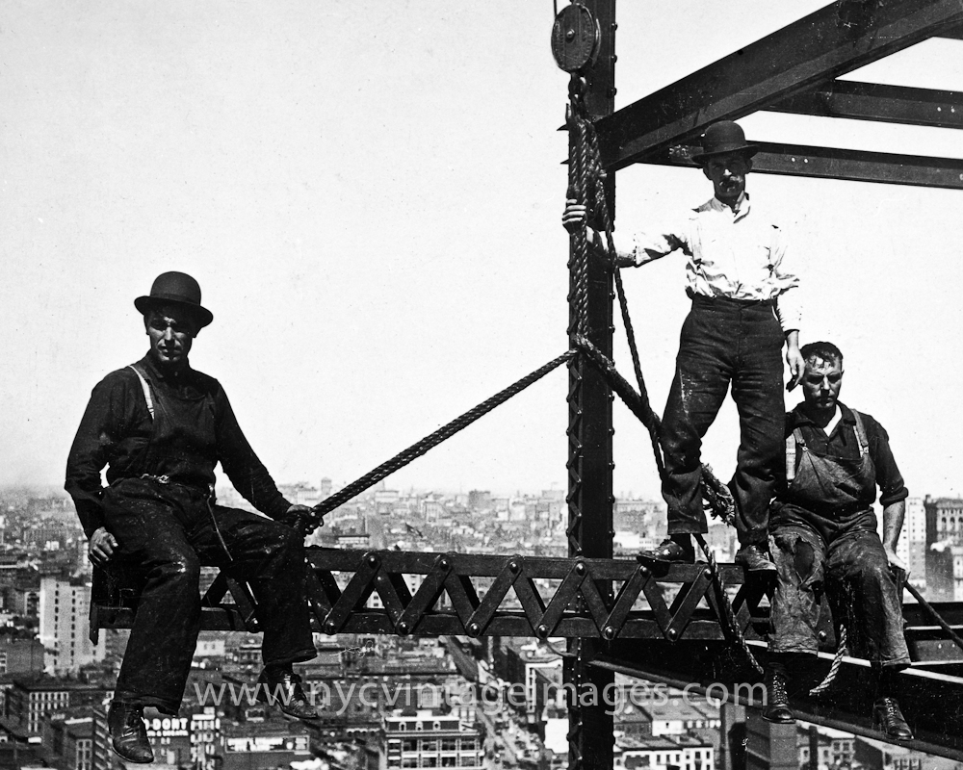
skyscrapers
Would you want to help build a skyscraper?

Slide 17
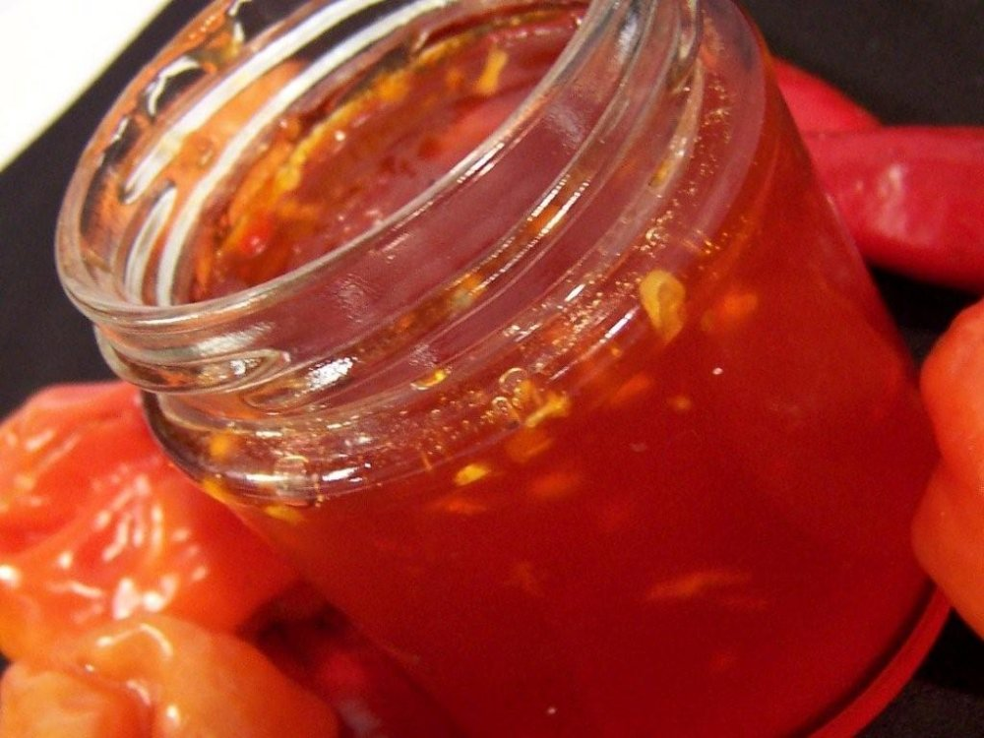
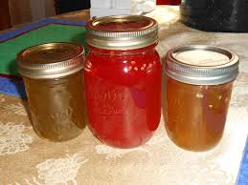
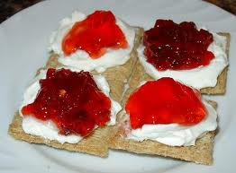
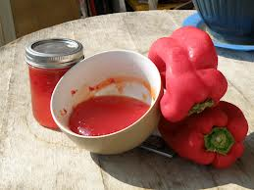
pepper jelly

Slide 18
Have you ever taken a big trip?
In our story, James takes a trip from his home in North Carolina to visit his aunt and uncle in New York City, which is more than 500 miles away!

