Slide 1
Wild Horses
4.5.5

Slide 2
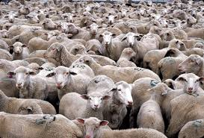
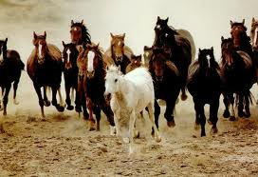
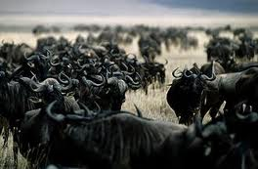
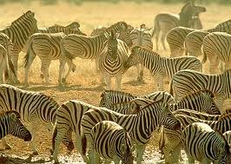
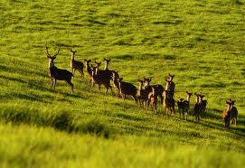
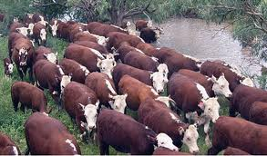
herd
When he sees them all, he knows the whole herd is accounted for.
herd (noun)- many of the same kind of animal

Slide 3
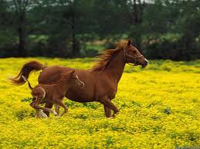
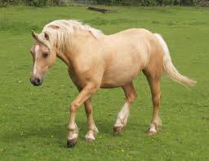
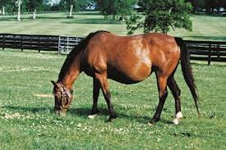
mare
The mare lies down and goes to sleep.
mare (noun)- a female horse

Slide 4
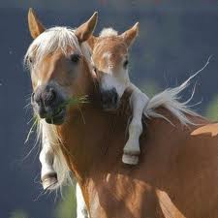
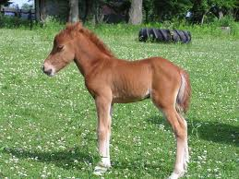
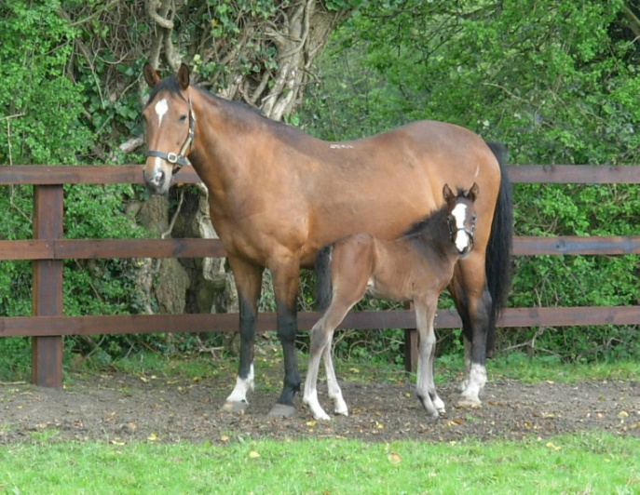
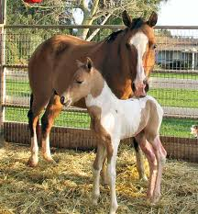
colt
Every spring, dozens of wild horses give birth to tottering colts.
colt (noun)- a baby horse

Slide 5
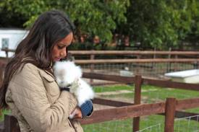
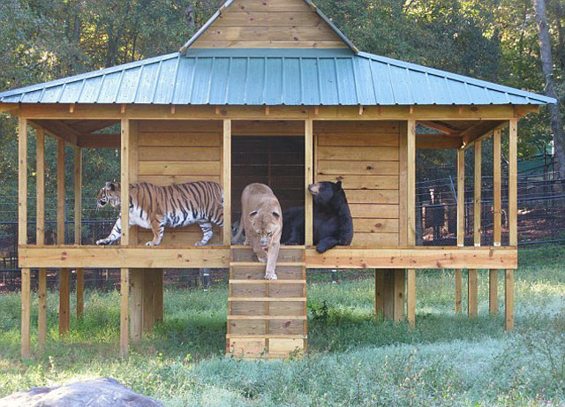
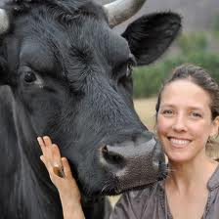
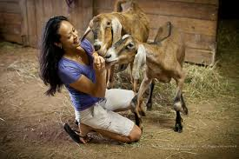
sanctuary
Scraggly buzzards perch on fence posts near the entry gate to the Black Hills Wild Horse Sanctuary.
sanctuary (noun)- a safe place for animals (maintained by people)

Slide 6
gangly
Dayton was a gangly teenage boy.
gangly (adjective)- tall, lanky and awkward in movement

Slide 7
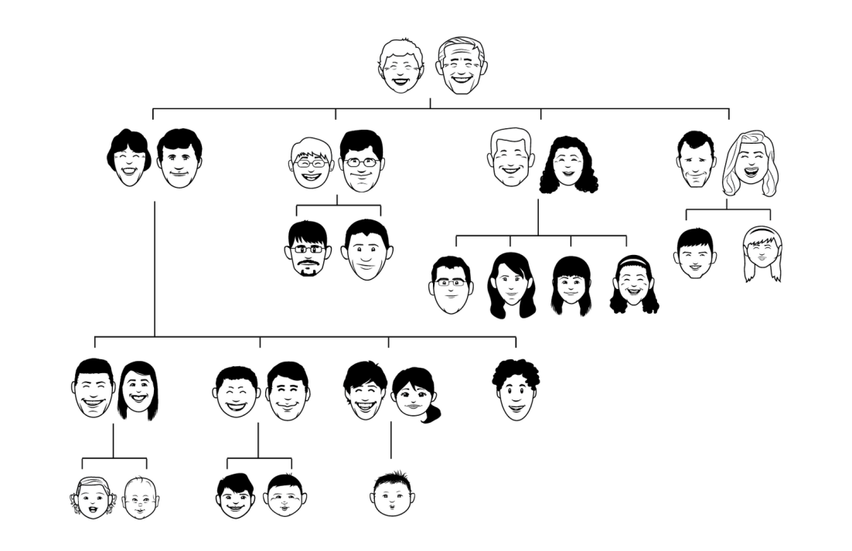
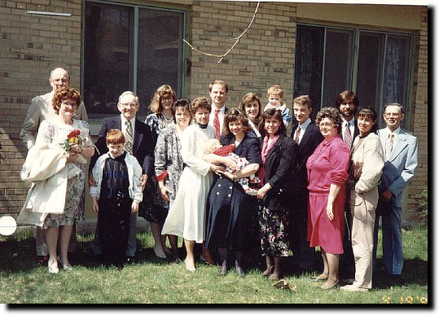
descendants
Mustangs are descendants of the horses brought to America by Spanish explorers.
descendants (noun)- children of children

Slide 8
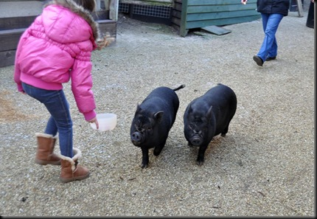
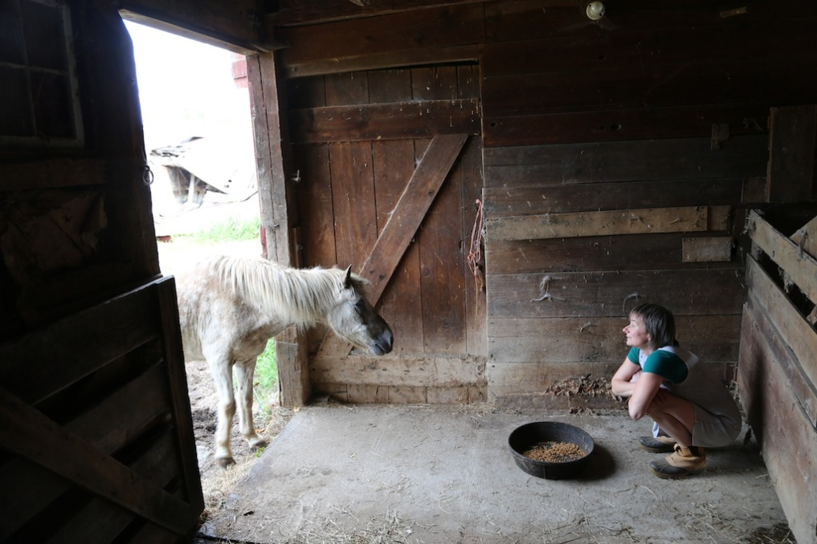
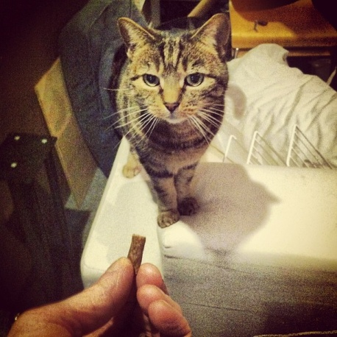
coaxing
After hours of coaxing, Dayton succeeded in getting Magnificent Mary to get off the trailer.
Coax (verb)- to try to get a person or animal to do something with gentle persuasion

Slide 9
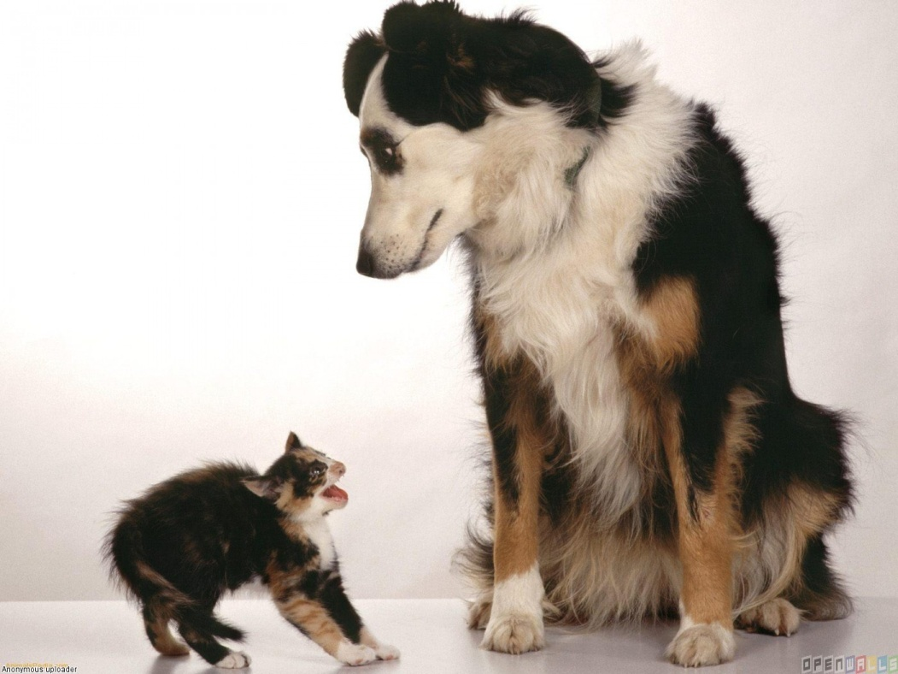
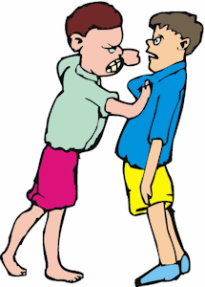
threatened
Wild horses feel threatened by being watched.
threatened (adjective) or threaten (verb)- scared of a specific person or idea

Slide 10
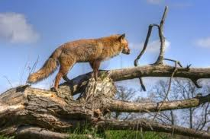
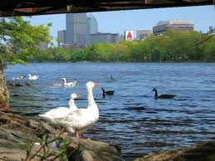
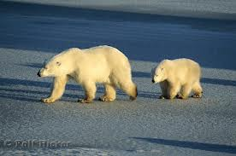
habitat
Visitors get to see horses in their natural habitat.
habitat (noun)- the place where an animal lives in nature and is most comfortable

Slide 11
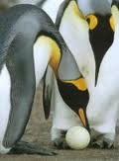
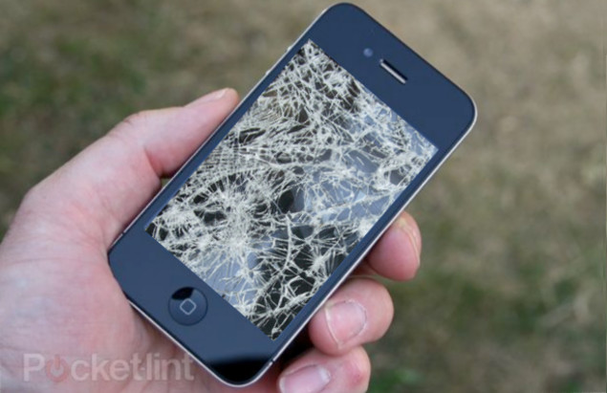
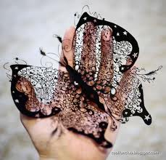
fragile
The herds of horses are moved around so they don’t damage the fragile land.
fragile (adjective)- easy to break

Slide 12
glistening
They splash through the glistening water.
glistening (verb)- reflecting light; sparkling

