Slide 1
This slide is HIDDEN
Your students won’t see it when you play the slideshow. Here are some resources for you for this week:
Teachers Pay Teachers Units
http://www.teacherspayteachers.com/Product/Davy-Crockett-History-Makers-Lesson-Packet-738002
http://www.teacherspayteachers.com/Product/5th-Grade-Treasures-Reading-Davy-Crockett-593174
Vocabulary matching practice
http://www.mhschool.com/mmh_games/content/reading/gr5/unit01/week2/v1/game1_type1/index.html
http://www.mhschool.com/mmh_games/content/reading/gr5/unit01/week2/v2/game1_type1/index.html
Note: be sure to “play show” when showing this PowerPoint so that gif files (which are moving pictures) will play. Example: the first gif file is for the word “impress”.

Slide 2
One more thing!
There are TWO parts to this presentation due to file size. Please be sure to get both parts before beginning.
This is part 1 of 2.

Slide 3
Unit 1.2
Part 1 of 2

Slide 4
Meet the Author
Hear Ms. Schanzer read the first page of the story in a true Tennessee accent:
http://www.youtube.com/watch?v=eirdPy_6TwQ

Slide 5
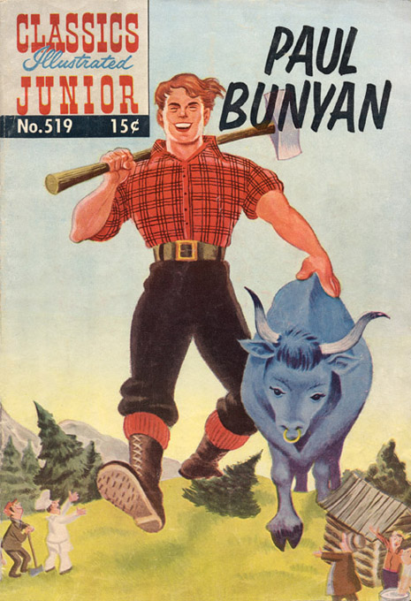
tall tale

Slide 6
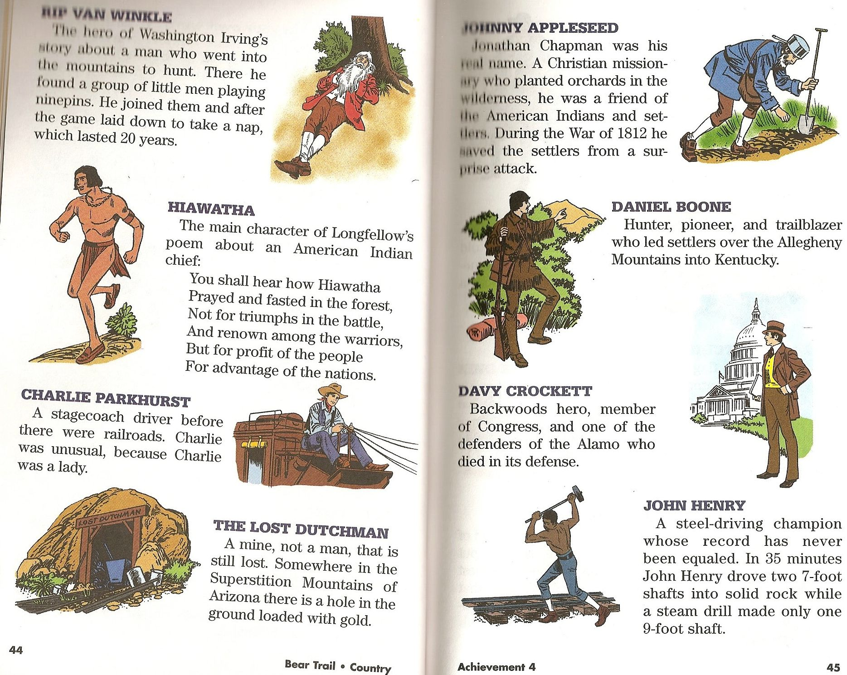
Other tall tale heroes

Slide 7
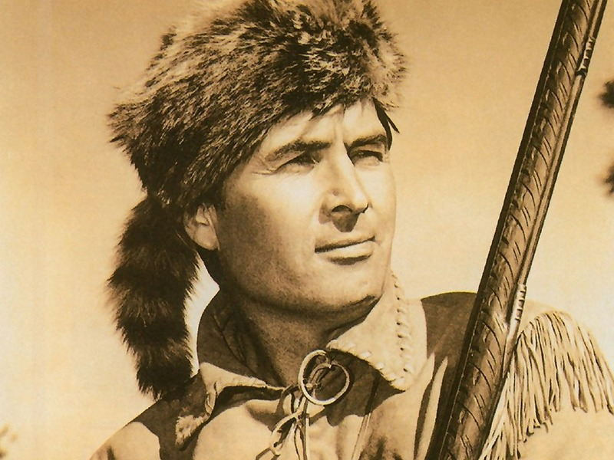
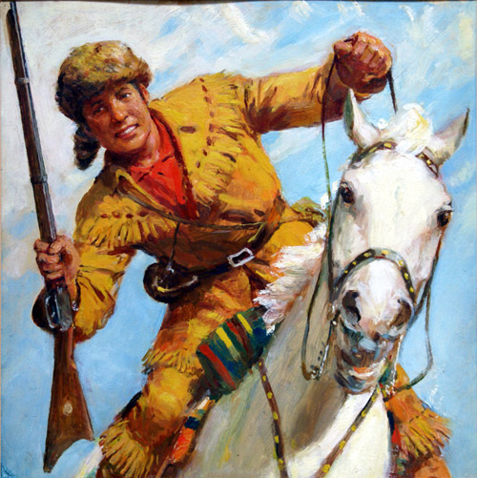
Davy Crockett

Slide 8
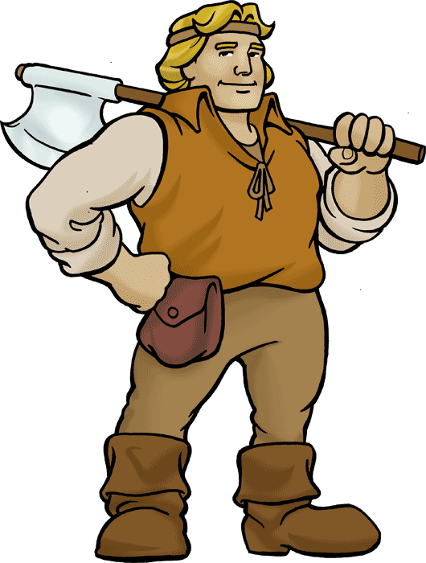
woodsman
Davy Crockett was a woodsman.
Meaning: A person who is used to living in the woods, and usually good at hunting or trapping

Slide 9
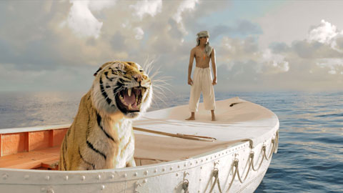
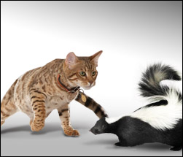
a heap of trouble
The world was in a heap of trouble!
Meaning: in a lot of trouble, in a bad situation
Why is this cat in a heap of trouble?

Slide 10
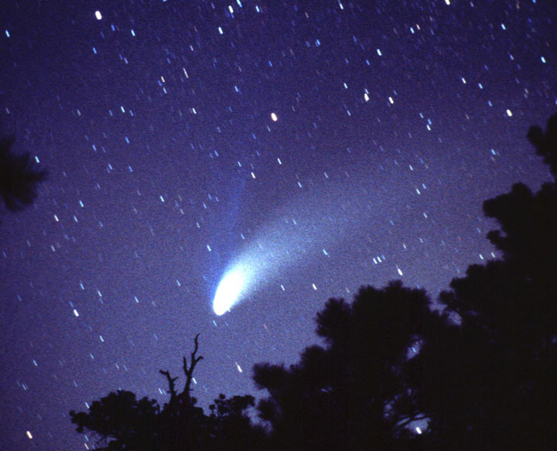
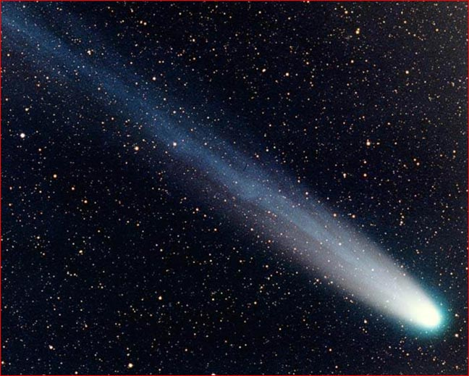
Halley’s Comet
Halley’s Comet was heading straight for America!
A comet is a large mass that is orbiting the sun.

Slide 11
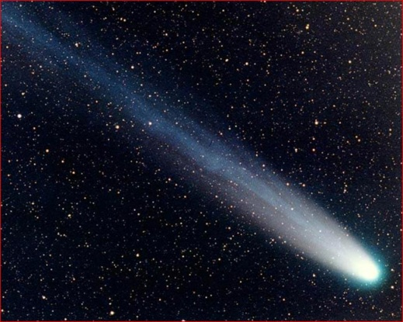
Halley’s Comet
In this week’s story, the author uses personification (giving human traits to an object) to make Halley’s Comet seem like a person.
In reality, Halley’s comet is just a comet that comes by earth every 74 years. Here is a video of Bill Nye talking about Halley’s Comet:
Halley’s Comet is a
https://www.youtube.com/watch?v=_apLqXMyirU

Slide 12
End of part 1
Please begin part 2

