Slide 1
Unit 1.2
Part 2 of 2

Slide 2
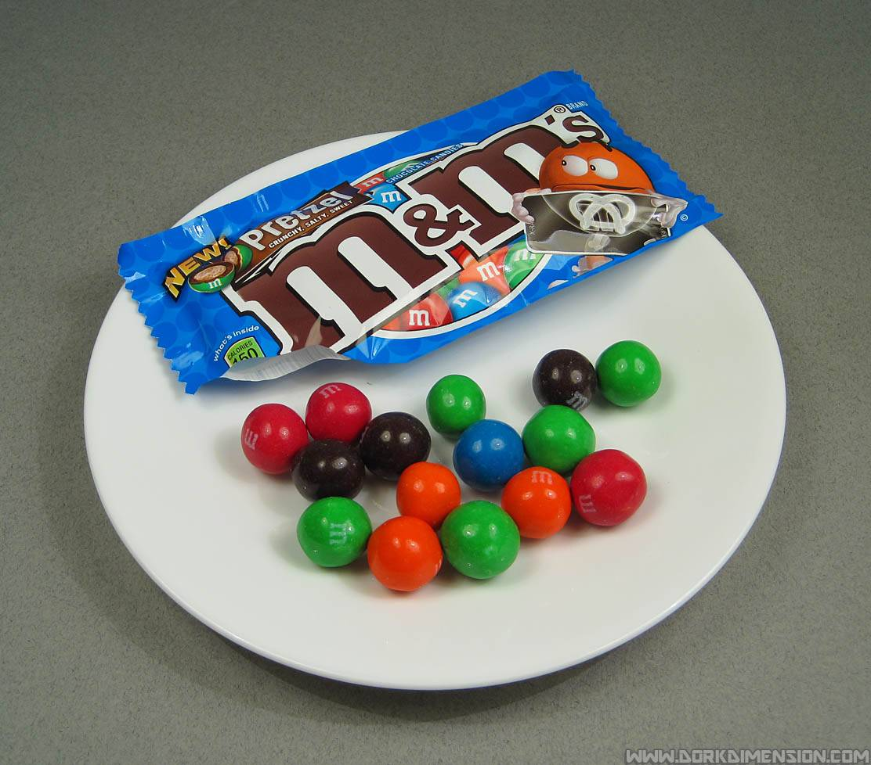
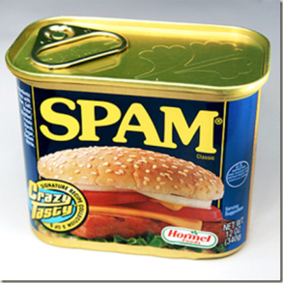
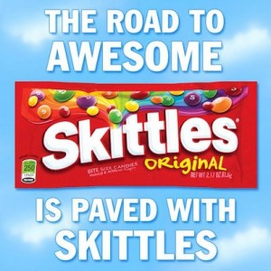
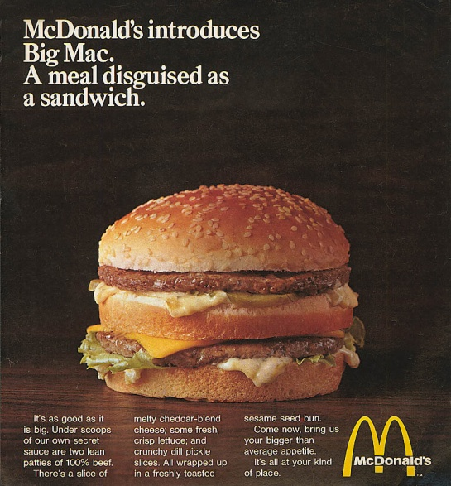
advertisement
He put an advertisement in the newspaper.

Slide 3
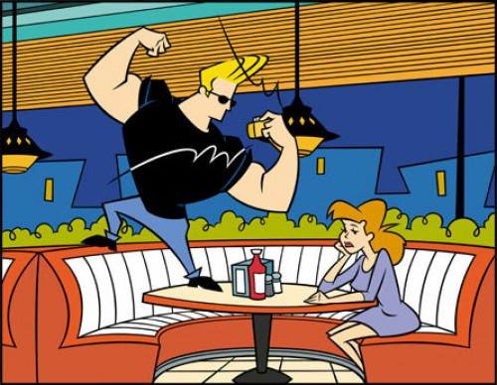
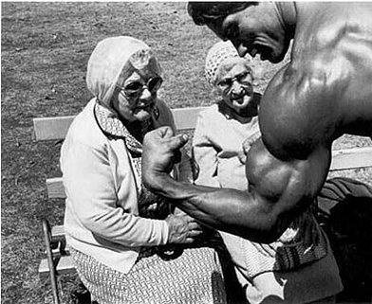
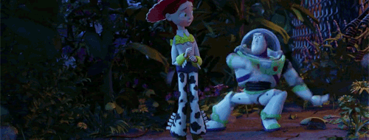
impress
He was teaching himself to dance so he could impress a girl.
Meaning: to change someone’s mind
(in this case, to make a girl like him!)

Slide 4
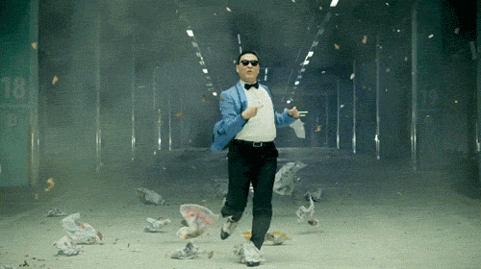
sauntered
Once Davy learned to dance, he sauntered off.
Meaning: to walk or stroll casually

Slide 5
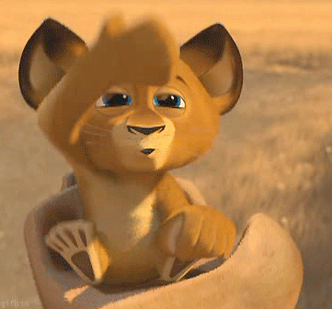
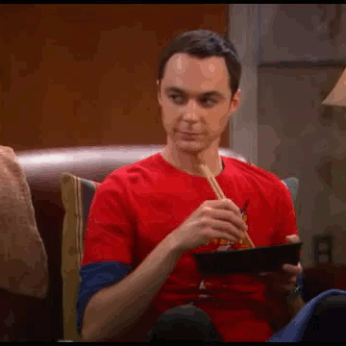
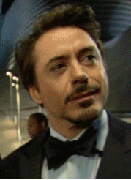
grinned
When Davy saw her, he grinned.
Meaning: smiled

Slide 6
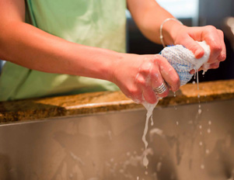
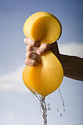
wring
The president told Davy to wring the comet’s tail off before it hit the earth.
Meaning: to force liquid out by squeezing and twisting

Slide 7
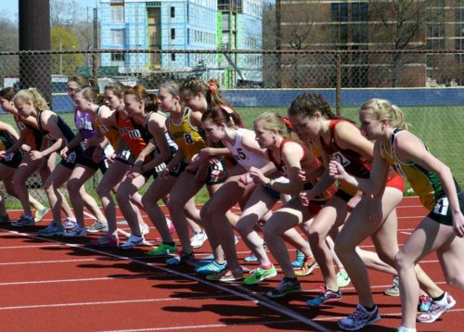
commenced
Then he commenced to climb the mountain.
Meaning: started

Slide 8
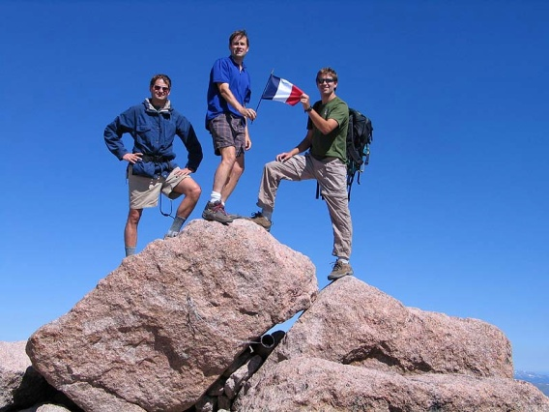
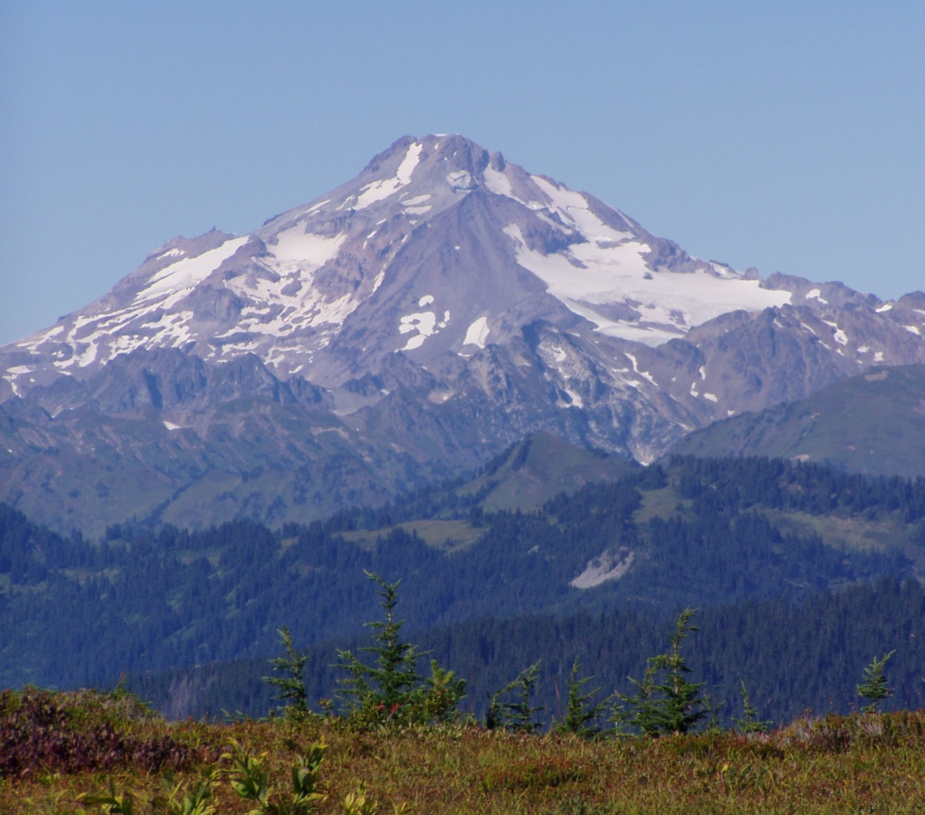
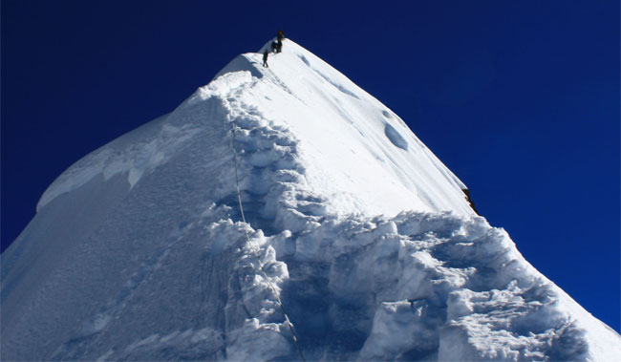
peak
Davy climbed all the way up to the mountain peak.

Slide 9
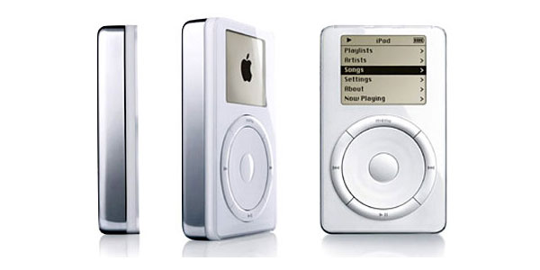
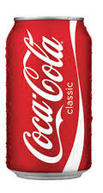
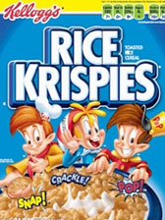
original
Before the comet could go back to its original size, Davy grabbed it!
Meaning: not a copy or imitation
new iPod
original iPod
original new original new

Slide 10
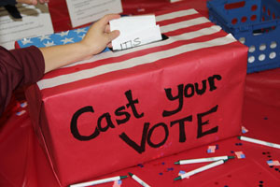
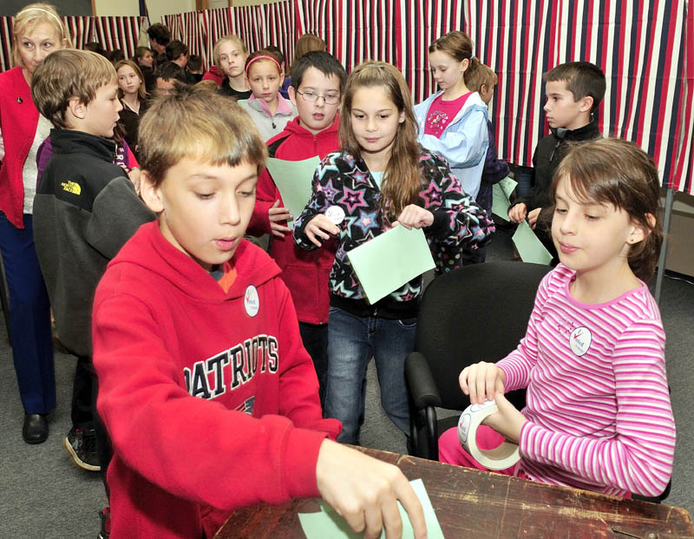
elected
Davy was so popular that he was even elected to Congress.
Meaning: chosen by voting

Slide 11
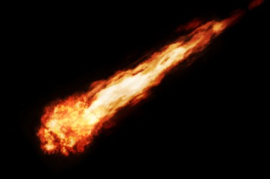
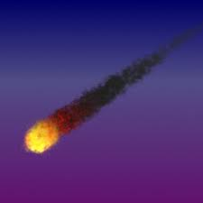
fireball
The fireball singed off part of Davy’s hair.

