Slide 1
Because of Winn-Dixie
Genre: Realistic fiction.
A made-up story that could
have happened in real life.

Slide 2
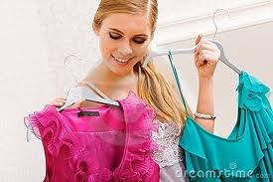
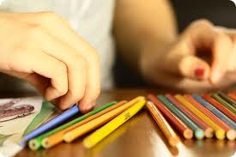
Selecting
To make a choice, pick
I am selecting a book to read with our class.
What are they selecting?

Slide 3
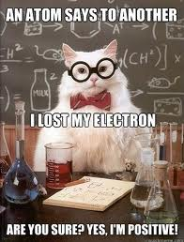
positive
Absolutely sure
What animal is this?
It’s an octopus.
Are you sure?
I’m positive!

Slide 4
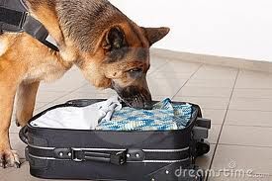
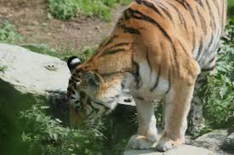
snuffled
To draw the air in the nose in order to smell something.
The dog was snuffling around my luggage.
What is the tiger snuffling around for?

Slide 5
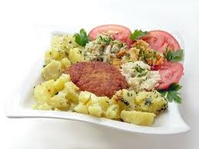
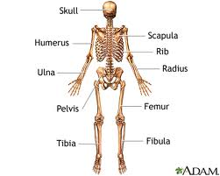
Consisted of
Included, was made of
My lunch consisted of potatoes, tomatoes, salad and a meat patty
An adult human skeleton consists of 206 bones.
Our class consists of____ girls and ____boys.

Slide 6
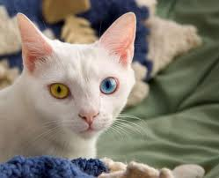
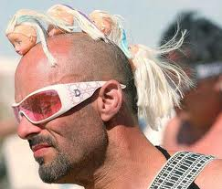
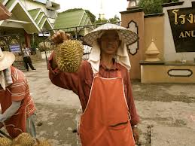
peculiar
Uncommon, unusual, strange, odd, weird
My cat has peculiar eye color. Do you think his hairdo is peculiar?
This peculiar fruit is called a durian.

Slide 7
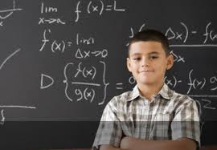
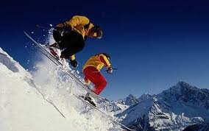
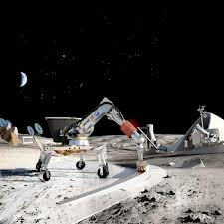
advanced
Ahead of everybody, far along in progress
This kid is advanced in math. Advanced mountain skiers
Advanced technology

Slide 8
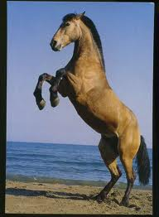
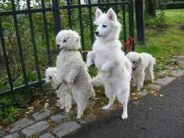
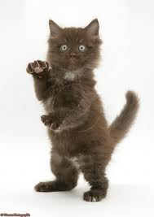
Stand on hind legs
stand on back legs

Slide 9
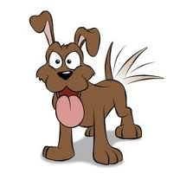
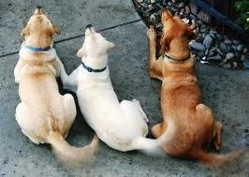
Wag one’s tail

Slide 10
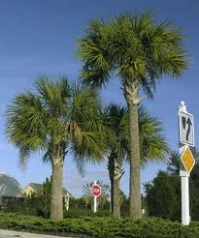
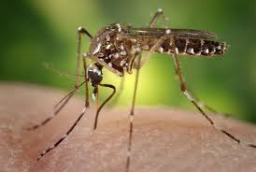
Palmetto trees Mosquitoes

Slide 11
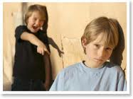
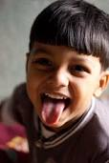
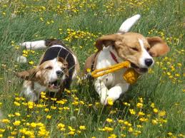
tease
Laugh at in a friendly way or unkindly. Annoy or bother
You can’t catch me!

