Slide 1
Olivia
Unit 5.1

Slide 2
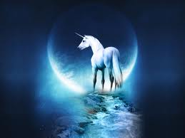
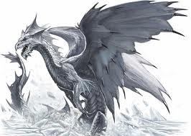
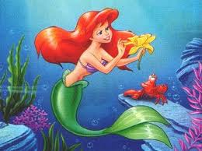
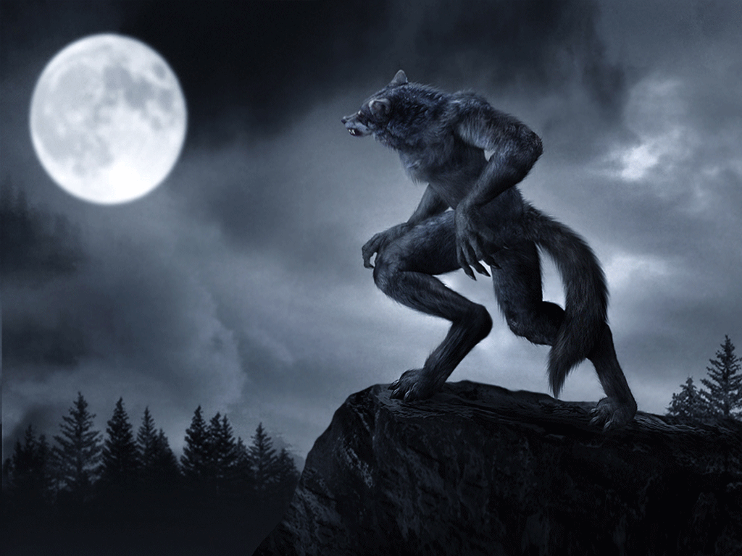
Fantasy
A fantasy is a made-up story
that could not happen in real life.

Slide 3
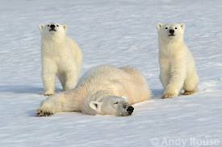
wearing people out
She is good at wearing people out.

Slide 4
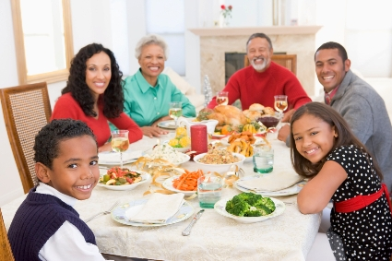
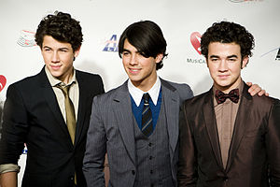
brother
Olivia has a little brother named Ian.
Where is the brother in this picture?

Slide 5
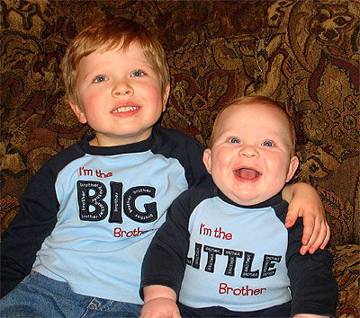
little brother
Olivia has a little brother named Ian.

Slide 6
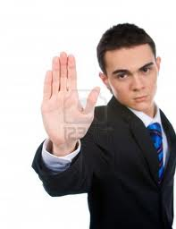
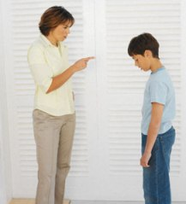
firm
Sometimes Ian won’t leave her alone, so Olivia has to be firm.

Slide 7
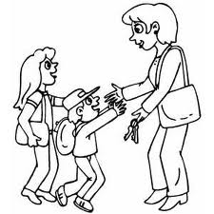
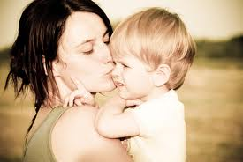
mother
Olivia lives with her mother, her father, her brother, her dog, Perry, and Edwin, the cat.
Where is the mother in this picture?

Slide 8
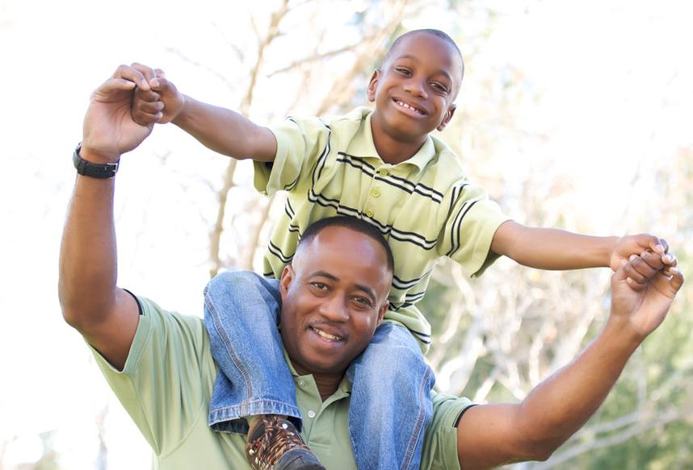
father
Olivia lives with her mother, her father, her brother, her dog, Perry, and Edwin, the cat.
Where is the father in this picture?

Slide 9
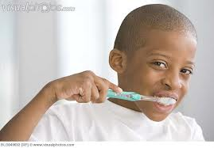
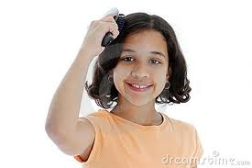
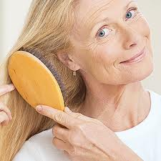
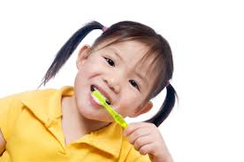
brushes
In the morning she brushes her teeth.
You can brush your teeth. You can also brush your hair!

Slide 10
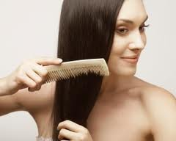
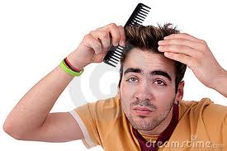
comb
In the morning she combs her ears.
Olivia combs her ears, but most people comb their hair.

Slide 11
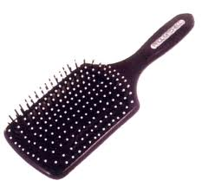
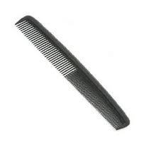
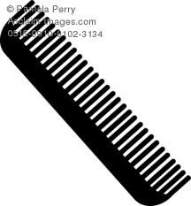
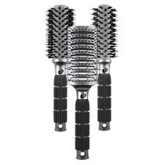
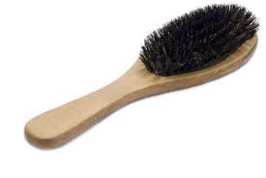
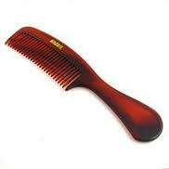
brush
comb

Slide 12
try on
She has to try on everything.

Slide 13
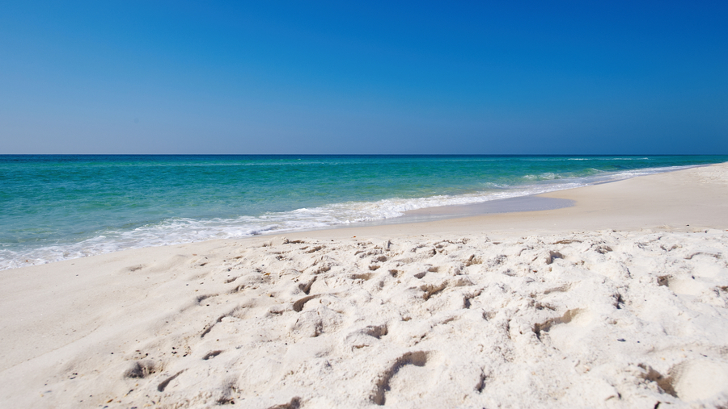
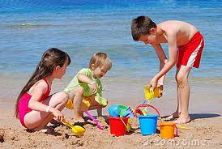
beach
On sunny day, Olivia likes to go to the beach.

Slide 14
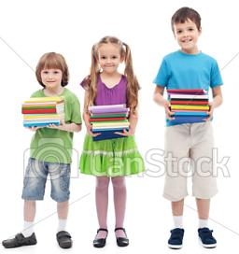
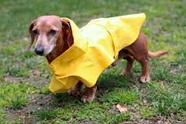
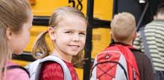
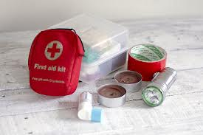
prepared
She feels it’s important to come prepared.
What do you need to be prepared for school?
What do people need to be prepared for a storm?

Slide 15
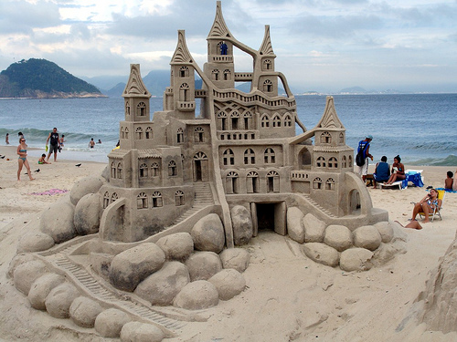
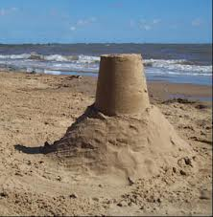
sand castles
Last summer when Olivia was little, her mother showed her how to make sand castles.
Sand castles can be very simple or very complicated!

Slide 16
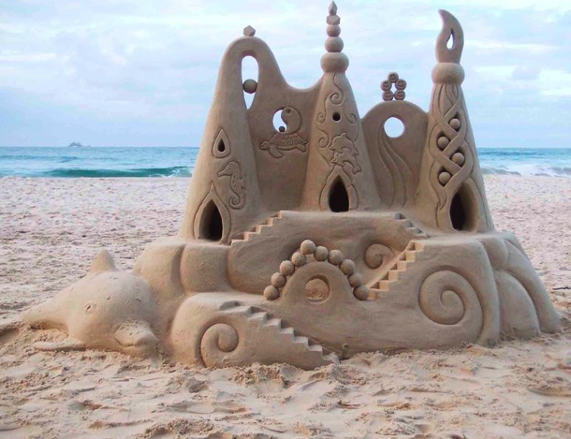
Amazing sand castles

Slide 17
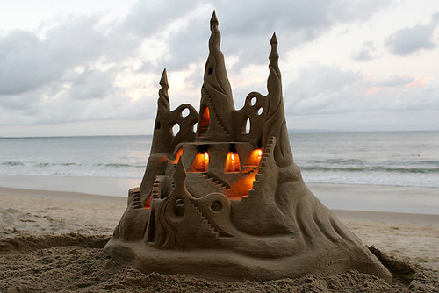
Amazing sand castles

Slide 18
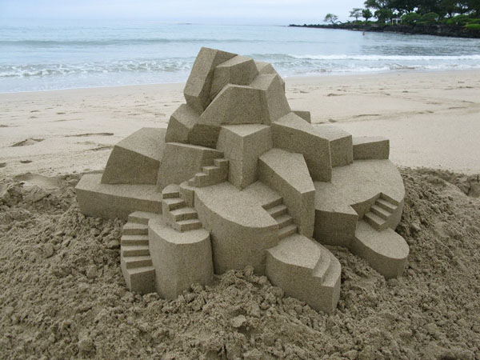
Amazing sand castles

Slide 19
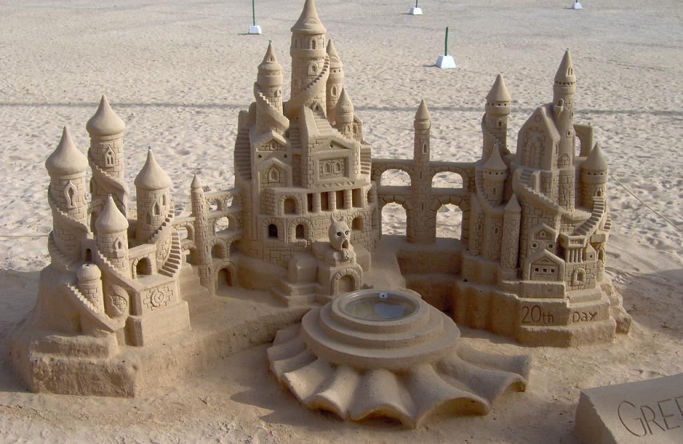
Amazing sand castles

Slide 20
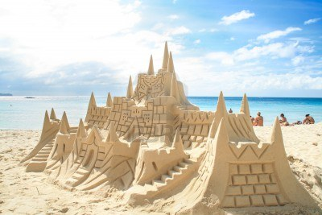
Amazing sand castles

Slide 21
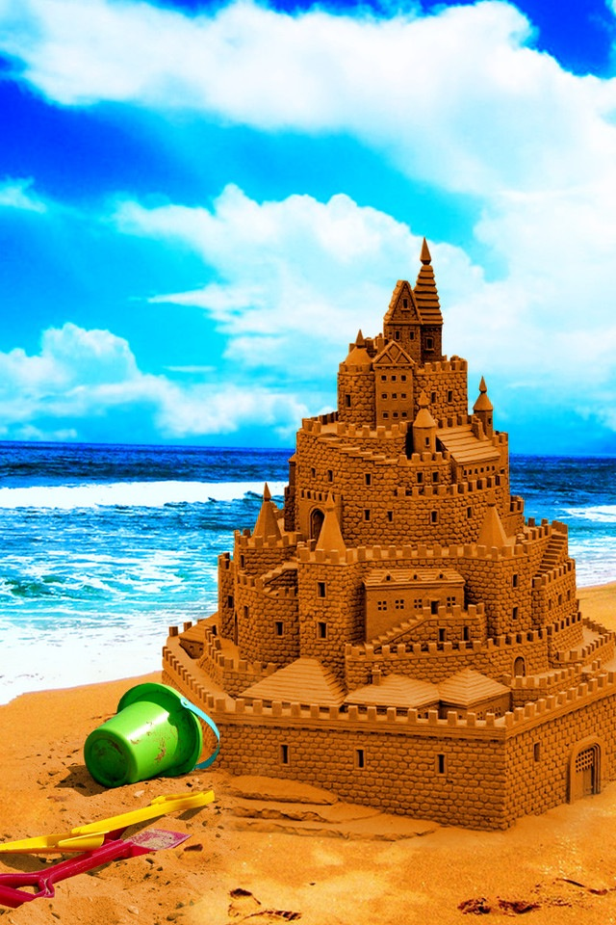
Amazing sand castles

Slide 22
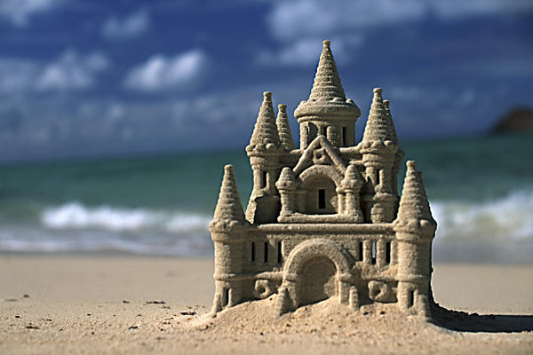
Amazing sand castles

Slide 23
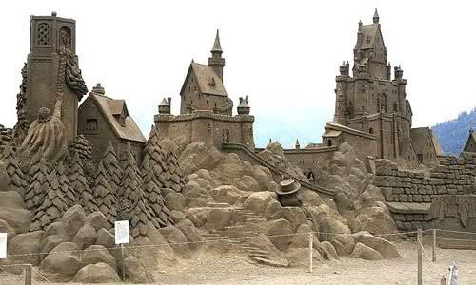
Amazing sand castles

Slide 24
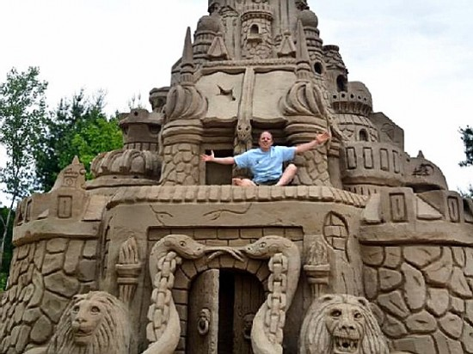
Amazing sand castles

Slide 25
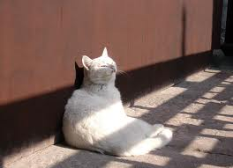
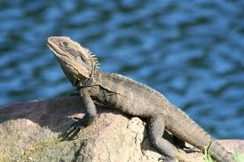
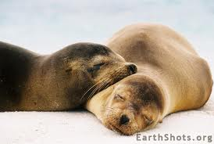
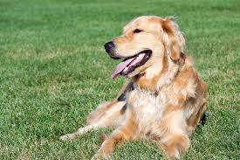
bask in the sun
Sometimes Olivia likes to bask in the sun.

Slide 26
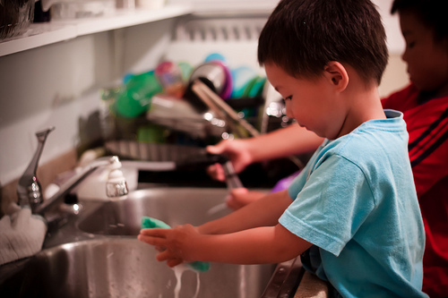
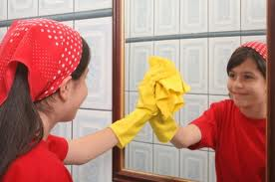
supposed
Every day Olivia is supposed to take a nap.
What chores are you supposed to do at home?

Slide 27
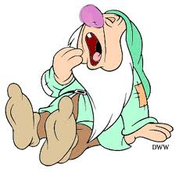
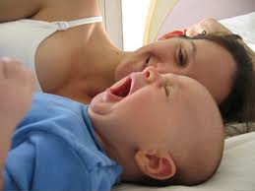
sleepy
Of course, Olivia’s not at all sleepy.

Slide 28
museum
On rainy days, Olivia likes to go to the museum.

Slide 29
time out
Olivia goes to time out for painting the wall.

Slide 30
love
You really wear me out sometimes, but I love you anyway.

Slide 31
Sight Words
always
Her brother is always copying.

