Slide 1
Kids’ Inventions
Unit 5.3

Slide 2
Nonfiction Article
A nonfiction article gives information about a topic.

Slide 3
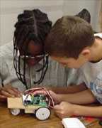
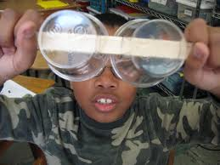
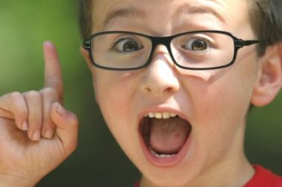
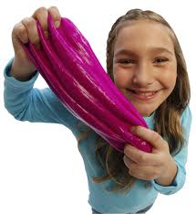
invent
What great things can kids invent?

Slide 4
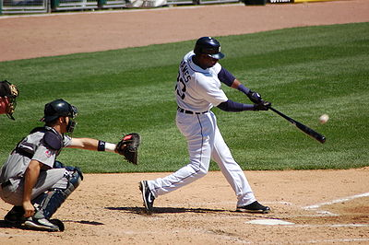
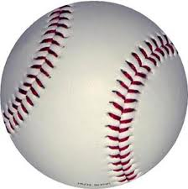
baseball
One day, he wanted to play baseball.

Slide 5
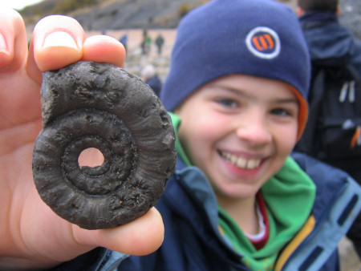
discovery
He made a discovery. He could keep the balls inside the bat.

Slide 6
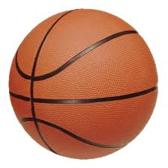
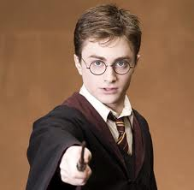
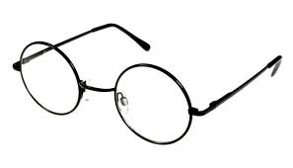
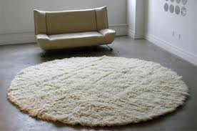
round
The round top came off.
Harry’s glasses are round.

Slide 7
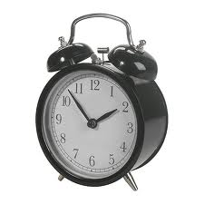
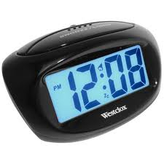
alarm clock
What if you could pick the sound your alarm clock made?

Slide 8
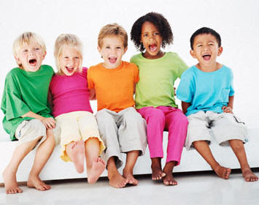
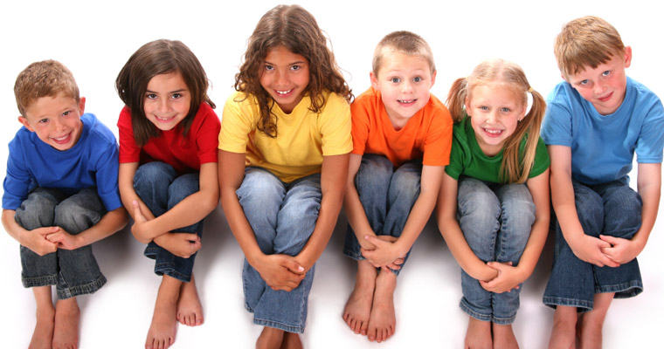
children
He saw children who had to take a big machine around with them.

Slide 9
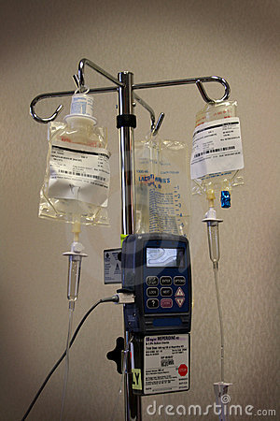
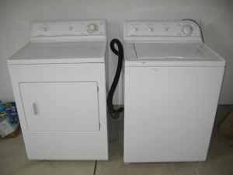
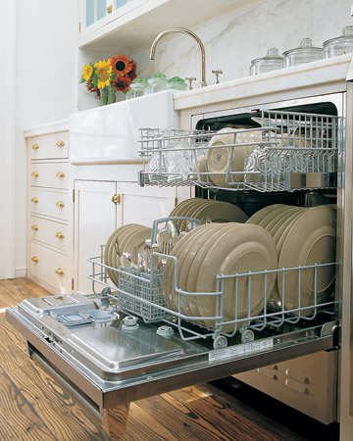
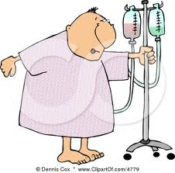
machine
He saw children who had to take a big machine around with them.
IV machine other machines

Slide 10
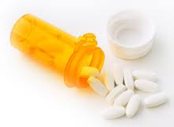
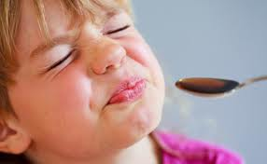
medicine
The children liked to ride in toy cars, but someone had to pull the medicine while they rode.

Slide 11
Sight Words
or
The sound could be you talking or singing.
better
How could he help these children play better?

