Slide 1
Whistle for Willie
Unit 5.4

Slide 2
Realistic Fiction
A nonfiction article gives information about a topic.

Slide 3
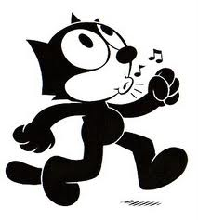
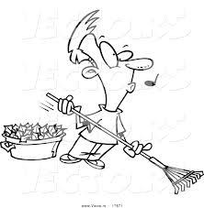
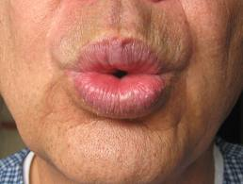
whistle
Oh, how Peter wished he could whistle!
In The Hunger Games, Katniss and Rue communicate by whistling. http://www.youtube.com/watch?v=9Vnsf4jlT0A

Slide 4
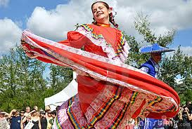
whirled
He whirled around and around.
See a girl whirling around [:08] http://www.youtube.com/watch?v=u_0ONCVzoFk

Slide 5
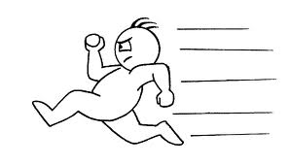
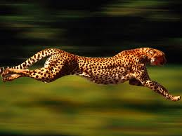
quick as a wink
Quick as a wink, he hid in an empty carton lying on the sidewalk.

Slide 6
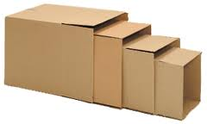
Carton
Quick as a wink, he hid in an empty carton lying on the sidewalk.

Slide 7
thought
“Wouldn’t it be funny if I whistled?” Peter thought.

Slide 8
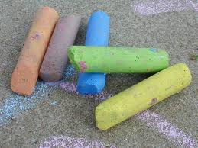
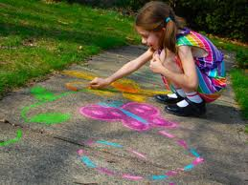
chalk
On the way home, Peter took some colored chalks out of his pocket and drew a long line right up to his door.

Slide 9
grown-up
He went into his house and put on his father’s old hat to make himself more grown-up.

Slide 10
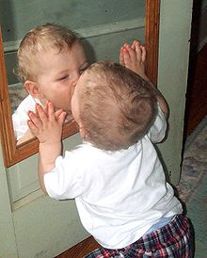
mirror
He looked into the mirror to practice whistling.

Slide 11
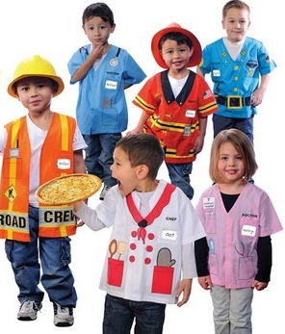
pretend
Peter pretended that
he was his father.

Slide 12
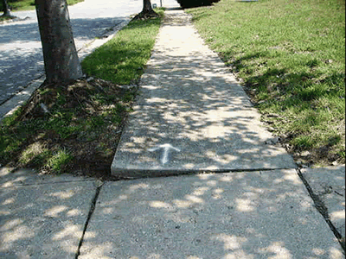
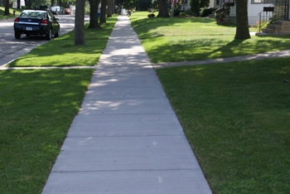
sidewalk
First he walked along a crack in the sidewalk.

Slide 13
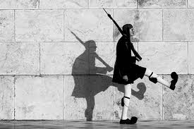
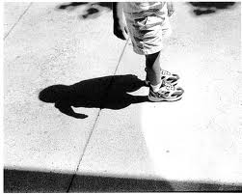
shadow
Then he tried to run away from his shadow.

Slide 14
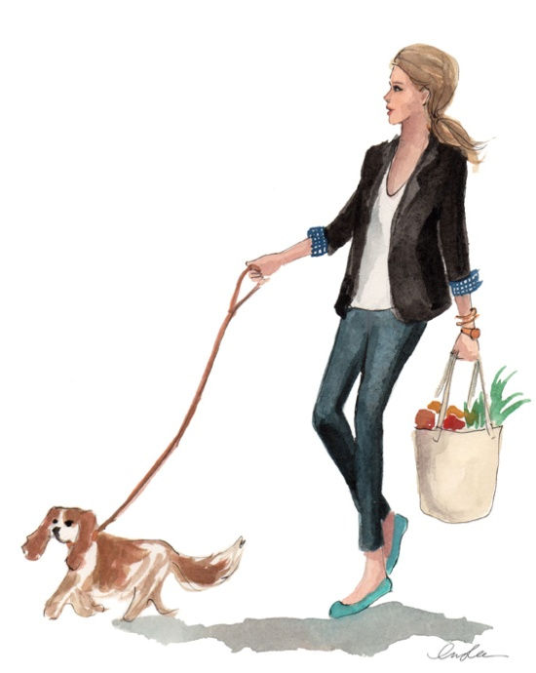
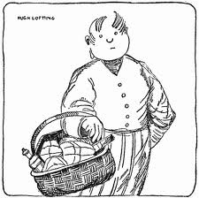
errand
Peter’s mother asked him and Willie to go on an errand to the grocery store.

Slide 15
Sight Words
instead
So instead he began to turn himself around.
along
First he walked along a crack in the sidewalk.
suddenly
Suddenly-out came a real whistle!
nothing
Nothing happened.

