Slide 1
Dot and Jabber and the Big Bug Mystery
Unit 6.1

Slide 2
mystery
In a mystery, the characters use clues to figure something out.

Slide 3
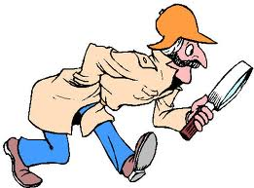
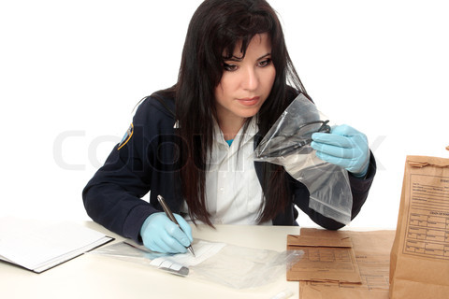
detective
A detective solves mysteries.

Slide 4
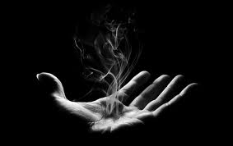
vanished
The bugs vanished!

Slide 5
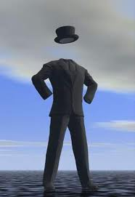
invisible
“Then they’re invisible,” said Jabber.

Slide 6
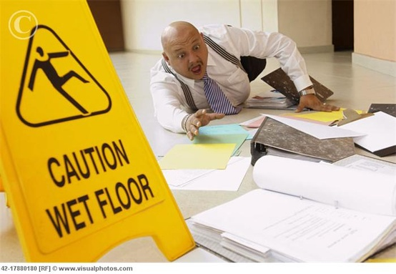
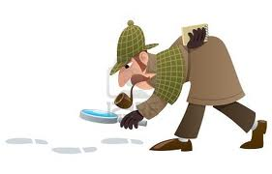
clues
“Let’s find those bugs! We need to look for clues.”

Slide 7
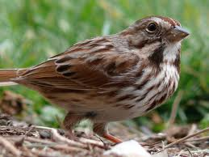
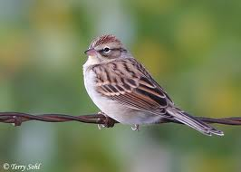
sparrow
“It’s a sparrow,” Jabber said. “No wonder the bugs disappeared. Sparrows eat bugs.”

Slide 8
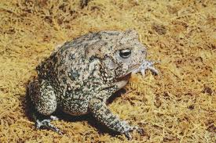
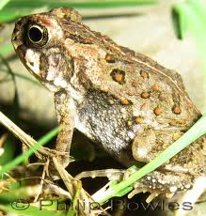
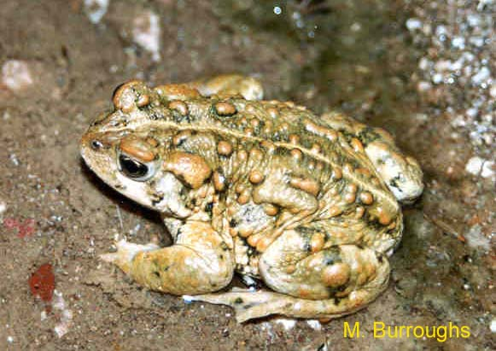
toad
“They’re hiding from the toad,” said a rabbit.

Slide 9
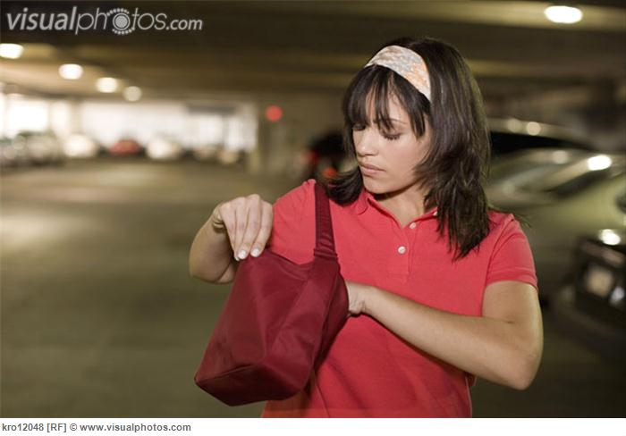
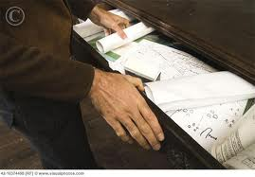
searching
“Let’s keep searching. The bugs can’t be far away.”

Slide 10
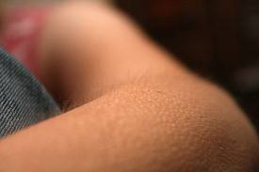
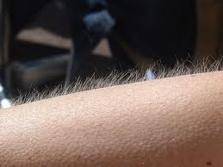
goose bumps
“This gives me goose bumps,” said Jabber. They can see us, but we can’t see them. I wonder what else is watching us.

Slide 11
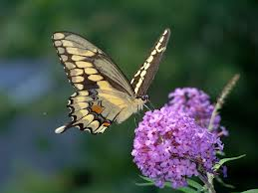
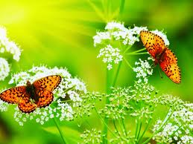
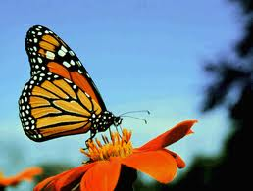
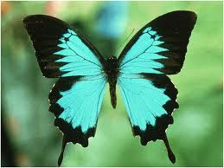
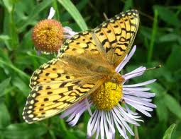
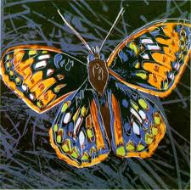
butterflies
“I think the butterflies are a clue.”

Slide 12
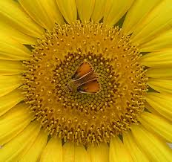
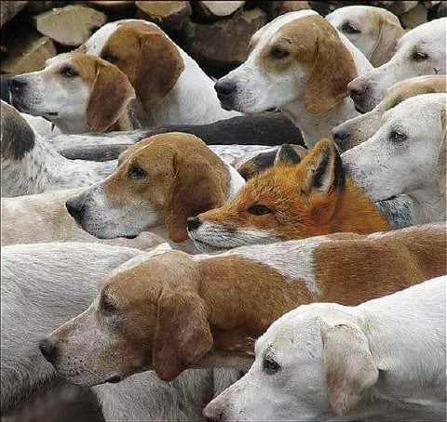
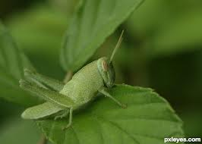
hiding in plain sight
The butterflies were hiding in plain sight.

Slide 13
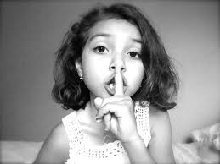
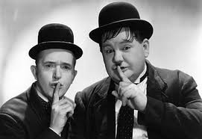
Shhh
“Shhh,” said a grasshopper.

Slide 14
Sight Words
gone
They couldn’t have gone away so fast.
been
“This is the mystery we’ve been looking for.”

