Slide 1
Cool Jobs
Unit 6.3

Slide 2
Nonfiction Article
A nonfiction article gives information about a topic.

Slide 3
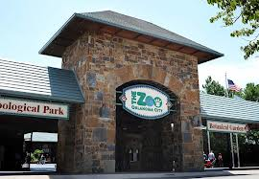
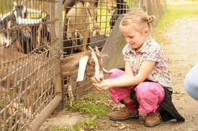
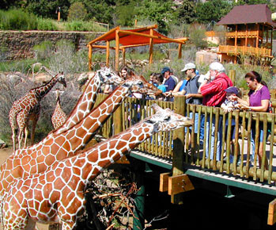
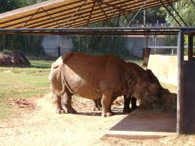
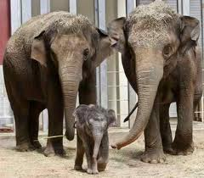
zoo
If you were a zoo dentist, you could fix and clean a tiger’s teeth.

Slide 4
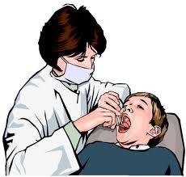
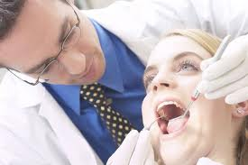
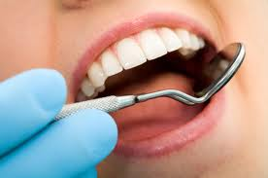
dentist
If you were a zoo dentist, you could fix and clean a tiger’s teeth.

Slide 5
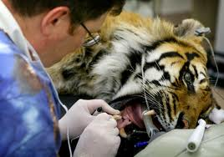
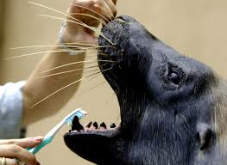
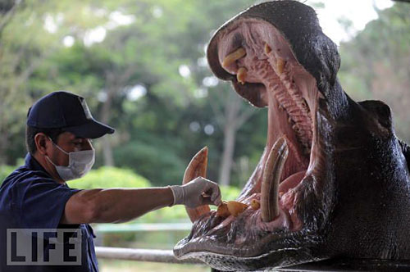
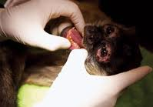
zoo dentist
If you were a zoo dentist, you could fix and clean a tiger’s teeth.

Slide 6
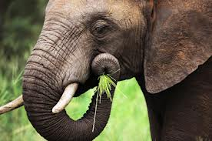
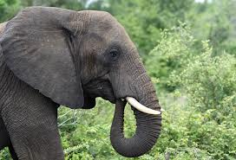
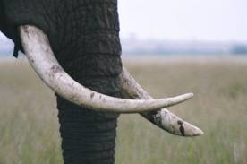
elephant’s tusk
You might even pull out an elephant’s tusk!

Slide 7
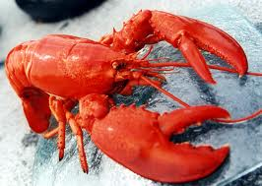
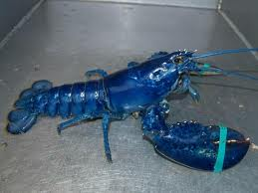
ordinary
Zoo dentists fix teeth like ordinary dentists do, but they work on animals that might bite!
ordinary dentist ordinary lobster
not-so-ordinary dentist not-so-ordinary (blue) lobster!

Slide 8
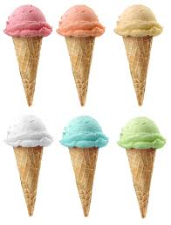
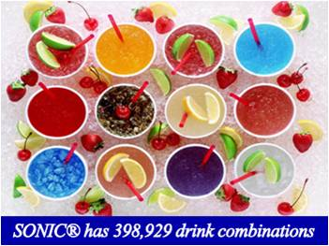
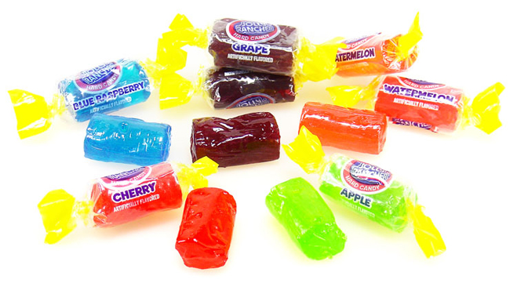
flavor
If you were a flavor maker, you could change the taste of a food!

Slide 9
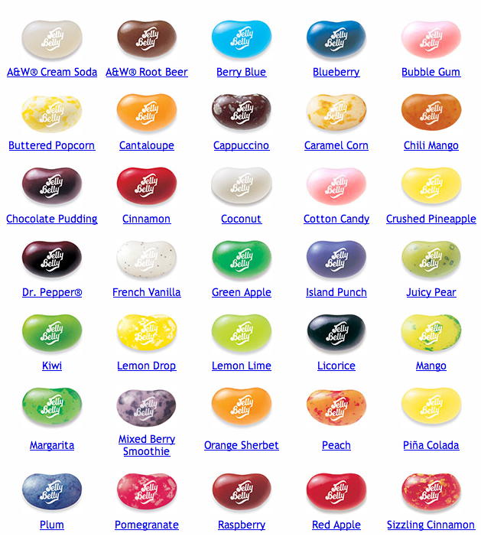

Slide 10
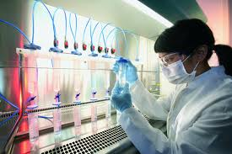
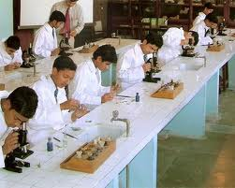
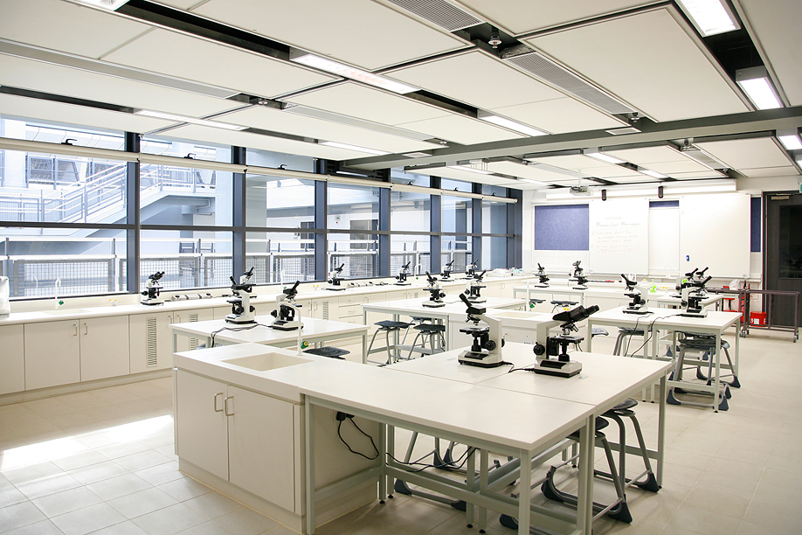
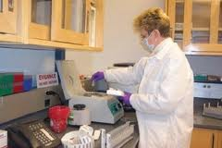
lab
Flavor makers work in a lab.

Slide 11
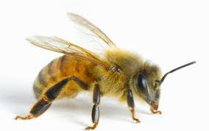
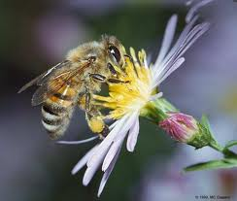
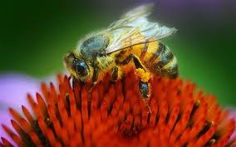
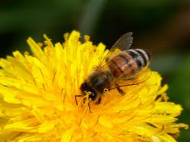
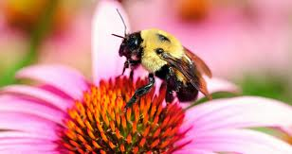
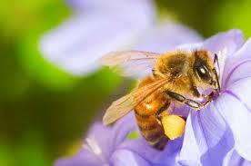
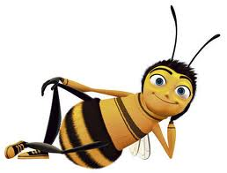
bees
Bees make honey.

Slide 12
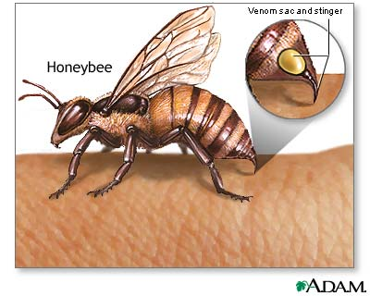
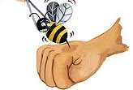
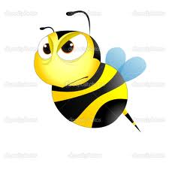
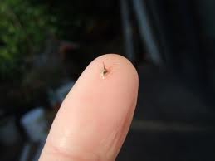
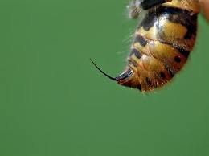
bee sting

Slide 13
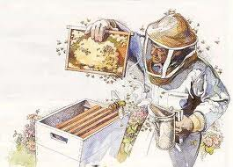
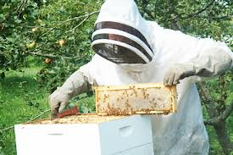
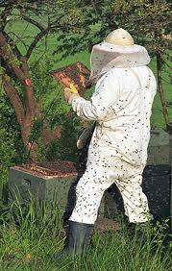
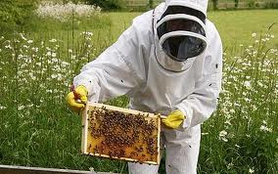
beekeeper
Bees make honey. A beekeeper helps the bees do their job.

Slide 14
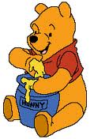
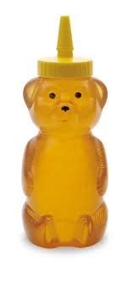
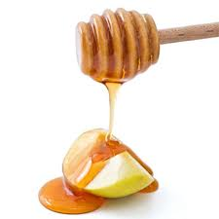
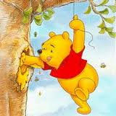
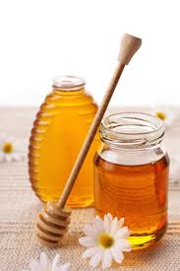
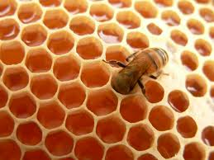
honey
Bees make honey. A beekeeper helps the bees do their job.
How do bees make honey? (1:03) http://app.discoveryeducation.com/player/view/assetGuid/671E0DF3-DF42-478E-8B03-B76C962C2AE7

Slide 15
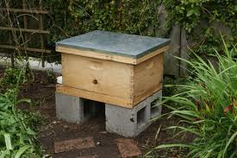
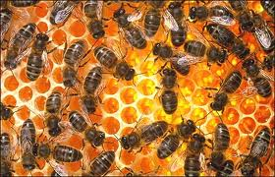
hives
If you were a beekeeper, you would build hives for bees to live in. These are not like the hives the bees make themselves. Beekeepers make hives out of wood.
Learn about beekeeping (1:02):
http://app.discoveryeducation.com/player/view/assetGuid/1D9C6E1C-A085-4939-AA78-3F3B0CE4A1FB
The Magic School Bus: In a Beehive (24:03): http://app.discoveryeducation.com/player/view/assetGuid/F343C383-B7F8-48AB-A740-9797800029DD

Slide 16
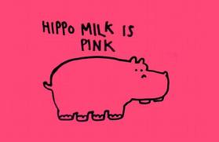
interesting
There are many interesting jobs in the world.

Slide 17
laugh
It’s fun to make people laugh.

Slide 18
Sight Words
goes
Then the animal goes to sleep.
ever
Did you ever want to change the taste of food?
only
With only a few drops, you could make a hot dog taste like a banana!

